Slide 1
LOOKING FORWARD: FREQUENCY AND PROFICIENCY EFFECTS IN SUPRASEGMENTAL AND SEGMENTAL CUES TO L1 AND L2 LEXICAL PREDICTION
Nuria Sagarra and Joseph V. Casillas
Rutgers University
ISB 2019
June, 2019

Slide 2
Anticipation allows comprehension
to occur quickly and incrementally
(Dell & Chang, 2014).

Slide 3
The importance of anticipation in monolinguals has been known for decades (Huettig, Rommers, & Meyer, 2011), but L2 anticipatory studies are recent, scant, and inconclusive (Kaan, 2014).
Moreover, most L1 and L2 anticipatory studies focus on morphological and semantic cues, but ignore acoustic cues such as prosody.

Slide 4
PROSODY, THE NEGLECTED SON
WHY PROSODY?
Essential to process:
words (McQueen, 2005)
sentences (Cutler et al., 1997)

Slide 5
GOAL
Do native and non-native speakers use suprasegmental and segmental information to predict morphology during spoken word recognition?
If yes, is their anticipation affected by L2 proficiency, frequency, and memory limitations?

Slide 6
SUPRASEGMENTAL INFORMATION:
LEXICAL STRESS
Spanish | English
Phonologically contrastive
Acoustic correlates = F0, duration, intensity
Oxytone (CANta) less frequent than paroxytone (canTÓ) (less frequent stress = fewer lexical competitors)
Since stress seems similar in both languages, one assumes that Anglophones should have no problem acquiring L2 Spanish stress….
BUT…
Notes:
Define lexical stress at beginning of slide: the relative prominence of a syllable compared to the other syllables in the word.

Slide 7

Studies show that Anglophones have difficulties producing (Lord, 2007) and perceiving (Face, 2005) lexical stress in L2 Spanish.
WHY?
Notes:
Define lexical stress at beginning of slide: the relative prominence of a syllable compared to the other syllables in the word.

Slide 8

Spanish | English
Phonologically contrastive
Acoustic correlates = F0, duration, intensity
Oxytone (CANta) less frequent than paroxytone (canTÓ) (less frequent stress = fewer lexical competitors)
Syllable-timed | Stress-timed
Lexical stress facilitates perception in Spanish monolinguals (Soto-Faraco et al., 2001), but not English monolinguals (Cooper et al., 2002), suggesting that Spanish uses stress to reduce the number of competitors during lexical access. This doesn’t seem to be the case in English, where vowel reduction can efficiently fill this role.
Notes:
First, Span is syllable-timed but English is stress-timed.
Second, Spanish uses stress to reduce the number of competitors for lexical access, but this does not seem to be the case in English, likely due to vowel reduction, which can efficiently fill this role.

Slide 9
SEGMENTAL INFORMATION:
SYLLABIC STRUCTURE
Spanish | English
CV (LAva) and CVC (CANta) syllables
Acoustic correlates = F0, duration, intensity
CVC less frequent than CV (less frequent CVC = fewer lexical competitors)
Similar in both languages.

Slide 10
MORPHOLOGICAL ANTICIPATION
 | MONOLINGUALS |  | L2 LEARNERS
 | YES | NO | YES | NO
SUPRASEGMENTALS | TONE (Roll et al., 2010; Söderström et al., 2012, Roll, 2015) |  | TONE in avanced L2rs (Schremm et al., 2016) | TONE in beginning L2rs (Gosselke et al., 2018)
 | VOWEL DURATION (Rehrig, 2017) |  |  | VOWEL DURATION (Rehrig, 2017)
SEGMENTALS | PHONOTAC-TIC FREQUENCY (Roll et al., 2017). |  | ? | ?

Slide 11
WM AND L2 PROCESSING
WM AND L2 SYNTACTIC PROCESSING:
WM AND L2 MORPHOSYNTACTIC PROCESSING:
WM EFFECTS Lower proficiency | NO WM EFFECTS Higher proficiency
Miyake & Friedman (1998), Havik (2009), | Felser & Roberts (2007), Juff´s work (see Juffs & Harrington, 2011, for a review), Rodríguez (2008) Fareta-Stutenberg et al (2013, 2015), Gabriele et al (15).
Dussias & Piñar (2010) but L2 RTS so Gabriele no WM in beginners bc GJ not taxing
confounding design Hopp (2014) WM int/adv/near-natives bc complex
structure
WM EFFECTS Lower proficiency | NO WM EFFECTS Higher proficiency
Sagarra (2008), Sagarra & Herschensohn (2010) | Foote (2011), Sagarra & Herschensohn (2010, 2011)
Notes:
WM seems to also be associated with L2 proficiency

Slide 12
EXPERIMENT

Slide 13
PARTICIPANTS
25 Spanish monolinguals born and raised in a monolingual region from Spain.
38 adult English classroom learners of Spanish: 12 beginners + 26 advanced. The beginners scored significantly lower in a Spanish proficiency test than the advanced, F(1,36) = 423.005, p = .001.
All groups had similar age (18-32 yrs old) and education (minimum high school).

Slide 14
MATERIALS AND PROCEDURE
Spanish proficiency test adapted from DELE (learners).
Language background questionnaire.
Oral eye-tracking task.
Oral gating task (reported elsewhere).
Working memory task.
Phonological short-term memory task.
Oral production task (reported elsewhere).

Slide 15
MATERIALS AND PROCEDURE
Spanish proficiency test adapted from DELE (learners).
Language background questionnaire.
Oral eye-tracking task.
Oral gating task.
Working memory task.
Phonological short-term memory task.
Oral production task.

Slide 16
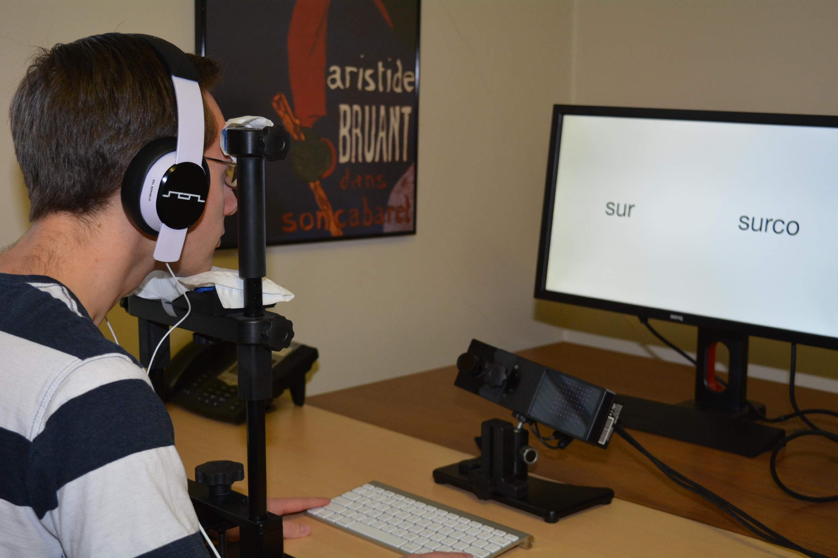
Participants listened to sentences in Spanish and chose one of two words in the screen by pressing a key.
There were 66 sentences:
18 practice
16 experimental (8 paroxytone, 8 oxytone)
32 fillers
Eye-Link 1000 Plus eye-tracker (SR-Research)

Slide 17

canta cantó
Self-paced (audio)
canta cantó
1,000 ms (no audio)
+
250 ms

Slide 18
MATERIALS AND PROCEDURE
Spanish proficiency test adapted from DELE (learners).
Language background questionnaire.
Oral eye-tracking task.
Oral gating task.
Working memory task.
Phonological short-term memory task.
Oral production task.

Slide 19

Adapted from a subtest of the Wechsler Adult Intelligence Scale test (Wechsler, 1997). Procedure:
1.Listen to a mixed series of letters and numbers
2. Type them, numbers first in ascending numerical order, then letters in alphabetical order.
Answer: 258AKSX
Notes:
Answer: 258AKSX

Slide 20
MATERIALS AND PROCEDURE
Spanish proficiency test adapted from DELE (learners).
Language background questionnaire.
Oral eye-tracking task.
Oral gating task.
Working memory task.
Phonological short-term memory task.
Oral production task.

Slide 21
Forward digit span. Procedure:
1.Listen to sets of numbers
2. Recall them.
Notes:
Answer: 258AKSX

Slide 22
RESULTS

Slide 24
CV results
Monolinguals fixate on targets above chance BEFORE hearing the suffix (offset of first syllable).
Everybody fixates on targets above chance AFTER having heard the suffix.
No effect of WM or PSTM for any groups.
Effects of word frequency (negative) but only for monolinguals
Effects of phonotactic probability (increased target fixations for more probable CV combinations).

Slide 26
CVC results
Monolinguals fixate on targets above chance BEFORE hearing the suffix (onset of coda).
Advanced learners fixate on target above chance BEFORE hearing the suffix (offset of first syllable).
Everybody fixate on targets above chance AFTER having heard the suffix.
No effect of WM or PSTM.
No effect of word frequency.
No effect of phonotactic probability. Positive trend for LA (p = 0.89)

Slide 27
CONCLUSIONS

Slide 28
Monolinguals and advanced, but not beginning, learners use lexical stress to anticipate word endings. Therefore:
Lexical stress is used to predict L1 and L2 verbal inflectional morphology
Lexical stress is language-specific but can be acquired post-puberty with enough exposure.
Monolinguals use lexical stress earlier and at a faster rate than L2 learners, and the advanced learners earlier and at a faster rate than beginners. Therefore:
Language experience guides L2 morphological anticipatory processes.
No WM or PSTM effects.
Notes:
RE WM, did not hold for eye tracking

Slide 29
ONGOING FOLLOW-UP STUDIES
Lexical stress comparing:
early (heritage) and late advanced learners (AoA Effects)
Mandarin Chinese and English learners (Transfer Effects)

Slide 30
Questions? nuria.sagarra@rutgers.edu .
Thank you
Research supported by:
Research Council Grant

