Slide 1


Audiovisual feedback modulates lexical competition in a second language
Miquel Llompart & Eva Reinisch
Institute of Phonetics and Speech Processing
LMU Munich
New Sounds, University of Aarhus
June 12th, 2016

Slide 2




Difficulties with L2 contrasts
L2 learners may have problems with L2 sound contrasts, especially with single category assimilations (2 L2 categories → 1 L1 category)
Production: no clear acoustic differentiation
Perception: categorization is not optimal
Lexicon: confusion between words with the 2 categories
p/æ/n
Notes:
Lexicon:
Especially minimal pairs (e.g., pen-pan)
Also for words that quasi-overlap at some point (pencil-panda)

Slide 3

Difficulties with L2 contrasts
Lexical difficulties are harder to overcome than problems at the sound level (Díaz et al., 2012, 2015)
Even when accurate in identification, many errors in lexical tasks
l[ɛ]mp

Slide 4
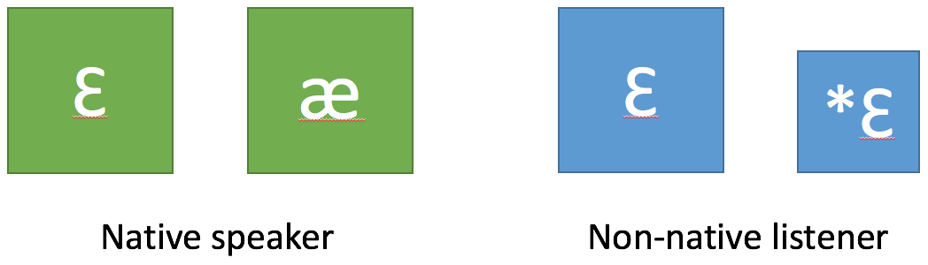
Lexical encoding of L2 contrasts
Difficulties at the lexical level proposed to stem from non-native asymmetrical encoding of L2 contrasts (Darcy et al., 2013):
Modulated by similarity to L1 category
Notes:
Evidence of this comes from visual-world eye-tracking experiments

Slide 5
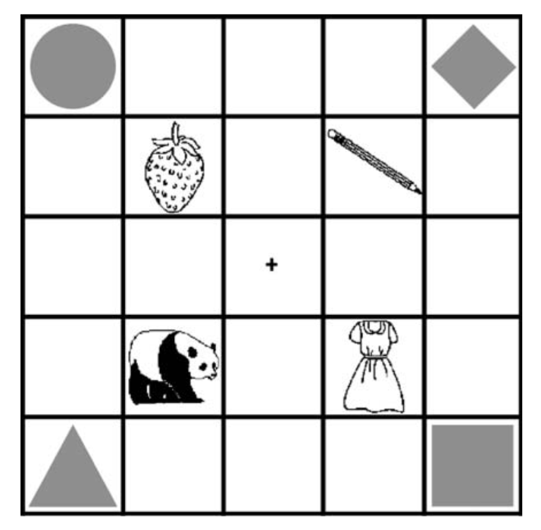
Lexical encoding of L2 contrasts
Dutch listeners, English /ɛ/-/æ/ contrast (Weber & Cutler, 2004)
In word pairs like pencil-panda:
If /ɛ/ and /æ/ were not distinguished: looks at pen- and pan- should be similar
If separately encoded but /ɛ/ was dominant → overall + looks to pen- than pan-

Slide 6
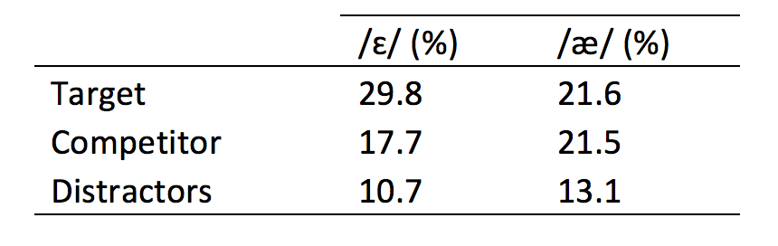
Lexical encoding of L2 contrasts
Targets like pencil are rapidly recognized (+ looks)
Targets like panda show delayed recognition (- looks)
Asymmetrical reaction to target types → lexical separation

Slide 7
The role of additional information
How are these contrasts established?
Is non-native (poor) perception enough or are there additional cues at play?
Additional sources of contrastive information? → Orthography!
[Click on the] pencil vs. panda

Slide 8

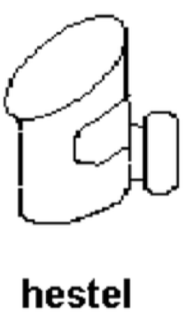
The role of additional information: orthography
Does orthography contribute to lexical encoding of L2 contrasts?
Dutch participants trained to learn new words in English with /ɛ/ and /æ/ (e.g. hestel, haskum) and then visual world paradigm (Escudero et al., 2008)
A) B)

Slide 9
The role of additional information: orthography
Results:
A) Auditory forms alone: no asymmetry
B) Auditory forms + spelling: asymmetric behavior as with real words
Acoustic input alone is not reliable enough for L2 learners to know which sound goes in each novel word
Listeners make use of additional information to establish a contrast
→ Orthography provides additional reliable evidence

Slide 10
Main question
Could visual articulatory information also be a valuable source of additional information for the encoding of a lexical distinction between L2 categories?

Slide 11
Visual articulatory information
Audiovisual benefit (AV better than A)
Categorization for L2 contrasts with visible articulatory gestures
(Navarra & Soto-Faraco, 2007)
Phonetic training for the same type of contrasts (Hazan et al., 2005)
These studies examined sound categorization
→ Will visual articulatory information also help at the lexical level?

Slide 12

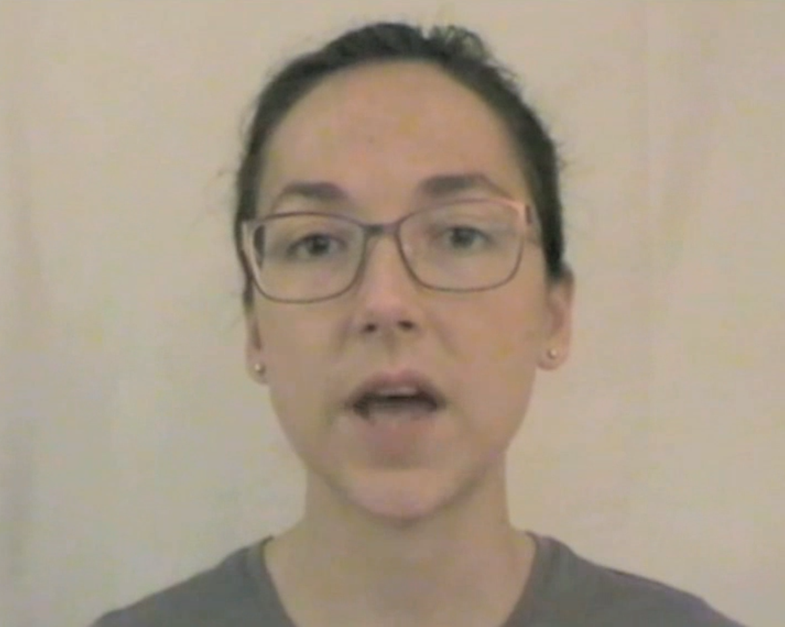
Present study
Adapt procedure in Escudero et al. (2008)
Training phase with feedback to learn new words
Feedback during training differs between conditions: vs.
Test phase where recognition is measured with a visual world eye-tracking task

Slide 13
Participants
41 Native speakers of German (20 Audio / 21 Video)
Between 18 and 30 of age
Not studying anything language-related
Less than half a year in an English-speaking country

Slide 14



Materials
hestel (/ɛ/)
haskum (/æ/)
5 target pairs with /ɛ/ vs. /æ/
5 filler pairs with /u/
AV recordings by a female speaker of Australian English
hoostel (/u/)
hooskum (/u/)

Slide 15
Procedure: Training Phase
Participants learn word-picture associations
Two parts of around 30 minutes each
First part with target and distractor on screen (2 alternatives)
Second part with target and 3 distractors on screen (4 alternatives)
240 trials each training part in 4 blocks

Slide 16
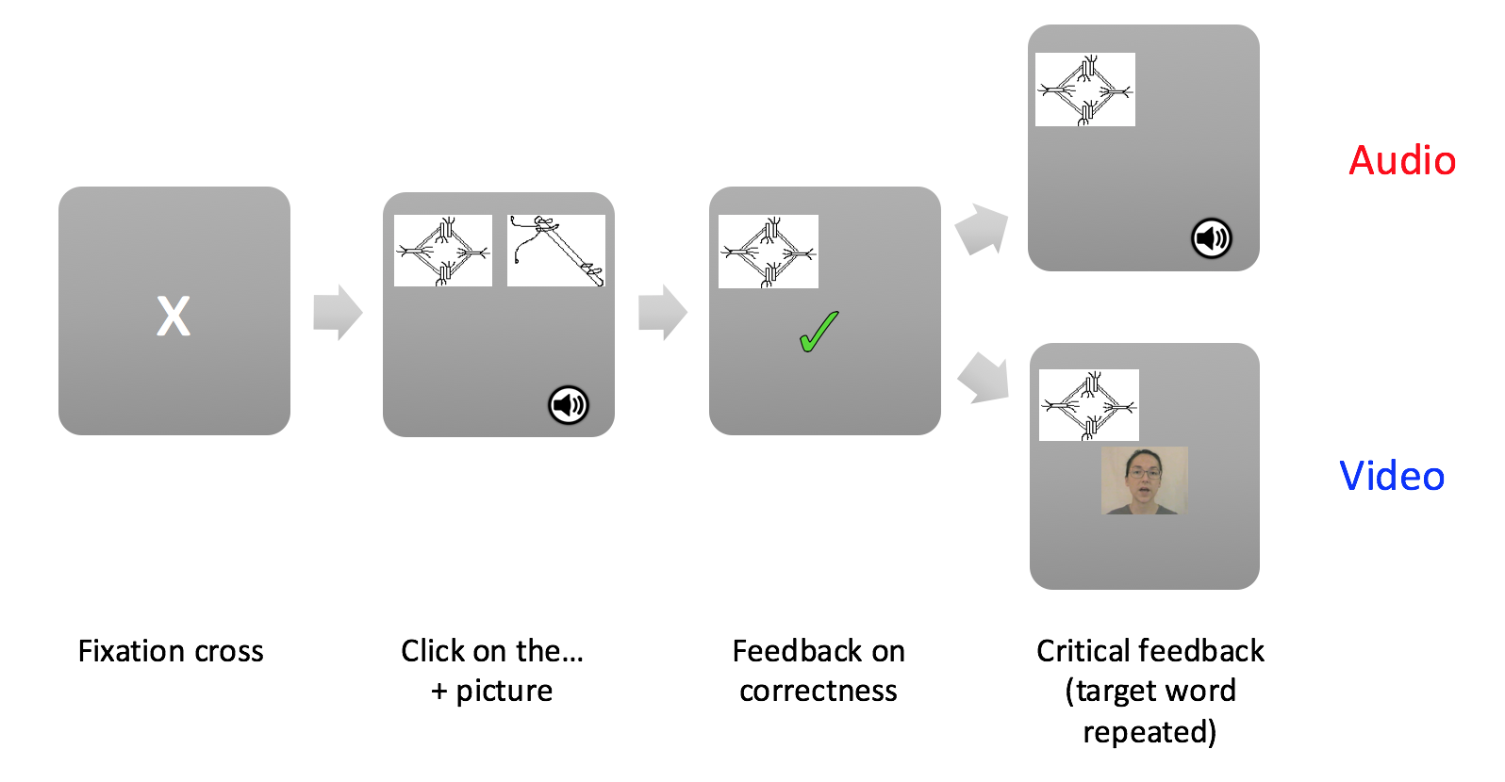
Design: Training phase

Slide 17
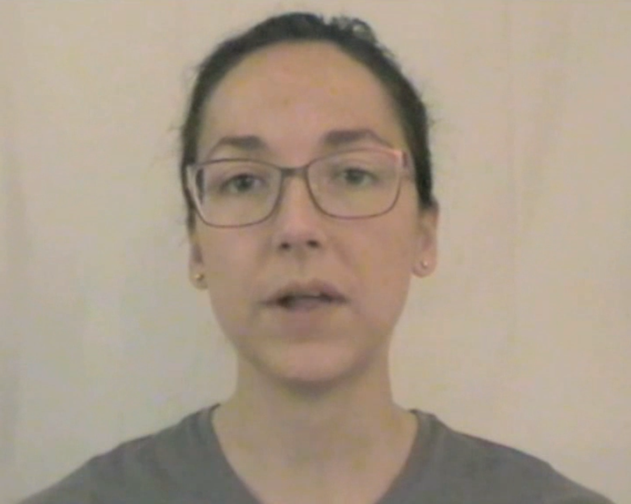
Visual cue: Jaw opening
/ɛ/
/æ/
Notes:
It’s videos, not pictures!

Slide 18
Procedure: Test Phase
Participants are tested on the words learned during training
4 pictures on the screen: target, direct competitor and 2 distractors
Target and (same pair) competitor:
Target = /ɛ/ (hestel), competitor = /æ/ (haskum) and other way round
Distractors:
Any other pair with a different first consonant (no competition)

Slide 19
Data Analysis: Test Phase
Eye-positions sampled at 60 Hz
Analyses on 200-800 ms (after target onset) time window
Dependent variable: Eye fixations on the target picture
Variables of interest:
Learning condition (Audio/Video)
Target vowel (/ɛ/-/æ/)

Slide 20
Predictions
Baseline Audio condition: no difference in fixations between
/ɛ/-words and /æ/-words
Experimental Video condition:
If difference in jaw opening works as a cue: asymmetry in favor of /ɛ/
If not, = Audio condition

Slide 21
Results: Training Phase
2 alternatives
4 alternatives
Notes:
Change axis values!

Slide 22
Results test phase: Audio condition

Slide 23
Results test phase: Video condition

Slide 24
Discussion
Exposure to audiovisual feedback triggered an asymmetry in word recognition, replicating findings for:
Real English words
Novel words cued by orthography
Can visual articulatory information lead to the establishment of a lexical distinction between L2 categories?
YES

Slide 25
Discussion
L2 learners seem to make use of whichever additional information that cues the existence of a contrast between L2 sounds to separate lexical entries with these sounds.
Notes:
Mention repetition condition!!!

Slide 26
Discussion
But how does audiovisual feedback actually contribute to the encoding of the L2 contrast?
Additional knowledge of the confusable sounds’ articulation affects how they are represented in the novel words
Additional articulatory knowledge → more accurate representations
Notes:
(i.e., is there one or two categories?)

Slide 27
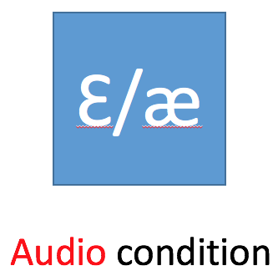
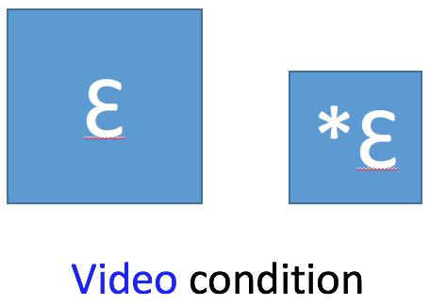
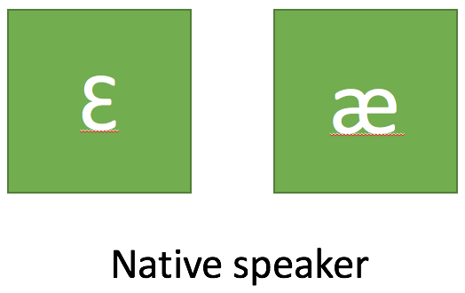
More accurate?
Additional articulatory knowledge → more accurate representations
Notes:
(i.e., is there one or two categories?)

