Slide 1


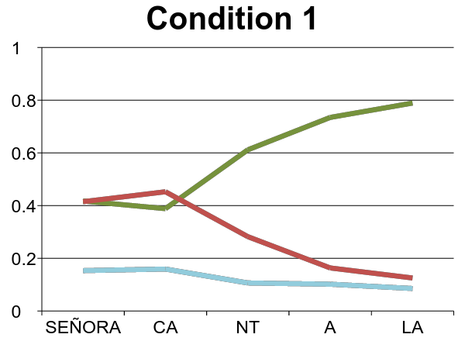
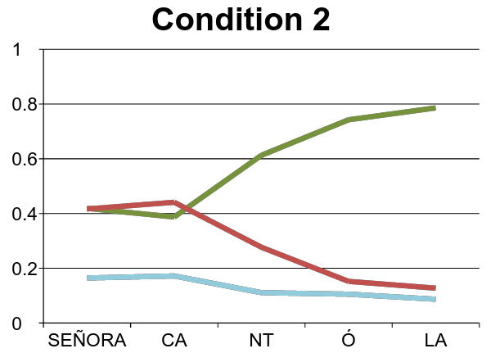
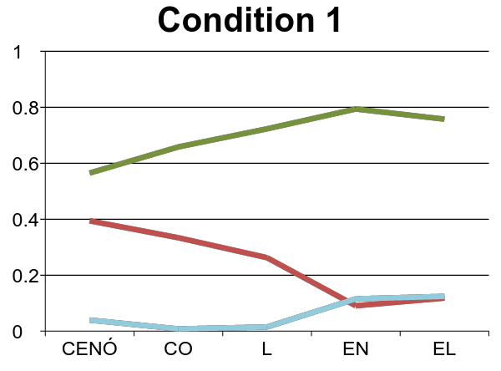
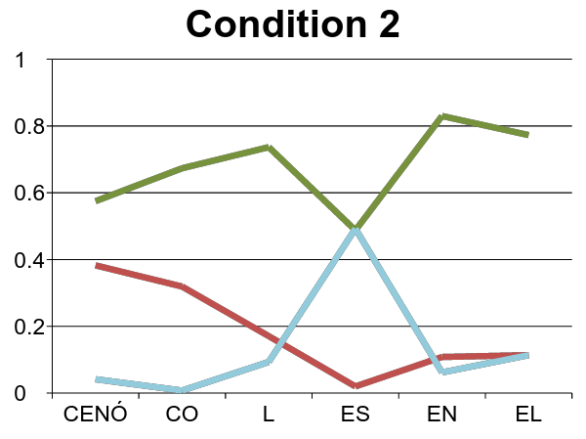
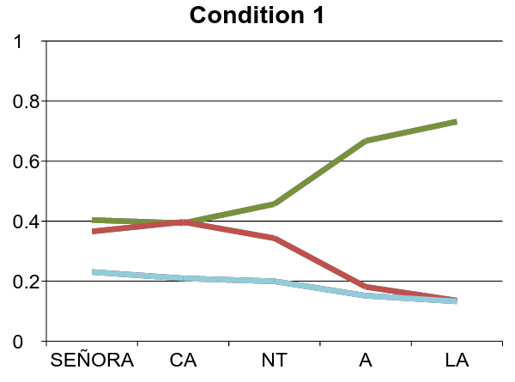
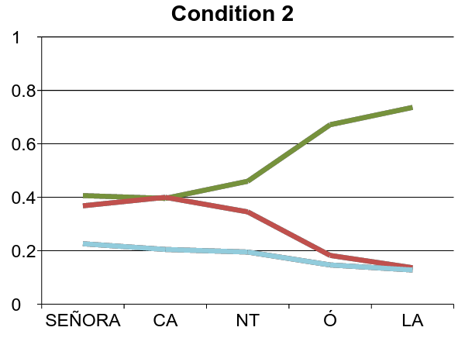
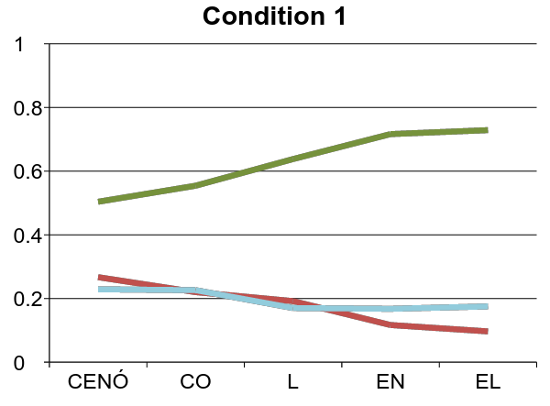
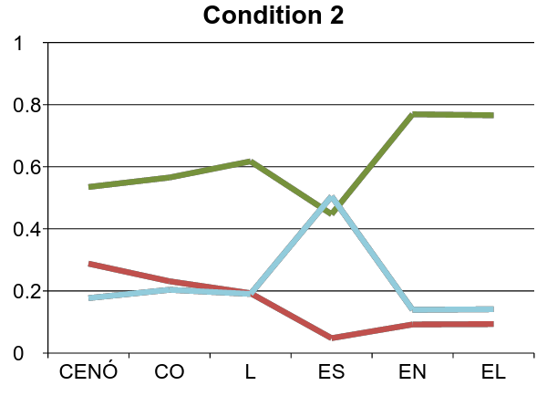
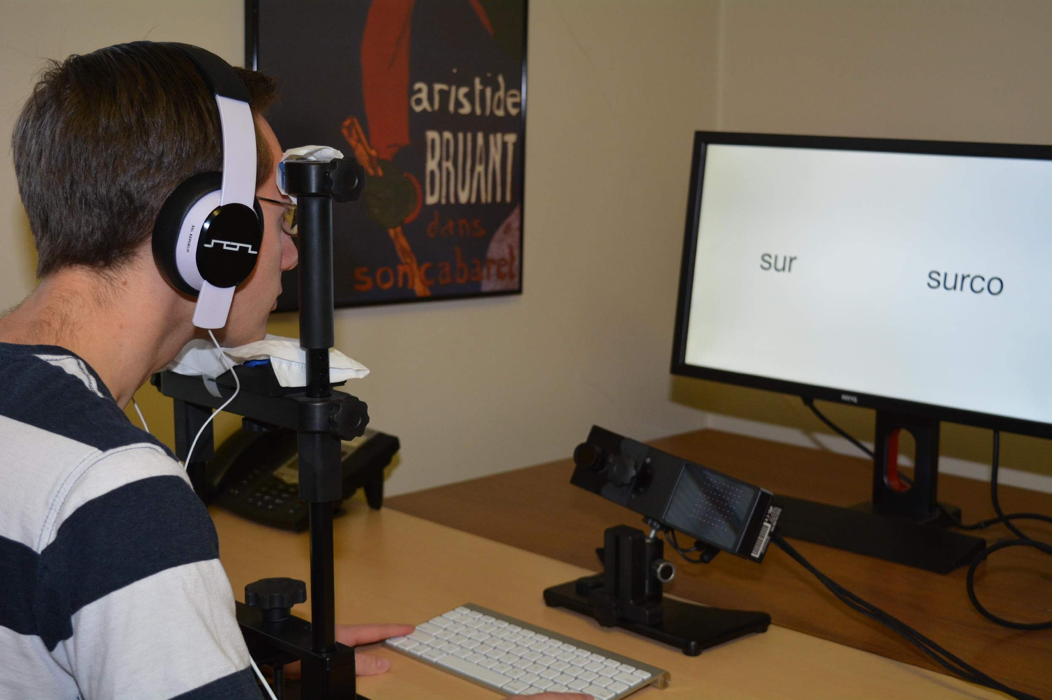
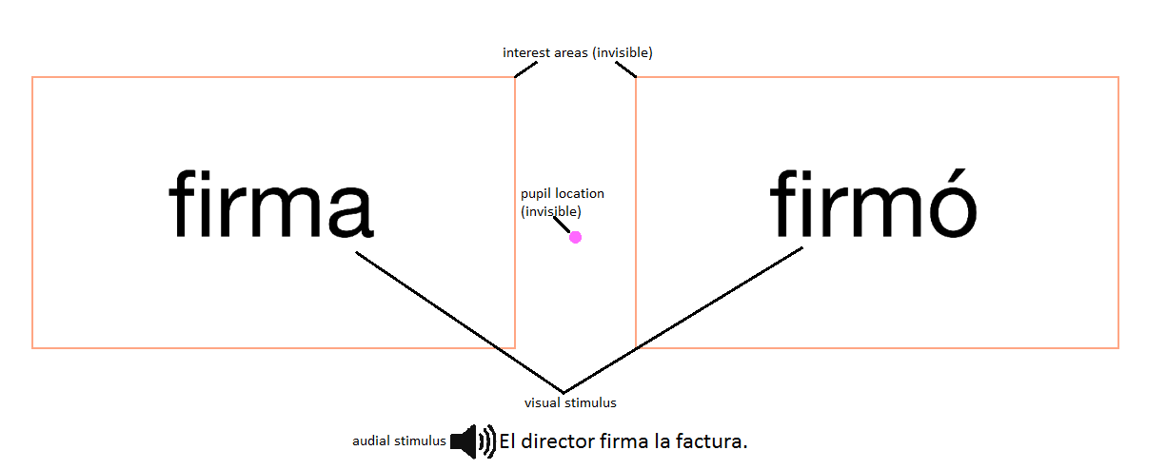
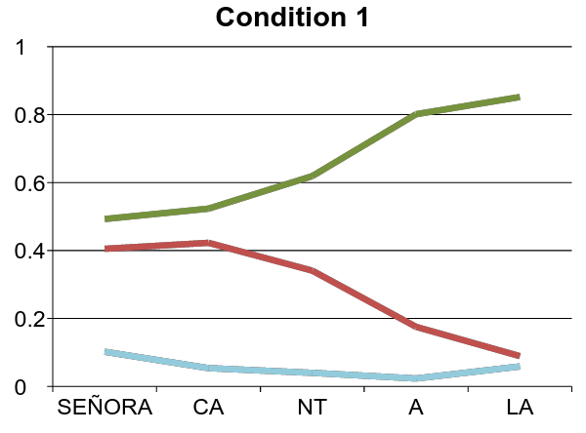
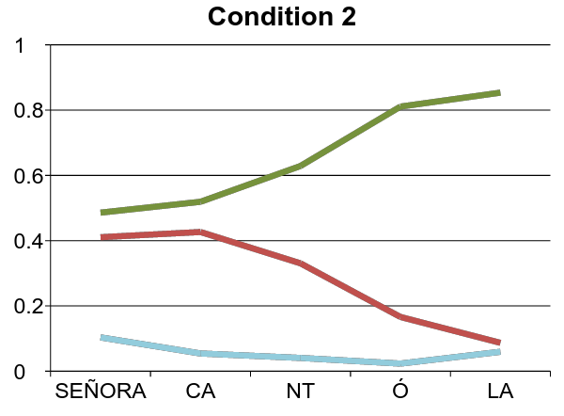
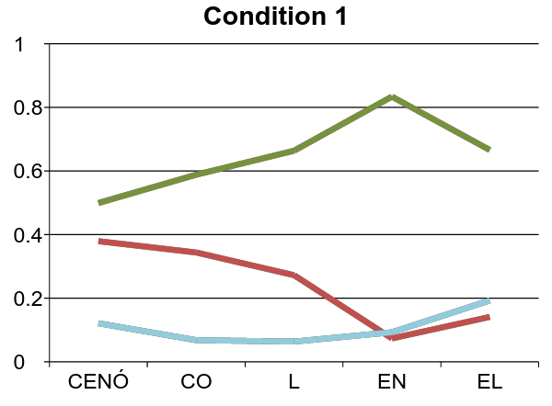
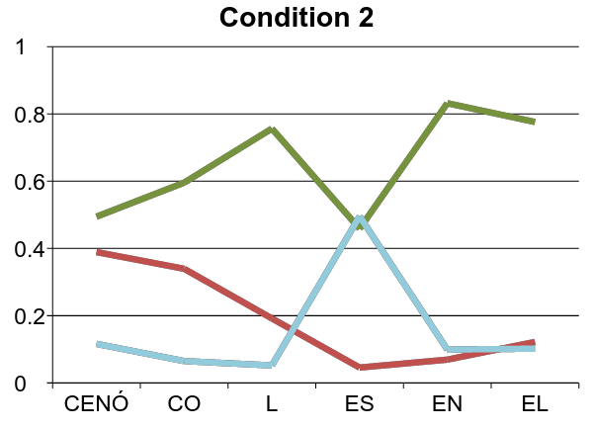
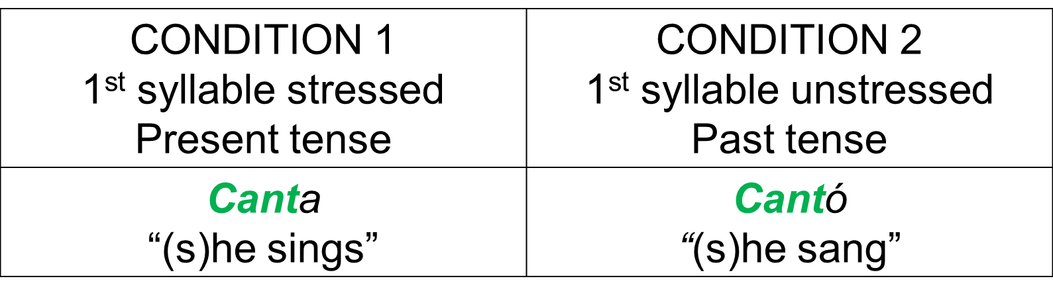
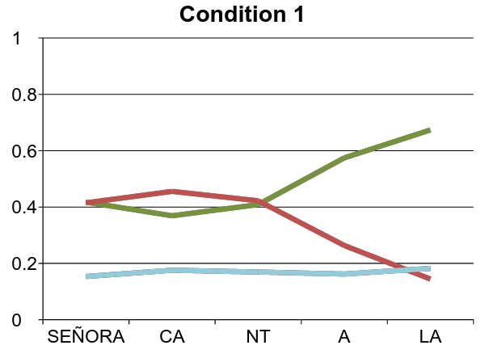
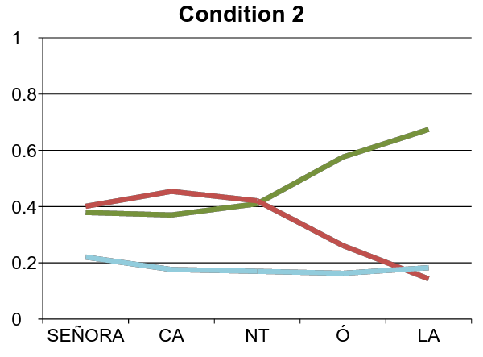
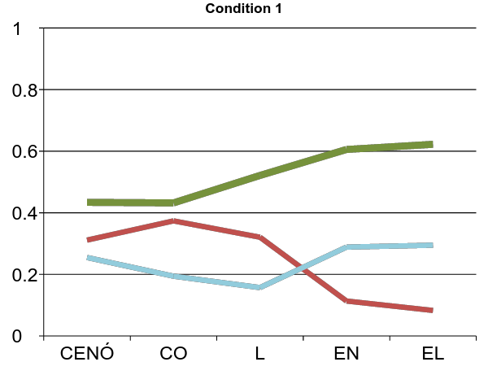
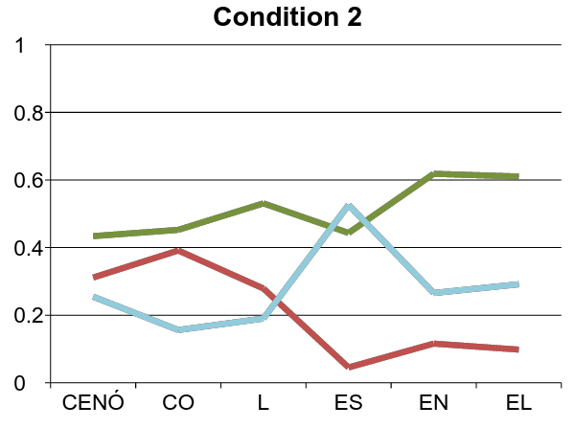
Guessing Before Hearing: Acoustic Cues Predict Inflectional Morphology
Rodriguez, N., Van Nostrand, S., Wang, J., DeLacy, P., & Sagarra, N.
Department of Spanish and Portuguese, Rutgers University, New Brunswick, NJ
ABSTRACT
People who start learning a foreign language after puberty have persistent difficulty acquiring inflectional morphology, such as verb and noun suffixes. Scholars have provided a vast array of explanations, ranging from representational to computational perspectives. However, studies have focused on the processing of suffixes, supposedly the root of the problem. We propose alternative explanations in terms of acoustic cues that precede suffixes in oral input, and that may be used to anticipate suffixes. In particular, we examine how Spanish monolinguals, beginning and advanced adult English learners of Spanish, and heritage speakers use stress (1st syllable stressed: canta “(s)he sings” vs. 2nd syllable stressed: cantó “(s)he sang”) and vowel duration (longer: col “cauliflower” vs. shorter: coles “cauliflowers") to anticipate suffixes. The eye-tracking data consisted of number of fixations to the target and the distractor pictures. The results revealed that the monolingual, late advanced, and early advanced groups used both stress and vowel duration to anticipate the suffix, and that the heritage speakers used both cues less than the other two groups. The late beginners also used vowel duration to predict the suffix, but significantly less than the other three groups; importantly, they were completely insensitive to stress cues.
METHODS AND PROCEDURE
TESTS: Participants completed 7 tests individually in 1hr 20min: language history questionnaire, Spanish proficiency test (bilinguals), eye-tracking task, production task, gating task, working memory test, phonological short-term memory test. This poster reports the eye-tracking task. EYE-TRACKING TASK: EyeLink 1000 eye-tracker (SR Research), sampling rate of 1k Hz, spatial resolution of .32 º horizontal and .25º vertical with an average calibration error of .01 º. Participants listened to sentences in Spanish and chose one of two words in the screen by pressing a key. Words were presented 1,000ms before the sentence began. There were 66 sentences: 18 practice, 20 experimental (stress, vowel duration), and 28 fillers. STRESS TRIALS: DURATION TRIALS: Why are vowels longer in condition 1 than in condition 2? Polysyllabic shortening: vowels in monosyllabic words are longer than in bisyllabic or trisyllabic words. Vowels in CVC syllables are longer than in CV syllables.
STRESS RESULTS
DURATION RESULTS
MONOLINGUALS
MONOLINGUALS
EARLY ADVANCED (heritage speakers)
EARLY ADVANCED (heritage speakers)
LATE ADVANCED
LATE ADVANCED
Fig 1. Eye-tracker Fig 2. Example of trial
GOAL
To investigate the effects of age of acquisition (before vs. after puberty) and proficiency (beginners vs. advanced) on adults’ processing of stress and vowel duration to predict inflectional morphology.
LATE BEGINNERS
LATE BEGINNERS
CONDITION 1 Longer vowel duration Monosyllabic word | CONDITION 2 Shorter vowel duration Bisyllabic word
Col “cauliflower” | Coles “cauliflowers”
PARTICIPANTS
MONOLINGUALS (n = 20): Spanish native speakers born and raised in a monolingual community in Spain. EARLY BILINGUALS (n = 33): heritage speakers born and raised in U.S., Spanish spoken at home (2nd generation), education in English, advanced in Spanish. LATE BILINGUALS (beginners: n = 15; advanced: n = 15): English native speakers who learned Spanish at or after puberty in a formal classroom setting. Advanced groups comparable in Spanish proficiency.
SCORING
ACCURACY: 1 pt per picture correctly selected with keyboard key. EYE-MOVEMENTS: sum of all fixations to target word, distractor word, and elsewhere, from one marker to the next one.
DISCUSSION
Monolinguals, late advanced learners, and heritage speakers used stress and duration to anticipate the suffix. Heritage speakers used stress and vowel duration less than monolinguals and late advanced learners. Late beginners used duration less than the rest, and did not use stress at all. AOA: Acquiring a language before puberty did not have any advantage on the use of stress and duration. Proficiency: in late learners, the more proficient the better use of stress and duration.
We would like to thank Paul de Lacy for sound file manipulation and marker generation, Marcus Johnson for scripts for data analysis, and María di Costanzo, Keshav Patel, Michael McGowen, and Rushi Mehta for help with data collection.

