Slide 1
Java Tuning Sun HotSpot JVM

Slide 2
Objectives
After completing this lesson, you should be able to:
  Monitor HotSpot JVM using JConsole
  Use jstat, jps, jinfo, jmap, jstack
  Use HotSpot ergonomics
  Monitor garbage collection
  Tune garbage collection
Notes:
Oracle WebLogic Server 10g R3: Monitoring and Performance Tuning 10 - <number>

Slide 3
Road Map
Monitoring and Tuning Sun HotSpot JVM
  Monitoring HotSpot JVM Using JConsole
  Using jstat, jps, jinfo, jmap, jstack
  Using HotSpot Ergonomics
  Monitoring Garbage Collection
  Tuning Garbage Collection
Notes:
Oracle WebLogic Server 10g R3: Monitoring and Performance Tuning 10 - <number>

Slide 4
Garbage Collection Review
  Garbage collection (GC) is the process of automatically freeing objects that are no longer referenced by the program.
    When an object is no longer referenced by the program, the heap space it occupies can be recycled so that the space is made available for subsequent new objects.
  Garbage collection relieves a Java developer from the burden of freeing allocated memory.
    Another advantage of GC is that it helps ensure program integrity by not allowing the developer to incorrectly manage memory.
Notes:
Oracle WebLogic Server 10g R3: Monitoring and Performance Tuning 10 - <number>
Garbage Collection Review
Garbage collection implies that objects no longer needed by the program are “garbage” and can be thrown away. Garbage collection is an important part of Java's security strategy. Java programmers are unable to accidentally (or purposely) crash the Java virtual machine by incorrectly freeing memory.
A potential disadvantage of a garbage-collected heap is that it adds an overhead that can affect program performance. The Java virtual machine has to keep track of which objects are being referenced by the executing program, and finalize and free unreferenced objects. This activity will likely require more CPU time than would have been required if the program explicitly freed unnecessary memory.

Slide 5
Generational Garbage Collection
  Heap memory is managed in generations holding objects of different ages.
  According to detailed studies, most server-side heap objects die young. And some objects live long.
  Generational garbage collection takes advantage of such early demise of objects to improve the real-time performance of garbage collection.
  Generational garbage collection is a key enhancement to the traditional garbage collection algorithm.
Notes:
Oracle WebLogic Server 10g R3: Monitoring and Performance Tuning 10 - <number>
Generational Garbage Collection
The Java heap is divided into different generations:
Young generation
Old generation
Permanent generation
When you are using generation garbage collection, objects are allocated by the program in the young generation. Young generation constantly filters out most objects (2/3), moves the rest to old generation (promotion). Old generation reclaims objects once in a while. Application Java classes and language classes will be allocated in the permanent generation.

Slide 6
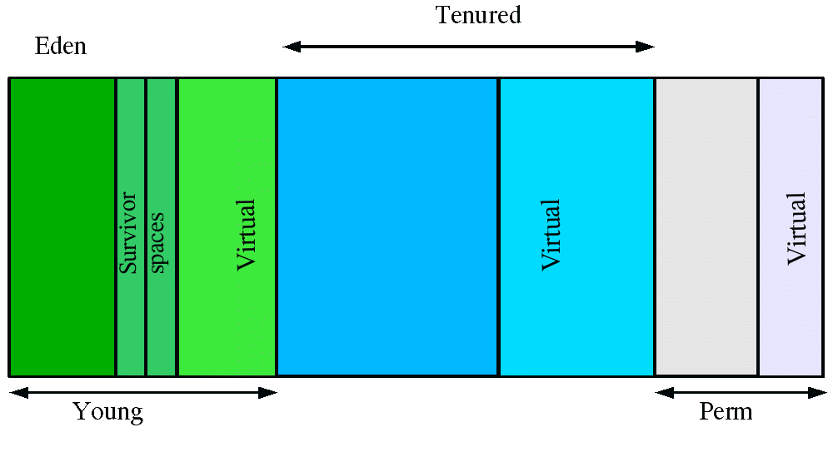
Review: Generational Heap
  Heap is divided broadly into three areas:
    Young (New) generation
    Tenured (Old) generation
    Permanent (Perm) generation
  Young generation is further divided into:
    Eden and two Survivor spaces
Xmx
Notes:
Oracle WebLogic Server 10g R3: Monitoring and Performance Tuning 10 - <number>
Review: Generational Heap
The graphic shows how the memory space is divided into various “areas.” This graphic is from: http://java.sun.com/docs/hotspot/gc5.0/gc_tuning_5.html.

Slide 7
Sun HotSpot JVM Monitoring Tools
In the 5.0 release, the Java virtual machine (JVM) is highly instrumented for monitoring and management.
Sun HotSpot JVM tools:
  JConsole: JMX-compliant JVM Monitoring and Management Console
  jps: JVM process status tool
  jstat: JVM performance and GC statistics monitoring tool
  jinfo: Tool that prints JVM configuration information
  jmap: Tool that prints heap and shared object memory map
  jstack: A printing tool that prints Java stack traces of Java threads
Notes:
Oracle WebLogic Server 10g R3: Monitoring and Performance Tuning 10 - <number>
Sun HotSpot JVM Monitoring Tools
You can use these tools to monitor JVM performance and resource consumption. You can also use some of the tools for troubleshooting. JConsole is a GUI-based tool that requires X-Windows. The other tools are command-line based tools.

Slide 8
J2SE Monitoring and Management Architecture
JMX-based
Management
Application
(e.g. JConsole)
Java application
Instrumentation
Platform
MBean
Server
Remote
Protocols
Instrumentation
SNMP
MIB
Java Virtual Machine
SNMP-based
Management
Application
(e.g. HP Network Node Manager, originally HP OpenView)
Operating System
Notes:
Oracle WebLogic Server 10g R3: Monitoring and Performance Tuning 10 - <number>
J2SE Monitoring and Management Architecture
A JMX-compliant client, such as JConsole, can connect to the platform MBean server and manage the application and the Java platform using JMX(JSR-3) technology. JMX Remote API (JSR-160) allows that instrumentation to be accessed remotely. Applications can also create their own MBeans and register them in the platform MBean server, which can serve as a single point for remote access.
J2SE Monitoring and Management Architecture: The graphic shows the JMX and SNMP-based Management Applications connecting to Java applications facilitating remote management.

Slide 9
Monitoring HotSpot VM
  JDK 5.0 and better includes the Java Monitoring and Management Console tool called JConsole.
  Java Management Extension (JMX) provides a standard way to instrument the Java runtime environment and applications running on the JVM.
  The Java platform provides a set of platform MBeans (Managed Beans) for monitoring and managing the Java virtual machine and the logging facility.
Notes:
Oracle WebLogic Server 10g R3: Monitoring and Performance Tuning 10 - <number>
Monitoring HotSpot VM
Recently Java has greatly expanded the JVM monitoring and management support capabilities and included the Java Monitoring and Management Console (JConsole) tool to take advantage of these capabilities.
When an application is run with JMX enabled, a JMX Agent process is activated within the JVM to manage JMX requests. JMX clients can then locate and connect to the JMX agent and query it for the available management resources. JMX was later complemented with the JMX Remote API (JSR 160), which allowed for remote clients to access the JMX agent. The JMX Remote API includes access control and SSL support, which makes it secure enough for use in production.
An MBean is a managed object that follows the design patterns conforming to the JMX Specification. An MBean can represent a device, an application, or any resource that needs to be managed. The management interface of an MBean comprises a set of readable and/or writable attributes and a set of invokable operations. MBeans can also emit notifications when predefined events occur.

Slide 10
JConsole
  JConsole is a JMX-compliant GUI tool that connects to a running JVM, which is started with the management agent.
  JDK 5.0 and better includes the monitoring and management tool, JConsole.
  JConsole allows you to see inside the JVM and the application while it is running.
  JConsole provides real-time viewing of the performance of applications and shows their resource consumption.
Notes:
Oracle WebLogic Server 10g R3: Monitoring and Performance Tuning 10 - <number>
JConsole
For more information, refer to JConsole documentation from Sun’s website: http://java.sun.com/developer/technicalArticles/J2SE/jconsole.html.
For Java 1.4.x, use the jvsstat and VisualGC technology (http://java.sun.com/performance/jvmstat/).

Slide 11
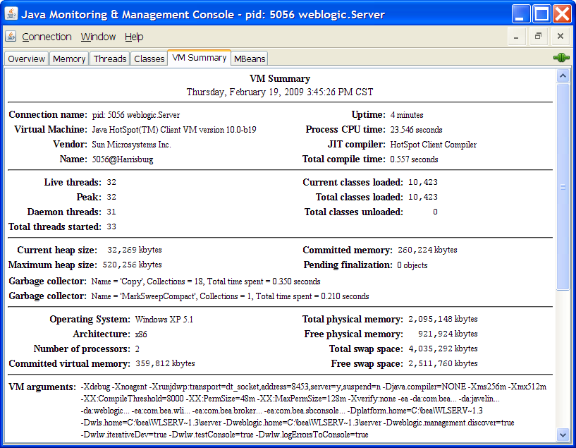
JConsole
  The management agent in the JVM should be started for monitoring.
  It can only connect to one JVM at any time.
  WebLogic Server
  should be started
  with the option
  -Dcom.sun.
  management.
  jmxremote
  to enable the
  management agent.
Notes:
Oracle WebLogic Server 10g R3: Monitoring and Performance Tuning 10 - <number>
JConsole (continued)
To start an application with the management agent for local monitoring, set the com.sun.management.jmxremote system property when you start the application.
For example, to enable the sample application DemoApp for local monitoring, enter the following command:
JDK_HOME/bin/java -Dcom.sun.management.jmxremote -jar DemoApp.jar
where JDK_HOME is the directory containing the JDK 5.0.
The screenshot shows JConsole.

Slide 12
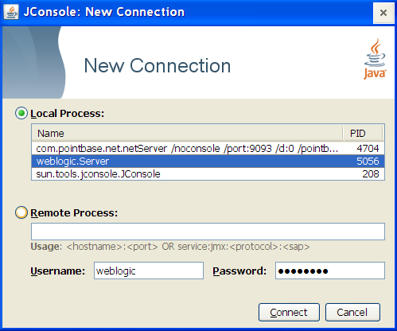
JConsole
JConsole can connect to a running JVM in the following ways:
  Local
    Connects to JVM running on the local system using RMI
  Remote
    Connects to a JMX agent
    using a RMI connector
  Advanced
    Connects to a JMX agent
    using a non-RMI connector
    (e.g. SNMP)
Notes:
Oracle WebLogic Server 10g R3: Monitoring and Performance Tuning 10 - <number>
JConsole (continued)
When started without any arguments, JConsole will automatically detect all local JVMs. Using JConsole locally is not recommended for production environments, because JConsole might consume significant system resources.
To enable the JMX agent (JConsole) for local access, set this system property when you start WebLogic Server or JVM:
com.sun.management.jmxremote
The screenshot shows how to connect JConsole to a running application.

Slide 13
Remote Monitoring
  To enable the JMX agent (JConsole) for remote access, set this system property when you start WebLogic Server or JVM :
    -Dcom.sun.management.jmxremote.port=portNo
  Connecting remotely through JConsole is the recommended way when monitoring or managing production environments.
  For security when remote monitoring is enabled, password authentication over SSL is enabled by default.
Notes:
Oracle WebLogic Server 10g R3: Monitoring and Performance Tuning 10 - <number>
Remote Monitoring
Local monitoring with JConsole is useful for development and prototyping. Using JConsole locally is not recommended for production environments, because JConsole itself consumes significant system resources. Rather, use JConsole on a remote system to isolate it from the platform being monitored.
To disable SSL for remote monitoring, set this system property when you start the JVM:
-Dcom.sun.management.jmxremote.ssl=false
Password authentication will still be required unless you disable it explicitly.
To disable password authentication, set:
-Dcom.sun.management.jmxremote.authenticate=false

Slide 14
Securing Remote Access
  Default roles defined in the access control file are:
    monitorRole, which provides Read-Only access for monitoring
    controlRole, which provides Read-Write access for monitoring and management
  You can define additional roles in the access control file.
  You can create passwords for the roles defined in the access control file by setting up a password file.
Notes:
Oracle WebLogic Server 10g R3: Monitoring and Performance Tuning 10 - <number>
Securing Remote Access
Instruction for setting up a password file:
Single User Environment: Set up the password file in the JDK_HOME/jre/lib/management directory as follows:
1. Copy the password template file, jmxremote.password.template, to management.jmxremote.password.
2. Set file permissions so that only the owner can read and write the password file.
3. Add passwords for roles such as monitorRole and controlRole.
Multi-user Environment: Set up the password file in the JDK_HOME/jre/lib/management directory as follows:
1. Copy the password template file, jmxremote.password.template, to your home directory.
2. Set file permissions so that only you can read and write the password file.
3. Add passwords for the roles such as monitorRole and controlRole.
4. Set this system property when you start the JVM: com.sun.management.jmxremote.password.file=pwFilePath
where pwFilePath is the path to the password file.

Slide 15
Securing Remote Access
  To use SSL, you need to set up a digital certificate on the system where the JMX agent (MBean server - JVM) is running.
  For improved security, you can enable client SSL authentication while starting the JVM using
    -Dcom.sun.management.jmxremote.ssl.need.
    client.auth=true
  You can use Keytool to generate certificates, and you can use the system properties to set SSL on the server.
Notes:
Oracle WebLogic Server 10g R3: Monitoring and Performance Tuning 10 - <number>
Securing Remote Access (continued)
The access control file is located at: JDK_HOME/jre/lib/management/jmxremote.access
The access levels are:
readonly: Grants access to read attributes of MBeans. For monitoring, this means that a remote client in this role can read measurements but cannot perform any action that changes the environment of the running program.
readwrite: Grants access to read and write attributes of MBeans to invoke operations on them and to create or remove them. This access should be granted to only trusted clients, since they can potentially interfere with the operation of an application.

Slide 16
JConsole
The JConsole interface is composed of six tabs:
  Summary tab: Summary information on the JVM and monitored values
  Memory tab: Information on memory use
  Threads tab: Information on thread use
  Classes tab: Information on class loading
  MBeans tab: Information on MBeans
  VM tab: Information on the JVM
Notes:
Oracle WebLogic Server 10g R3: Monitoring and Performance Tuning 10 - <number>

Slide 17

JConsole Summary
Notes:
Oracle WebLogic Server 10g R3: Monitoring and Performance Tuning 10 - <number>
JConsole Summary
The Summary tab displays some key monitoring information on thread usage, memory consumption, and class loading, plus information on the JVM and operating system.
The screenshot shows the VM summary tab in JConsole. The Garbage Collector summary is highlighted.

Slide 18
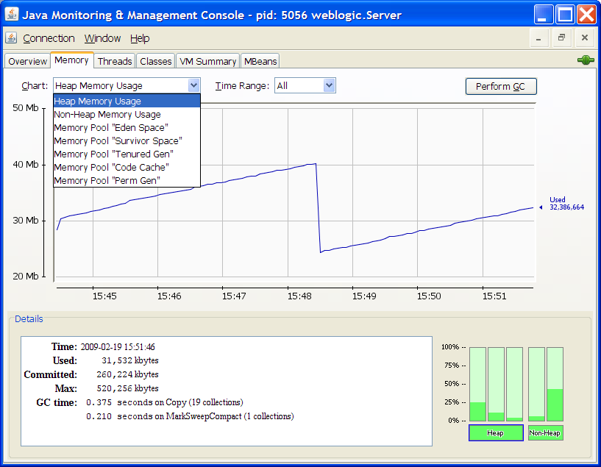
Monitoring Memory
Notes:
Oracle WebLogic Server 10g R3: Monitoring and Performance Tuning 10 - <number>
Monitoring Memory
The Memory tab provides information on memory consumption and memory pools.
The screenshot shows the Memory graphs generated by JConsole.

Slide 19
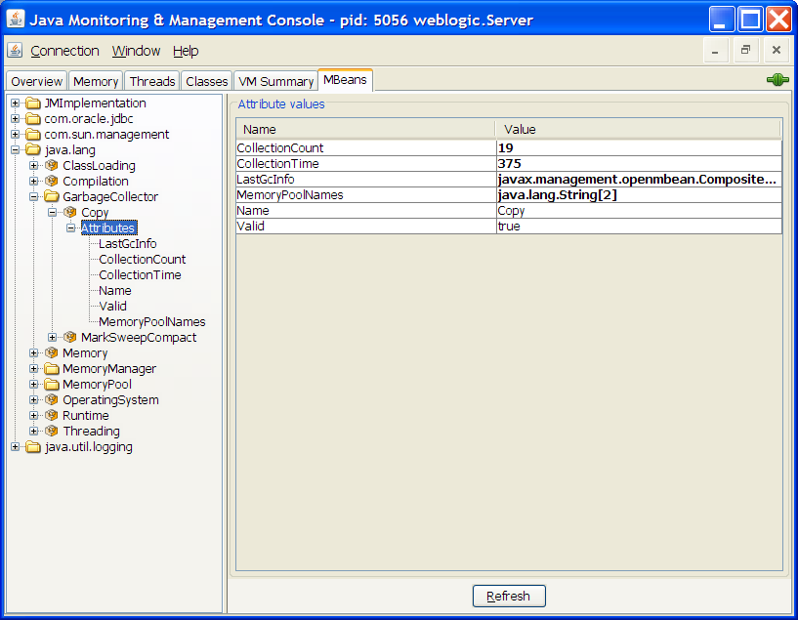
Monitoring MBeans
Notes:
Oracle WebLogic Server 10g R3: Monitoring and Performance Tuning 10 - <number>
Monitoring MBeans
The MBeans tab displays information on all the MBeans registered with the platform MBean server.
Platform MBeans:
java.lang.management.ClassLoadingMXBean
java.lang.management.CompilationMXBean
java.lang.management.MemoryMXBean
java.lang.management.MemoryManagerMXBean
java.lang.management.MemoryPoolMXBean
java.lang.management.GarbageCollectorMXBean
java.lang.management.ThreadMXBean
java.lang.management.RuntimeMXBean
java.lang.management.OperatingSystemMXBean
java.util.logging.LoggingMXBean Logging facility
The screenshot shows the Garbage Collector MBean and its attributes.

Slide 20
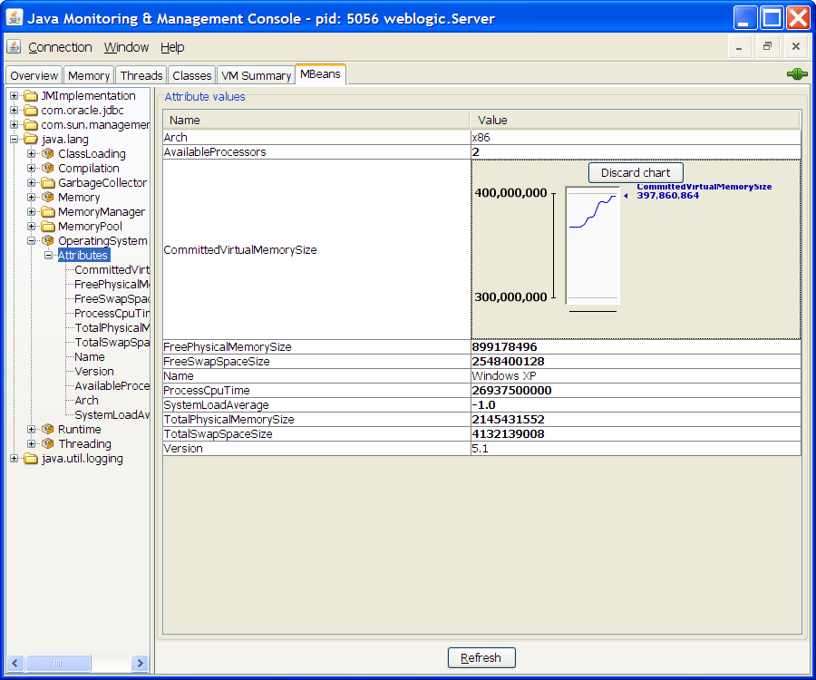
Displaying Chart
Double-click an MBean attribute value from MBeans tab to display a chart of the value versus time.
Notes:
Oracle WebLogic Server 10g R3: Monitoring and Performance Tuning 10 - <number>
Displaying Chart
The screenshot shows the graph generated from an attribute’s values.

Slide 21
jps
  This is the JVM Process Status Tool.
  It lists all the virtual machines that run in monitoring mode on a given computer using command-line options.
  If jps is run without specifying a hostid, it looks for instrumented JVMs on the local host.
  If jps is started with a hostid, it looks for JVMs on the indicated host, using the specified protocol and port.
  This can be used to retrieve the vmid (virtual machine identifier) or lvmid (Local Virtual Machine Identifier), which can be used as an input for other commands like jstat and so on.
Notes:
Oracle WebLogic Server 10g R3: Monitoring and Performance Tuning 10 - <number>
jps
The host identifier, or hostid, is a string that indicates the target system. The syntax of the hostid string largely corresponds to the syntax of a URI:
[protocol:][[//]hostname][:port][/servername]
For more information, refer to http://java.sun.com/j2se/1.5.0/docs/tooldocs/share/jps.html.
Note: This tool is classified as unsupported and experimental by Sun.

Slide 22
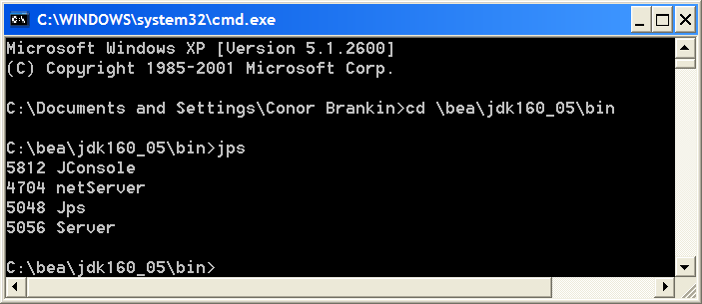
jps
  Output from a jps command with no options lists each Java application's lvmid followed by the short form of the application's class name (or) JAR file name.
  The -l option outputs the full package name for the application's main class (or) the full path name to the application's JAR file.
lvmids
Notes:
Oracle WebLogic Server 10g R3: Monitoring and Performance Tuning 10 - <number>
jps (continued)
The list of JVMs produced by the jps command may be limited by the permissions granted to the principal running the command. The command will only list the JVMs for which the principle has access rights as determined by operating system-specific access control mechanisms.
This command is important to retrieve the lvmids of the JVMs running so that we can use them in other commands.
The screenshot shows the result of a jps call.

Slide 23
jstat
  This is a Java Virtual Machine Statistics Monitoring Tool.
  This tool displays performance statistics for an instrumented HotSpot JVM using command-line options.
  It can connect to a local JVM using a lvmid.
  It can also connect to a remote JVM using a vmid.
  You can retrieve the lvmid on a target machine using the jps tool.
Notes:
Oracle WebLogic Server 10g R3: Monitoring and Performance Tuning 10 - <number>
jstat
vmid is represented as
[protocol:][//]lvmid[@hostname][:port][/servername]
The following is a Note from Sun about jstat:
Note: This utility is unsupported and may not be available in future versions of the J2SE SDK. It is not currently available on Windows 98 and Windows ME platforms.
Also this tool is classified as unsupported and experimental by Sun.
For more information, refer to http://java.sun.com/j2se/1.5.0/docs/tooldocs/share/jstat.html.

Slide 24
jstat
You can obtain the following JVM statistics dynamically using jstat:
  Compiler statistics
  Class loader statistics
  Garbage collection statistics
GC statistics include
  Cause of GC
  Generation information
    Capacity
    Utilization
Notes:
Oracle WebLogic Server 10g R3: Monitoring and Performance Tuning 10 - <number>
jstat (continued)
For more information, refer to http://java.sun.com/j2se/1.5.0/docs/tooldocs/share/jstat.html.
The following is a Note from Sun about jstat:
Note: This utility is unsupported and may not be available in future versions of the J2SE SDK. It is not currently available on Windows 98 and Windows ME platforms.
Also this tool is classified as unsupported and experimental by Sun.

Slide 25
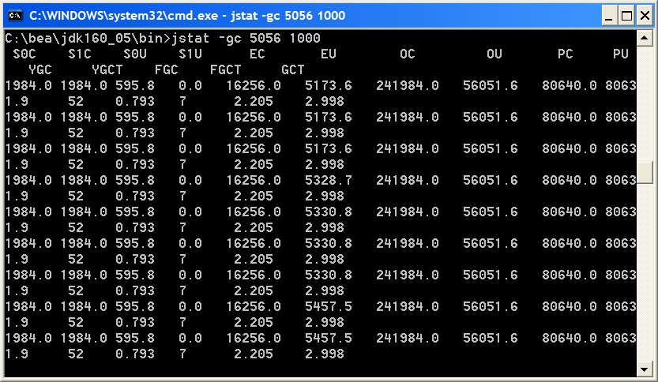
jstat Usage
jstat –gc jvmid
  Provides statistics on the behavior of the garbage collected heap
This example attaches to lvmid 5056 and takes samples at 1000 millisecond intervals.
Notes:
Oracle WebLogic Server 10g R3: Monitoring and Performance Tuning 10 - <number>
jstat Usage
Column Description
S0C Current survivor space 0 capacity (KB)
S1C Current survivor space 1 capacity (KB)
S0U Survivor space 0 utilization (KB)
S1U Survivor space 1 utilization (KB)
EC Current eden space capacity (KB)
EU Eden space utilization (KB)
OC Current old space capacity (KB)
OU Old space utilization (KB)
PC Current permanent space capacity (KB)
PU Permanent space utilization (KB)
YGC Number of young generation GC events
YGCT Young generation garbage collection time
FGC Number of full GC events
FGCT Full garbage collection time
GCT Total garbage collection time
The screenshot shows the results of a jstat call.

Slide 26
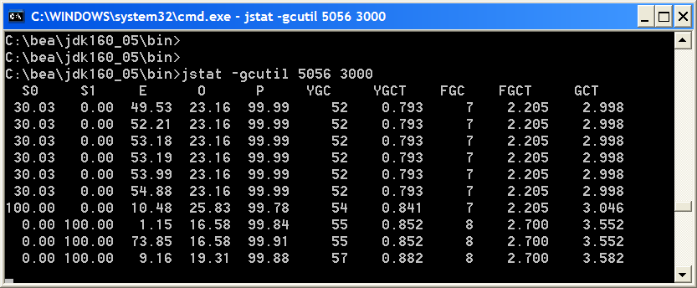
jstat Usage
jstat –gcutil jvmid
  Provides a concise summary of the garbage collection statistics
This example attaches to lvmid 2988 and takes six samples at 3000 millisecond intervals.
Notes:
Oracle WebLogic Server 10g R3: Monitoring and Performance Tuning 10 - <number>
jstat Usage (continued)
Column Description
S0 Survivor space 0 utilization as a percentage of the space’s current capacity
S1 Survivor space 1 utilization as a percentage of the space’s current capacity
E Eden space utilization as a percentage of the space’s current capacity
O Old space utilization as a percentage of the space’s current capacity
P Permanent space utilization as a percentage of the space’s current capacity
YGC Number of young generation GC events
YGCT Young generation garbage collection time
FGC Number of full GC events
FGCT Full garbage collection time
GCT Total garbage collection time
The screenshot shows the results of a jstat call.

Slide 27
jstat: Usage Tips
Look for the following while monitoring garbage collection statistics using jstat:
  If young generation collections grow rapidly, try increasing new generation size (-XX:MaxNewSize).
  If full generation collections grow rapidly and the total GC time increases frequently, try reducing the total heap size allocated for the VM (-Xmx).
  If the difference between the current permanent space utilization and the current permanent space capacity stays too low, try increasing the permanent size (-XX:MaxPermSize=n).
Notes:
Oracle WebLogic Server 10g R3: Monitoring and Performance Tuning 10 - <number>

Slide 28
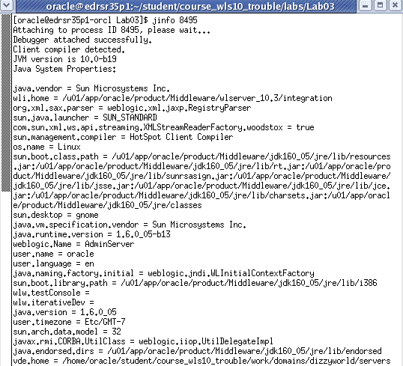
jinfo
jinfo prints Java configuration information for a given Java process or core file or a remote debug server.
Notes:
Oracle WebLogic Server 10g R3: Monitoring and Performance Tuning 10 - <number>
jinfo
Syntax : jinfo [ option ] pid | executable core |[server-id@]remote-hostname-or-IP
where
pid = Java process ID
executable = Java executable from which the core dump was produced
core = core file for which the configuration info is to be printed
server-id = unique server id
remote-hostname-or-IP = remote server’s IP or hostname
The screenshot shows an example of running jinfo.

Slide 29
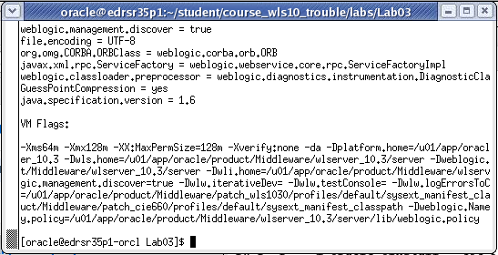
jinfo
You can display all the Java system properties and VM flags using the jinfo tool.
Notes:
Oracle WebLogic Server 10g R3: Monitoring and Performance Tuning 10 - <number>
jinfo (continued)
For more information, refer to http://java.sun.com/j2se/1.5.0/docs/tooldocs/share/jinfo.html.
The screenshot shows the VM flags being displayed using jinfo.

Slide 30
Why Use jinfo
You can use jinfo to find the following information about a running VM either locally or remotely:
  Version of the VM running
  Compiler options being currently used
  Classpath currently being used
  Locale information
  Command line options set during the VM startup
Notes:
Oracle WebLogic Server 10g R3: Monitoring and Performance Tuning 10 - <number>

Slide 31
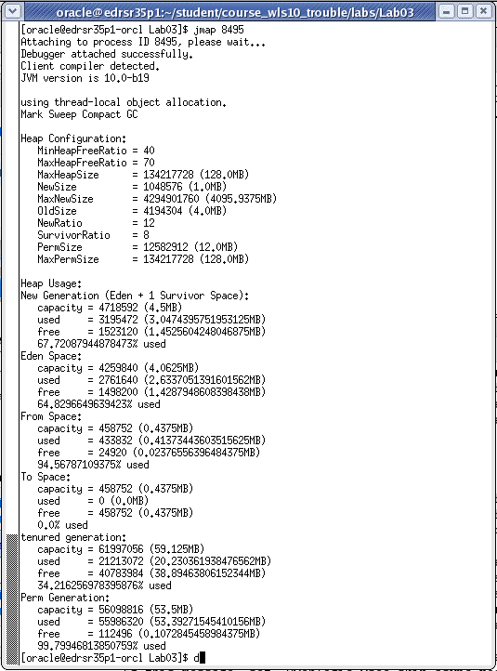
jmap
jmap prints shared object memory maps, heap memory details of a given process, a core file, or a remote debug server.
Notes:
Oracle WebLogic Server 10g R3: Monitoring and Performance Tuning 10 - <number>
jmap
Syntax : jmap [ option ] pid | executable core |[server-id@]remote-hostname-or-IP
where
pid = Java process ID
executable = a Java executable from which the core dump was produced
core = a core file for which the configuration info is to be printed
server-id = unique server id
remote-hostname-or-IP = remote server’s IP or hostname
The screenshot shows how jmap prints the memory details.

Slide 32
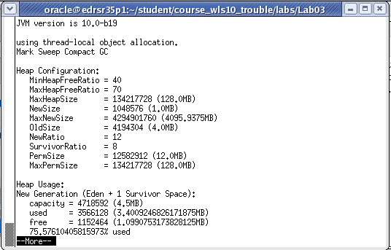
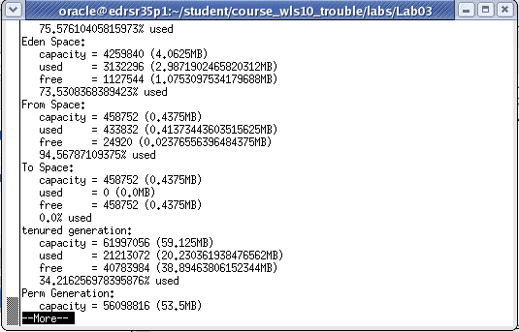
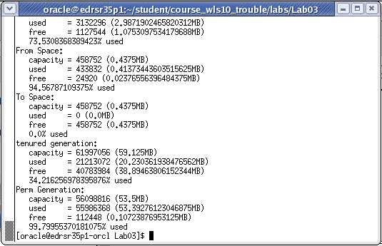
jmap
Notes:
Oracle WebLogic Server 10g R3: Monitoring and Performance Tuning 10 - <number>
jmap (continued)
The -heap option prints the following:
Heap summary
GC algorithm used
Heap configuration
Generation wise heap usage
For more information, refer to http://java.sun.com/j2se/1.5.0/docs/tooldocs/share/jmap.html.
The screenshots show the detail rendered from jmap with the -heap option.

Slide 33
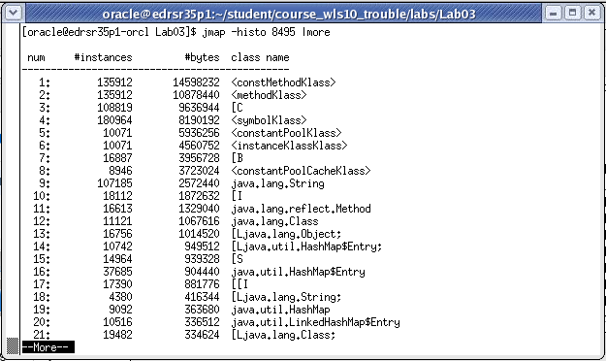
jmap
The -histo option prints a histogram of the heap.
For each Java class, the number of objects, the memory size in bytes, and the fully qualified class names are printed.
Notes:
Oracle WebLogic Server 10g R3: Monitoring and Performance Tuning 10 - <number>
jmap (continued)
You can use the -histo option to obtain a class-wise histogram of the heap.
The screenshot shows an example of the -histo option.

Slide 34
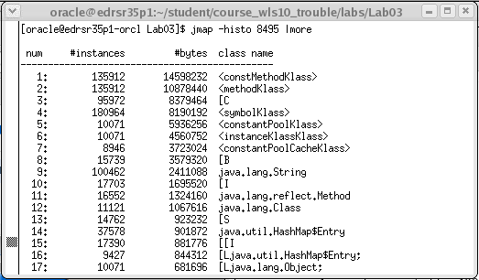
jmap
VM internal class names are encapsulated between ‘<‘ and ‘>’ characters.
Notes:
Oracle WebLogic Server 10g R3: Monitoring and Performance Tuning 10 - <number>
jmap (continued)
The screenshot shows internal VM classes being displayed between ‘< ’ and ‘>’ characters.

Slide 35
jmap: Usage Tips
You can use jmap to find the following information:
  The version of the VM running
  The shared libraries currently loaded in the VM, their location, and the size of memory occupied by them
  The current heap configuration
  The type of garbage collector used and GC algorithm-specific information
  The heap memory usage
  The object types, their size, and the count in memory (including VM internal classes)
Notes:
Oracle WebLogic Server 10g R3: Monitoring and Performance Tuning 10 - <number>
jmap: Usage Tips
The histogram is useful when you are trying to understand how the heap is used. To get the size of an object, you need to divide the total size by the count of that object type.

Slide 36
jstack
  You can use jstack to print a stack trace of all the threads currently running in a VM.
  jstack is different from the normal thread dump process in the following ways:
    Prints thread stack for a VM running remotely
    Prints thread stack from core file
    Prints thread stack on the stdout where this command is running, whereas thread dump (kill -3 pid or Ctrl-Break) prints thread stack trace on the VM’s stdout
    Is a vendor dependent, platform dependent implementation, whereas thread dump is not
Notes:
Oracle WebLogic Server 10g R3: Monitoring and Performance Tuning 10 - <number>
jstack
Syntax : jstack [ option ] pid | executable core |[server-id@]remote-hostname-or-IP
where
pid = Java process ID
executable = Java executable from which the core dump was produced
core = the core file for which the configuration info is to be printed
server-id = unique server id
remote-hostname-or-IP = remote server’s IP or hostname
For each Java frame, the full class name, method name, 'bci' (byte code index) and line number, if available are printed. jmap is not currently available on Windows platforms or on the Linux Itanium platform.
Note: This utility is unsupported and may or may not be available in future versions of the J2SE SDK.
For more information, refer to http://java.sun.com/j2se/1.5.0/docs/tooldocs/share/jstack.html.

Slide 37
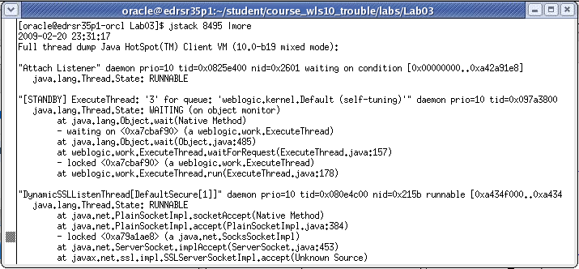
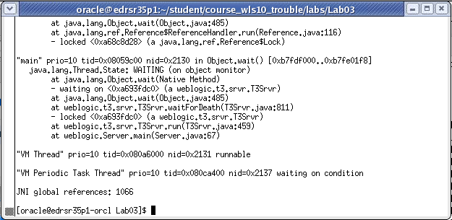
jstack
jstack prints Java stack traces of Java threads for a given Java process, core file, or a remote debug server.
Notes:
Oracle WebLogic Server 10g R3: Monitoring and Performance Tuning 10 - <number>
jstack (continued)
A stack trace of all threads can be useful when you are trying to diagnose a number of issues such as deadlocks or hangs. Deadlocks and hangs may consume a server’s resources more, which may let the user request deprive or starve. Diagnosing and eliminating these issues from the applications deployed on WebLogic Server will increase the performance of the server.
The following are the possible thread states (as of JDK5.0):
NEW: Thread has been created, but it has not started running yet.
IN_NATIVE: Thread is running native code.
IN_VM: Thread is running VM code.
IN_JAVA: Thread is running (either interpreted or compiled) Java code.
BLOCKED: Thread is blocked.
..._TRANS: If you see any of the preceding states followed by "_TRANS," it
means that the thread is changing to a different state.
UNINTIALIZED: Thread is not created. This will normally not happen (unless there is a serious bug such as memory corruption).
The screenshots show an example of running jstack.

Slide 38
Tuning GC Manually
  The self-tuning feature is not available while tuning JVMs before version 1.5, and manual tuning is required.
  The following are the common tuning parameters available while tuning the garbage collection manually:
    Size of the the overall heap:
      -Xms[n]
      -Xmx[n]
    Size of the generations in the heap:
      -XX:NewSize=n
      -XX:MaxNewSize=n
      -XX:NewRatio=n
Notes:
Oracle WebLogic Server 10g R3: Monitoring and Performance Tuning 10 - <number>
Tuning GC Manually
Command-line switches definition:
-Xms[n]: Minimum heap size
-Xmx[n]: Maximum heap size
-XX:NewRatio=[n]: Old/new region ratio
(Default: 8 for HotSpot client VM; 2 for HotSpot server VM)
-XX:SurvivorRatio=[n]: New/Survivor spaces ratio (Default: 25)
XX:+AggressiveHeap: Inspects the machine resources (size of memory and number of processors) and attempts to set various parameters to be optimal for long-running, memory allocation-intensive jobs. –ms and –mx are not compatible with this option.
-XX:ParallelGCThreads=[n]: The number of garbage collector threads when using throughput (parallel) collector

Slide 39
Tuning GC Manually
    The size of the survivor spaces in the young generation
      -XX:SurvivorRatio=n
    The size of the permanent generation
      -XX:PermSize=n
      -XX:MaxPermSize=n
    The threshold for promotion from the young generation to the old generation
      -XX:MaxTenuringThreshold=n
  Tuning involves either a series of experiments with a specialized tool (or) good judgment to decide that GC was performing well.
Notes:
Oracle WebLogic Server 10g R3: Monitoring and Performance Tuning 10 - <number>
Tuning GC Manually (continued)
-XX:PermSize=[n]: Permanent generation size
-XX:MaxPermSize=[n]: Maximum permanent generation size
-XX:+DisableExplicitGC: Disables the explicit
(The performance impact of explicit garbage collections can be measured by disabling explicit garbage collections using the flag.)
-XX:+UsePerfData: This flag enables the JVM to be monitored by VisualGC.
-verbosegc: Verbose the GC information
-XX:+PrintGCDetails: Prints additional information about the collections
-XX:+PrintGCTimeStamps: Prints a time stamp at the start of each collection

Slide 40
GC Algorithms
These are the Sun HotSpot VM command line switches that affect GC algorithms.
Option | Description | Generation
-XX:+UseParallelGC | Parallel / throughput collector | Young
-XX:+UseConMarkSweepGC | Concurrent low pause collector | Tenured
-XX:+UseTrainGC | Incremental / train low pause collector | Tenured
default | Serial collector – stops the world | Young and Tenured
Notes:
Oracle WebLogic Server 10g R3: Monitoring and Performance Tuning 10 - <number>
GC Algorithms
Note that -XX:+UseParallelGC should not be used with -XX:+UseConcMarkSweepGC. The argument parsing in the J2SE platform, version 1.4.2 should only allow legal combinations of command line options for garbage collectors, but earlier releases may not detect all illegal combinations and the results for illegal combinations are unpredictable.
The table shows Sun HotSpot VM options with the option description and the associated generation.

Slide 41
Ergonomics
  Ergonomics is a J2SE 1.5 self-tuning feature.
  Ergonomics provides good performance with minimum command-line tuning.
  It introduces a new tuning strategy called behavior- based tuning.
  Instead of setting various parameters to tune GC, you can simply specify one of the desired behaviors.
  You can set the desired behavior as one of the following:
    Maximum pause time goal
    Application throughput goal
Notes:
Oracle WebLogic Server 10g R3: Monitoring and Performance Tuning 10 - <number>

Slide 42
Maximum Pause Time Goal
  Pause time is the time taken by the garbage collector to recover heap space that is no longer in use by stopping the application.
  Setting this goal will limit the longest of such application pauses.
  You specify it with the command-line flag:
    -XX:MaxGCPauseMillis=nnn
  When this goal is specified, the garbage collector adjusts the heap size and various other parameters to keep the pauses shorter than the specified time.
Notes:
Oracle WebLogic Server 10g R3: Monitoring and Performance Tuning 10 - <number>
Maximum Pause Time Goal
The throughput collector is a generational collector, so there are separate collections for the young generation and the old generation. Averages and variances are kept separately for each generation. The maximum pause time goal is applied to the average plus the variance of the collections of each generation separately. Each generation may separately fail to meet the pause time goal.

Slide 43
Throughput Goal
  By setting the throughput goal, you can specify how much total time the garbage collector can spend for GC.
  You specify it with the command-line flag:
    -XX:GCTimeRatio=nnn
  The ratio of garbage collection time to application time is
  1 / (1 + nnn).
  The throughput goal is measured in terms of the time spent while garbage collecting the heap and the time spent outside of garbage collection (also know as application time).
Notes:
Oracle WebLogic Server 10g R3: Monitoring and Performance Tuning 10 - <number>
Throughput Goal
For example, if you set -XX:GCTimeRatio=24, this will set a goal of 1/25th or 4%, which means 4% of the total time is the goal for garbage collection, and the rest will be application time.
The time spent in garbage collection is the total time for both the young generation and old generation collections combined. If the throughput goal is not being met, the sizes of the generations are increased in an effort to increase the time the application can run between collections.

Slide 44
Footprint Goal
  While achieving the throughput and maximum pause time goal set, JVM will try to reduce the total memory footprint.
  The garbage collector will keep reducing the size of the heap and will check to see whether it meets the maximum pause time goal and throughput goal.
  Once it finds that a goal is not being met, the garbage collector will address that goal.
  So, ultimately the total memory footprint of the JVM will also decrease.
Notes:
Oracle WebLogic Server 10g R3: Monitoring and Performance Tuning 10 - <number>
Footprint Goal
The implementation checks (in this order):
If the GC pause time is greater than the pause time goal, reduce the generation sizes to better attain the goal.
If the pause time goal is being met, consider the application's throughput goal. If the application’s throughput goal is not being met, increase the sizes of the generations to better attain the goal.
If both the pause time goal and the throughput goal are being met, the size of the generations is decreased to reduce footprint.

Slide 45
Ergonomics Behavior
  In order to achieve the throughput goal defined by the command-line flag, the garbage collector automatically resizes the heap.
  Heap size oscillation can be found during:
    JVM initialization
    A change in WebLogic Server behavior
  To achieve the throughput goal, larger heaps are used.
  To achieve the maximum pause time goal and a minimum footprint, smaller heaps are used.
Notes:
Oracle WebLogic Server 10g R3: Monitoring and Performance Tuning 10 - <number>

Slide 46
Server-Class Machine Detection
  In J2SE 5.0 or higher, when a machine with at least two CPUs and at least 2GB of physical memory is used, it is said to be a server-class machine.
  During JVM launch, the JVM detects whether the application/server is running in a server-class machine; if so, Java HotSpot Server VM is used.
  Server-class detection occurs if you specify neither -server nor -client when launching the application on a Pentium or SPARC 32-bit machine running Solaris or Linux.
Notes:
Oracle WebLogic Server 10g R3: Monitoring and Performance Tuning 10 - <number>

Slide 47
More Ergonomics
  On server-class machines, the default collector is Parallel Collector.
  The implementation of -XX:+UseAdaptiveSizePolicy is used by default with the Parallel Collector.
  By default, the initial heap size is the larger of 1/64th of the machine's physical memory on the machine or some reasonable minimum.
  By default, the maximum heap size is the smaller of 1/4th of the physical memory or 1GB.
Notes:
Oracle WebLogic Server 10g R3: Monitoring and Performance Tuning 10 - <number>
More Ergonomics
The default collector in releases prior to J2SE 5.0 was Serial Collector. You can set this now by using the -XX:+UseSerialGC command-line option.
The heap size parameters selected by ergonomics plus the features of the adaptive size policy are meant to provide good performance for server applications.

Slide 48
More Ergonomics
  Multiple goals, such as –XX:GCTimeRatio and
  –XX:MaxGCPauseMillis, can also be defined on the command-line while starting the JVM.
  The priority in which the goals will be addressed if multiple goals are present at the same time would be:
    Maximum pause time goal
    Throughput goal
    Minimum footprint goal
Notes:
Oracle WebLogic Server 10g R3: Monitoring and Performance Tuning 10 - <number>

Slide 49
64-Bit Enhancements
  Sun provides only a server VM to enhance the performance when running Java on a 64-bit OS (Solaris, Linux, MS Windows) that runs on:
    SPARC 64-bit
    AMD 64
  Support for large heaps (> 4GB) are enabled with a 64-bit address space.
Notes:
Oracle WebLogic Server 10g R3: Monitoring and Performance Tuning 10 - <number>
64-Bit Enhancements
There are several classes of applications where using 64-bit addressing can be useful, for example, those that store very large data sets in memory. Applications can now avoid the overhead of paging data from disk or extracting it from a RDBMS. This can lead to dramatic performance improvements in applications of this type.

Slide 50
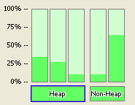
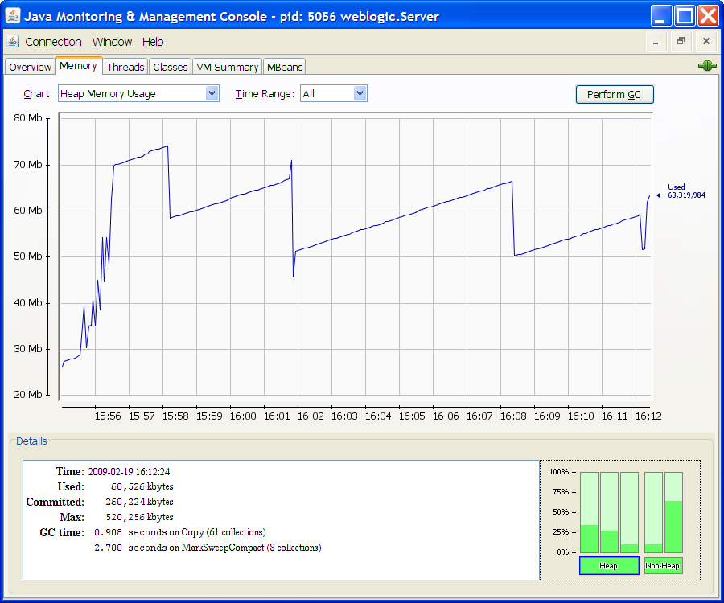
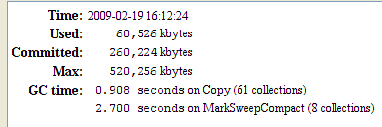
Monitoring Heap and GC: JConsole
Tenured
space
Eden space
Survivor space
Code
cache
space
Permanent
generation
Notes:
Oracle WebLogic Server 10g R3: Monitoring and Performance Tuning 10 - <number>
Monitoring Heap and GC: JConsole
The Memory tab of JConsole provides information about memory consumption, memory pools, and garbage collection statistics by accessing the memory system, memory pools, and garbage collector MBeans.
Monitoring Memory: The screenshot shows the Memory graphs generated by JConsole.

Slide 51

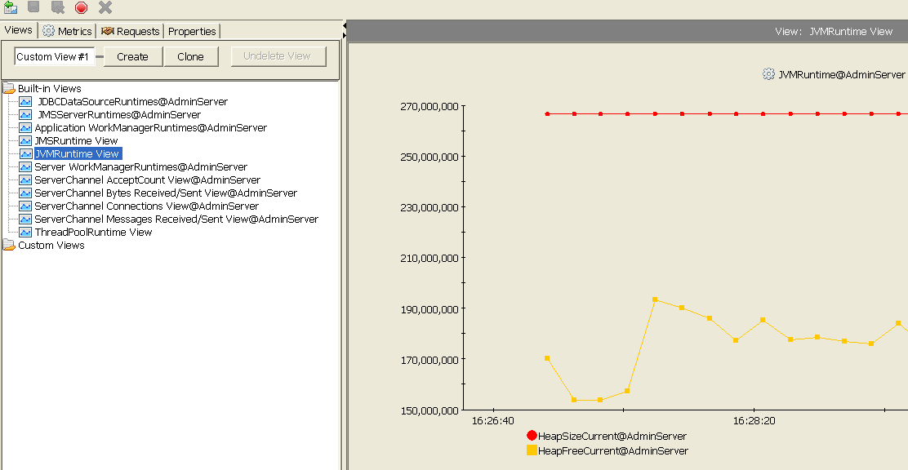
Monitoring Heap: WLDF Console Extension
Notes:
Oracle WebLogic Server 10g R3: Monitoring and Performance Tuning 10 - <number>
Monitoring Heap: WLDF Console Extension
The WebLogic Diagnostic Framework (WLDF) Console Extension is an extension to the WebLogic Server Administration Console that provides views and tools for graphically presenting (visualizing) diagnostic data in charts and graphs. There are a few built-in views available immediately. Users can also create custom views either from scratch or by cloning existing/built-in views. One such built-in view is “JVMRuntime View,” which provides information about the current heap size of the JVM and the current free heap in the JVM. You can also modify an existing view either by adding or deleting one or more parameters.
The WLDF console extension can also be used to monitor JVM heap usage information right from the WebLogic Administration Console.
The screenshot shows the extension to the standard console.

Slide 52
Monitoring GC: verbose:gc
  You can enable garbage collection statistics gathering in HotSpot VM by turning on the verbose:gc command-line flag.
    java –ms200m –mx512m –verbose:gc …
    weblogic.Server
  In releases prior to J2SE 5.0, this attribute could be changed dynamically.
  In J2SE 5.0 and higher, you can set this flag dynamically by changing the verbose attribute of java.lang.management.MemoryMXBean
    You can use JConsole to change this attribute.
Notes:
Oracle WebLogic Server 10g R3: Monitoring and Performance Tuning 10 - <number>
Monitoring GC: verbose:gc
Redirect both the standard error and standard output to a log file to analyze verbose:gc output:
For example, on Windows and Solaris:
% java –ms200m –mx512m –verbosegc … weblogic.Server >> logfile.txt 2>&1
The flag -XX:+PrintGCDetails prints additional information about the collections.

Slide 53
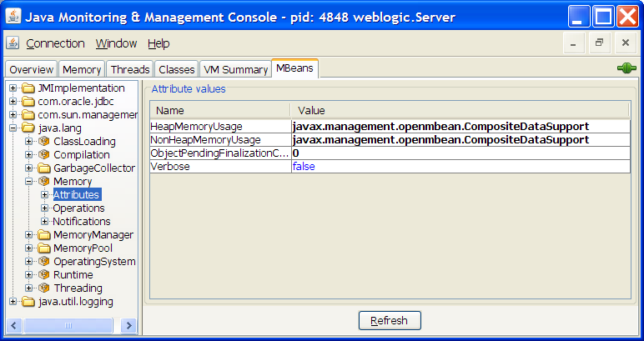
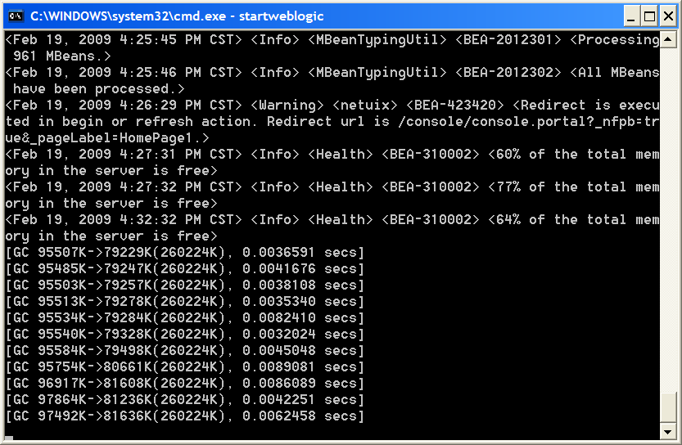
Monitoring GC: verbose:gc
Change this to true to enable GC verbose.
Notes:
Oracle WebLogic Server 10g R3: Monitoring and Performance Tuning 10 - <number>
Monitoring GC: verbose:gc (continued)
To enable or disable the GC verbose tracing, select Memory MBean under the MBeans tab and set the Verbose attribute to true or false.
[GC 95534K->79284K (260224K), 0.0082410 secs]
GC: Indicates that it was a minor collection (young generation). If it had said Full GC, it was a major collection (tenured generation).
95534K: The combined size of live objects before garbage collection
79284K: The combined size of live objects after garbage collection
(260224K): The total available space, not counting the space in the permanent generation, which is the total heap minus one of the survivor spaces
0.0082410 secs: The time it took for garbage collection to occur
You can get more detailed output using -XX:+PrintGCDetails and
-XX:+PrintGCTimeStamps
The screenshot shows the verbose attribute in the Monitoring and Management Console. The results of changing the attribute to true are highlighted in the server log.

Slide 54
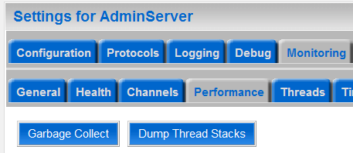
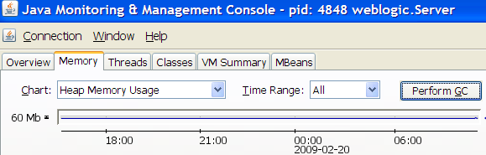
Requesting GC Manually
When required, you can manually request a full garbage collection by:
  Using the WebLogic Administration Console
  Using JConsole
  Calling the gc() method on java.lang.System [System.gc()]
  Calling the gc() method on java.lang.management.MemoryMXBean
Notes:
Oracle WebLogic Server 10g R3: Monitoring and Performance Tuning 10 - <number>
Requesting GC Manually
If you want to disable calls to request GC manually, set -XX:+DisableExplicitGC on the command line while starting WebLogic Server. This will disable calls to System.gc(), but JVM performs garbage collection when necessary.
The screenshots show how garbage collection can be forced from the administration console and from the Monitoring and Management console.

Slide 55
Sizing Heap Memory
  The –Xms value is the space in memory that is committed to the VM at startup.
  The JVM can grow up to the size of the –Xmx value.
  The difference between –Xmx and –Xms is virtual memory (virtually committed).
    java –Xms256m –Xmx512m … weblogic.Server
  To have a controlled environment, try setting minimum and maximum heap values to be the same.
    java -Xms512m –Xmx512m … weblogic.Server
Notes:
Oracle WebLogic Server 10g R3: Monitoring and Performance Tuning 10 - <number>

Slide 56
Evaluating GC Algorithm
The following criteria should be considered when evaluating a garbage collection algorithm:
  Pause time
    Does the collector introduce pauses by stopping the world?
  Memory footprint
    What is the total memory allocated versus the total memory available to the application?
  Virtual memory usage and interaction
    How efficiently does the garbage collector manage the locality reference for pages outside the resident memory during a full GC?
  Parallel
    Does the collector make use of multiple CPUs if available?
Notes:
Oracle WebLogic Server 10g R3: Monitoring and Performance Tuning 10 - <number>
Evaluating GC Algorithm
Measuring JVM performance:
JVM performance is usually measured using these common metrics.
Throughput
Percentage of time not spent in GC over a long period of time
Pauses
When an application becomes unresponsive because of GC
Footprint
Overall memory a process takes to execute versus the memory actively available to the process

Slide 57
Evaluating GC Algorithm
  CPU usage
    What is the percentage of CPU spent in garbage collection?
  Concurrency
    Does the collector run concurrently with the application threads?
  Locality improvement
    To improve the reference locality of the application, does the collector efficiently relocate objects during collection to improve locality?
  Compiler and runtime
    GC instructions are run by the runtime and are generated by the compiler. Whether this impacts compile-time optimizations is another factor to consider.
Notes:
Oracle WebLogic Server 10g R3: Monitoring and Performance Tuning 10 - <number>
Evaluating GC Algorithm (continued)
Dynamic memory allocation and garbage collection can have detrimental performance effects because the placement of objects in memory can occur in a rather non-systematic, unpredictable way. In contrast, most computers are dependent on memory data placement for good performance. In particular, high performance computers use memory hierarchies that perform better when data (objects) accessed close together in time are also placed close together in memory; this is a form of data "locality" that is exploited by cache memories and paged virtual memory systems.
On modern systems, memories are organized in a hierarchy, from the top of the pyramid, the small and fast memory, to the bottom, the larger and slower memories, that is, from caches, to the main memory, to the even slower hard disks. The smaller and expensive memory gives a processor fast data access, whereas the bottom of the pyramid provides cheap and large capacity at the cost of speed. Due to the limitedness of the amount of the physical resource at the higher end of hierarchy, organizing the placement of data in the fast memory or preserving the memory locality is essential to high performance.

Slide 58
GC Tuning Tips
  The heap size influences the following:
    The GC frequency and the pause during collections
    The number of short and long term objects
    Fragmentation and locality problems
  An undersized heap with the concurrent collector leads to full GCs with an increase in load and also fragmentation problems.
  An oversized heap leads to increased collection times and locality problems (smear problem).
  The permanent generation may be a factor on applications that dynamically generate and load many classes (JSP and CFM application servers).
Notes:
Oracle WebLogic Server 10g R3: Monitoring and Performance Tuning 10 - <number>

Slide 59
GC Tuning Tips
  Size the heap to handle peak and burst loads.
  Be sure to increase the memory as you increase the number of processors, since allocation can be parallelized.
  Configure as much memory as possible to the virtual machine unless you have problems with pauses.
  Do not choose a maximum value for the heap unless you know that the heap is greater than the default maximum heap size.
    Explicit garbage collection calls (System.gc()) force a major collection.
Notes:
Oracle WebLogic Server 10g R3: Monitoring and Performance Tuning 10 - <number>
GC Tuning Tips
If you want to disable calls to request GC manually, set -XX:+DisableExplicitGC on the command line while starting WebLogic Server. This disables calls to System.gc() and distributed RMI GC, but JVM performs garbage collection when necessary.

Slide 60
GC Tuning Tips
  Measure the effectiveness of explicit GC calls by disabling them using the following option:
    -XX:+DisableExplicitGC
  Increase the MaxPermSize to accommodate the dynamically generated classes.
    -XX:MaxPermSize=nnn
  Use -XX:+AggressiveHeap for throughput applications.
Notes:
Oracle WebLogic Server 10g R3: Monitoring and Performance Tuning 10 - <number>
GC Tuning Tips (continued)
When Aggressive heap is set, the JVM uses all available memory. This option is incompatible with -Xms -Xmx. Heap may even steal memory from stack. So explicitly set the stack size using -Xss30m.
This option instructs the JVM to push memory use to the limit; the memory management policy defers collection as long as possible, and (in some VMs) some GC activity is done in parallel. Because this option sets heap size, do not use it with the -Xms or -Xmx options.
Example: java -XX:+AggressiveHeap … weblogic.Server

Slide 61
GC Tuning Tips
  Applications that rely on finalization (finalize method) will cause lag in garbage collection. Try reducing the dependency on finalization.
  The more CPUs, the more the advantages of the concurrent collector increase.
  The increase in the lifetime of objects increases the frequency of collection as live objects take heap space. So keep live objects to the needed minimum.
    Set a limit for pooled objects and do not set this value too high.
Notes:
Oracle WebLogic Server 10g R3: Monitoring and Performance Tuning 10 - <number>
GC Tuning Tips (continued)
For more information on tuning Sun HotSpot JVM, refer to GCPortal at:
http://java.sun.com/developer/technicalArticles/Programming/GCPortal/ReadMe_Win32.html (Windows).
http://java.sun.com/developer/technicalArticles/Programming/GCPortal/ReadMe_Solaris.html (Solaris).
GCPortal enables a service, Application Modeling, and Performance Tuning from a GC perspective. It is implemented in J2EE and available as a J2EE WAR module that can run on any J2EE Application Server. It allows developers to submit log files and analyze application behavior. You can use GCPortal to performance tune and size the application to run optimally under lean, peak, and burst conditions.

Slide 62
GC Tuning Tips
  Avoid setting old generation size too small as this may result in undersized heaps.
    An undersized heap may reduce collection time and lead to fragmentation and frequent full GCs.
  Increase young generation to decrease the frequency of collection, but this will increase pause. So choose a size for the young generation where the pause is tolerable.
  An increase in load will fill up the heap faster and this will increase the collection frequency. To reduce the collection frequency, increase the heap size.
Notes:
Oracle WebLogic Server 10g R3: Monitoring and Performance Tuning 10 - <number>
GC Tuning Tips (continued)
To find more information about aggressive options, use -XX:+PrintCommandLine.

Slide 63
GC Tuning Tips
  Use the default serial collector for smaller applications.
  For larger applications hosted on WebLogic Server, use the throughput collector.
    -XX:+UseParallelGC
  Use -Xconcgc for low pause applications.
  Use Intimate Shared Memory (ISM) and variable page sizes to reduce the smear problem where available.
    -XX:+UseISM
Notes:
Oracle WebLogic Server 10g R3: Monitoring and Performance Tuning 10 - <number>
GC Tuning Tips (continued)
Intimate Shared Memory (ISM) increases page size from 8k to 4MB. It uses real addresses not virtual addresses, but it locks pages in memory.
Intimate Shared Memory Warnings:
It is a Solaris only feature.
It locks memory and should be used only on dedicated systems.
Memory fragmentation may prevent allocation of contiguous 4MB pages.
Abnormal JVM termination may result in locked segments.
Use ipcs/ipcrm to discover and delete.

Slide 64
Practice 10-1 Overview:
Monitoring and Tuning Sun HotSpot JVM
This practice covers the following topics:
  Monitoring Sun HotSpot JVM using JConsole
  Tuning HotSpot JVM garbage collection
  Investigating GC statistics using jstat
Notes:
Oracle WebLogic Server 10g R3: Monitoring and Performance Tuning 10 - <number>

Slide 65
Summary
In this lesson, you learned how to:
  Monitor Sun HotSpot JVM
  Use JConsole, jps, jstat, jinfo, jmap, and jstack
  Use Sun HotSpot ergonomics
  Tune Sun HotSpot JVM garbage collection
Notes:
Oracle WebLogic Server 10g R3: Monitoring and Performance Tuning 10 - <number>

Slide 66
Quiz
Which statement(s) is (are) true?
  To enable the JMX agent (JConsole) for remote access, set this system property when you start WebLogic Server or JVM:
    -Dcom.sun.management.jmxremote.port=portNo
  Connecting remotely through JConsole is the recommended way when you are monitoring or managing production environments.
  For security, when remote monitoring is enabled, it is suggested that you enable password authentication over SSL, as it is disabled by default.
Notes:
Answers: 1, 2

