Slide 1
Tuning Oracle JRockit JVM

Slide 2
Objectives
After completing this lesson, you should be able to:
  Understand the benefits of using the JRockit JVM
  Use the JRockit Mission Control application
  Determine the cause and location of memory leaks
Notes:
Oracle WebLogic Server 10g R3: Monitoring and Performance Tuning 11 - <number>

Slide 3
JRockit JVM
  WebLogic JRockit Java Virtual Machine (JVM) was the first commercial server-side JVM that was J2SE 5.0 compatible.
  A typical Oracle WebLogic installation includes the JRockit SDK.
  WebLogic Configuration Wizard can be used to select JRockit as the JVM for WLS domains.
  JRockit is the default production JVM for WLS domains.
Notes:
Oracle WebLogic Server 10g R3: Monitoring and Performance Tuning 11 - <number>

Slide 4
JRockit Benefits
  Weblogic JRockit JVM is designed for server-side applications.
  It employs adaptive optimization to significantly improve runtime performance.
  It has adaptive garbage collection and heap management.
  It offers full support for 32- and 64-bit JRockit on Intel EM64T/AMD64 and compatibles.
  JRockit also supports Solaris/SPARC architecture.
  It offers support for very large heaps on 64-bit platforms.
  The tools suite for JRockit Mission Control offers better management, tuning, and troubleshooting.
Notes:
Oracle WebLogic Server 10g R3: Monitoring and Performance Tuning 11 - <number>
JRockit Benefits
JRockit JVM delivers a new level of performance for Java applications deployed on Intel 32-bit and 64-bit (Itanium) architecture (Windows/Linux). It is supported on Windows, Linux, and Solaris/SPARC. WebLogic JRockit SDK provides optimal runtime performance for applications developed for and running on WebLogic Server.

Slide 5
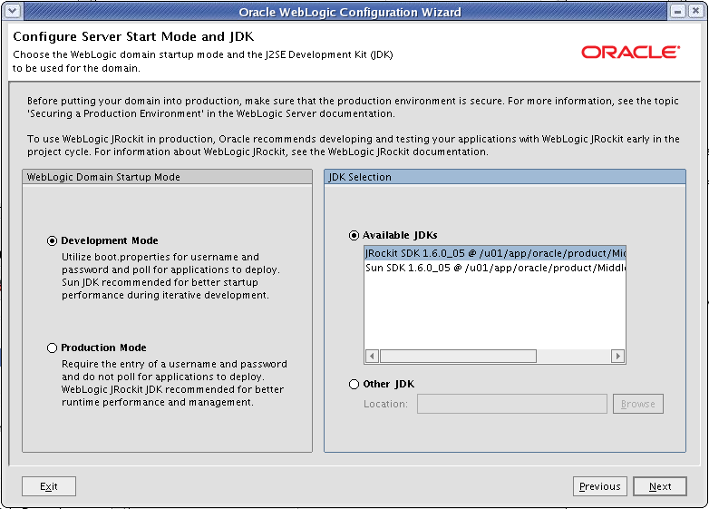
JRockit in the Configuration Wizard
Notes:
Oracle WebLogic Server 10g R3: Monitoring and Performance Tuning 11 - <number>
JRockit in the Configuration Wizard
You can use WebLogic JRockit JVM for development mode or production mode (the default). The Configuration Wizard creates start-up scripts that invoke the WebLogic JRockit JVM, making its use simple and transparent.

Slide 6
Garbage Collection Review
  Garbage collection (GC) is the process of automatically freeing objects that are no longer referenced by the program.
    When an object is no longer referenced by the program, the heap space it occupies can be recycled so that the space is made available for subsequent new objects.
  Garbage collection relieves a Java developer from the burden of freeing allocated memory.
    Another advantage of GC is that it helps ensure program integrity by not allowing the developer to incorrectly manage memory.
Notes:
Oracle WebLogic Server 10g R3: Monitoring and Performance Tuning 11 - <number>
Garbage Collection Review
The name “garbage collection” implies that objects no longer needed by the program are “garbage” and can be thrown away. Garbage collection is an important part of Java's security strategy. Java programmers are unable to accidentally (or purposely) crash the Java virtual machine by incorrectly freeing memory.
A potential disadvantage of a garbage-collected heap is that it adds an overhead that can affect program performance. The Java virtual machine has to keep track of which objects are being referenced by the executing program and finalize and free unreferenced objects. This activity will likely require more CPU time than would have been required if the program explicitly freed unnecessary memory.

Slide 7
Generational Garbage Collection
  Heap memory is managed in generations holding objects of different ages.
  Generational garbage collection is a key enhancement to the traditional garbage-collection algorithm.
  The two types of garbage collection possible in JRockit:
    Two-generational garbage collection
    Single-generational garbage collection
Notes:
Oracle WebLogic Server 10g R3: Monitoring and Performance Tuning 11 - <number>
Generational Garbage Collection
According to detailed studies, most server-side heap objects die young. And some objects live long. Generational garbage collection takes advantage of the early demise of objects to improve the real-time performance of garbage collection.
The Java heap in JRockit is divided into different generations:
Young generation or nursery
Old generation
When using generation garbage collection, objects are allocated by the program in the young generation. Young generation constantly filters out most objects (two-third) and moves the rest to old generation (promotion). Old generation reclaims objects once in a while.

Slide 8
Generational Heap: JRockit
In the two-generational model, heap is divided into two generations:
  Young generation (Nursery)
  Old generation
In a single-spaced model, all the objects are allocated in a single space on the heap.
Nursery
Old Space
Xns
Xmx
Xmx
Notes:
Oracle WebLogic Server 10g R3: Monitoring and Performance Tuning 11 - <number>
Generational Heap: JRockit
In the case of a two-generational garbage collector, objects are allocated in the young generation and eventually moved to the old generation if they are alive. In a single-generation garbage collection, heap is treated as a single contiguous space, and there is no notion of nursery.
When a two-generational garbage collector is used, all thread-local areas (used for allocation of small objects) are allocated in the nursery, whereas large objects are allocated in the old space.
The graphic shows the difference between generational heap and non-generational heap. In the non-generational heap, all objects are bundled together; the garbage collector has to sweep the entire heap to perform garbage collection. In the generational model, the heap is split into old space and nursery space. This allows the garbage collector to be more efficient.

Slide 9
JRockit Mission Control
JRockit ships with JRockit Mission Control.
This is a group of management and monitoring tools.
  JRockit Management Console: JMX-compliant monitoring tool
  JRockit Runtime Analyzer: Records and helps you analyze JVM and running application
  JRockit Memory Leak Detector: Detects and finds the cause for memory leaks
The main focus of JRockit Mission Control is to do the necessary instrumentation with the lowest possible impact on the system.
Notes:
Oracle WebLogic Server 10g R3: Monitoring and Performance Tuning 11 - <number>
JRockit Mission Control
JRockit Mission Control provides a set of tools you can use to collect and analyze information from the JRockit runtime in different ways. The latest versions of JRockit Mission Control are deployed using the Eclipse platform; older versions, shipped with the initial releases of WLS 9.2 and 10.0, provided these tools as standalone applications.
To use some of the included Mission Control tools in JRockit JVM, you need to download a suitable license. For more information, refer to http://download.oracle.com/docs/cd/E13150_01/jrockit_jvm/jrockit/geninfo/diagnos/part_03.
html.
JRockit is shipped with an empty license file, which can simply be replaced with the new one. If you already have a license for deterministic GC or something else other than Mission Control, you can copy the relevant parts from the Mission Control license (the licenses for the “JRA” and the “Memory Leak Detector” components) and paste them into your existing license file.

Slide 10
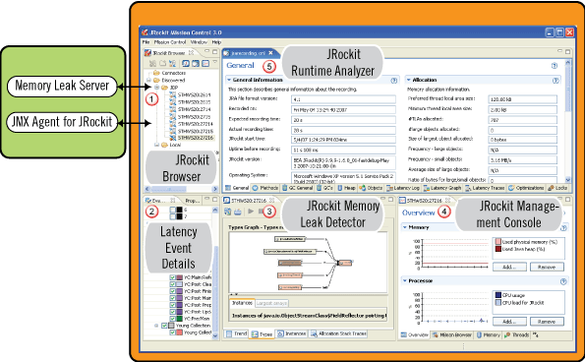
JRockit Mission Control
Notes:
JRockit Mission Control (continued)
The graphic shows that JRockit Mission Control comprises many components, which will be covered in detail on the following slides.

Slide 11
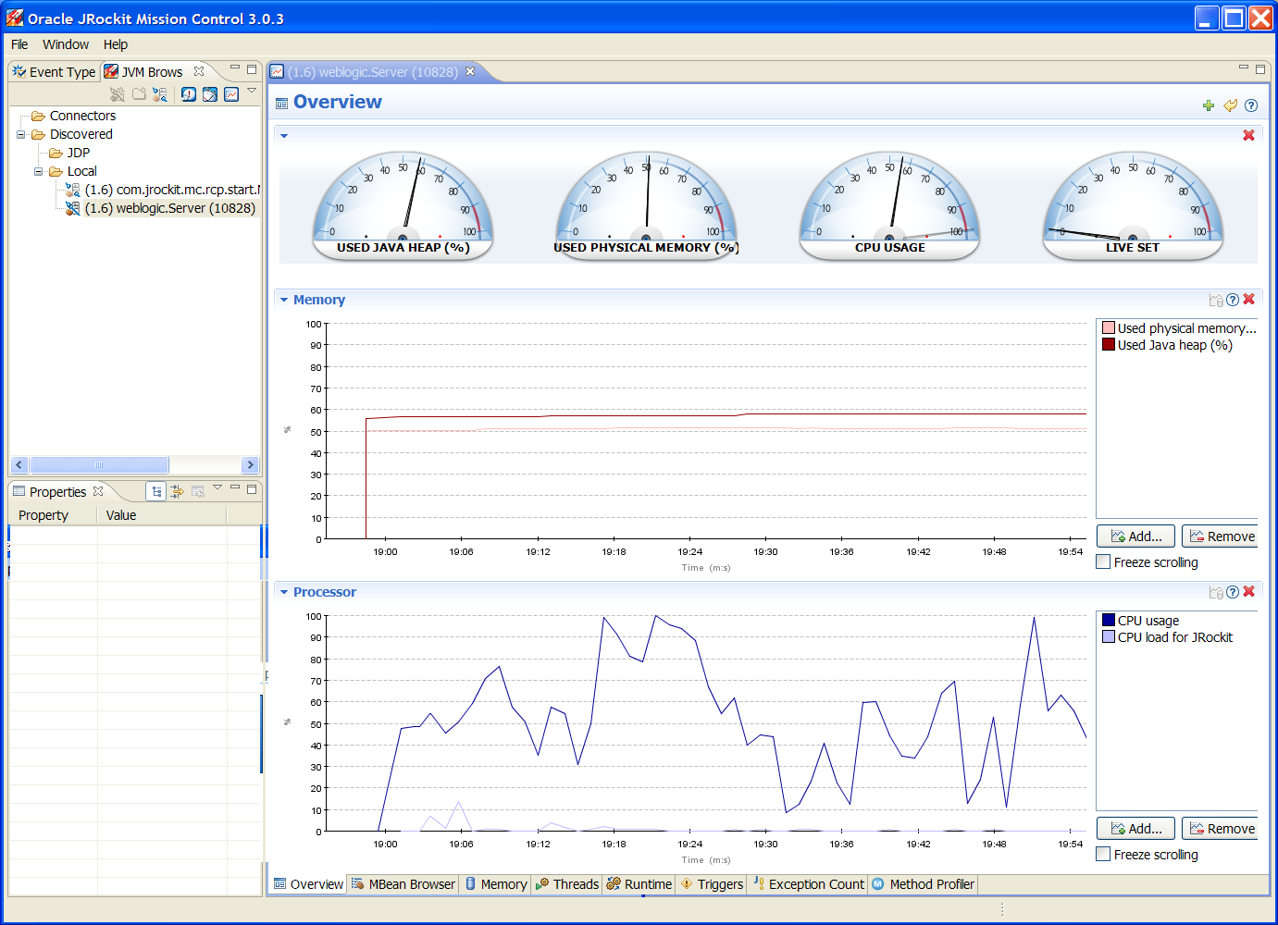
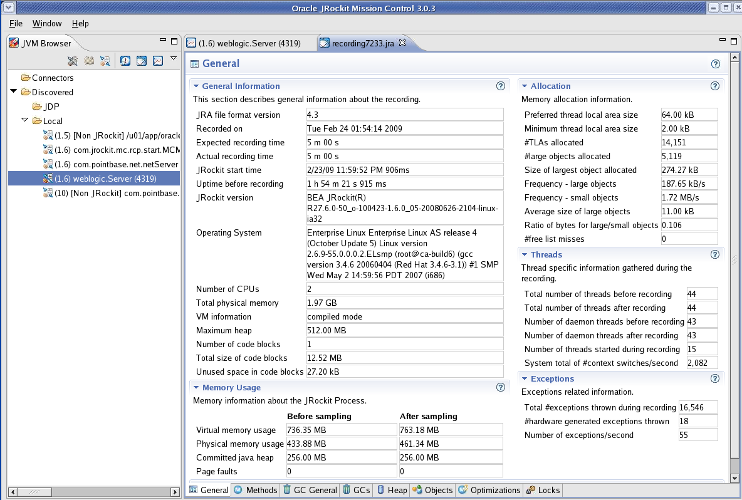
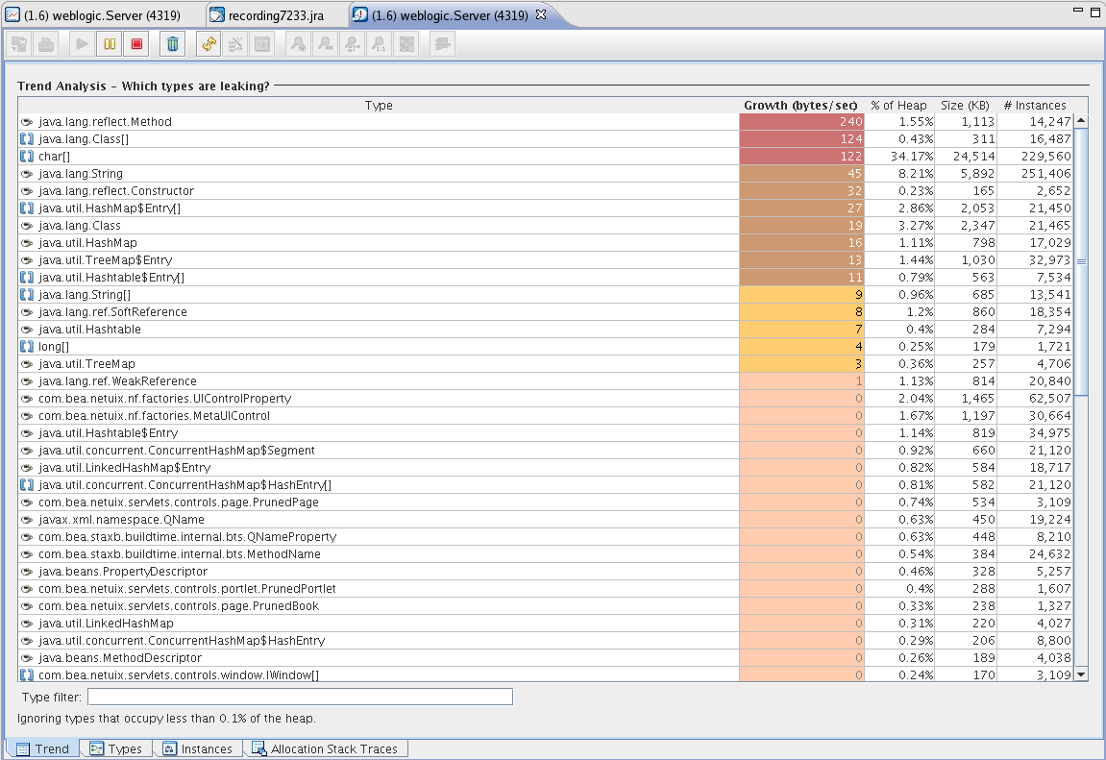
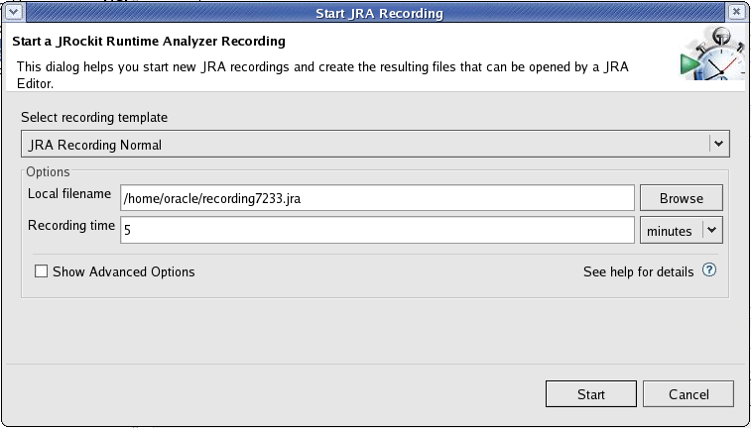
JRockit Mission Control: Architecture
JRockit Management Console
JRockit Runtime Analyzer (JRA)
JRockit Memory Leak Detector
JRA recordings
JMX agent
Memory Leak server
JRockit process
Notes:
Oracle WebLogic Server 10g R3: Monitoring and Performance Tuning 11 - <number>
JRockit Mission Control: Architecture
The main focus of JRockit Mission Control is to do the necessary instrumentation with the lowest possible impact on the running system. The technology used also enables the application to run at full speed once the tool is disconnected from the JVM, which makes JRockit Mission Control uniquely suitable for use in production environments.
The graphic shows that the JRockit Management Console interfaces with the JMX agent. The JRockit Runtime Analyzer is able to analyze and display the results from the JRA recordings. The Memory Leak Detector interfaces with the Memory Leak server.

Slide 12
JRockit Management Console
  The JRockit Management Console is a JMX-based console used to manage and monitor the JRockit JVM.
  The JRockit Management Console can be used to monitor and manage multiple JRockit instances.
  It captures and presents live data about GC pauses, memory and CPU usage, as well as information from any JMX MBean deployed in the JVM internal MBean server.
  The JRockit Management Console also includes a low overhead method profiler and an exception counter.
Notes:
Oracle WebLogic Server 10g R3: Monitoring and Performance Tuning 11 - <number>
JRockit Management Console
The JRockit Management Console was previously using JRockit Management API JMAPI to connect to the VM, but it is now JMX-based since JRockit 5.0.

Slide 13
JRockit Management Console Architecture
JRockit Process
JRockit Mission Control
JMX agent
JRockit Remote JMX services
JDP server
JDP Client
Platform MBean server
Memory Leak Detector
MemLeak server
The Management Console GUI
JRockit Process
JRockit Mission Control
JMX agent
JRockit Remote JMX services
JDP server
JDP Client
Platform MBean server
Memory Leak Detector
MemLeak server
The Management Console GUI
.
.
.
.
Notes:
Oracle WebLogic Server 10g R3: Monitoring and Performance Tuning 11 - <number>
JRockit Management Console Architecture
The JRockit process includes:
An agent exposing the interfaces: Communication with the console is achieved with remote JMX over RMI.
The JRockit Discovery Protocol (JDP) server: The Management Console carries out automatic detection by using multicasting to communicate the location of the particular JRockit. The JDP server is optional.
To enable JDP, you need to start your JVM with the following option:
-Djrockit.managementserver.autodiscovery=true
The Management Console includes:
JRockit Remote JMX services (RJMX): Provides services such as persistence, the attribute subscription abstraction, and the notification framework
The JDP Client: Automatically discovers JRockit JVMs that have JDP enabled
The Management Console GUI: The Swing application
JRockit Management Console Architecture: The graphic shows how the components are connected.

Slide 14
Management Server
  The management server in the JRockit VM is disabled by default.
  To enable the management server, add the following command-line argument to the JVM start script:
    java -Xmanagement … weblogic.Server
  The default port that the management server uses to connect is 7091.
  You can change the management server port by setting the following command-line argument:
    -Djrockit.managementserver.port=<port> …
Notes:
Oracle WebLogic Server 10g R3: Monitoring and Performance Tuning 11 - <number>
Management Server
The port in which the management server is started will be printed to the stdout of the server. To change the port, use the command-line argument, for example:
java –Xmanagement –Djrockit.managementserver.port=<portnumber> …
You can also start and stop the management server by invoking the Ctrl-Break handler using the jrcmd utility provided with JRockit VM. Here is an example:
jrcmd 2368 start_management_server
The preceding command starts the management server dynamically after starting the VM. Here is an example:
jrcmd 2368 help kill_management_server
The preceding command stops the management server dynamically while the VM is running.
For more information about Ctrl-Break handlers, see the section on Ctrl-Break handlers.

Slide 15
JRockit Management Console
The JRockit Management Console interface is composed of eight tabs:
  Overview tab: Displays summary information for the selected JRockit JVM connection(s)
  MBean tab: Provides access to the MBean tree within the JVM
  Memory tab: Provides information about the memory status of the system
  Threads tab: Shows a list of live threads and the stack trace of a chosen thread
  Runtime tab: Displays processor usage, system statistics, and system properties
Notes:
Oracle WebLogic Server 10g R3: Monitoring and Performance Tuning 11 - <number>
JRockit Management Console
The Management Console executable is located in JROCKIT_HOME/bin. It is named jrmc.sh or jrmc.cmd
You can also start the Management Console without using the launcher. From the command prompt, type:
java -jar <jRockit-directory>/console/ManagementConsole.jar

Slide 16
JRockit Management Console
  Triggers tab: Lists all available rules for the alerts that you have created
  Exception Count tab: Provides information on the exceptions thrown in JRockit JVM
  Method Profiler tab: Allows you to monitor method execution in a non-intrusive way
Notes:
Oracle WebLogic Server 10g R3: Monitoring and Performance Tuning 11 - <number>

Slide 17
Overview
Notes:
Oracle WebLogic Server 10g R3: Monitoring and Performance Tuning 11 - <number>
Overview
The screenshot shows the Overview tab, which contains the following information for the selected connection(s):
Used physical memory
Used Java heap
Live set
CPU usage
Heap usage chart
CPU usage chart
You can select multiple connections at once to view information about all of them in a single screen.

Slide 18
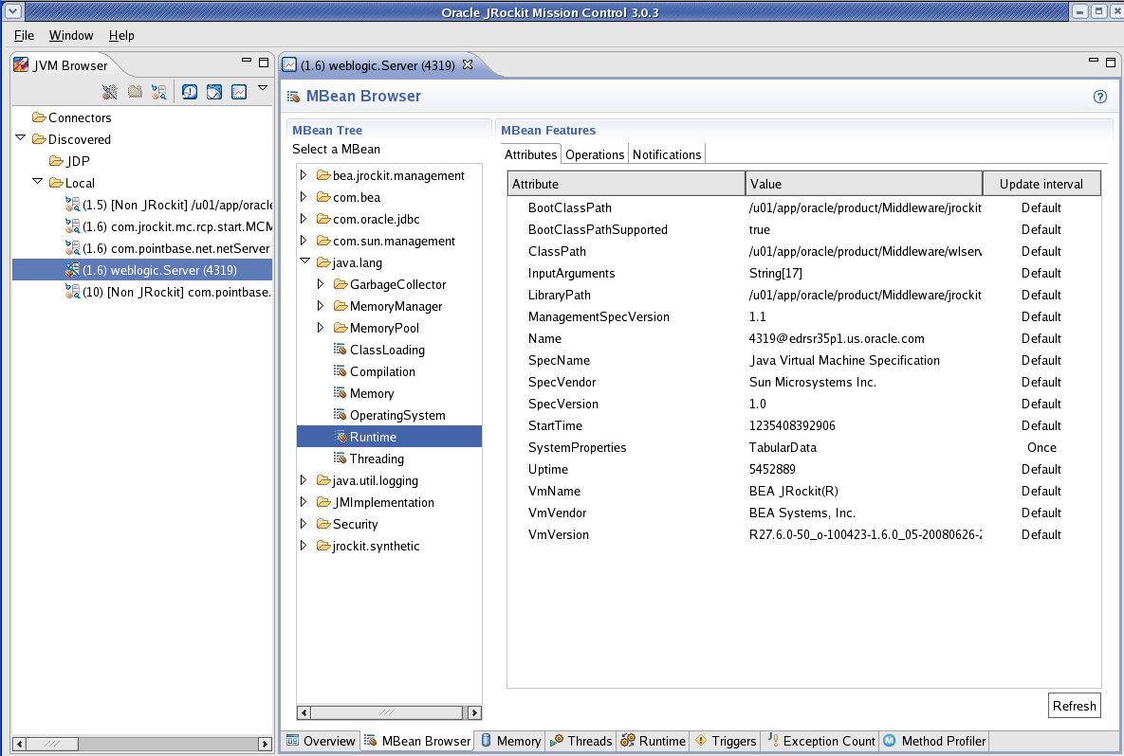
MBean Browser
Notes:
Oracle WebLogic Server 10g R3: Monitoring and Performance Tuning 11 - <number>
MBean Browser
The screenshot shows the MBean Browser tab, which contains the following information from within the JVM for the selected connection(s):
A selection tree of MBeans available in the JVM
A list of the Attributes, Operations, and Notifications of the selected MBean

Slide 19
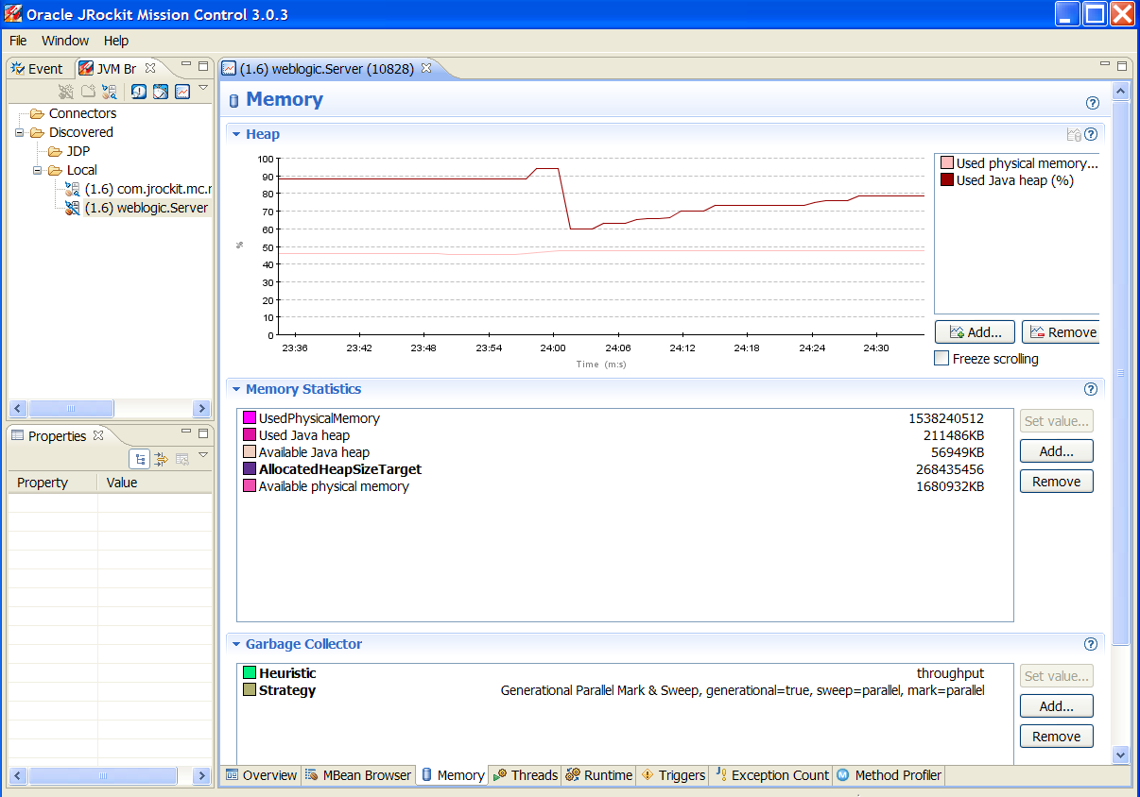
Memory
Notes:
Oracle WebLogic Server 10g R3: Monitoring and Performance Tuning 11 - <number>
Memory
The screenshot shows the Memory tab, which, by default, shows the following information for the selected connection(s):
Heap Usage is charted graphically
Current Memory Statistics are refreshed constantly
Garbage Collector configuration
Each of these data groupings is customizable allowing the user to add and remove attributes.

Slide 20
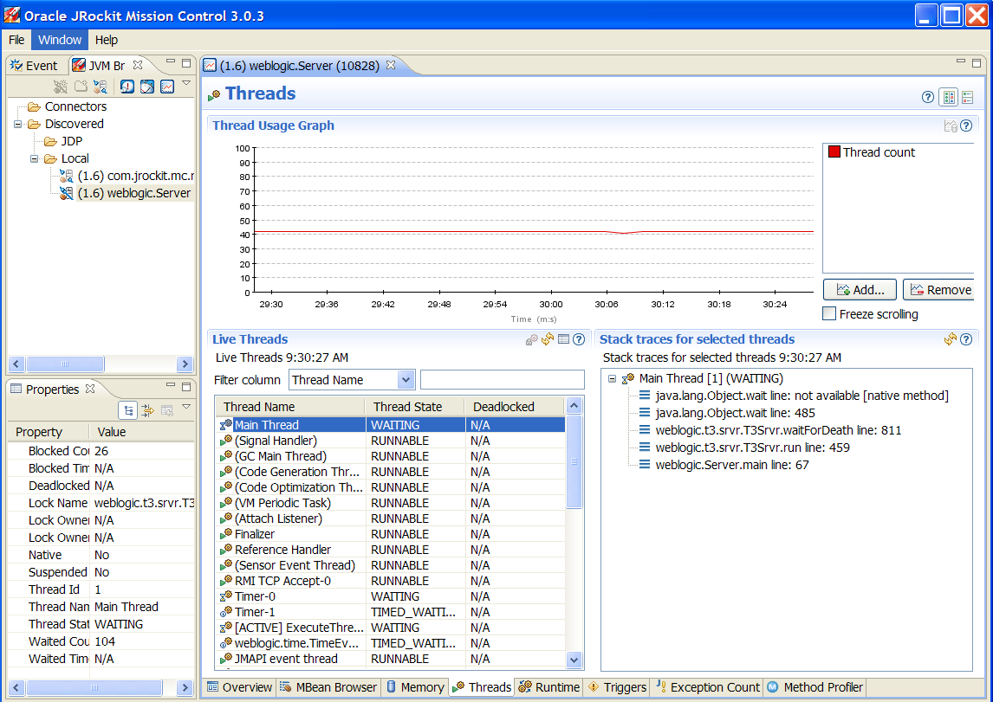
Threads
Notes:
Oracle WebLogic Server 10g R3: Monitoring and Performance Tuning 11 - <number>
Threads
The screenshot shows the Threads tab, which contains the following information for the selected connection(s):
Thread Usage Graph
A list of Live Threads
The stack trace for the thread currently selected in the Live Threads list
A list of the Properties of the thread currently selected in the Live Threads list
The Thread Usage Graph is customizable allowing the user to add and remove attributes from the graph.

Slide 21
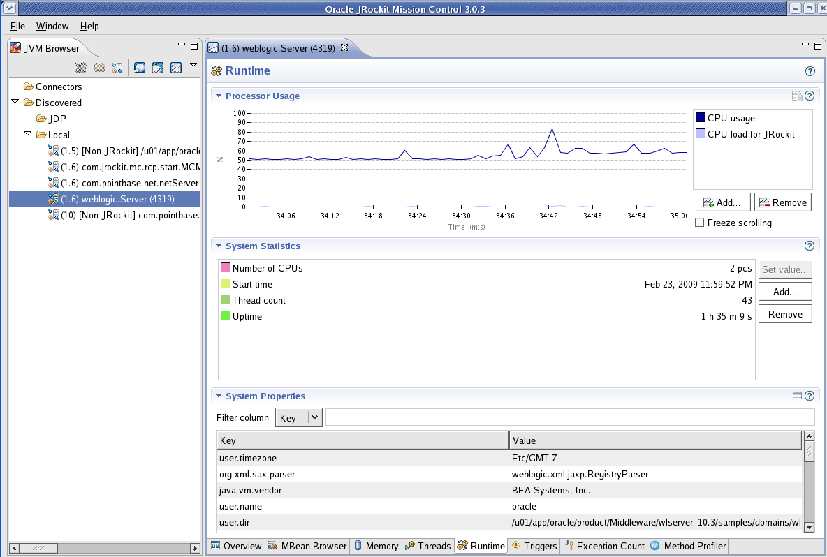
Runtime
Notes:
Oracle WebLogic Server 10g R3: Monitoring and Performance Tuning 11 - <number>
Runtime
The screenshot shows the Runtime tab, which shows the following information for the selected connection(s):
Processor Usage is charted graphically; by default, it shows total CPU usage and the portion consumed by this JRockit instance
System Statistics including uptime and thread count
System Properties, which includes the JVM configuration and start up parameters

Slide 22
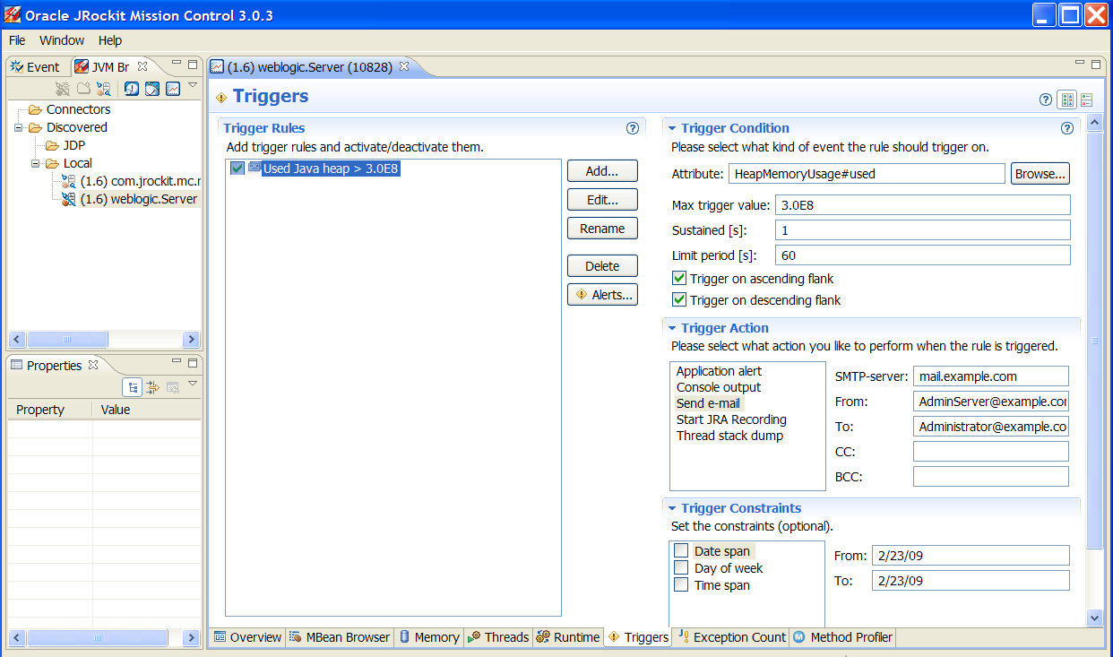
Triggers
Notes:
Oracle WebLogic Server 10g R3: Monitoring and Performance Tuning 11 - <number>
Triggers
The screenshot shows the Triggers tab, which shows a list of Trigger Rules created for this JVM for the selected connection(s).
Options are provided to Add, Edit, and Remove trigger rules and to activate and deactivate them.
For the selected Trigger Rule, the following details are provided:
Trigger Conditions
Trigger Action
Trigger Constraints

Slide 23
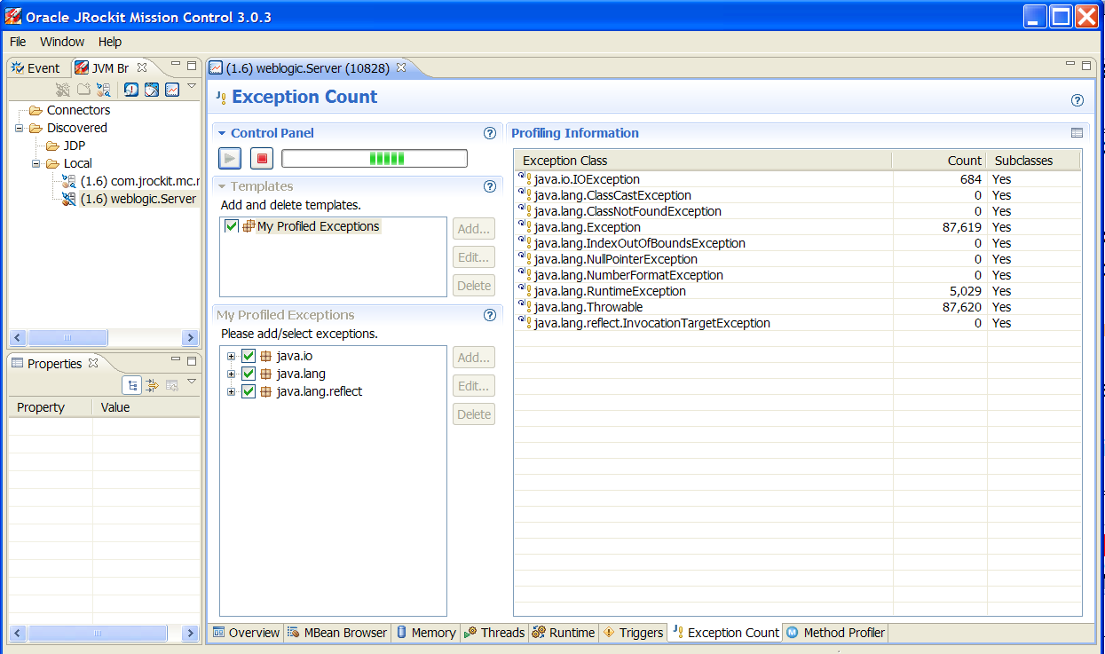
Exception Count
Notes:
Oracle WebLogic Server 10g R3: Monitoring and Performance Tuning 11 - <number>
Exception Count
The screenshot shows the Exception Count tab, which shows the following information for the selected connection(s):
The number of exceptions of a certain type
An option for starting, stopping, and removing an exception count

Slide 24
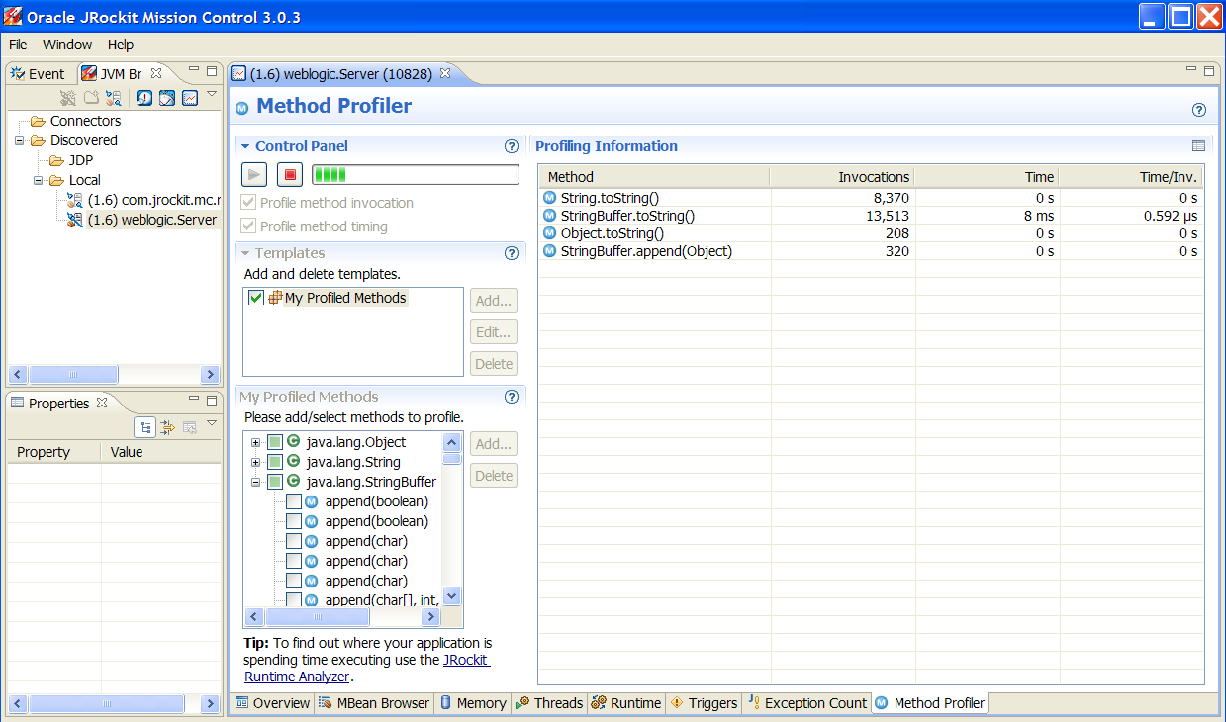
Method Profiler
Notes:
Oracle WebLogic Server 10g R3: Monitoring and Performance Tuning 11 - <number>
Method Profiler
The screenshot shows the Method Profiler tab, which shows the following information for the selected connection(s):
Method profiling information for the selected template that allows you to monitor method execution in a non-intrusive way
An option for creating and removing method-profiling templates
An option for starting and stopping a method-profiling template

Slide 25
Ctrl-Break Handler
  The handler makes it possible to invoke commands on a running JRockit JVM on an OS signal.
  A command script that contains a set of commands is executed when the break-signal is caught on a running JRockit process.
  When a break-signal is caught, JRockit searches for the file in the current working directory (ctrlhandler.act).
  If not found, it will look in the directory of the JVM. If it still cannot find the file, JRockit JVM will generate a normal thread stack dump.
Notes:
Oracle WebLogic Server 10g R3: Monitoring and Performance Tuning 11 - <number>
Ctrl-Break Handler
To create a Ctrl_Break handler:
1. Create a file named ctrlhandler.act.
2. Add commands to the ctrlhandler.act file.
3. End the file with "stop," which is a reserved command that ends the parsing of the file.
The following example act file (ctrlhandler.act) first prints a timestamp, and then the command line used to start JRockit, and finally a thread stack dump.
# ctrlhandler.act file
timestamp
command_line
print_threads
stop
When you press ctrl-break, each command is processed in the order of appearance (Unix : kill -3 <PID>). To list what Ctrl-Break Handlers are available in a certain JRockit, you can use the help command:
jrcmd <PID> help
For more information on Ctrl-Break handler, refer to http://download.oracle.com/docs/cd/E13150_01/jrockit_jvm/jrockit/geninfo/diagnos
/using_threaddumps.html.

Slide 26
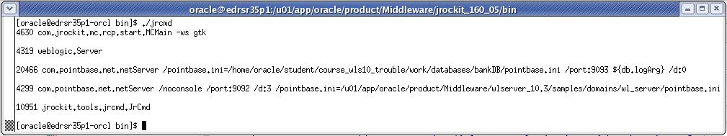
jrcmd
  Is a command-line utility that makes it possible to send commands to a running JRockit JVM
  Can be used to find the process IDs of all the JRockit JVMs running on the local machine
  Can be used to invoke Ctrl-Break handlers in JRockit JVMs
Notes:
Oracle WebLogic Server 10g R3: Monitoring and Performance Tuning 11 - <number>
jrcmd
If no options are specified, jrcmd works like Sun’s jps command-line utility (lists all the JRockits running on the local machine). You can also use jrcmd to read and execute commands from a file. If ‘0’ is specified as the pid, the commands are sent to all JRockit processes.
Syntax : jrcmd [PID] <command>
To list the Ctrl-Break Handlers that are available in a certain JRockit, use the help command:
jrcmd <PID> help
Using jrcmd, you can execute many dynamic commands on a running JRockit JVM.
For example, if JRockit was started without enabling the management server using the
-Xmanagement option, it can be enabled without restarting the VM using the jrcmd utility. Here is an example:
jrcmd 2480 start_management_server
You can use jrcmd to stop the management server running in a JRockit JVM without restart:
jrcmd 2480 kill_management_server
For more information on jrcmd, refer to http://download.oracle.com/docs/cd/E13150_01/jrockit_jvm/jrockit/geninfo/diagnos
/introdiatools.html.
The screenshot shows the results of running the jrcmd command in a Linux environment.

Slide 27
Best Practices
  Running the Management Console on the same machine as the WebLogic Server (JRockit JVM ) is not recommended.
  To prevent the GUI from stealing valuable resources from WebLogic Server, run the Management Console remotely.
  To prevent unauthorized access to the JRockit management server, block the port used by the management server in your firewall, for example, 7091.
Notes:
Oracle WebLogic Server 10g R3: Monitoring and Performance Tuning 11 - <number>

Slide 28
JRockit Runtime Analyzer
  The JRockit Runtime Analyzer (JRA) is a Java application and JVM profiler.
  JRockit Runtime Analyzer is a part of Oracle JRockit Mission Control and currently included in Oracle JRockit 5.0 R26 JDK and later.
  JRA consists of two parts:
    Recording engine
    JRA application (GUI)
Notes:
Oracle WebLogic Server 10g R3: Monitoring and Performance Tuning 11 - <number>
JRockit Runtime Analyzer
The Support organization uses JRA recordings from customers on a regular basis to help customers resolve issues.

Slide 29
Recording Engine
  The recording engine in the JVM can create detailed recordings about the JVM and the application it is running.
  Recording can be triggered by using:
    The JRockit Management Console
    jrcmd
    The JRockit command line
    Trigger rules in JRockit Management Console
  The overhead while recording is very low—typically less than two percent.
Notes:
Oracle WebLogic Server 10g R3: Monitoring and Performance Tuning 11 - <number>
Recording Engine
Even though the overhead while recording data using the JRA recoding engine is very low, because JRA is forcing a full garbage collection at the beginning and at the end of the recording to generate the heap histogram data, there may be a spike at the beginning and at the end of a recording.

Slide 30
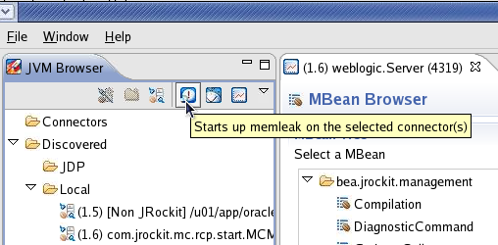
Recording from JRockit Management Console
  Start the JVM with the –Xmanagement option.
  Run your application under load.
  Start the recording by selecting the JRA icon on the JVM Browser menu bar.
Notes:
Oracle WebLogic Server 10g R3: Monitoring and Performance Tuning 11 - <number>
Recording from JRockit Management Console
The screenshot shows an instance of the JVM browser.

Slide 31
Recording from JRockit Management Console
  Specify the local File name to store the recordings.
  Specify the length or duration of the recording.
  Optionally, select Show Advanced Options to select sampling options.
  Start the recording.
Notes:
Oracle WebLogic Server 10g R3: Monitoring and Performance Tuning 11 - <number>
Recording from JRockit Management Console (continued)
You can display advanced options by selecting Show Advanced Options. Advanced options include configurable attributes for the following:
Inclusion of Garbage Collection sampling
Method sampling
Inclusion of native code sampling
Stack trace options
Thread dumps
Latency Recording
CPU sampling
The screenshot shows how the local filename is set in the GUI.

Slide 32
JRA Recording from the Command Line
  Start JRockit with the –Xmanagement option.
  Run your application under load.
  Invoke jrcmd from the command line:
    Windows platforms:
      bin\jrcmd.exe <pid> jrarecording time=<jrarecording time> filename=<filename>
    Unix platforms:
      bin/jrcmd <pid> jrarecording time=<jrarecordingtime> filename=<filename>
Notes:
Oracle WebLogic Server 10g R3: Monitoring and Performance Tuning 11 - <number>
JRA Recording from the Command Line
The jrcmd command line arguments are:
jrarecording time\u2014: The duration of the recording in seconds (a good length is 300 seconds, that is, five minutes).
filename\u2014: The name of the file you want to save the recording to (for example, jrarecording.xml.zip). The file will be created in the current directory of the JRockit JVM process. It will be overwritten if it already exists.
Here is an example:
bin\jrcmd.exe <pid> jrarecording time=300 filename=c:\temp\jra.xml.zip
This starts a JRA recording of 300s and stores the result in the specified file.
After the recording is initiated, the JRockit JVM prints a message indicating that the recording has started. When the recording is done, it will print another message; it is now safe to shut down your application.

Slide 33
Recording from jrcmd
Use the jrcmd command to start recording from the command line or from scripts:
  jrcmd [PID] jrarecording [options]
Option | Description
filename | Specify the local file name to store the recording.
recordingtime | Specify the length or duration of recording.
nomethodsampling | Disable method sampling.
nogcsampling | Disable GC information.
methodtraces | Include stack traces.
nozip | Do not zip the recording.
sampletime | Specify the time between the samples.
nativesamples | Include native code in sampling.
Notes:
Oracle WebLogic Server 10g R3: Monitoring and Performance Tuning 11 - <number>
Recording from jrcmd
The table shows the jrcmd options and their associated descriptions.

Slide 34
Recording from JRockit Command Line
Start WebLogic JRockit with the –XXjra JVM argument to trigger a JRA recording.
java –XXjra:[option=<value>],…
Option | Description
delay | Amount of time, in seconds, to wait before the recording starts
recordingtime | Duration of the recording (default is 60 sec.)
filename | Local filename to store the recording
sampletime | Time between the samples (ms)
nativesamples | native code in sampling is included
Notes:
Oracle WebLogic Server 10g R3: Monitoring and Performance Tuning 11 - <number>
Recording from JRockit Command Line
Example: java –XXjra:delay=60,recordingtime=300, filename=/home/oracle/temp/jrarecording.xml …
If you are running JRockit version 1.4.2_03 or older, you need to set each parameter with its own startup option.
The table shows the java -XXjra options and their associated descriptions.

Slide 35
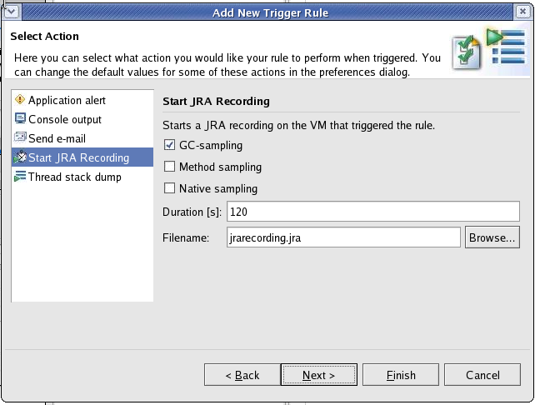
Recording Using Trigger Rules
Configure trigger rules in the JRockit Management Console.
Notes:
Oracle WebLogic Server 10g R3: Monitoring and Performance Tuning 11 - <number>
Recording Using Trigger Rules
To configure notification rules in the JRockit Management Console to start JRA recording automatically:
1. Go to the Trigger tab on the JRockit Management Console. Select Add to create a new trigger rule.
2. Pick the attribute on which you want to set the trigger. Define a threshold value to trigger the notification.
3. Select Next to proceed to the next screen. Select an action to perform.
4. Configure the settings for the respective action. Select Next to proceed to the next screen.
5. Configure constraints for the rule or select Next to proceed to the next screen.
6. Define a name for the trigger rule. Select Finish to create the notification rule.
7. Add the created rule to the respective server connection. The newly created rule appears in the ‘Active rules for this connection’ list on the Trigger tab.
Recording Using Trigger Rules: The screenshot shows the final screen in the trigger rule process. You can set the filename used for recording on this screen.

Slide 36
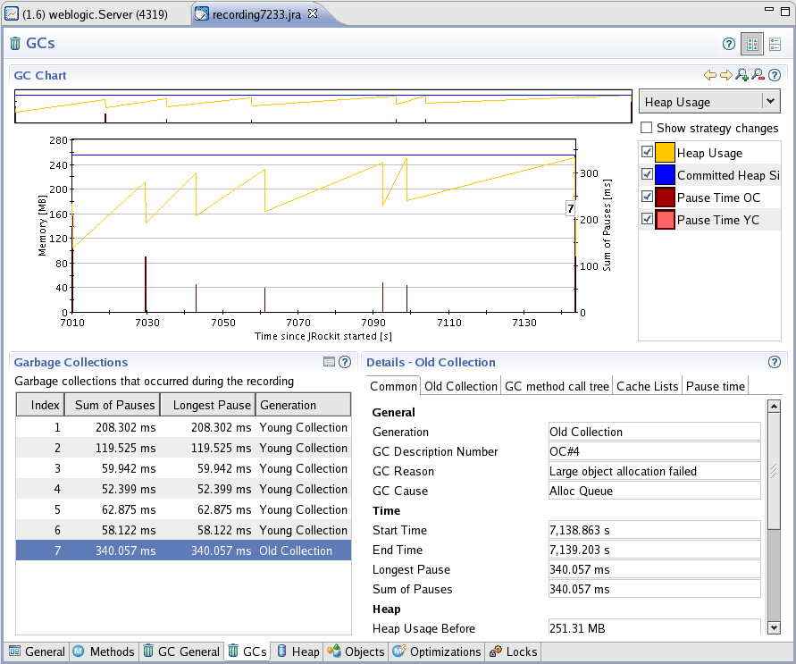
JRA Application
You can then analyze the recordings created by the recording engine offline using the JRA application.
You can analyze information about call traces for hot methods, bad synchronization, and other important application/JVM behavior graphically using the JRA tool.
Notes:
Oracle WebLogic Server 10g R3: Monitoring and Performance Tuning 11 - <number>
JRA Application
You can start the JRA tool either by invoking the following command:
java -jar RuntimeAnalyzer.jar
Or by using the following command:
<JROCKIT_HOME>/bin/jra.exe (Windows) or
<JROCKIT_HOME>/bin/jra (Unix/Linux)
The overhead while recording is very low—typically less than two percent. However, because JRA is forcing a full garbage collection at the beginning and at the end of the recording to generate the heap histogram data, there may be a spike at the beginning and at the end of a recording.
The screenshot shows the results of running analytics using the JRA application.

Slide 37
General Tab
Notes:
Oracle WebLogic Server 10g R3: Monitoring and Performance Tuning 11 - <number>
General Tab
The General tab of JRA displays a high level information about the recording. It displays memory usage, thread, allocation, and exception information. The VM arguments you specified on the command line when starting JRockit are also available on the General tab. You can achieve a very high level of understanding by investigating this data. For more information on the specific areas, further investigation is required on the other tabs.
The exception section of this tab provides the total number of exceptions during the recording interval. Too many exceptions thrown from the applications will also degrade the performance.
The screenshot shows an example of the General tab.

Slide 38
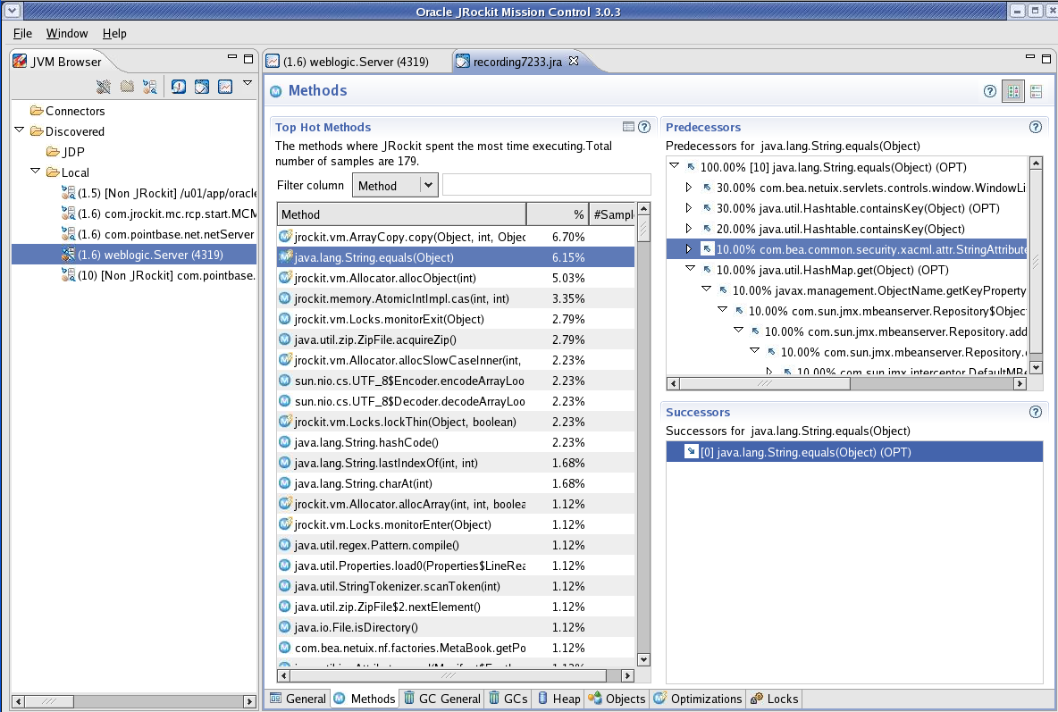
Methods Tab
Notes:
Oracle WebLogic Server 10g R3: Monitoring and Performance Tuning 11 - <number>
Methods Tab
The Methods tab provides information on Hot Methods during the recording. While recording is being performed, JRockit will sample the running threads to find out which methods are hot methods. Hot Methods are methods invoked frequently where the JVM spent most of its time. By selecting a specific method from the list of Top Hot Methods, its predecessor and successor methods can be viewed.
From the call traces you can view whether or not an optimized version of the method was called.
The screenshot shows an example of the Methods tab.

Slide 39
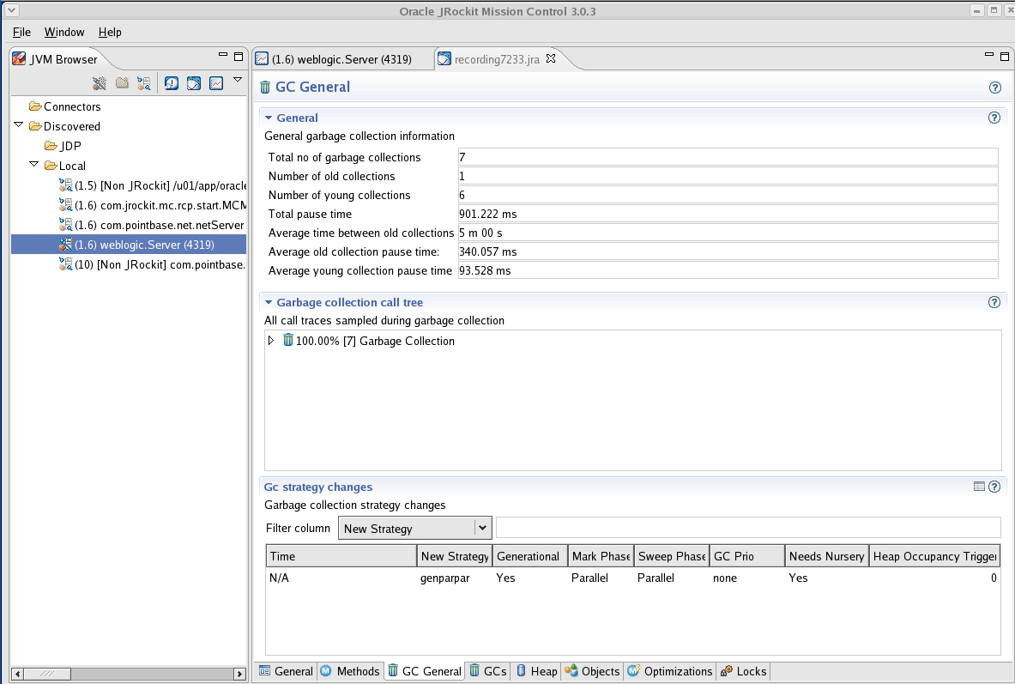
Garbage Collection
Notes:
Garbage Collection
The screenshot shows an example of the Garbage Collection tab.

Slide 40
GCs Tab
Notes:
Oracle WebLogic Server 10g R3: Monitoring and Performance Tuning 11 - <number>
GCs Tab
The GCs tab gives information about the garbage collected during the recording. The GC charts show heap usage right before and after each GC. You can obtain more information about a specific collection by selecting a particular collection from the list of all the GCs during the recording. For a selected GC from the list, you can find the details under the appropriate subtab under Details on the selected GC.
General information, such as the time between old collections, the average old collection pause time, the average young collection pause time, the total number of collections, and the total number of young and old collections, is also available. Also if there is a garbage collection strategy change during the recording, it will be available under the GC strategy changes subtab.
The screenshot shows an example of the GCs tab.

Slide 41
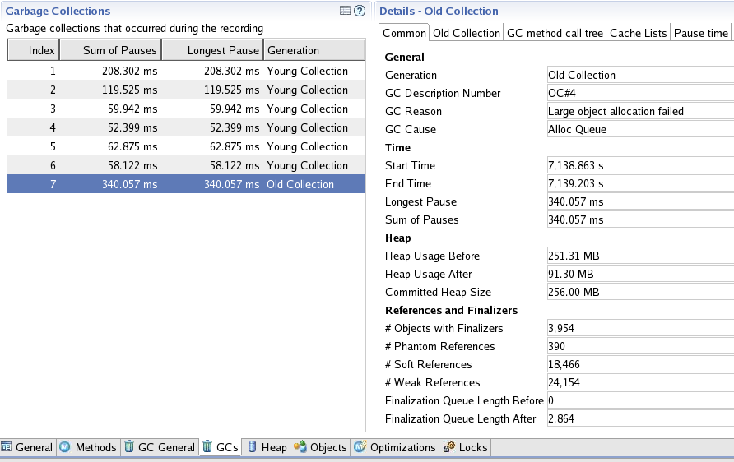
Details of a Selected GC
Notes:
Oracle WebLogic Server 10g R3: Monitoring and Performance Tuning 11 - <number>
Details of a Selected GC
The Details subtab contains the duration of pause, the total heap usage before and after the collection, and the number of soft, weak, and phantom references. Also you can see the number of objects with finalizers. Too much code implemented on the finalizers might increase the pause time during the garbage collection.
When an old collection (OC) is selected from the list of GCs, you can find the specific information about that collection under the OC-specific subtab. Similarly, for a young collection (YC) you can find information under the YC-specific subtab. For an old collection, information like concurrent or parallel collection was performed during the Mark phase and the Sweep phase. During each phase, the reason for GC and the nursery size before and after the collection will be available. For a young collection, the size of the nursery before and after the collection will be available.
The screenshot shows an example of the Details on a selected GC.

Slide 42
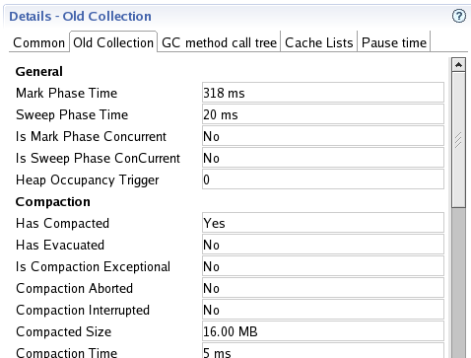
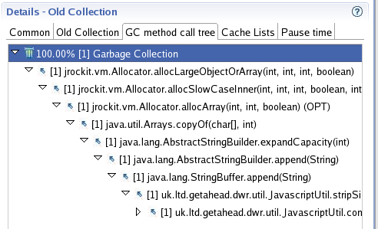
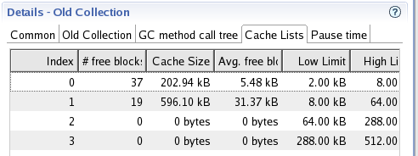
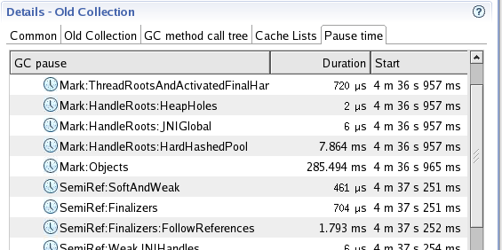
Details of a Selected GC
Select a tab for additional GC details.
Notes:
Oracle WebLogic Server 10g R3: Monitoring and Performance Tuning 11 - <number>
Details of a Selected GC (continued)
The screenshots show examples of how you can drill down into a GC and gain additional insight with the Old Collection, GC method call tree, Cache Lists, and Pause time tabs.

Slide 43
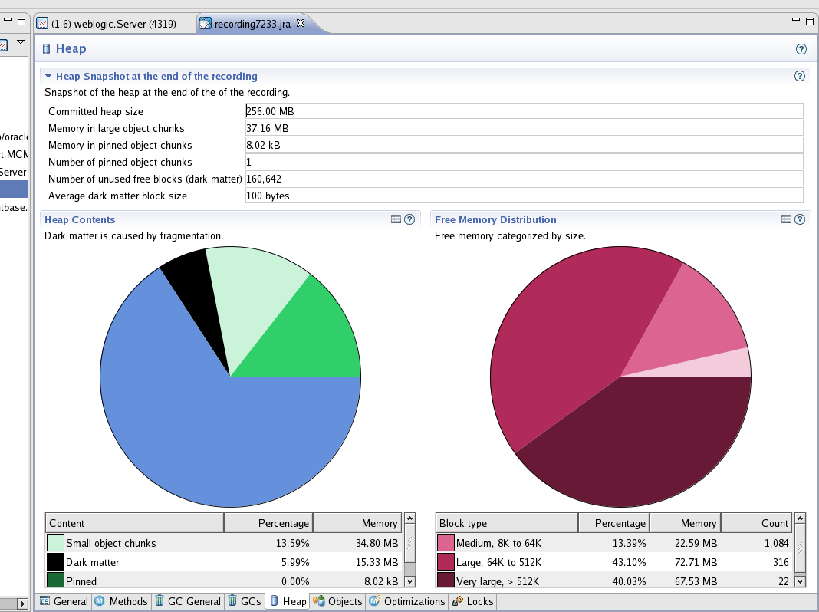
Heap Overview
Notes:
Oracle WebLogic Server 10g R3: Monitoring and Performance Tuning 11 - <number>
Heap Overview
The Heap contents pie chart shows how much of the heap consists of large and small object chunks, dark matter, and free space. It is normal to have a certain amount of dark matter in the heap. The amount of dark matter indicates how much space in the Java heap is wasted due to the fragmentation of the Java heap.
The pie chart for the Free memory distribution shows how the free memory is distributed in free blocks of different sizes on the Java heap.
The screenshot shows an example of the Heap pie charts.

Slide 44
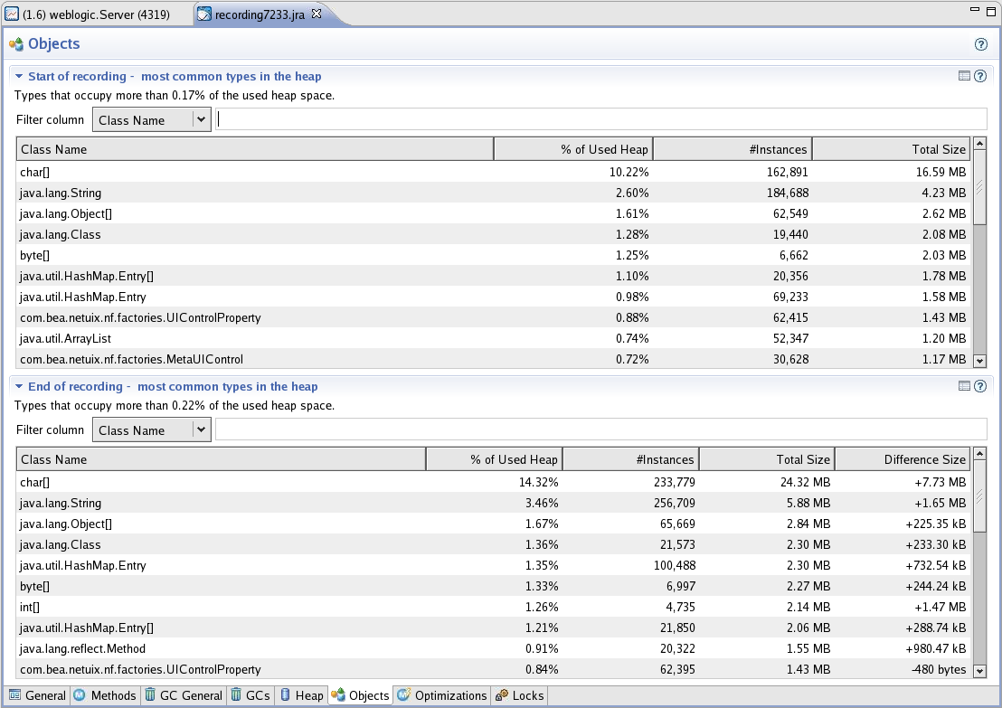
Object Statistics
Notes:
Oracle WebLogic Server 10g R3: Monitoring and Performance Tuning 11 - <number>
Object Statistics
The Java heap contains objects that get allocated during the run. The Object Statistics tab gives you a snap of the objects present in the Java Heap at the start of the recording and at the end of the recording. You can use this information to detect a possible memory leak in the application running on the JVM. It can also identify the object types that occupy most of the heap and their number of instances. You can also use this to identify the type of object that might possibly be leaked. For further investigation to pinpoint a memory leak in the application, use the JRockit Memory Leak Detector, which is discussed in detail later.
The screenshot shows an example of the Object Statistics screen.

Slide 45
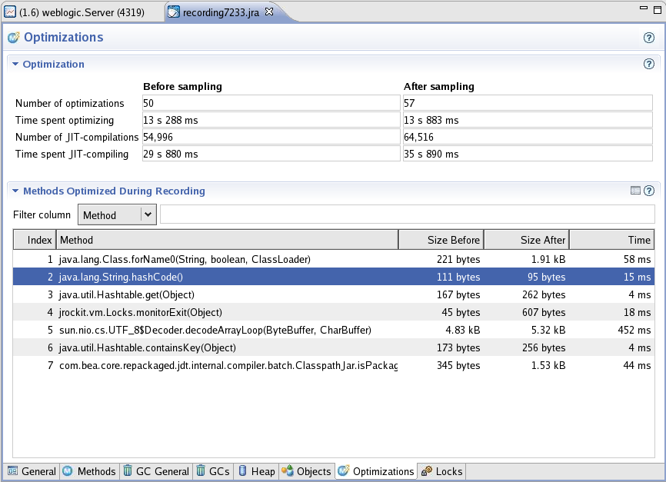
Optimizations
Notes:
Oracle WebLogic Server 10g R3: Monitoring and Performance Tuning 11 - <number>
Optimizations
For the best performance of the application, JRockit compiles the application during startup using JIT compilation. Compiled code will execute faster than interpreted code. But to improve the performance, JRockit will further optimize the code using a technique called adaptive optimization. A low-cost, sampling-based technique is used to identify which functions merit optimization. Many optimizations are done during this adaptive optimization. For example, method inlining is an optimization performed to improve the performance. The methods that got optimized during the recording and the size of the methods before and after the optimization will be listed. As a result of some of the optimizations, the method size will decrease, whereas some optimizations like method inlining might increase the method size. The optimization is run in the background and does not disturb the running application.
The screenshot shows the Optimizations screen.

Slide 46
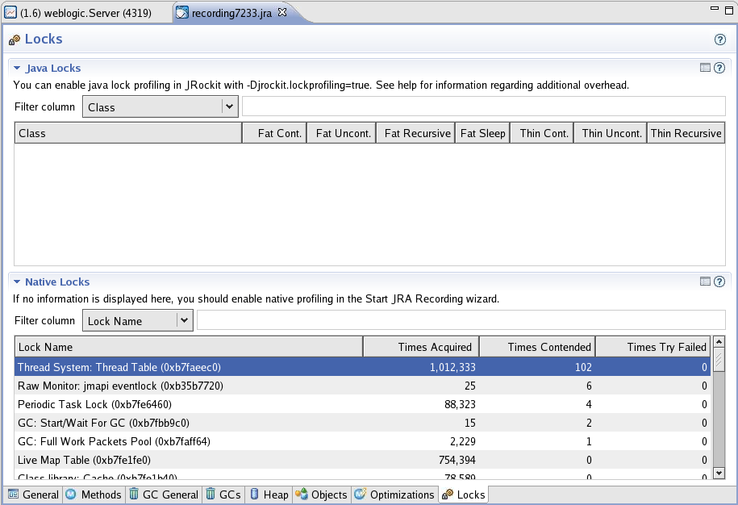
Lock Profiling
Notes:
Oracle WebLogic Server 10g R3: Monitoring and Performance Tuning 11 - <number>
Lock Profiling
The lock profiling tab shows information on lock activity for the running application. The Java lock profiling is disabled by default and can be enabled using the following command-line argument:
-Djrockit.lockprofiling
The screenshot shows the Locks screen.

Slide 47
JRockit Memory Leak Detector
  JRockit Memory Leak Detector is a real-time tool that detects memory leaks within Java applications running on JRockit.
  The JRockit Memory Leak Detector is a part of JRockit Mission Control and is currently included in JRockit 5.0 R26 JDK and later.
  The JRockit Memory Leak Detector provides:
    The type of objects getting allocated
    The number of objects
    The size of objects
    The relationship between objects and so on
Notes:
Oracle WebLogic Server 10g R3: Monitoring and Performance Tuning 11 - <number>
JRockit Memory Leak Detector
Memory leaks are often discovered only after deployment and can be challenged to reproduce in a testing environment. The JRockit Memory Leak Detector connects to a running JVM to fetch real-time data with a relatively small overhead. It does not create full heap dumps to analyze like other profiling tools. After analysis, the tool can be disconnected from the running JVM, which will totally eliminate even that small overhead. But the overhead of enabling allocation stack traces can be more significant and should therefore be used with care.
The Memory Leak Detector uses advanced graphical presentation techniques to make it easier to navigate and understand the sometimes complex information.

Slide 48
Memory Leaks
  A memory leak is caused by the application code that holds objects that are not used by the application any more.
  Memory leaks are a common and difficult problem to solve in large Java enterprise systems.
  The common cause for memory leaks is the failure to release the unused memory so that the garbage collector can reclaim that memory.
    Garbage collection will not reclaim a heap chunk if there are any references to it.
  Memory leaks can be in either Java or native code.
Notes:
Oracle WebLogic Server 10g R3: Monitoring and Performance Tuning 11 - <number>
Memory Leaks
Although memory management might be said to be automatic, it does not free the developer from thinking about memory management issues. For example, there will always be a cost associated with allocating (and freeing) memory, although this cost is not made explicit to the programmer. A program that creates too many objects will be slower than one that does the same thing with fewer objects (provided all other things are equal).
It is possible to create a memory leak by forgetting to “free” memory that has previously been allocated. If the program keeps references to objects that will never be used, the objects will hang around and eat up memory, because there is no way for the automatic garbage collector to prove that these objects will not be used. If a reference to an object exists, it is by definition live and therefore is not deleted.

Slide 49
JRockit Memory Leak Detector
The JRockit Memory Leak Detector interface is composed of four tabs:
  Trend tab: Provides information on object types, their growth in bytes/sec, % of heap, size, and number of instances
  Types tab: Provides a view of the relationships between all the types pointing to the type you are investigating
  Instances tab: Allows you to view the instances of the type that you suspect is leaking memory
  Allocation stack traces: Provides information about source code where allocations of a certain type are done
Notes:
Oracle WebLogic Server 10g R3: Monitoring and Performance Tuning 11 - <number>

Slide 50
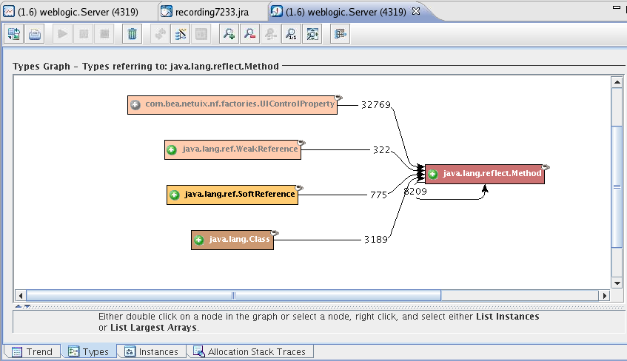
JRockit Memory Leak Detector
Double-click object types with higher growth rate (suspect for a memory leak).
Notes:
Oracle WebLogic Server 10g R3: Monitoring and Performance Tuning 11 - <number>
JRockit Memory Leak Detector
This is a low-level tool that connects directly to the JVM and deals with classes, instances, and arrays. No bytecode instrumentation is used. When analyzed with the Memory Leak Detector, the Java code will continue executing as if it were never connected. No Java code will be modified.
The advanced user interface provided by the JRockit Memory Leak Detector lets you find and examine the relationships between the leaking type and other types, or the leaking instance and other instances. The longer the trend analysis runs, the more reliable the trend analysis is. On the trend tab the types are sorted in the order of growth rate, and it is the type with the higher growth rate that we are interested in.
The screen shows show how a single object type can be expanded to gain additional insight into how that object is being used.

Slide 51
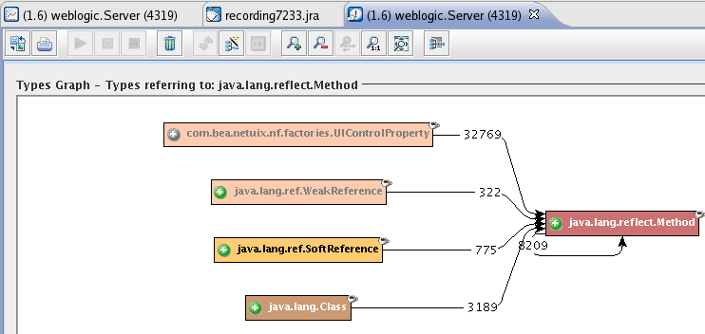
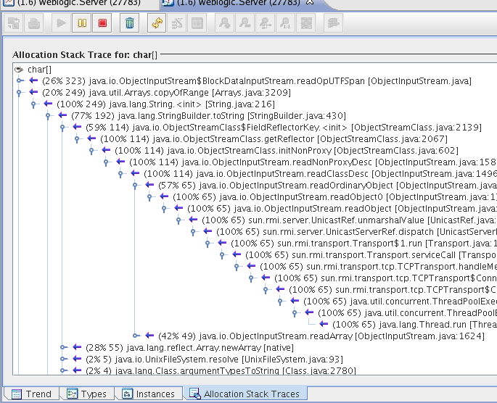
JRockit Memory Leak Detector
Right-click a suspicious object type, and select Show Allocation Traces to investigate its origins.
Notes:
Oracle WebLogic Server 10g R3: Monitoring and Performance Tuning 11 - <number>
JRockit Memory Leak Detector (continued)
The allocation stack trace gives you information about the exact method from where the selected instances are being allocated. In the example in the slide, the suspected object char[] is being allocated from the readOpUTFSpan method of the ObjectInputStream class.
The overhead of enabling allocation stack traces can be more significant and should therefore be used with care. After analysis, allocation stack traces can be disabled from the menu option.
The screenshot shows how an object can be analyzed by determining where in the stack it was instantiated.

Slide 52
Tips to Avoid Memory Leaks
  Always use caches with limits.
  Never use object pools without limits.
  If long-lived objects are used in the application, reduce their number or life span.
  Ensure that registered event listeners are being unregistered when no longer required.
  Check whether application code is authored properly to release all objects when no longer required (for example, JDBC Connections, Statement, ResultSet, and so on).
  Check the server heap usage from time to time.
Notes:
Oracle WebLogic Server 10g R3: Monitoring and Performance Tuning 11 - <number>

Slide 53
Best Practices
To avoid the JRockit Memory Leak Detector GUI stealing valuable resources from WebLogic Server, run the Management Console remotely.
Stop monitoring the application ( ) when completed with the Trend analysis.
To avoid additional overhead, separately stop ( ) Allocation Stack Trace.
To reduce the UI overhead, you can pause ( ) the screen from updating.
To prevent unauthorized access to the JRockit management server, block the port used by the management server in your firewall (for example, 7091).
Notes:
Oracle WebLogic Server 10g R3: Monitoring and Performance Tuning 11 - <number>

Slide 54
JRockit Garbage Collectors
Dynamic garbage collectors
  Use predefined heuristics to determine, in runtime, which garbage collection algorithm to use.
    No need to specify which garbage collector to use.
  Allow you to specify the following priorities:
    Maximum application throughput
      -Xgcprio:throughput
    Length of each garbage collection pause
      -Xgcprio:pausetime
    Minimal transaction latency
      -Xgcprio:deterministic
Notes:
Oracle WebLogic Server 10g R3: Monitoring and Performance Tuning 11 - <number>
JRockit Garbage Collectors
Starting the Dynamic Garbage Collector:
To start the dynamic garbage collector, use the -Xgcprio command line option with either the throughput or pausetime parameter, depending upon which priority you want to use:
-Xgcprio:<throughput|pausetime|deterministic>
In JRockit 5.0 R25 and later, the default garbage collector is -Xgcprio:throughput.

Slide 55
JRockit Garbage Collectors
Static Garbage Collectors
  The actual collector to be used can be explicitly specified during VM startup.
  It is compatible with the earlier version of JRockit.
  It can be used in situations where dynamic collectors are not effective.
  The following static collectors are available:
    Single-space concurrent (singlecon)
    Generational concurrent (gencon)
    Parallel (parallel)
Notes:
Oracle WebLogic Server 10g R3: Monitoring and Performance Tuning 11 - <number>

Slide 56
JRockit GC Tuning Tips
  To avoid slow startup, allocate an initial heap size as the approximate size of live data (–Xms:nn).
  To obtain a controlled environment, set a fixed heap size by setting –Xms:nn and –Xmx:nn equal.
  When using generational garbage collection, set the size of nursery using –Xns:nn.
  If your application creates a lot of temporary objects (short lived), set –Xns:nn as large as possible.
  If compaction during every old collection is an overkill, disable it using –XXnocompaction.
Notes:
Oracle WebLogic Server 10g R3: Monitoring and Performance Tuning 11 - <number>

Slide 57
JRockit GC Tuning Tips
  To avoid getting OutOfMemory prematurely, do not explicitly disable compaction, which is enabled by default.
  To reduce the pause time during an old collection due to compaction, reduce the percentage of the heap that should be compacted during each old collection by using
  –XXcompactratio:nn.
  To avoid long pauses during GC as a result of paging, set the –Xmx to be less than 75% of the physical memory in the system.
Notes:
Oracle WebLogic Server 10g R3: Monitoring and Performance Tuning 11 - <number>

Slide 58
JRockit GC Tuning Tips
  Explicitly set –Xmx:nn to avoid paging. If not, the default maximum heap size is a dynamic value determined by the VM.
  To prevent the concurrent collector from stealing valuable CPU time from the application, do not use oversized heap because the cost of each collection is directly proportional to the size of the heap.
  To avoid a locality of reference problem, do not set the heap size larger than the physical memory in the system.
Notes:
Oracle WebLogic Server 10g R3: Monitoring and Performance Tuning 11 - <number>

Slide 59
JRockit GC Tuning Tips
  On 32-bit platforms, use less than 1.6GB to 1.8GB for the maximum heap size as the processes are limited to less than 2GB.
  If you have more physical memory, consider running multiple WebLogic Server instances.
  For an application with high work loads, try setting the thread local size to improve performance:
  (–XXtlasize=nn)
  To avoid larger dark matter, do not set the thread local size (–XXtlasize) to a larger value.
Notes:
Oracle WebLogic Server 10g R3: Monitoring and Performance Tuning 11 - <number>

Slide 60
Monitor Garbage Collection
In JRockit, you can monitor garbage collection in real time using:
  JRockit Management Console
  Command-line arguments
    -Xverbose:memory: Runtime GC information
    -XgcPause: Runtime GC pause information
    -XgcReport: Comprehensive report of GC at the end
Notes:
Oracle WebLogic Server 10g R3: Monitoring and Performance Tuning 11 - <number>

Slide 61
Monitoring Garbage Collection
Notes:
Oracle WebLogic Server 10g R3: Monitoring and Performance Tuning 11 - <number>
Monitoring Garbage Collection
The screenshot shows memory utilization, memory statistics, and garbage collector information.

Slide 62
Monitoring Garbage Collection
Notes:
Oracle WebLogic Server 10g R3: Monitoring and Performance Tuning 11 - <number>
Monitoring Garbage Collection (continued)
The screenshot shows the GCs tab with details of Old Collections highlighted.

Slide 63
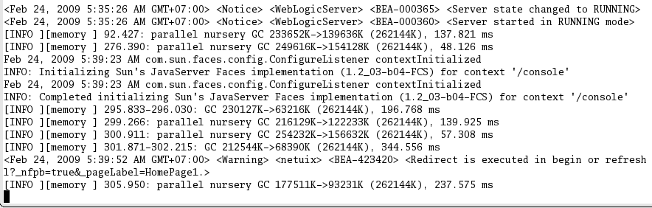
Monitoring Garbage Collection
-Xverbose:memory
Young garbage collections
Full garbage collection
Notes:
Oracle WebLogic Server 10g R3: Monitoring and Performance Tuning 11 - <number>
Monitoring Garbage Collection (continued)
If you want information about the garbage collection during run time, set the
-Xverbose:memory option at startup. The information about each garbage collection appears in your console window.
If the JRockit JVM was started without this option enabled, you can enable it dynamically using the jrcmd utility.
jrcmd 2480 verbosity set=memory
Similarly, it can be disabled using the jrcmd utility.
jrcmd 2480 verbosity remove=memory
The screenshot shows an example of running the
–Xverbose:memory option. Memory statistics can be seen in the server log.

Slide 64
Notes:
Monitoring Garbage Collection (continued)
Example:
[memory ] 32090.524: nursery GC 119583K->111900K (262144K), 152.523 ms
memory: This verbose information is printed by the memory subsystem in JRockit.
32090.524: The VM uptime in seconds
nursery GC: Whether it was nursery collection or young collection
119583k: The combined size of live objects before garbage collection
111900k: The combined size of live objects after garbage collection
(262144k): The total available space
152.523 ms: The time it took for this garbage collection

Slide 65
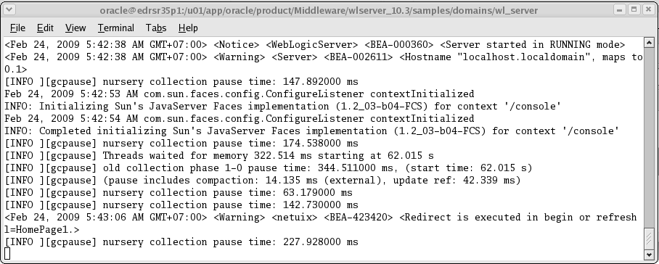
Monitoring Garbage Collection
-XgcPause
Notes:
Oracle WebLogic Server 10g R3: Monitoring and Performance Tuning 11 - <number>
Monitoring Garbage Collection (continued)
If you want to see the garbage collection activity when it occurs, enter the -XgcPause option, which causes the VM to print a line each time Java threads are stopped for garbage collection.
The screenshot shows an example of running WebLogic server with the –XgcPause option.

Slide 66
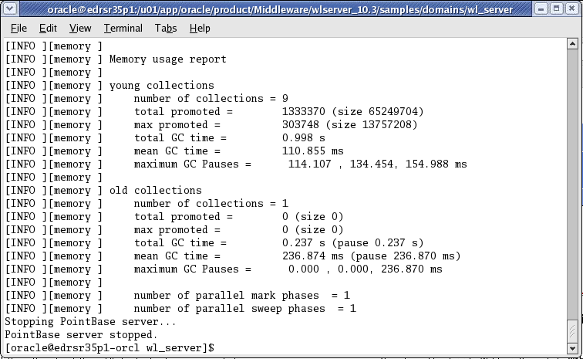
Monitoring Garbage Collection
-XgcReport
Notes:
Oracle WebLogic Server 10g R3: Monitoring and Performance Tuning 11 - <number>
Monitoring Garbage Collection (continued)
If you want to see a comprehensive report of garbage collection activity, enter the -XgcReport option at startup. With this option JRockit prints a comprehensive garbage collection report when the application run is completed.
The screenshot shows an example of running -XgcReport.

Slide 67
Detecting Low Memory Conditions
  You can configure WebLogic Server to automatically detect low memory conditions.
  When low memory is detected by sampling the available free memory, WebLogic Server logs the condition and changes the server health state to “Warning.”
  The average free memory of different samples during a configured time interval is compared with the average of the next time interval and if the difference drops by a configured value, this condition is also logged and the health state of the server changes to “Warning.”
Notes:
Oracle WebLogic Server 10g R3: Monitoring and Performance Tuning 11 - <number>

Slide 68
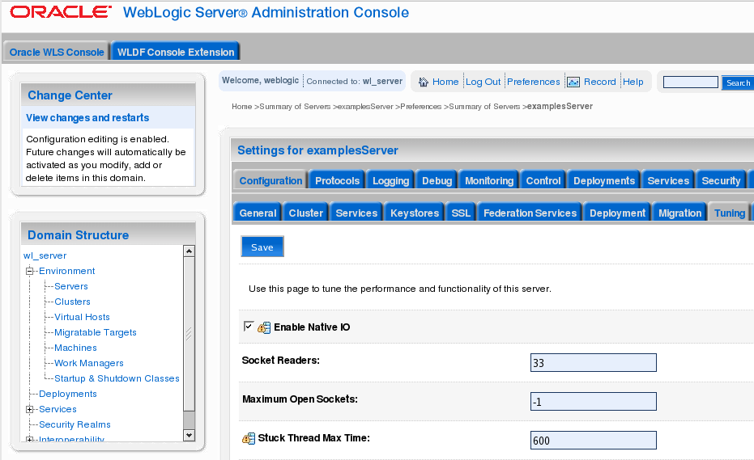
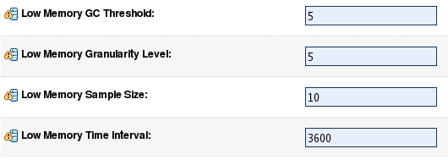
Detecting Low Memory Conditions
Notes:
Oracle WebLogic Server 10g R3: Monitoring and Performance Tuning 11 - <number>
Detecting Low Memory Conditions
The screenshot shows how you can set thresholds for low memory in the administration console.

Slide 69
Section Summary
In this section, you learned about:
  Monitoring JRockit using the JRockit Management Console
  Using the JRA and Memory Leak Detector
  Configuring self-tuning in JRockit JVM
  Monitoring garbage collection
Notes:
Oracle WebLogic Server 10g R3: Monitoring and Performance Tuning 11 - <number>

Slide 70
Practice 11-1 Overview:
Monitoring and Tuning JRockit JVM
This practice covers the following topics:
  Monitoring Oracle JRockit using the JRockit Management Console
  Using the Oracle JRockit Memory Leak Detector tool
  Investigating memory leaks in applications running on WebLogic Server instances
Notes:
Oracle WebLogic Server 10g R3: Monitoring and Performance Tuning 11 - <number>

Slide 71
Summary
In this lesson, you learned how to:
  Monitor the JRockit JVM
  Use the JRockit Management Console, JRA, and the Memory Leak Detector
  Use the Ctrl-Break handler and jrcmd
  Use JRockit self-tuning
  Tune JRockit JVM garbage collection
Notes:
Oracle WebLogic Server 10g R3: Monitoring and Performance Tuning 11 - <number>

Slide 72
Quiz
Which statements are true?
  WebLogic JRockit JVM is designed for server-side applications.
  It employs adaptive optimization to significantly improve runtime performance.
  It has adaptive garbage collection and heap management.
  It offers full support for 32- and 64-bit JRockit on Intel EM64T/AMD64 and compatibles.
  JRockit also supports Solaris/SPARC architecture.
  It does not offer support for very large heaps on 64-bit platforms.
  The tools suite for JRockit Mission Control offers better management, tuning, and troubleshooting.
Notes:
Answers: 1, 2, 3, 4, 5, 7

