Slide 1
Core WebLogic Server Tuning

Slide 2
Objectives
After completing this lesson, you should be able to:
  Configure the server to handle stuck threads
  Configure WebLogic Server’s garbage collection options
  Set up connection backlog buffering
  Describe SSL
Notes:
Oracle WebLogic Server 10g R3: Monitoring and Performance Tuning 12 - <number>

Slide 3
Road Map
  Performance Packs
  Stuck Threads
  Garbage Collection
  Chunk Tuning
  Connection Backlog Buffering
  SSL
Notes:
Oracle WebLogic Server 10g R3: Monitoring and Performance Tuning 12 - <number>

Slide 4
Threads
  A thread is a program’s path of execution.
  Threads enhance performance and functionality in various programming languages.
  Two types of threads:
    Native threads: Use the operating system's native ability to manage multithreaded processes
    Green threads: Emulate multithreaded environments without relying on any native OS capabilities
Notes:
Oracle WebLogic Server 10g R3: Monitoring and Performance Tuning 12 - <number>

Slide 5
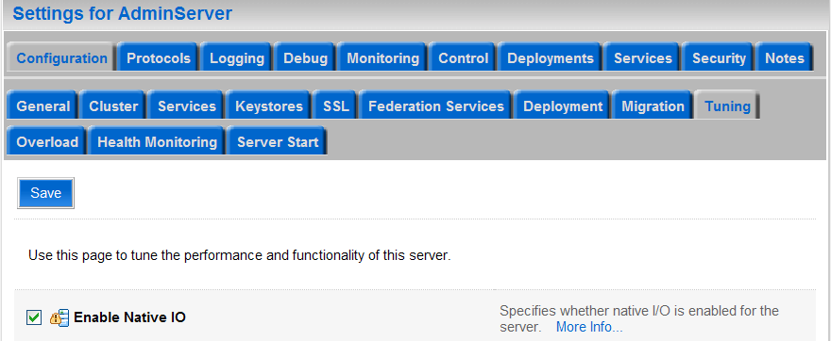
Native IO Performance Pack
  Native performance packs use a platform-optimized socket multiplexor to improve server performance.
  You can enable native IO on the Administration Console.
Notes:
Oracle WebLogic Server 10g R3: Monitoring and Performance Tuning 12 - <number>
Native IO Performance Pack
The screenshot shows how to enable native IO.

Slide 6
Native IO Performance Pack
  The use of native performance packs is enabled by default.
  Performance packs are platform dependent.
  You can also enable native IO in the config.xml
config.xml snippet:
<server>
<name>ServerName</name>
<listen-address>localhost</listen-address>
<native-io-enabled>true<native-io-enabled>
</server>
Notes:
Oracle WebLogic Server 10g R3: Monitoring and Performance Tuning 12 - <number>

Slide 7
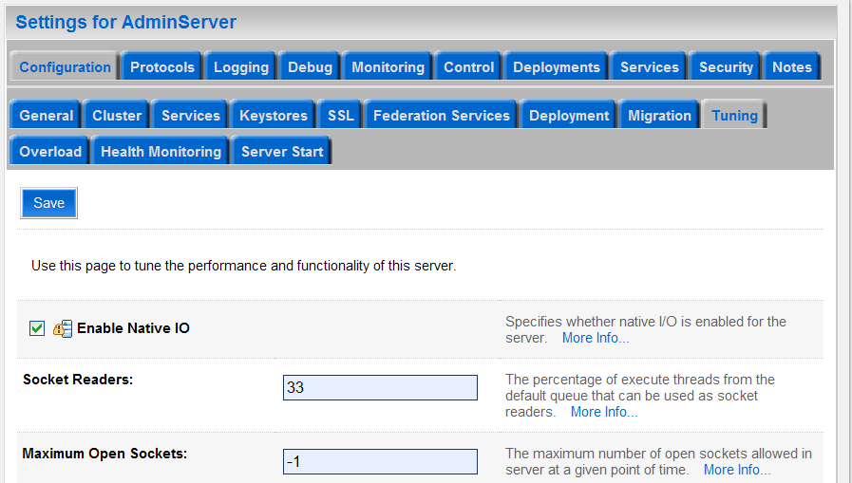
Socket Reader
  Socket readers are the percentage of execute threads from the default queue that can be used as socket readers.
    Default value: 33%
    Minimum value: 1%
    Maximum value: 99%
  The optimal value
  is application-
  specific.
Notes:
Oracle WebLogic Server 10g R3: Monitoring and Performance Tuning 12 - <number>
Socket Reader
By allocating execute threads to act as socket reader threads, you increase the speed and the ability of the server to accept client requests. There should be a balance between the number of execute threads that are devoted to reading messages from a socket and those threads that perform the actual execution of tasks in the server. The ThreadPoolPercentSocketReaders attribute in config.xml sets the maximum percentage of execute threads that are set to read messages from a socket.
The screenshot shows how to set the Socket Reader percentage.

Slide 8
Socket Reader
  The command-line attribute to set the socket reader on the client:
    -Dweblogic.ThreadPoolPercentSocketReaders=value
  You can also set this value in the config.xml.
config.xml snippet:
<server>
<name>ServerName</name>
<listen-address>localhost</listen-address>
<thread-pool-percent-socket-readers> 50
</thread-pool-percent-socket-readers>
</server>
Notes:
Oracle WebLogic Server 10g R3: Monitoring and Performance Tuning 12 - <number>
.

Slide 9
Section Summary
In this section, you learned about the use native performance packs.
Notes:
Oracle WebLogic Server 10g R3: Monitoring and Performance Tuning 12 - <number>

Slide 10
Quiz
Which statement is true?
  The two types of threads are Native Threads and Green Threads.
  The two types of threads are Native Threads and Red Threads.
  The two types of threads are Native Threads and Socket Threads.
  The only type of thread is a Native Thread.
Notes:
Answer: 1

Slide 11
Road Map
  Performance Packs
  Stuck Threads
  Garbage Collection
  Chunk Tuning
  Connection Backlog Buffering
  SSL
Notes:
Oracle WebLogic Server 10g R3: Monitoring and Performance Tuning 12 - <number>

Slide 12
Stuck Threads
  Every client request makes use of a thread from one of the execute queues.
  Some operations (for example, database call, computation loop inside an application) can get into an infinite loop.
  This can cause the thread to be stuck with that operation for whatever time it takes to complete that operation.
  Performance of the server can degrade significantly if many such threads get stuck.
Notes:
Oracle WebLogic Server 10g R3: Monitoring and Performance Tuning 12 - <number>

Slide 13
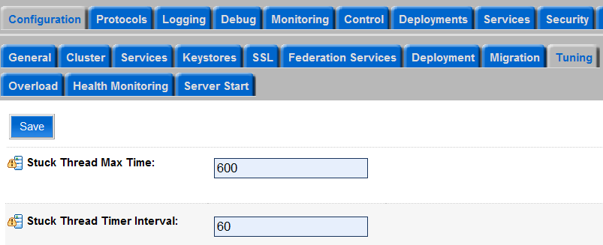
Stuck Threads
Based on certain thresholds, the server can identify such situations and mark the server’s state as FAILED.
Thresholds include:
  Max Stuck Thread Time
  Stuck Thread Timer Interval
Notes:
Oracle WebLogic Server 10g R3: Monitoring and Performance Tuning 12 - <number>
Stuck Threads
Max Stuck Thread Time: The number of seconds that a thread must be continually working before this server diagnoses the thread as being stuck. For example, if you set this to 600 seconds, WebLogic Server considers a thread to be stuck after 600 seconds of continuous use.
Stuck Thread Count: The number of stuck threads after which the server is transitioned into a FAILED state. There are options in OverloadProtectionMBean to suspend and shut down a FAILED server. By default, the server continues to run in a FAILED state. If the StuckThreadCount value is set to zero, the server never transitions into FAILED server irrespective of the number of stuck threads.
Stuck Thread Timer Interval: The number of seconds after which WebLogic Server periodically scans threads to see if they have been continually working for the configured maximum length of time
The screenshot shows how to set the Max Time and Timer Interval.

Slide 14
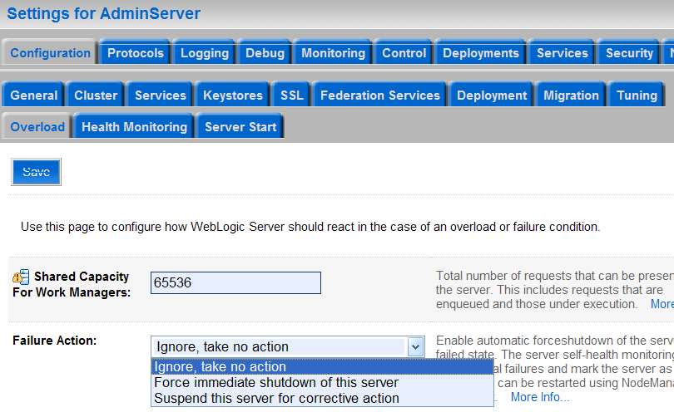

Stuck Threads
Thresholds include:
  Max Stuck
  Thread Time
  Stuck Thread
  Count
  Failure Action
Notes:
Oracle WebLogic Server 10g R3: Monitoring and Performance Tuning 12 - <number>
Stuck Threads (continued)
The screenshot shows how to set the Failure Action, the Max Stuck Thread Time, and Stuck Thread Count.

Slide 15
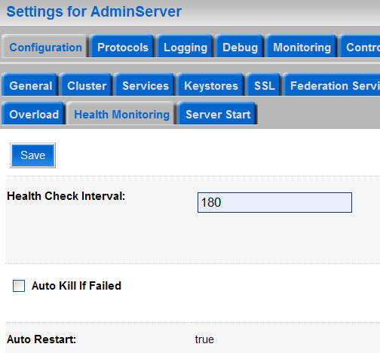
Auto Restart of Server
  If the server goes to a FAILED state, it can be forced to shut down and can be restarted using the Node Manager.
  This process of restarting the server can be automated.
Notes:
Oracle WebLogic Server 10g R3: Monitoring and Performance Tuning 12 - <number>
Auto Restart of Server
The screenshot shows how to set the option to perform an auto restart.

Slide 16
Section Summary
In this section, you learned about stuck threads.
Notes:
Oracle WebLogic Server 10g R3: Monitoring and Performance Tuning 12 - <number>

Slide 17
Quiz
Which statement is true?
  Performance of the server can degrade significantly if many client request threads get stuck.
  Server performance will not be affected if many client request threads get stuck. The JVM will allocate more to compensate.
Notes:
Answer: 1

Slide 18
Road Map
  Performance Packs
  Stuck Threads
  Garbage Collection
  Chunk Tuning
  Connection Backlog Buffering
  SSL
Notes:
Oracle WebLogic Server 10g R3: Monitoring and Performance Tuning 12 - <number>

Slide 19
Garbage Collection Thresholds
  Low memory can significantly impact the performance of the server.
  Low memory conditions trigger tasks like paging and garbage collection, which are expensive.
  It is important for the administrator to know of such situations beforehand so as to prevent the dreaded OutOfMemory situation.
Notes:
Oracle WebLogic Server 10g R3: Monitoring and Performance Tuning 12 - <number>

Slide 20
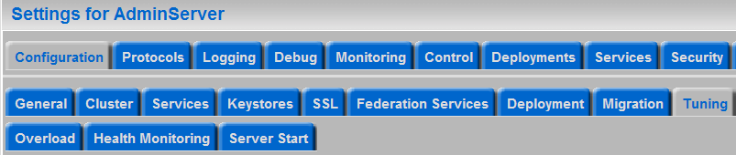
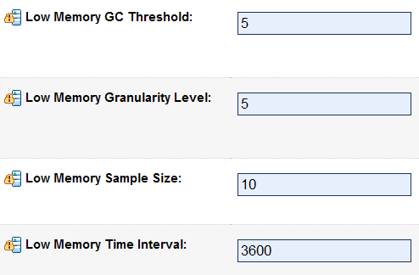
Garbage Collection Thresholds
Based on certain thresholds, the server can identify such situations and mark the server’s state as WARNING.
Thresholds include:
  Low Memory
  GC Threshold
  Low Memory
  Granularity Level
  Low Memory
  Sample Size
  Low Memory
  Time Interval
Notes:
Oracle WebLogic Server 10g R3: Monitoring and Performance Tuning 12 - <number>
Garbage Collection Thresholds
Low Memory GC Threshold: The threshold level (in percent) that this server uses for logging low memory conditions and changing the server health state to Warning. For example, if you specify 5, the server logs a low memory warning in the log file and changes the server health state to Warning after the average free memory reaches 5% of the initial free memory measured at the server's boot time.
Low Memory Granularity Level: The granularity level (in percent) that this server uses for logging low memory conditions and changing the server health state to Warning. For example, if you specify 5 and the average free memory drops by 5% or more over two measured intervals, the server logs a low memory warning in the log file and changes the server health state to Warning.
The screenshot shows how to set the garbage collection options.

Slide 21
Notes:
Garbage Collection Thresholds (continued)
Low Memory Sample Size: The number of times this server samples free memory during the time period specified by LowMemoryTimeInterval. Increasing the sample size can improve the accuracy of the reading.
Low Memory Time Interval: The amount of time (in seconds) that defines the interval over which this server determines average free memory values. By default, the server obtains an average free memory value every 3600 seconds. This interval is not used if the JRockit VM is used, as the memory samples are collected immediately after a VM-scheduled garbage collection. Taking memory samples after a garbage collection gives a more accurate average value of the free memory.

Slide 22
Section Summary
In this section, you learned about tuning WebLogic Server garbage collection.
Notes:
Oracle WebLogic Server 10g R3: Monitoring and Performance Tuning 12 - <number>

Slide 23
Quiz
Which statement is true?
  You will never run low on memory as the hardware has become so cheap that there is always lots to spare.
  Low memory can significantly impact the performance of the server.
  The WLS server health checking system will always block incoming requests to ensure that the server never has to deallocate an EJB due to lack of memory.
Notes:
Answer: 2

Slide 24
Road Map
  Performance Packs
  Stuck Threads
  Garbage Collection
  Chunk Tuning
  Connection Backlog Buffering
  SSL
Notes:
Oracle WebLogic Server 10g R3: Monitoring and Performance Tuning 12 - <number>

Slide 25
Chunk Tuning
  Chunks are temporary buffers used for I/O.
  WebLogic JVMs divide network data into chunks.
  The default chunk size is 4080 bytes(4 KB).
  You should tune chunk size for network intensive applications.
  Tuning chunk size also reduces number of socket reads/writes.
  The command-line property to set chunk size:
    -Dweblogic.Chunksize=n (n = chunk size)
Notes:
Oracle WebLogic Server 10g R3: Monitoring and Performance Tuning 12 - <number>

Slide 26
Tuning Chunk Size
  Set a smaller chunk size for high-frequency small payload workloads.
    And a higher value for high payload workloads
  Set the chunk size on both the client and server JVM for better performance.
  Tune the chunk size to match the network MTU size and operating system memory page size for better performance.
  Ensure that the chunk size is a multiple of 8.
  Ensure that the chunk size is a multiple of the MTU size.
Notes:
Oracle WebLogic Server 10g R3: Monitoring and Performance Tuning 12 - <number>

Slide 27
Tuning Chunk Pool Size
  WebLogic caches chunks in an internal chunk pool for reuse.
  Chunks are pooled to prevent allocation cost.
  The command-line property to set chunk size:
    -Dweblogic.utils.io.chunkpoolsize=n
  The default chunk pool size is 512.
  Tuning the pool size accommodates workloads with particular payloads and concurrent client activity.
  You should set a large pool size to accommodate workloads with many concurrent clients.
Notes:
Oracle WebLogic Server 10g R3: Monitoring and Performance Tuning 12 - <number>

Slide 28
Section Summary
In this section, you learned about:
  Chuck size
  Chuck pool size
Notes:
Oracle WebLogic Server 10g R3: Monitoring and Performance Tuning 12 - <number>

Slide 29
Quiz
Which statements are true?
  Chunks are temporary buffers used for I/O.
  WebLogic JVMs divide network data into chunks.
  The default chunk size is 1024 bytes(1 KB).
  You should tune chunk size for network intensive applications.
  Tuning chunk size also reduces number of socket reads/writes.
  The command-line property to set chunk size is:
  -Dweblogic.Chunksize=n (n = chunk size)
Notes:
Answers: 1, 2, 4, 5, 6

Slide 30
Road Map
  Performance Packs
  Stuck Threads
  Garbage Collection
  Chunk Tuning
  Connection Backlog Buffering
  SSL
Notes:
Oracle WebLogic Server 10g R3: Monitoring and Performance Tuning 12 - <number>

Slide 31
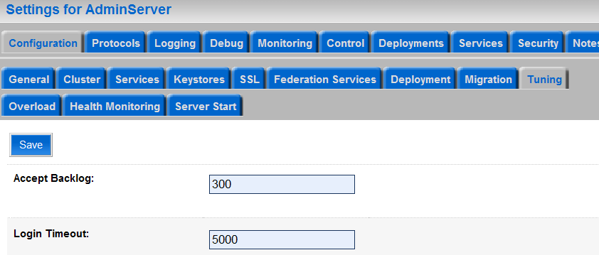
Connection Backlog Buffering
Specifies how many TCP connections can be buffered before refusing additional requests.
The configuration options:
  Default Value: 300
  Minimum: 0
  Maximum: Operating System dependent
Notes:
Oracle WebLogic Server 10g R3: Monitoring and Performance Tuning 12 - <number>
Connection Backlog Buffering
Connection backlog buffering is the number of connection requests that a WebLogic Server instance will accept before refusing additional requests. The accept-backlog parameter in config.xml specifies how many Transmission Control Protocol (TCP) connections can be buffered in a wait queue.
The fixed-size queue is populated with requests for connections that the TCP stack has received, but the application has not yet accepted.
The screenshot shows where to configure the Accept Backlog setting in the administration console.

Slide 32
Connection Backlog Buffering
The accept-backlog parameter in config.xml sets the buffer size for TCP connections.
config.xml snippet:
<server>
<name>ServerName</name>
<listen-address>localhost</listen-address>
<accept-backlog>100</accept-backlog>
</server>
Notes:
Oracle WebLogic Server 10g R3: Monitoring and Performance Tuning 12 - <number>

Slide 33
Connection Backlog Buffering
  If the Accept Backlog value is set too low, most connections will be dropped or refused at the client.
  A very high Accept Backlog value creates an overhead on the server.
  You should iterate the Accept Backlog value before the connections are refused and a load is created on the server.
Notes:
Oracle WebLogic Server 10g R3: Monitoring and Performance Tuning 12 - <number>
Connection Backlog Buffering (continued)
Raise the Accept Backlog value from the default by 25 percent for every "connection refused" message when accessing WebLogic Server.
Setting the backlog to 0 prevents accepting incoming connections on some OS.
A guideline for setting Connection Backlog Buffering is 8192 for a server with 4 GB of physical memory.

Slide 34
Section Summary
In this section, you learned about tune connection backlog buffering.
Notes:
Oracle WebLogic Server 10g R3: Monitoring and Performance Tuning 12 - <number>

Slide 35
Quiz
If the Accept Backlog value is set too low, most connections will be dropped or refused at the client.
  True
  False
Notes:
Answer: 1

Slide 36
Road Map
  Performance Packs
  Stuck Threads
  Garbage Collection
  Chunk Tuning
  Connection Backlog Buffering
  SSL
Notes:
Oracle WebLogic Server 10g R3: Monitoring and Performance Tuning 12 - <number>

Slide 37
Secure Sockets Layer (SSL)
  The following are two areas related to Secure Sockets Layer (SSL) performance:
    Handshake
    Bulk encryption and decryption
  To enhance SSL performance, decrease the number of individual SSL connections and handshakes.
    One way to decrease individual SSL connections is to use a browser that supports HTTP 1.1
  Use hardware accelerators to offload SSL processing from the application server to the dedicated SSL accelerator.
Notes:
Oracle WebLogic Server 10g R3: Monitoring and Performance Tuning 12 - <number>
Secure Sockets Layer (SSL)
SSL is a TCP protocol that uses port 443. SSL is also known as Secure HTTP (HTTPS), because it defines secure wrapping, authentication, and encryption for HTTP content. From a performance perspective, SSL encryption and decryption create an additional processing layer, beyond regular HTTP processing. This layer includes the following two major CPU intensive phases:
SSL handshake
After establishing a TCP connection, SSL creates a security context between endpoints using Public Key Interchange (PKI). This is known as an SSL handshake. In terms of aggregate network traffic, an SSL handshake consumes processing power that is proportional to the connection rate (measured in connections per second).
Encryption
After a security context is established, an endpoint uses it to encrypt or decrypt HTTP content, using symmetric encryption. This processing is performed on each byte of HTTP data. Therefore, it consumes processor cycles proportional to aggregate network throughput (measured in megabits per second).
Decreasing the number of connections increases performance for secure communication through SSL connections, as well as non-secure communication through simple TCP/IP connections. Use a browser that supports HTTP 1.1.

Slide 38
Section Summary
In this section, you learned about tuning SSL.
Notes:
Oracle WebLogic Server 10g R3: Monitoring and Performance Tuning 12 - <number>

Slide 39
Summary
In this lesson, you learned how to:
  Use performance packs
  Tune chunk size and chunk pools
  Tune connection backlog buffering
Notes:
Oracle WebLogic Server 10g R3: Monitoring and Performance Tuning 12 - <number>

Slide 40
Quiz
Using hardware accelerators to offload SSL processing from the application server to the dedicated SSL accelerator will accelerate performance.
Which statement(s) is (are) true?
  This statement is false. WLS can process SSL faster than a dedicated SSL accelerator.
  The statement is false. There is no such thing as a dedicated SSL accelerator.
  This statement is true.
Notes:
Answer: 3

