Slide 1
Tuning JMS

Slide 2
Objectives
After completing this lesson, you should be able to:
  JMS client tuning
  Aggregation
  Persistent stores
  Throttling
  Quota
  Acknowledgement modes
  Transactions and SAF tuning
Notes:
Oracle WebLogic Server 10g R3: Monitoring and Performance Tuning 16 - <number>

Slide 3
Road Map
JMS Tuning
  Introduction
  Tuning JMS Clients
  Aggregation
  Persistent Stores
  Throttling
  Quota
  Acknowledgement Modes
  Transactions
  SAF Tuning
Notes:
Oracle WebLogic Server 10g R3: Monitoring and Performance Tuning 16 - <number>

Slide 4

Definition: Java Message Service
  Java Message Service (JMS) is a standard API for accessing message-oriented middleware.
  JMS is beneficial because it allows:
    Two Java programs to communicate even if one of them is unavailable
    Queuing of messages for faster performance
MOM
system
Program A
Program B
Notes:
Oracle WebLogic Server 10g R3: Monitoring and Performance Tuning 16 - <number>
Definition: Java Message Service
A message-oriented middleware system, also referred to as an enterprise messaging system, enables applications to communicate with one another through the exchange of messages.
JMS is not a service provider or Message-Oriented Middleware (MOM) server; it is merely a set of interfaces that define a Java standard for accessing enterprise messaging products.
The Java Message Service (JMS) is a standard API for accessing enterprise messaging systems. Specifically, JMS:
Enables Java applications sharing a messaging system to exchange messages
Simplifies application development by providing a standard interface for creating, sending, and receiving messages
The graphic shows that two programs can be decoupled by a MOM system. The provider of data puts the message into the MOM; the consumer takes the message from the MOM and processes it.

Slide 5
Notes:
Definition: Java Message Service (continued)
The JMS specification defines many aspects about messages, such as their format and their interaction with different service providers. The JMS specification does not address:
Load-balancing
Fault tolerance
Error notification
Administration
Security or the integrity of messages
Wire protocol of messages in binary form
A message type repository for storing message data type definitions

Slide 6
Definitions: JMS Clients
  JMS clients are Java programs that produce or consume messages.
  A destination is a location on a JMS server where messages wait to be processed.
MOM System
Program A
Program B
7
6
5
JMS client
message producer
Destination
JMS client
message consumer
Notes:
Oracle WebLogic Server 10g R3: Monitoring and Performance Tuning 16 - <number>
Definitions: JMS Clients
The graphic shows that JMS clients are applications connected to the MOM system. The message producer and the message consumer are both considered JMS clients.

Slide 7
Two Types of Domains
JMS defines two domains:
  Point-to-point
  Publish/subscribe
Subscriber 1
Sender
Receiver
Point-to-point
Subscriber 2
Publisher
Subscriber 3
Publish/subscribe
Notes:
Oracle WebLogic Server 10g R3: Monitoring and Performance Tuning 16 - <number>
Two Types of Domains
The JMS specification defines two domains that are accessible: the point-to-point (PTP) and publish/subscribe (pub/sub) domain. The JMS specification broadly classifies all messaging products into one of these domains.
An example of a point-to-point domain is an application that sends a log message to a queue, which will be written to a text file by another system.
An example of a publish/subscribe domain is an application that posts a new stock price to multiple stock trading systems.
Two Types of Domains: The graphic shows that in point-to-point messaging the message is consumed by a single consumer, or receiver. In the case of publish/subscribe, the message is consumed by multiple consumers, or subscribers.

Slide 8
JMS Architecture
ConnectionFactory
Creates
JMS Connection
Creates
Creates
Creates
Message Producer
Session
MessageConsumer
Sends message
Receives
message
Creates
JMS message
JMS Destination (Topic/Queue)
Notes:
Oracle WebLogic Server 10g R3: Monitoring and Performance Tuning 16 - <number>
JMS Architecture
JMS is a standard Application Programming Interface (API) for accessing enterprise messaging systems. JMS enables the Java applications that share a messaging system to exchange messages. It also simplifies application development by providing a standard interface for creating, sending, and receiving messages.
JNDI is used to create an initial context to a JMS connection factory, which is used to create connections to JMS-based service providers. In a JMS connection, a particular session context can be retrieved to create message producers and message consumers.
JMS Architecture: The graphic shows that you can use a message producer to send a message to a destination. To send a message, first create a connection factory to establish a connection with the JMS server. A ConnectionFactory object encapsulates connection configuration information and enables JMS applications to create connections. When the connection is established, a session that enables the message producer to send the message to the destination (topic or queue) is invoked. The target destination then forwards the message to a message consumer.

Slide 9
JMS Clients
A method call from a JMS client to a MOM server would involve:
  Getting the connection factory from the naming service
  Using the connection factory to obtain a connection
  Using the connection to create a session
  Getting the destination (queue/topic) from the naming service
  Using the session and the destination to create either a message producer or a consumer
  Creating and sending a message or receiving a message
  Performing multiple serializations and deserializations
Notes:
Oracle WebLogic Server 10g R3: Monitoring and Performance Tuning 16 - <number>

Slide 10
Tuning JMS Clients
  JMS pooling
    Pool and or cache JMS resources when possible.
    Avoid creating and closing a connection, session, producer, consumer, or temporary destination for each message.
  Choose the message type that minimizes memory overheads.
  Use transient variables to reduce serialization overheads.
Notes:
Oracle WebLogic Server 10g R3: Monitoring and Performance Tuning 16 - <number>

Slide 11
Asynchronous Messages
  Asynchronous messages:
    May be preferred over invoking synchronous methods that merely return void
    Allow for better management of server resources
  Queuing of messages:
    Can improve performance
    Allows prioritization (high priority messages may need to be processed first)
  Receiving messages asynchronously with a MessageListener implementation can improve performance.
Notes:
Oracle WebLogic Server 10g R3: Monitoring and Performance Tuning 16 - <number>
Asynchronous Messages
Asynchronous invocations can be beneficial in situations where clients may have alternatively called a synchronous method that only returns void. Why should a client block and wait for a response that it knows does not exist? Some client-side processing time may be saved by using an asynchronous invocation in this scenario. However, a client would still want to use a synchronous invocation on a method that returns void for two reasons. First, if the client wants to know when the method has completed, blocking and waiting for the method to complete is the quickest way to determine this. Second, a synchronous method may still return a server-generated exception that needs to be handled by the client at the time or point of the exception. If the exception is severe enough, it may warrant a second invocation or a completely different path of execution. If your business logic is complex, making use of asynchronous services may be more troublesome than beneficial.
Because asynchronous requests are decoupled from the clients that generate the requests, objects that handle their execution can make use of a pool of available threads to handle the processing. By delegating processing activities to a pool of threads, an asynchronous system can better manage the resources required to handle requests. And, as the frequency of messages increases, the need to manage server-side resources becomes critical.
Request thread pooling can provide better scalability and performance of the system than may be capable when using services that only handle synchronous requests.

Slide 12
Notes:
Asynchronous Messages (continued)
Incoming asynchronous requests are queued upon their arrival into the processing system, so the requests can be filtered by the clients based on their priority and handled in a different order than they arrive into the system.

Slide 13
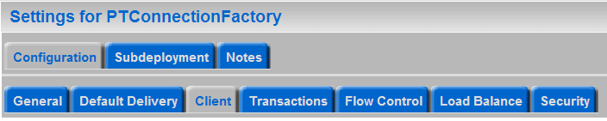

Aggregation and Message Pipeline
  Multiple asynchronous messages can be sent in a single delivery as opposed to multiple deliveries.
  This implies that JMS servers aggregate concurrent client requests into single I/Os.
  Messages are pushed and pipelined to the message listener.
  Pipelining supports the aggregation of multiple messages into a single network call.
    Tune via Maximum Messages on the connection factory.
Notes:
Oracle WebLogic Server 10g R3: Monitoring and Performance Tuning 16 - <number>
Aggregation and Message Pipeline
Leverage aggregation involves sending multiple asynchronous messages in a single delivery. That is, JMS servers aggregate simultaneous client requests into single I/Os. Messages are pushed in one direction only, and they are pipelined to the message listener. Pipelining supports the aggregation of multiple messages into a single network call.
Performance of JMS messages is improved when JMS is used with the third-party MQ series, where you need to send bulk messages.
The screenshot shows how to configure the Maximum Messages per Session using the WebLogic Server Administration Console.

Slide 14
Persistent Stores
  Choose non-durable (NON_PERSISTENT) messages wherever appropriate to avoid the persistency overhead.
  Persistent stores require more memory during initialization of the WebLogic Server instance if the number of stored messages increases.
  If the application absolutely needs to persist messages, you can increase the heap size of the JVM to accommodate the messages currently stored in the persistent store.
  Two types of persistent stores:
    File stores
    JDBC stores
Notes:
Oracle WebLogic Server 10g R3: Monitoring and Performance Tuning 16 - <number>
Persistent Stores
If the number of stored messages increases, persistent stores require more memory during the initialization of a WebLogic Server instance. If initialization fails due to insufficient memory while rebooting WebLogic Server, you can increase the heap size of the JVM in proportion to the number of messages that are currently stored in the persistent store.
WebLogic JMS can store persistent messages in either a file store or a JDBC store. A comparison between a file store and a JDBC is as follows:
File stores and JDBC stores both have the same transaction semantics and guarantees.
File stores and JDBC stores both have the same application interface.
File stores are generally faster and easier to configure.
File stores are better suited to paging nonpersistent messages.
JDBC stores may make it easier to handle failure recovery because the JMS store can access the data from any machine on the network. In a file store, the disk must be shared or migrated when the JMS server is moved to another machine.

Slide 15
Comparing a JDBC Store with a File Store
Benchmark and compare both mechanisms to find out which one better suits your application.
JDBC Store | File Store
JDBC stores generate network traffic if the database is on a different machine from the JMS server. | File stores do not generate network traffic.
JDBC stores are easier to manage because the data is centralized on the database server. | You need to manage each managed server’s physical disks.
If a JMS server is associated with a JDBC store, both pages persistent and nonpersistent messages are always written to the JMS server’s paging directory. | If a JMS server is associated with a file store, paged persistent messages are written to the file store, whereas nonpersistent messages are always written to the paging directory of the JMS server.
Notes:
Comparing a JDBC Store with a File Store
The table provides the pros and cons of using JDBC stores versus file stores.

Slide 16
File Persistence
  The disk write policy that determines how the file store writes data to disk.
  This policy also affects the JMS file store's performance, scalability, and reliability.
    Direct-Write: File store writes are written directly to disk.
    Disabled: Instead of waiting for the writes to successfully reach the disk, transactions are complete as soon as their writes are cached in memory.
    Cache-Flush: Transactions cannot complete until all of their writes have been flushed down to disk.
Notes:
Oracle WebLogic Server 10g R3: Monitoring and Performance Tuning 16 - <number>
File Persistence
Synchronous Write Policy: The disk write policy that determines how the file store writes data to disk. This policy also affects the JMS file store's performance, scalability, and reliability. The valid policy options are:
Direct-Write: File store writes are written directly to disk. This policy is supported on Solaris, HP-UX, and Windows. On Windows systems, this option generally performs faster than the Cache-Flush option.
Disabled: Transactions are complete as soon as their writes are cached in memory, instead of waiting for the writes to successfully reach the disk. This policy is the fastest, but the least reliable (that is, transactionally safe). It can be more than 100 times faster than the other policies, but power outages or operating system failures can cause lost and/or duplicate messages.
Cache-Flush: Transactions cannot complete until all of their writes have been flushed down to disk. This policy is reliable and scales well as the number of simultaneous users increases.

Slide 17
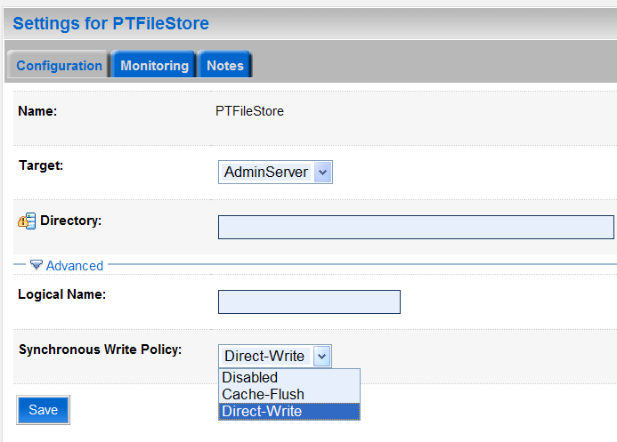
File Persistence
  The performance of the file store based on the data write policy also depends on the operating system.
  For example, on Windows systems, Direct-Write generally performs faster than the Cache-Flush.
Notes:
Oracle WebLogic Server 10g R3: Monitoring and Performance Tuning 16 - <number>
File Persistence (continued)
The screenshot shows how to set the synchronous write policy using the WebLogic Server Administration Console.

Slide 18
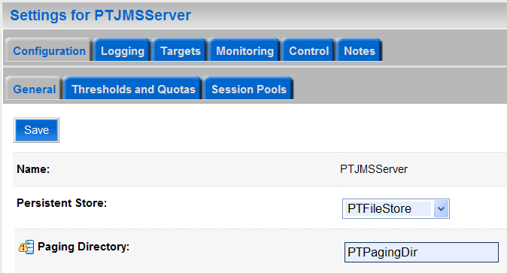
Paging
  During peak message load situations, messages are paged onto disk to conserve memory.
  For best performance, the paging directory should be different from the JMS server's persistent store.
  Excessive paging may degrade performance.
  Paging can be minimized by:
    Increasing the
    message buffer
    size
    Increasing the
    JVM heap size
    Throttling
Notes:
Oracle WebLogic Server 10g R3: Monitoring and Performance Tuning 16 - <number>
Paging
Paging is always enabled on WebLogic Server.
If a paging directory is not specified, paged-out message bodies are written to the default \tmp directory inside the servername subdirectory of a domain's root directory.
The screenshot shows how to set the paging directory using the WebLogic Server Administration Console.

Slide 19
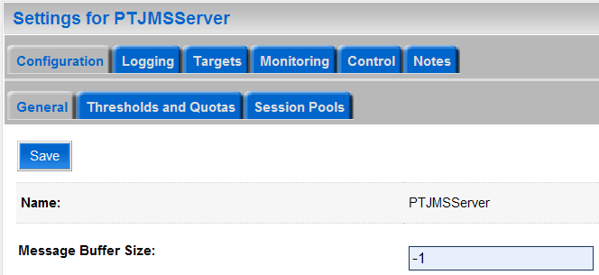
Message Buffer Size
Specifies the amount of memory that will be used to store message bodies in memory before they are paged out to disk
  Increasing this number and/or increasing the JVM heap size can minimize paging and therefore improve performance.
Notes:
Oracle WebLogic Server 10g R3: Monitoring and Performance Tuning 16 - <number>
Message Buffer Size
The Message Buffer Size option specifies the amount of memory that will be used to store message bodies in memory before they are paged out to disk. The default value of Message Buffer Size is approximately one-third of the maximum heap size for the JVM, or a maximum of 512 megabytes. The larger this parameter is set, the more memory JMS will consume when many messages are waiting on queues or topics. Once this threshold is crossed, JMS may write message bodies to the directory specified by the Paging Directory option in an effort to reduce memory usage below this threshold.
It is important to note that this parameter is not a quota. If the number of messages on the server passes the threshold, the server will write messages to disk and evict them from memory as fast as it can to reduce memory usage, but it will not stop accepting new messages. It is still possible to run out of memory if messages are arriving faster than they can be paged out. Users with high messaging loads who wish to support the highest possible availability should consider setting a quota, or setting a threshold, and enabling flow control to reduce memory usage on the server.
The screenshot shows how to set the Message Buffer Size using the WebLogic Server Administration Console.

Slide 20
Throttling
  Message traffic under high-volume conditions is unpredictable and could be in spurts.
  Messages can be produced far faster than they can be consumed, causing congestion.
  This condition requires the message sends to be throttled with flow control.
  Throttling also addresses the issue of senders starving the receivers out of their share of CPU and other server resources.
Notes:
Oracle WebLogic Server 10g R3: Monitoring and Performance Tuning 16 - <number>
Throttling
In most messaging systems, the message sender is faster than a message receiver because the message sender is usually required to do less work. However, the message receiver incurs additional overhead because it issues an obligatory acknowledgment call for each message. If not limited, this imbalance can lead to overflow conditions that degrade response time and may even cause a WebLogic Server instance to run out of memory.
Throttling addresses the issue of message senders outpacing message receivers. Throttling also balances the CPU and JVM resource shares.

Slide 21
Throttling Techniques
The various throttling techniques are:
  Configuring message quotas
  Tuning flow control
  Designing applications using a request/response pattern
  Increasing the blocking send timeout
  Configuring message expiration policy
Notes:
Oracle WebLogic Server 10g R3: Monitoring and Performance Tuning 16 - <number>
Throttling Techniques
JMS provides the following throttling techniques:
Configuring message quotas: Configuring quotas helps you to prevent a server from running out of memory.
Tuning flow control: Flow control is configurable through a producer’s connection factory. WebLogic JMS 7.0 and later provide tunable flow control to slow down overactive producers. This flow control takes effect when the configurable messages or bytes threshold is exceeded. In this situation, producers are forced to slow down by delaying the time when their calls produce a message return.
Designing applications using a request/response pattern: Request/response is an effective and commonly used throttling method that is incorporated into an application’s design. In request/response, a requester is blocked from sending the message again until it gets a response from a receiver.

Slide 22
Notes:
Throttling Techniques (continued)
Increasing the blocking send timeout: WebLogic JMS temporarily blocks the producer send operations if a certain quota is reached. If the quota condition eases during the time the producer blocks the message, the message sending will still succeed. For example, when a message times out or a consumer consumes a message, the message sending will still succeed. This enhances the performance of applications that retry message sending on quota failures. By default, producers block up to 10 messages.
Configuring message expiration policy: When a message expires, it is either deleted or redirected to another destination. You can use this feature to alleviate overflow conditions because it cleans up older messages.

Slide 23
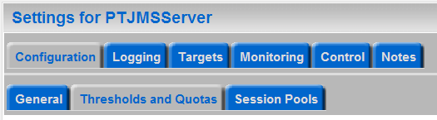
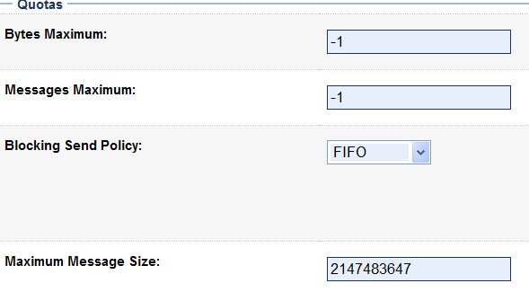
Quotas
Quotas limit the number of messages on a destination that are pending delivery.
This limit can be specified as:
  Number of bytes
  Number of messages
  Size of message
  Blocking send policy
Notes:
Oracle WebLogic Server 10g R3: Monitoring and Performance Tuning 16 - <number>
Quotas
Bytes Maximum
The total number of bytes that can be stored in a destination that uses this quota. A value of zero means that no messages can be placed on a destination without exceeding the quota. A value of -1 prevents WebLogic Server from imposing a limit. Because excessive bytes volume can cause memory saturation, Oracle recommends that the maximum correspond to the amount of system memory that is available after accounting for the rest of your application load.
Messages Maximum
The maximum number of messages that can be stored in this JMS server. A value of -1 removes any WebLogic Server limits. Because excessive message volume can cause memory saturation, Oracle recommends that this value corresponds to the total amount of system memory available after accounting for the rest of your application load.
The screenshot shows how to set the quotas for Bytes Maximum, Messages Maximum, Blocking Send Policy, and Maximum Message Size using the WebLogic Server Administration Console.

Slide 24
Notes:
Quotas (continued)
Blocking Send Policy
Determines whether the JMS server delivers smaller messages before larger ones when a destination has exceeded its maximum number of messages. FIFO prevents the JMS server from delivering smaller messages when larger ones are already waiting for space. Preemptive allows smaller send requests to preempt previous larger ones when there is sufficient space for smaller messages on the destination. This policy is defined only for the JMS server; it cannot be set on individual destinations.
Maximum Message Size
The maximum number of bytes allowed in individual messages on this JMS server. The size of a message includes the message body, any user-defined properties, and the user-defined JMS header fields JMSCorrelationID and JMSType.

Slide 25
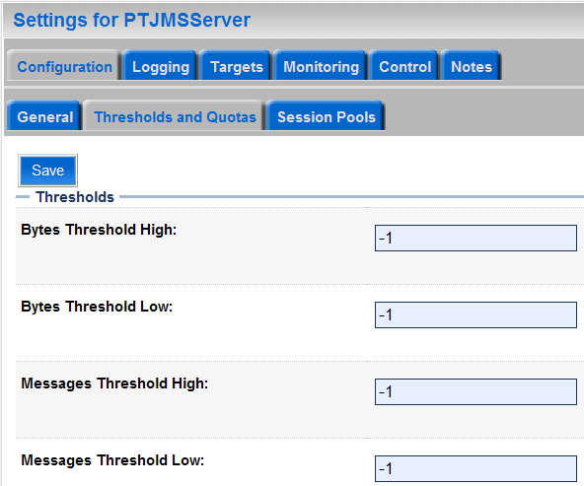
Threshold
Threshold limits trigger events when they are specified.
Threshold limits include:
  Lower and upper limit for the number of bytes
The triggered events include:
  Flow control
  Logging
Notes:
Oracle WebLogic Server 10g R3: Monitoring and Performance Tuning 16 - <number>
Threshold
Bytes Threshold High: The upper threshold (number of bytes stored in this JMS server) that triggers flow control and logging events. A value of -1 disables the events for this JMS server.
Bytes Threshold Low: The lower threshold (number of bytes stored in this JMS server) that triggers flow control and logging events. A value of -1 disables the events for this JMS server.
Messages Threshold High: The upper threshold (number of messages stored in this JMS server) that triggers flow control and logging events. A value of -1 disables the events for this JMS server.
The screenshot shows how to set the Bytes Threshold High, Bytes Threshold Low, Messages Threshold High, and Message Threshold Low settings using the WebLogic Server Administration Console.

Slide 26
Notes:
Threshold (continued)
Messages Threshold Low: The lower threshold (number of messages stored in this JMS server) that triggers flow control and logging events. A value of -1 disables the events for this JMS server.
The triggered events are:
Log Messages: A message is logged on the server indicating a high threshold condition.
Flow Control: If flow control is enabled, the JMS server becomes armed and instructs producers to begin decreasing their message flow.

Slide 27
Flow Control
  Flow control enables a JMS server or destination to slow down message producers when it determines that it is becoming overloaded.
  Flow Control parameters include:
    Max. number of messages/second
    Min. number of messages/second
    Adjustment period
    Number of steps to adjust
Notes:
Oracle WebLogic Server 10g R3: Monitoring and Performance Tuning 16 - <number>
Flow Control
Flow Maximum: The maximum number of messages-per-second allowed for a producer that is experiencing a threshold condition. When a producer is flow controlled, it will never be allowed to go faster than the FlowMaximum messages per second. If a producer is not currently limiting its flow when a threshold condition is reached, the initial flow limit for that producer is set to FlowMaximum. If a producer is already limiting its flow when a threshold condition is reached (the flow limit is less than FlowMaximum), the producer will continue at its current flow limit until the next time the flow is evaluated.
Flow Minimum: The minimum number of messages-per-second allowed for a producer that is experiencing a threshold condition. This is the lower boundary of a producer's flow limit. That is, WebLogic JMS will not further slow down a producer whose message flow limit is at its FlowMinimum. When a producer is flow controlled, it will never be required to go slower than FlowMinimum messages per second.
Flow Interval: The adjustment period of time, in seconds, when a producer adjusts its flow from the FlowMaximum number of messages to the FlowMinimum amount, or vice versa. When a producer is flow controlled, it is slowed down from its FlowMaximum to its FlowMinimum over the specified FlowInterval amount of seconds.

Slide 28
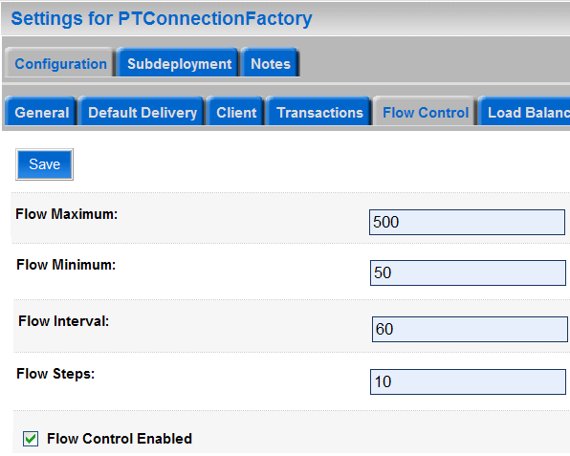
Flow Control
Notes:
Flow Control (continued)
Flow Steps: The number of steps used when a producer is adjusting its flow from the Flow Maximum amount of messages to the Flow Minimum amount, or vice versa. Specifically, the Flow Interval adjustment period is divided into the number of Flow Steps (for example, 60 seconds divided by 6 steps is 10 seconds per step).
Flow Control Enabled: Specifies whether a producer created using a connection factory allows flow control. If true, the associated message producers will be slowed down if a JMS server or a destination reaches its specified upper byte or message threshold.
The screenshot shows how to set the Flow Maximum, Flow Minimum, Flow Interval, Flow Steps, and Flow Control Enabled settings using the WebLogic Server Administration Console.

Slide 29
Handling Expired Messages
  To handle expired messages, you can configure a message expiration policy.
  The message expiration policy feature defines an alternate to message redelivery when a message expires.
  This parameter can be used to prevent the destination from filling up by marking as expired the unconsumed messages that have crossed a threshold.
Notes:
Oracle WebLogic Server 10g R3: Monitoring and Performance Tuning 16 - <number>
Handling Expired Messages
The Message Expiration Policy feature defines an alternate to the redelivery of messages when a message expires. An expiration policy can be set on a per destination basis using the Expiration Policy attribute on the Destinations node. The Expiration Policy attribute defines the action that a destination should take when an expired message is encountered. The attribute may discard the message, discard the message and log its removal, or redirect the message to an error destination.
Note: The Expiration Logging Policy parameter has been deprecated in this release of WebLogic Server. In its place, Oracle recommends using the Message Life Cycle Logging feature, which provides a more comprehensive view of the basic events that JMS messages will traverse through once they are accepted by a JMS server, including detailed message expiration data. For more information about message life cycle logging options, see http://download-llnw.oracle.com/docs/cd/E12840_01/wls/docs103/jms_admin/troubleshoot.html.

Slide 30
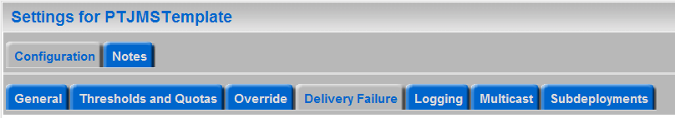
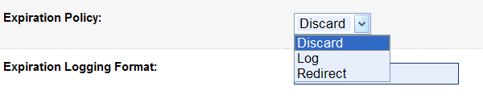
Configure Expiration Policy
  JMS templates provide similar attribute settings for multiple destinations.
  Configuring the expiration policy on a JMS template configures the expiration policy on all the destinations.
The expiration policy attribute may:
  Discard the message
  Discard the message and log its removal
  Redirect the message to an error destination
Notes:
Oracle WebLogic Server 10g R3: Monitoring and Performance Tuning 16 - <number>
Configure Expiration Policy
JMS templates provide an efficient way to define multiple destinations (topics or queues) with similar attribute settings. If you use JMS templates to configure multiple destinations, you can use the Expiration Policy field to configure an expiration policy on all your destinations. To override a template's expiration policy for specific destinations, you can modify the expiration policy on any destination.
To configure a Message Expiration Policy on an existing template(s) for your destinations, you can select one of the following options from the Expiration Policy list in the Delivery Failure page on the Configuration tab:
Discard: Removes expired messages from the messaging system. The removal of messages is not logged, and the message is not redirected to another location.
Log: Removes expired messages and writes an entry to the server log file indicating that the messages were removed from the system. This feature has been deprecated.
Redirect: Moves expired messages from their current location into the Error Destination defined for the destination.
The screenshot shows how to set the Expiration Policy using the WebLogic Server Administration Console.

Slide 31
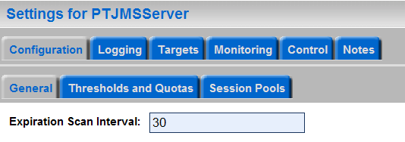
Expired Message Scanning
  The system searches for the expired messages.
  This feature ensures that the expired messages are cleaned up immediately based on the expiration policy of the destination.
  You can configure a JMS server to actively scan destinations for expired messages.
  A smaller value could result in excessive scanning and a higher value can result in expired messages occupying memory in the destination.
Notes:
Oracle WebLogic Server 10g R3: Monitoring and Performance Tuning 16 - <number>
Expired Message Scanning
The expiration policy will define the amount of time in which messages expire and what happens to them once they expire. Messages are not necessarily removed from the system or moved to a new destination at their expiration time.
You can configure a JMS server to actively scan destinations for expired messages. To define this, you can specify a value, in seconds, in the Expiration Scan Interval field of the General tab under the Configuration tab. The value specified in this field is the amount of time you want the JMS server to pause between its cycles of scanning the destinations for processing the expired messages. The default value is 30 seconds, which means that the JMS server waits for 30 seconds between each scan interval. To disable active scanning, enter a value of 0 seconds. Expired messages will be passively removed from the system as they are discovered.
The screenshot shows how to set the Expiration Scan Interval using the WebLogic Server Administration Console.

Slide 32
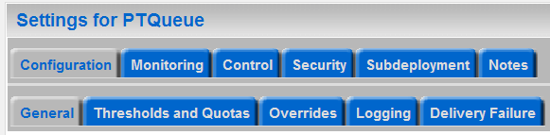
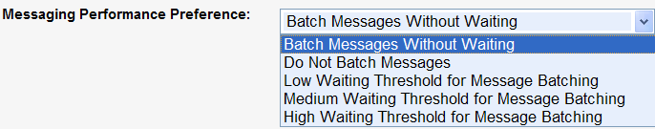
Messaging Preference
  Messaging preference specifies the destination’s performance preference in regard to message latency or throughput.
  The lower the value, the more the destination will emphasize latency over throughput.
  The higher the value, the more the destination will emphasize throughput over latency.
Notes:
Oracle WebLogic Server 10g R3: Monitoring and Performance Tuning 16 - <number>
Messaging Preference
The screenshot shows how to set the Messaging Performance Preference using the WebLogic Server Administration Console.

Slide 33
Acknowledgement
  DUPS_OK_ACKNOWLEDGE and AUTO_ACKNOWLEDGE perform better than CLIENT_ACKNOWLEDGE.
  Both AUTO_ACKNOWLEDGE and DUPS_OK_ACKNOWLEDGE guarantee delivery of messages, but duplicate okay mode can have a higher throughput at the cost of the occasionally duplicated message.
  You should defer JMS acknowledgments and commits.
Notes:
Oracle WebLogic Server 10g R3: Monitoring and Performance Tuning 16 - <number>
Acknowledgement
Acknowledgement mode is specified on a JMS client while it is creating a session object from the connection.
Session session = connection.createSession(false, Session.AUTO_ACKNOWLEDGE);

Slide 34
Message Selectors
  A JMS server can filter messages based on the properties specified for a message.
  This can impact performance depending on the complexity of the message selector criteria.
  Whenever possible, avoid JMS message selectors and use multiple queues/topics to select messages.
Notes:
Oracle WebLogic Server 10g R3: Monitoring and Performance Tuning 16 - <number>

Slide 35
Transactions
  There can be several applications where the messages need to be part of a transaction.
  Use separate transactional sessions for transactional messages and non-transactional sessions for non-transactional messages.
  This eliminates the overhead of transactions when the message need not be part of a transaction.
Notes:
Oracle WebLogic Server 10g R3: Monitoring and Performance Tuning 16 - <number>

Slide 36
Store and Forward (SAF)
  SAF facilitates asynchronous communication between two messaging applications.
  SAF enables message delivery to applications distributed across WebLogic Server instances.
  SAF ensures reliable message delivery when used with the new unified persistent store subsystem in WebLogic Server 10.
Notes:
Oracle WebLogic Server 10g R3: Monitoring and Performance Tuning 16 - <number>
Store and Forward (SAF)
SAF is an asynchronous communication mechanism. Through SAF, a producer on a local sending endpoint can send a message to a consumer on a remote receiving endpoint, regardless of the availability of the remote endpoint. If the remote endpoint is not available when the producer sends a message, the message is stored in a persistent store or in the memory of the local sending endpoint and forwarded to the remote endpoint when it is available.
SAF enables message delivery to applications that are distributed across WebLogic Server instances. For example, application A runs on a local WebLogic Server and communicates with application B running on a remote WebLogic Server. Applications A and B are often not connected to each other because of network problems. Therefore, if application A sends a message to application B using the WebLogic SAF service, the message is stored either in the persistent store of the local WebLogic Server or the memory of the local WebLogic Server. The message is forwarded when application B is available.
SAF uses the unified persistent store subsystem of WebLogic Server 10. Through this subsystem, file or database, stores can be created for WebLogic Server and SAF. These store messages on the hard disk of the machine hosting WebLogic Server ensure that the messages are not lost before they are forwarded.

Slide 37
Notes:
Oracle WebLogic Server 10g R3: Monitoring and Performance Tuning 16 - <number>
Store and Forward (SAF) (continued)
Note: WebLogic SAF can be used by JMS applications and Web Services Reliable Messaging (WSRM). In JMS SAF, local JMS producers can send messages to remote JMS destinations. In WSRM SAF, Web services located on separate WebLogic Server instances can exchange messages.
The advantages of SAF are:
Enables fast and reliable delivery of messages across applications running on WebLogic Server
Ensures the sequential delivery of messages by supporting the Unit-of-Order mechanism
Is transparent to the applications using it
The disadvantages of SAF are:
Cannot forward messages to prior releases of WebLogic Server
Cannot interoperate with third-party JMS products

Slide 38
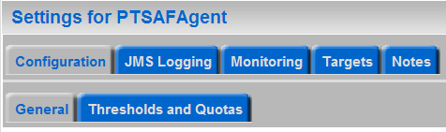
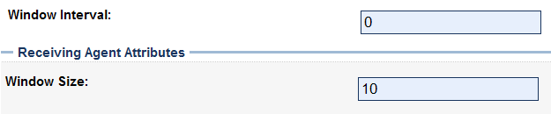
SAF Tuning
  Window Interval
    The maximum amount of time that a JMS sending agent will wait before forwarding messages in a single batch.
  Window Size
    The number of messages in a batch
  You can use this to improve performance by forwarding messages in a batch as opposed to individually.
Notes:
Oracle WebLogic Server 10g R3: Monitoring and Performance Tuning 16 - <number>
SAF Tuning
Window Interval
A sending agent will wait to forward the message batch until either: (A) the source destination message count is greater than or equal to the configured Window Size; (B) it has waited for a specified Window Interval, whichever comes first.
Window intervals take effect and improve performance only in cases where the forwarder is already able to forward messages as fast as they arrive. In this case, instead of immediately forwarding newly arrived messages, the forwarder pauses in an attempt to accumulate more messages and forward them as a batch. The resulting larger batch sizes may improve forwarding throughput and reduce overall system disk and CPU usage, but may also increase message latency.
Window Size
For WSRM, the maximum number of unacknowledged messages allowed between a source destination and a target destination during a conversation. A sending agent waits to forward a message batch until the source destination message count is greater than or equal to this value.
The screenshots show how to set the Window Interval and the Window Size using the WebLogic Server Administration Console.

Slide 39
Practice 16-1 Overview:
Tuning JMS
This practice covers the following topics:
  Understanding the various disk write policies for writing to a file store
  Tuning the file persistence store for persisting JMS messages
Notes:
Oracle WebLogic Server 10g R3: Monitoring and Performance Tuning 16 - <number>

Slide 40
Summary
In this lesson, you learned how to tune:
  JMS client tuning
  Aggregation
  Persistent stores
  Throttling
  Quota
  Acknowledgement modes
  Transactions
  SAF tuning
Notes:
Oracle WebLogic Server 10g R3: Monitoring and Performance Tuning 16 - <number>

Slide 41
Quiz
Which statements are throttling techniques?
  Configuring message quotas
  Tuning flow control
  Designing applications using a request/response pattern
  Designing applications with synchronization blocks
  Increasing the blocking send time out
  Designing servlets that run in a single threaded model
  Configuring message expiration policy
Notes:
Answers: 1, 2, 3, 5, 7

