Slide 1
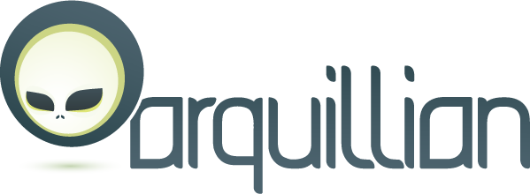

No more mocks. No more container lifecycle and deployment hassles. Just real tests!
So you can rule your code. Not the bugs.

Slide 2

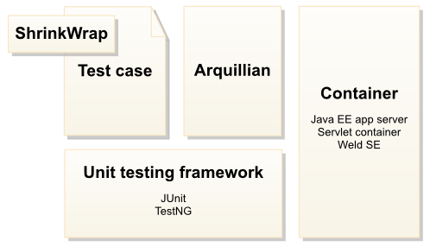
Architecture
ShrinkWrap is the simplest way to create archives in Java.
Using ShrinkWrap API, developers may assemble JARs, WARs, and EARs to be deployed directly by Arquillian during testing.

Slide 3
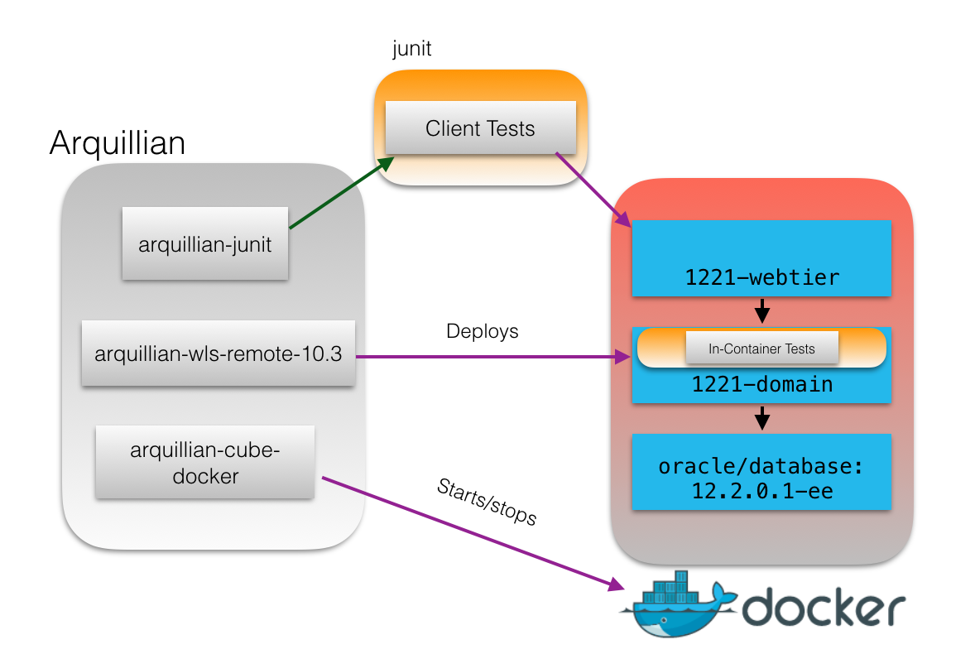
Arquillian is a powerful and flexible testing framework that allows you to test your applications or frameworks with your target application server.
It will create and start the necessary Docker containers and deploy test artifacts prior to your tests executing.

Slide 4
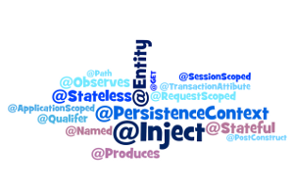
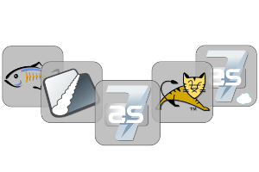
Features
Mocks are used to make code work outside of a real environment. Arquillian lets you ditch the mocks and write real tests. That's because Arquillian brings your test to the runtime, giving you access to container resources and insight about how the code really works.
Your application and tests can share the same programming model, regardless of technology stack.
Its enables Micro-deployments which are much smaller than the full application, so the test archive deploys faster, which means you get a faster test-code-test development cycle.
Arquillian brings you server-side debugging like never before. you hit the breakpoint inside the server from the comfort of your IDE. Prepare for an eye opening experience!

Slide 5
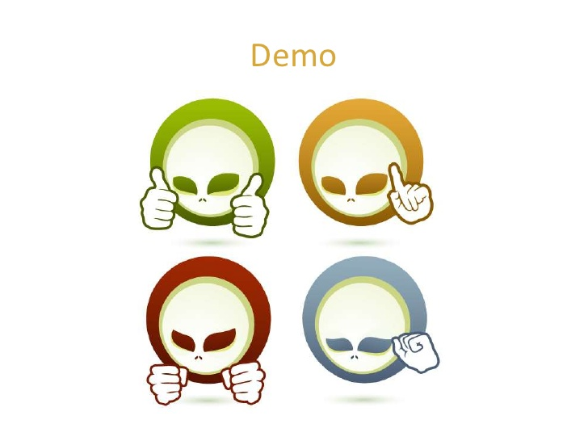
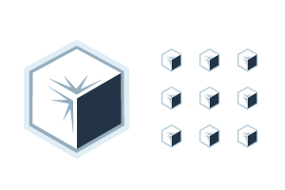
Scenario
Altworklife application which has around 5000 java files.
I have to test mytask functionality. So, I will extract only java files related to this functionality and archive it into .war with the help of arquillian for deployment and run test cases.
Also if I want, I can debug this chunk of code.
I don’t have to deploy that whole application.

