Slide 1
Introduction to three.js
https://github.com/Toronto-WebGL-Meetup/Talk_10-December-2015

Slide 2
About Me
Gareth Marland (@garethmarland)
British
By day, Autodesk Revit Server
By night, Dotstorming and Boardthing

Slide 3
Moving from 2D to 3D
Traditional 2D web development is like creating a shareable document
3D web development is like creating a shareable movie scene

Slide 4
Creating your scene
The light source
The camera
The renderer
Lights, Camera, Action!

Slide 5
example1.html

Slide 6
The light source
Ambient Light
  Applies a light globally. To every object in the scene
Point Light
  Shines light in all directions and lights up anything that is in range
Directional Light
  The most commonly used lighting
  Works like a spotlight, in a position and shines in a direction

Slide 7
Light source examples
Ambient Light
var ambLight = new THREE.AmbientLight(0x404040);
scene.add(ambLight);
Point Light
var pointLight = new THREE.PointLight(0x0033ff, 3, 150);
pointLight.position.set(70, 5, 70);
scene.add(pointLight);
Directional Light
var dirLight = new THREE.DirectionalLight(0xffffff, 1);
dirLight.position.set(100, 100, 50);
scene.add(dirLight);

Slide 8
The camera
Orthographic Camera
  Does not take a objects distance from the camera into account when drawing
  Created with top, bottom, left, right, near and far
Perspective Camera
  The most commonly used
  Takes an objects distance from he camera into account
  Created with fov, aspect ratio, near and far

Slide 9
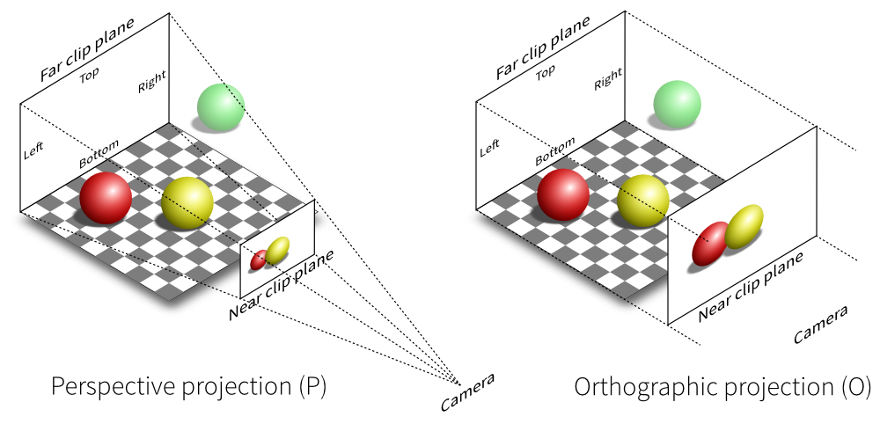
The camera

Slide 10
The renderer
Draws the scene
Can be set up to loop in order to animate
Needs to be attached to an HTML element
var renderer = new THREE.WebGLRenderer({ antialias: true });
renderer.setSize(containerWidth, containerHeight);
document.getElementById(“container”).appendChild(renderer.domElement);
var renderScene = function () {
  requestAnimationFrame( renderScene );
  renderer.render(scene, camera);
};
renderScene()

Slide 11
Putting it together
var scene = new THREE.Scene();
var camera = new THREE.PerspectiveCamera(75, containerWidth/containerHeight, 0.1, far);
scene.add(camera);
var pointLight = new THREE.PointLight(0xffffff, 1);
pointLight.position.set(0,5,5);
scene.add(pointLight);
var renderer = new THREE.WebGLRenderer({ antialias: true });
renderer.setSize(containerWidth, containerHeight);
document.getElementById(“container”).appendChild(renderer.domElement);
var renderScene = function () {
  requestAnimationFrame( renderScene );
  renderer.render(scene, camera);
};
renderScene();

Slide 12
Creating an object
Define the geometry
  Use a predefined three.js object
  Define your own vertices
  Use a modelling tool
Define the material
  Basic
  Lambert
  Phong
  Custom
Create the mesh
Add it to the scene

Slide 13
example2.html

Slide 14
Animating an object
Should be updated within the rendering method
The rendering only needs to be called when a change needs to be made
var render = function () {
  var that = this;
  var updateScene = function() {
    // Do your updates to the object here
  }
  var renderScene = function () {
    requestAnimationFrame( renderScene );
    updateScene();
    renderer.render(scene, camera);
};
  renderScene();
}

Slide 15
example3.html

Slide 16
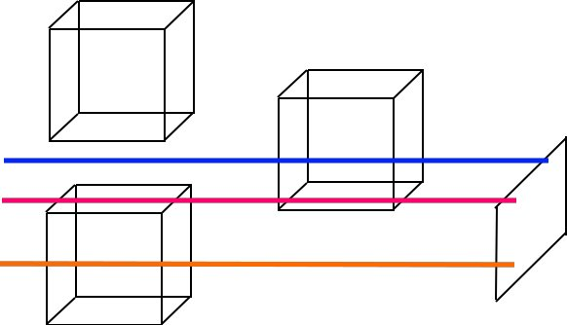
Selecting objects
Selecting needs to work differently in 3D
We using something called “raycasting”
It's basically shooting lazers in space and seeing what we hit!

Slide 17
Selecting objects example
var mousePosition = new THREE.Vector2();
mousePosition.x = 2 * (mouseEvent.x / renderer.domElement.clientWidth) - 1;
mousePosition.y = 1 - 2 * (mouseEvent.y / renderer.domElement.clientHeight );
var raycaster = new THREE.Raycaster();
raycaster.setFromCamera(mousePosition, camera);
var intersected = raycaster.intersectObject(scene, true);

Slide 18
example4.html

Slide 19
Controlling the camera
Bind the camera to a mouse event
Include a library such as OrbitControls.js

Slide 20
example5.html

Slide 21
Advantages of the medium
Can be opened in a browser
Can be mixed and matched with other web based technologies
  Websockets
  HTML Canvas
Fairly easy to understand

Slide 22
fin

