Slide 1
EIFFEL AS A WEB SERVICE
Notes:
Give a name to the project and also change it in the documentation for the project

Slide 2
Motivation
New 3 layer architecture for Cloudstudio.
Pros
Frontend
All Eiffel commands are a standalone service (like Compilation, Execution, etc).
Greater security, by separating the main CloudStudio server with the part that compiles and runs the code.
Greater Scalability, by handling multiple requests for the various functions.
Can be used for any other purpose, which needs a eiffel backend compiler.
Cloudstudio Server
Standalone Eiffel Server
Notes:
Make boxes and compare with the previous CloudStudio version

Slide 3
Motivation
Experimenting with the Eiffel Web Framework
How the Eiffel Web Framework compares with the other web frameworks
The integration of Eiffel Web Framework with the latest frontend technologies like AngularJS
Notes:
Both are the latest technology in their respective fields.

Slide 4
Features Implemented
Compilation
Execution
Class Views (Flat, Contract)
Class Descendants, Ancestors, Clients and Suppliers
Feature Callers
General Command Line Service

Slide 5
Notes:
Demo here

Slide 6
Compilation
http://localhost/compile?clean=true;path=your-path;id=your-id;target=your-target
The JSON response from the server:
[{
"Compile_Message":"Eiffel Compilation Manager\nVersion 14.05.9.5158 GPL Edition - win64\n\nDegree 6: Examining System\nDegree ",
"Output_Message":"C/C++ Compilation Tool - Version: 14.05\nCopyright Eiffel Software 1996-2012. All Rights Reserved",
"Error_Message":"",
"Has_Compilation_Error":false,
"Warning_Message":"",
"Has_Warning":true,
"Needs_Target":false,
"Dump ":"",
"Errors":null,
"Warnings”:null,
"Targets":null,
"Compilation_Succeeded":true
}]
And the status code is set to 200 (Success).
Notes:
Talk about the how every project gets its own id.
Talk about the JSON elements.
Talk about how all other features also have the similar JSON responses.

Slide 7
Error parsing
Example of Parsed Error Message
"Error": [{
"Error_Code":"VEEN\n",
"Error":"unknown identifier.\n",
"What_to_do":"make sure that identifier, if needed, is final name of\n feature of class, or local entity or formal argument of routine.\n\n",
"Class":"APPLICATION\n",
"Feature":"extra_feature\n",
"Line":40,
"Before_Line":"Identifier: asdas\nTarget type: [like Current] attached APPLICATION\n",
"After_Line":" create s.make_from_string (\"abcd\")\n-> asdas\n ensure\n\n",
"Dump":"Error code: VEEN\n\nError: unknown identifier.\nWhat to do: make sure that identifier, if needed, is final name of\n feature of class, or local entity or formal argument of routine.\n\nClass: APPLICATION\nFeature: extra_feature\nIdentifier: asdas\nTarget type: [like Current] attached APPLICATION\nLine: 40\n create s.make_from_string (\"abcd\")\n-> asdas\n ensure\n\n“
}]
The Compilation_Succeeded Field is set to false.
Several Unit Tests were made based on Most Known Errors, Warnings and Runtime Errors and were parsed correctly.
Notes:
Warnings and Runtime Error also have such JSON parsing
Maybe show an example of 1-2 unit tests

Slide 8
Other Requirements
Timeouts
Deleting old projects

Slide 9

Timeouts
There can be situations where the compilation or the execution is taking a lot of time (say infinite loop). So, it is useful to have a timeout value.
The values can be specified in a config file, which the server reads when it is initialized.
Whenever a timeout occurs, the status code is set to the HTTP standard 504 (Gateway timeout), and the compilation_succeeded field or Execution_Succeeded field is set to false.

Slide 10
Execution
A web socket connection is opened with the server for execution.
Motivation :
Real time outputs can be delivered from the server to the client.
Web sockets make the execution of programs interactive, i.e. sockets being a 2 way connection allows users to send inputs to the execution as well.

Slide 11
Execution
Workflow of execution
Request for execution (http://localhost:9090/run?id=id-given)
Opens a socket
Sends messages to and fro via the socket
Closes socket after the execution is finished
Returns response
Again, for interactive execution, there is a time interval (Configurable) within which the user should enter the input, otherwise a timeout occurs.
Notes:
Merge with 10

Slide 12

Cleanup
Every user has his own copy of the project, and the number of such projects in the server will grow exponentially overtime.
So, a cleanup is done every 24 hour(configurable), which will remove the user project if it has not been used for 30 days (configurable).
Notes:
Merge with timeouts

Slide 13
DEMO
The features in this application
What happens when a timeout occurs
Interactive Web Socket Session
Notes:
Remove

Slide 14

Documentation
The API for using the features is well documented.
Notes:
Depend on the time

Slide 15

Challenges
There is no concurrent Nino.
Change in architecture, because multiple server instances are running now instead of one instance with multiple threads.
Can’t use web sockets because we have to switch to Apache.
Notes:
No text over the image
Don’t talk about nino before.
Ews bulit in web server, good for development

Slide 16

Future Work
Debugger for this service
Autocompletion

Slide 17
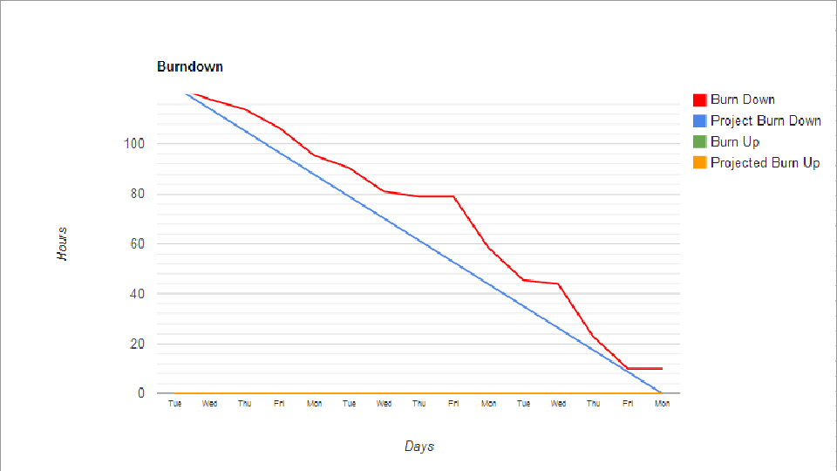
Lessons Learned
Eiffel and Design by Contract
Eiffel Web Framework
Standard Web Practices
Software Engineering Practices ( Testing, Estimation)
Testing
Project planning and estimation
API design
SCRUM development methodology
2 sprints
Duration
User stories
Notes:
Used scrum, 2 sprints, duration
Say something about the diagram
Add sprint 2 as well

Slide 18




Europe

