Slide 1

MANTRA : EIFFEL AS A WEB SERVICE
Chair of
Software Engineering

Slide 2


CloudStudio Architecture
Chair of
Software Engineering
Previous
2-layer architecture
New
3-layer architecture
Frontend
Frontend
CloudStudio Server
CloudStudio Server
Database
Database
Command Line
Eiffel Server
Command Line
Notes:
Clear browser cache
Why mantra ? Mantra is a sacred utterance, group of words believed by some to have psychological and spiritual power

Slide 3
Motivation
Chair of
Software Engineering
New 3 layer architecture for CloudStudio
Greater security, by separating the main CloudStudio server from the part that compiles and runs the code
Greater scalability, as more languages can be added, without overloading the CloudStudio server
Mantra can be used for any other purpose, which needs a Eiffel compiler
Experimenting with the Eiffel Web Framework
How the Eiffel Web Framework compares with the other web frameworks
The integration of Eiffel Web Framework with the latest frontend technologies like AngularJS
Notes:
All Eiffel commands are a standalone service (like Compilation, Execution, etc).
Scalability :The ability to enhance the system by adding new functionality at minimal effort
Both are the latest technology in their respective fields, don’t mention about nodejs, and other stuff.

Slide 4

Goal
Chair of
Software Engineering
Provide ec command line as a web service
ec –config ace.ecf
You send an http GET request :
http://localhost/compile?path=“.../ace.ecf”
The server sends an http response:
JSON response containing useful compilation message
An id for further calls to the same project

Slide 5


Compilation
Chair of
Software Engineering
Ec command line
The JSON response from the server:
[{
"Compile_Message":"Degree 6: Examining System\nDegree 5 ",
"Error_Message":"",
"Has_Compilation_Error":false,
"Warning_Message":"",
"Needs_Target":false,
"Warnings”:null,
"Targets":null,
"Compilation_Succeeded":true,
…..
}]
Standalone server
Messages
Errors
Warnings
Notes:
Show how the compiler simply dumps stuff, and you extract useful information out of it, by parsing it.
After http GET, go to browser and show a demo for the localhost call

Slide 6
Error parsing
Chair of
Software Engineering
Compiler Dump
Useful Information
[{
"Error_Code":"VEEN\n",
"Error":"unknown identifier.\n",
"What_to_do":"make sure that identifier”,
"Class":"APPLICATION\n",
"Feature":“make\n",
"Line":40
}]
Error code: VEEN
Error: unknown identifier.
What to do: make sure that identifier
Class: APPLICATION
Feature: make
Line: 40
Several unit tests were made based on most known errors, warnings and runtime errors and were parsed correctly
Notes:
Warnings and Runtime Error also have such JSON parsing
Show the frontend, done and built in angularjs. Say it is only for testing and will not be merged with CloudStudio.
Give a brief demo of all the features.
Use interesting and known classes, like LINKED LIST,etc

Slide 7
Features Implemented
Chair of
Software Engineering
Compilation
Execution
Class Views (Flat, Contract)
Class Descendants, Ancestors, Clients and Suppliers
Feature Callers
General Command Line Service

Slide 8
Demo
Chair of
Software Engineering

Slide 9
Execution
Chair of
Software Engineering
A web socket connection is opened with the server for execution
Motivation :
Real time outputs can be delivered from the server to the client
Web sockets make the execution of programs interactive, i.e. sockets being a 2 way connection allows users to send inputs to the execution as well

Slide 10


Other Requirements
Chair of
Software Engineering
Timeouts
Situations where the compilation or the execution takes time (e.g. infinite loop)
Values configurable
Whenever a timeout occurs, the status code is set to the HTTP standard 504 (Gateway timeout), and the compilation or execution fails
Deleting old projects
As the number of user grows, more memory will be consumed
So, a cleanup is done which will remove the user’s copy if it has not been used for a long time
Notes:
Why useful to have a timeout?
Why useful to delete old projects?
Now after all that is achieved, we moved to the next step to see if dynamic interaction was possible between the user and the service. Talk about Eiffel Web Sockets, relatively new.
First give a demo and then show the slide.

Slide 11

Documentation
Chair of
Software Engineering
The API for using the features is well documented
Notes:
Keep it

Slide 12

Challenges
Chair of
Software Engineering
There is no concurrent Nino
Apache + fastCGI
Multiple server instances are created instead of one instance with multiple threads
Eiffel Web Framework does not support web sockets with fastCGI
Notes:
Talk about Nino as a standalone built in web server in EWS, and good for development and debugging, but doesn’t support concurrency.
So we had to use fastCGI+Apache
Web sockets were good with Nino, but EWF does not support it with libfcgi

Slide 13

Future Work
Chair of
Software Engineering
Debugger for this service
Autocompletion

Slide 14
Lessons Learned
Chair of
Software Engineering
Eiffel and Design by Contract
Eiffel Web Framework
Standard Web Practices
Software Engineering Practices
Testing
Project planning and estimation
API design
SCRUM development methodology
2 sprints
19 user stories implemented
Notes:
Say 1-2 lines about everything
Design by contract – learnt and used a lot of preconditions, postconditions
Framework and its working
http response, request, web sockets
Unit testing using autotest
Add sprint 2 as well (depends on time)

Slide 15
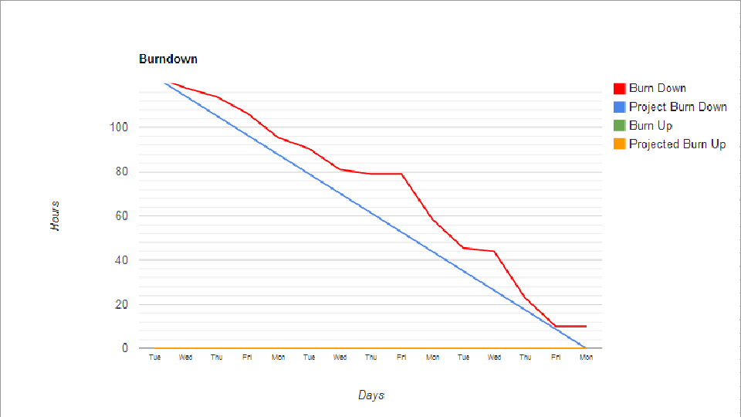
Chair of
Software Engineering
Duration: 3 weeks
User stories: 11
Notes:
Describe the burndown chart ( why is it flat at some parts, why the last one is incomplete)
3 weeks
11 user stories
Football app

Slide 16




Europe

