Slide 1
Computational thinking
CMD Seminar Week 1 – Justin Ventura

Slide 2
What is Computational Thinking?
A logical way of thinking:
Problem solving oriented
Efficiency & effectiveness
What does ‘computational’ have to do with it?
Some problems we suck at
Computers solve problems
Computers take logical instructions
“Algorithms”
A different perspective

Slide 3
What even is an “Algorithm”?
Algorithm
A list of steps to follow in order to complete some defined task

Slide 4
How can we construct these “algorithms”?
We take various actions to define our task
What is the expected outcome?
Does the outcome rely on some input?
Can we produce a “dirty” solution at first?
Ex) Determine whether an integer N is even or not
Outcome: a yes or no decision on N being even
The input is just N
We know 0, 2, … 8 are even from school
We say even numbers end in one of those numbers
If N’s last digit is one of those, we say yes

Slide 5

Let’s break it down further…
Computational Thinking consists of 4 tactics combined:
Decomposition
Pattern Recognition
Abstraction
Algorithmic Thinking

Slide 6
Decomposition
Break a complex problem into smaller, potentially easier problems
Reduce the complexity of a problem
Try to create easier problems to assist with harder ones
Makes it easier to manage the problem
Ex) Break it down: getting ready for school in the morning
Washing face
Brushing teeth
Getting dressed
Making coffee
Prepare backpack

Slide 7
Pattern Recognition
Recalling approaches taken to solve similar problems you’ve encountered before
Some problems have similar solutions
Notice patterns and take advantage
Try approaches that have proven effective
Ex) Recall the past: faulty technology
Wi-Fi router not working
Printer unresponsive
Cellular service glitching
Software not behaving as expected
Cliché but a good possible approach: try to turn the device off and back on!

Slide 8
Abstraction
“Abstract” out only details that matter for the task at hand
Focus on components that play a role in results
Ignore details that aren’t related to the problem
Ex) Filter: navigate your way to school/work
Utilize a map
Only focus on transportation routes
Ignore routes that don’t take you to your destination
Ignore landmarks/buildings that you need not go to

Slide 9
Algorithmic Thinking
Once the previous are satisfied, we need steps to follow
We may need sub-algorithms for sub-problems in final algorithm
We might re-use algorithms we’ve used before
Our algorithm may not rely on certain details that we won’t need
We need steps that anyone can follow to solve the problem
Steps should be unambiguous
It should be theoretically repeatable by anyone (and computers*)
*computability is a topic for another time

Slide 10
Characteristics of an algorithm
Being able to logically follow an algorithm is good:
Calculations: not uncommon to perform calculations along the way
Looping; some steps may repeat until some condition is met
Branching: we may need “if this, then that, otherwise the other” logic
Storage: we may need to memorize information for future use
Objects: we may consider noting/utilizing similar objects
People, animals, mobile devices, buildings
Shapes, online accounts, video game entities

Slide 11
Putting it all together
Using these techniques can help solve problems
Having a new perspective
More organized approaches
Producing algorithms for computers:
Computers need steps to follow
We can have computers automate tasks

Slide 12
Why would we need computers?
Some problems are too large for us to handle
Computers are extremely quick at computation
Computers are less prone to error with well thought out algorithms
Problems we complete in days, computers can do in seconds
We get fatigued, bored, or distracted; computers don’t
Some problems are trivial and/or computers can do better (controversial)
Automation of cashiers, tech support, financial management
Machines in a factory mass producing items
Online sites for consumers, education, finances, etc.
Some problems we just don’t understand (yet!)
Use computers to test/research heuristics
Have computers visualize data, quickly crunch numbers, etc.
Machine learning and AI… beyond the scope of this lecture

Slide 13
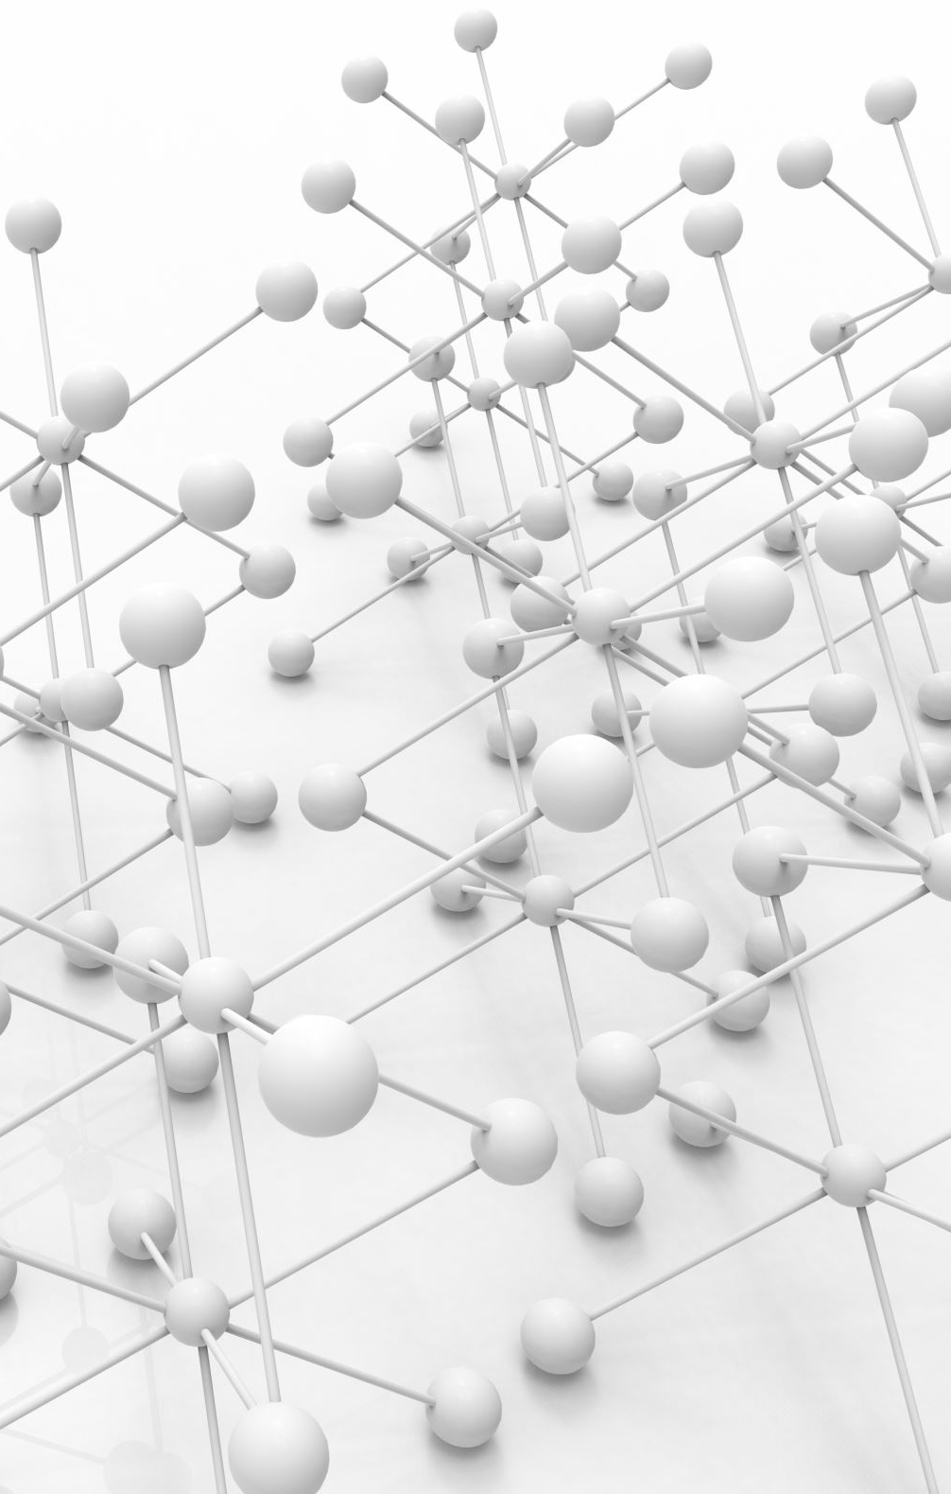
Summary
Key techniques:
Decomposition
Pattern Recognition
Abstraction
Algorithmic Thinking
Goal: make problem solving easier (perhaps with computers!)
Purpose:
Develop better problem-solving skills
Be able to automate with computers
Enhance research, testing, and quality of life

