Slide 1
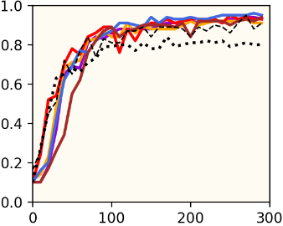
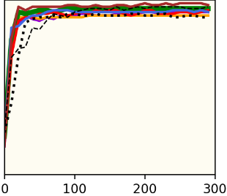
Synchronous, Benign, i.i.d. Environment
MNIST
Regular
Transfer

Slide 2
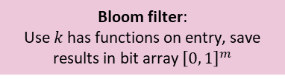







Peer 1
Peer 2
Available classes (= $C1$)
Available classes (= C₂)
$pr1$ = random big prime number
$φ_{P, 1}$ = $pr1 – 1$
$secret1$ = random 32-bit integer that is invertible in modulus $φ_{P, 1}$
$secret_{1}^{−1}$ = $\frac{1}{secret_{1} mod φ_{P, 1}}$
1) Encrypt each entry $i$ in $C_{1}→$ $Enc_{secret_{1}}\left(C_{1, i}\right)=C_{1}^{{secret}_{1}} mod {pr}_{1}$
2) Shuffle $Enc_{secret_{1}}\left(C_{1}\right)$
3) Send to peer 2
7) Decrypt each entry i in $C_{1, i}→$
$$Enc_{secret_{2}}\left(C_{1}\right)= Enc_{secret_{2}}{\left(Enc_{secret_{1}}\left(C_{1}\right)\right)}^{secret_{1}^{−1}}mod pr_{1}$$
9) Calculate $BF(Enc_{secret_{2}}(C_{1, i})$ for each entry $i$ in $C_{1}$
10) Check for matches with $BF\left(Enc_{secret_{2}}\left(C_{2}\right)\right)$
11) Get cardinality of intersections
$pr2$ = random big prime number
$φ_{P, 2}$ = $pr2 – 1$
$secret1$ = random 32-bit integer that is invertible in modulus $φ_{P, 2}$
$secret_{2}^{−1}$ = $\frac{1}{secret_{2} mod φ_{P, 2}}$
4) Shuffle $Enc_{secret_{1}}\left(C_{1}\right)$
5) Encrypt $→$ ${Enc}_{{secret}_{2}}\left(Enc_{secret_{1}}\left(C_{1}\right)\right)=Enc_{secret_{1}}{\left(C_{1}\right)}^{secret_{2}} mod {pr}_{2}$
6) Send to peer 1
8) Send bloom filter: $BF\left(Enc_{secret_{2}}\left(C_{2}\right)\right)$
(BF can be pre-computed)
$$Enc_{secret_{1}}\left(C_{1}\right)$$
$$Enc_{secret_{2}}\left(Enc_{secret_{1}}\left(C_{1}\right)\right)$$
Commutative encryption:
$$Enc_{A}\left(Enc_{B}\left(x\right)\right)=Enc_{B}\left(Enc_{A}\left(x\right)\right)$$
$$BF\left(Enc_{secret_{2}}\left(C_{2}\right)\right)$$
Bloom filter:
Use $k$ has functions on entry, save results in bit array ${\left[0, 1\right]}^{m}$

