Slide 1
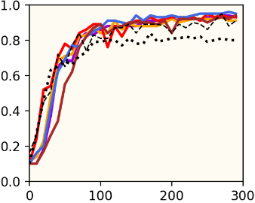
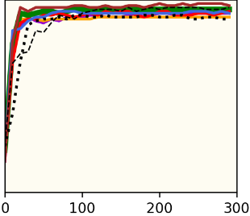
Synchronous, Benign, i.i.d. Environment
MNIST
Regular
Transfer

Slide 2
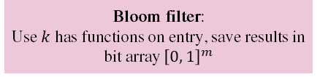







These challenges/design principles are overcome/integrated in Pro-Bristle by using a mix of interrelated technologies.
Peer 1
Peer 2
Available classes (= $C1$)
Available classes (= C₂)
$pr1$ = random big prime number
$φ_{P, 1}$ = $pr1 – 1$
$secret1$ = random 32-bit integer that is invertible in modulus $φ_{P, 1}$
$secret_{1}^{−1}$ = $\frac{1}{secret_{1} mod φ_{P, 1}}$
1) Encrypt each entry $i$ in $C_{1}→$ $Enc_{secret_{1}}\left(C_{1, i}\right)=C_{1}^{{secret}_{1}} mod {pr}_{1}$
2) Shuffle $Enc_{secret_{1}}\left(C_{1}\right)$
3) Send to peer 2
7) Decrypt each entry i in $C_{1, i}→$
$$Enc_{secret_{2}}\left(C_{1}\right)= Enc_{secret_{2}}{\left(Enc_{secret_{1}}\left(C_{1}\right)\right)}^{secret_{1}^{−1}}mod pr_{1}$$
9) Calculate $BF\left(Enc_{secret_{2}}\left(C_{1, i}\right)\right)$ for each entry $i$ in $C_{1}$
10) Check for matches with $BF\left(Enc_{secret_{2}}\left(C_{2}\right)\right)$
11) Get cardinality of intersections
$pr2$ = random big prime number
$φ_{P, 2}$ = $pr2 – 1$
$secret1$ = random 32-bit integer that is invertible in modulus $φ_{P, 2}$
$secret_{2}^{−1}$ = $\frac{1}{secret_{2} mod φ_{P, 2}}$
4) Shuffle $Enc_{secret_{1}}\left(C_{1}\right)$
5) Encrypt $→$ ${Enc}_{{secret}_{2}}\left(Enc_{secret_{1}}\left(C_{1}\right)\right)=Enc_{secret_{1}}{\left(C_{1}\right)}^{secret_{2}} mod {pr}_{2}$
6) Send to peer 1
8) Send bloom filter: $BF\left(Enc_{secret_{2}}\left(C_{2}\right)\right)$
(BF can be pre-computed)
$$Enc_{secret_{1}}\left(C_{1}\right)$$
$$Enc_{secret_{2}}\left(Enc_{secret_{1}}\left(C_{1}\right)\right)$$
Commutative encryption:
$$Enc_{A}\left(Enc_{B}\left(x\right)\right)=Enc_{B}\left(Enc_{A}\left(x\right)\right)$$
$$BF\left(Enc_{secret_{2}}\left(C_{2}\right)\right)$$
Bloom filter:
Use $k$ has functions on entry, save results in bit array ${\left[0, 1\right]}^{m}$

Slide 3
Highest IP-address
Lowest IP-address
Our node
1 + 2 + 4 + 8
1
1 + 2 + 4
1 + 2
We use two separate ways to test the performance of Pro-Bristle, namely in a local simulation and in a truly decentralized environment. In the former case, we run a single program that iteratively trains and combines up to 250 models to simulate a small-scale federated setting. This approach is not only relatively fast, but also makes it easy to accurately control a variety of settings, such as little computation power, low bandwidth, nodes that randomly join/exit, etc. We also emulate 16 completely independent smartphones to test if the results are comparable in a “real” setting. Unfortunately, this limit of 16 emulators is hardcoded in the Android emulator executable which makes it unpractical to run more emulators simultaneously. However, 16 emulators are enough to accurately measure the performance of different GARs and, if the programs works well on 16 emulators, gives us confidence that the code works as intended and scales to a higher number of nodes given the gossiping nature of the system and the cheap distance-based filter.

Slide 4
These challenges/design principles are overcome/integrated in Pro-Bristle by using a mix of interrelated technologies.
Section
Challenges
Solutions
3
Decentralization
3
Reliability
Decentralized P2P gossip learning
3
Massively distributed
Distance-based filter
4
Byzantine-resilience
Sigmoid weighted averaging
5
Async: received a stale model
Per class performance-based filter
6
Non-i.i.d. data
CWR*
PSI-CA (Private-Set Intersection Cardinality)
7
Communication-efficient
Deep transfer learning
Model compression
5
Async: received too few models
Model buffer
5
Async: received a too good model
Exploration vs exploitation strategy

Slide 5
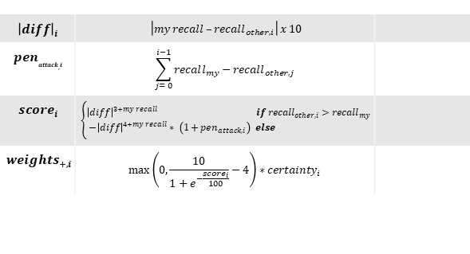
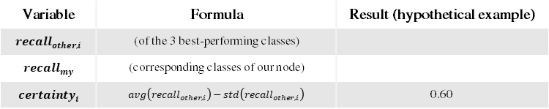
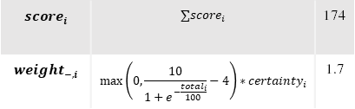
These challenges/design principles are overcome/integrated in Pro-Bristle by using a mix of interrelated technologies.
Variable | Formula | Result (hypothetical example)
$$recall_{other, i}$$ | (of the 3 best-performing classes)
$$recall_{my}$$ | (corresponding classes of our node)
$$certainty_{i}$$ | $$avg\left(recall_{other, i}\right)−std\left(recall_{other, i}\right)$$ | 0.60
1
0.7
0.6
0.7
1
0
Weights for familiar classes
Weight for foreign classes
$${\left|diff\right|}_{i}$$ | $$\left|my recall –recall_{other, i}\right| x 10$$
$$pen_{attack, i}$$ | $$\sum_{j= 0}^{i−1}{recall_{my}−recall_{other, j}}$$
$$score_{i}$$ | $$\left\{\begin{aligned}{\left|diff\right|}^{3+my recall} if recall_{other,i}>recall_{my} \\ −{\left|diff\right|}^{4+my recall}∗ \left(1+pen_{attack,i}\right) else \end{aligned}\right.$$
$$weigh{ts}_{+,i}$$ | $$\max\left(0,\frac{10}{1+e^{−\frac{score_{i}}{100}}}−4\right)∗certainty_{i}$$
2
2
3
0
0
0
58
-100
216
$$score_{i}$$ | $$∑score_{i}$$ | 174
$$weight_{−,i}$$ | $$\max\left(0,\frac{10}{1+e^{−\frac{total_{i}}{100}}}−4\right)∗certainty_{i}$$ | 1.7
1.44
0
2.96

Slide 6

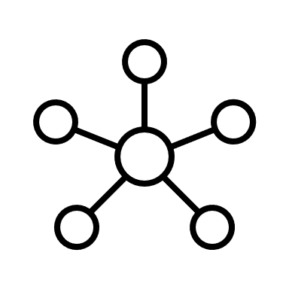



Peer 0
Peer 1
Peer 2
Available classes in dataset: 1, 2, 3, 4
Cw
Old cw
1
PSI-CA
Peer 0
Peer 1
Peer 2
Copy available columns into tw
Peer 0
-
3
0
Tw
0
0
0
0
0
0
Peer 1
3
-
1
4-5
Train network
Peer 2
0
1
-
Tw
?
?
?
?
?
?
PSI-CA overlap with peer 0 is 3 => send model to peer 0
PSI-CA overlap with peer 0 is 0 => do not send model to peer 0
Copy updated columns into cw
Cw
?
?
?
?
?
?
?
?
?
?
?
History of older models
6
7
?
?
?
?
?
?
?
?
?
?
?
?
?
?
?
?
?
?
?
?
?
?
?
?
?
?
?
?
?
9-12
Distance-based filter
13-14
Accept anyway with probability $α$
16-20
Test recall for every class and select the 3 best performing classes
Peer 0
?
0.9
0.7
0.8
0.5
?
?
?
?
?
Peer 1
?
0.3
0.8
0.4
0.9
?
?
?
?
?
21-35
Integrate selected class parameters
0.75
0.8
0.82
21-36
Integrate foreign class parameters
New cw
?*
?*
?*
?*
?*
?*
?*
0.9
0.75
0.8
0.82
?*
?*
?*
?*
?*

Slide 7
These challenges/design principles are overcome/integrated in Pro-Bristle by using a mix of interrelated technologies.
ML node
Parameter server
ML node
ML node
ML node
ML node
ML node
ML node
ML node
(a) Single, centralized parameter server
(b) Decentralized peer-to-peer

Slide 8
Rehearsal
Generative Replay
Pure rehearsal
GR
Exstream
MeRGAN
ICARL
FearNet
EWC
GEM
GDM
SI
CWR
LWF
PNN
AR1
Regularization
Architectural

