Slide 1
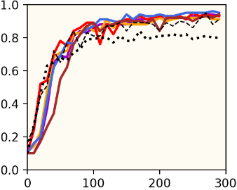
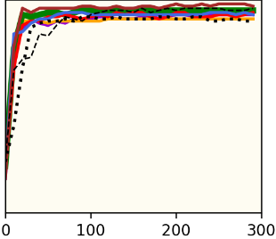
Synchronous, Benign, i.i.d. Environment
MNIST
Regular
Transfer

