Slide 1
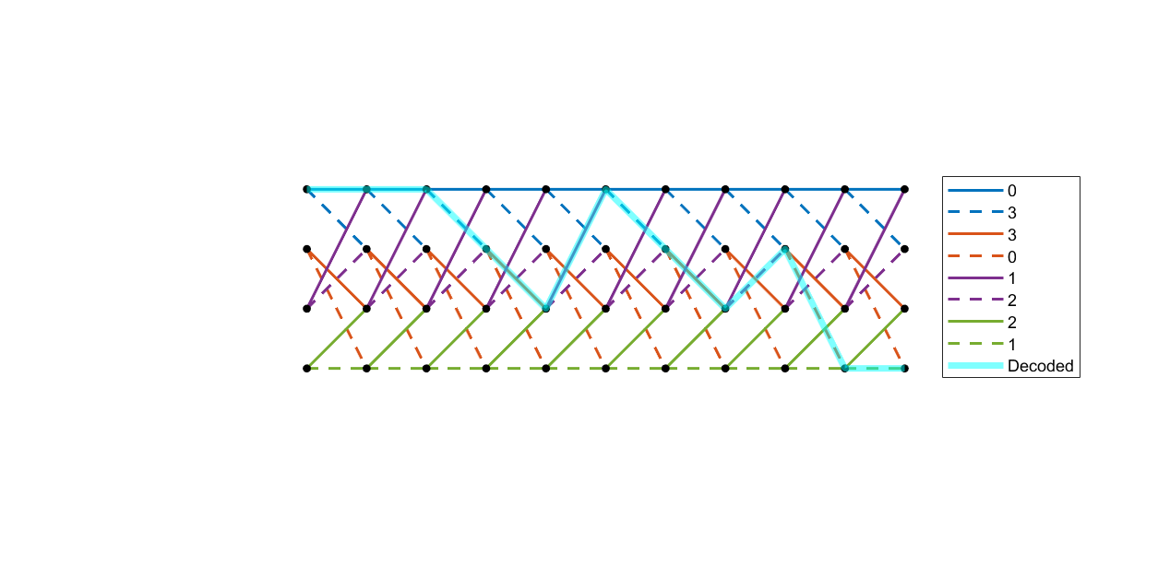

x = 0 0 3 3 1 3 3 2 0 1
u = 0 0 1 0 0 1 0 1 1 1

Slide 2
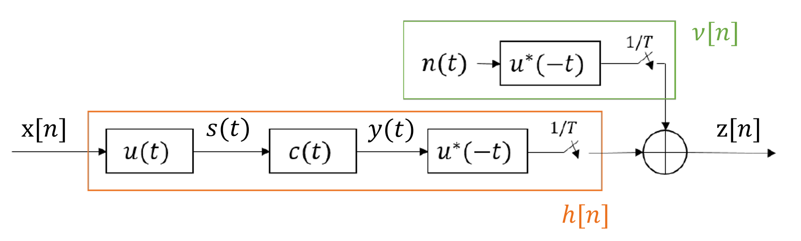


$$s[n]$$
$$r[n]$$
OFDM
MOD
OFDM
DEMOD

