Slide 1
Online payment fraud detection
A Data Driven Approach
GRAD 505
Jagruti M.
March 05, 2025

Slide 2
Introduction

Slide 3

Digital transactions are growing rapidly, increasing fraud risks.
Traditional rule-based fraud detection is insufficient.
OBJECTIVE: To analyze fraud using statistical and machine learning techniques.
KEY RESEARCH FOCUS:
What factors influence fraudulent transactions?
Does transactions amount impact fraud detection?
How do flagged fraudulent transactions behave?

Slide 4
RESEARCH QUESTIONS & HYPOTHESES

Slide 5
Research question 1: What factors influence the likelihood of fraud?
H0: Fraud likelihood is independent of transaction attributes.
H1: Fraud is significantly influenced by transaction attributes.
Research Question 2: Does transaction amount impact fraud detection?
H0: No difference in amounts between flagged and non-flagged transactions.
H1: Flagged transactions have significantly different amounts.
Research Question 3: How do flagged fraudulent transactions differ?
H0: No difference between flagged fraudulent and non-fraudulent transactions.
H1: Flagged fraudulent transactions differ significantly.

Slide 6
METHODOlogy

Slide 7
Dataset: Public dataset from Kaggle
Statistical Technique Used:
Logistic Regression: To identify key fraud factors.
Mann-Whitney U Test: To compare transaction amounts.
Descriptive Analysis: Since all flagged transactions were fraudulent.

Slide 8
Logistic Regression

Slide 9
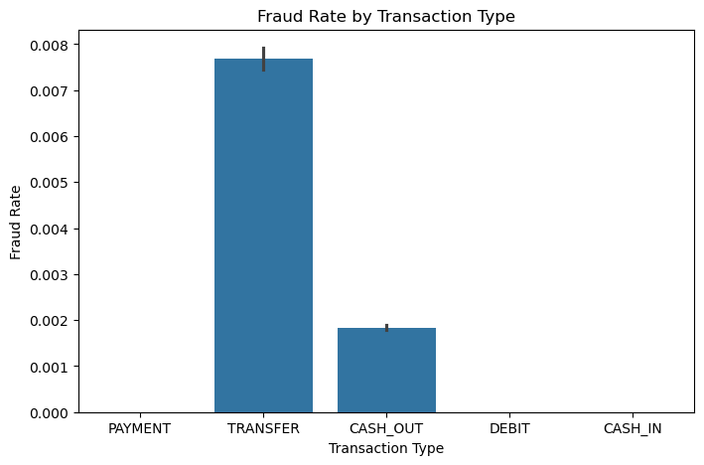
Variables considered: Transaction Amount, Old Balance of Origin, New Balance Destination.
The transaction amount has the highest positive impact.
New Balance Destinations has a strong negative correlation.
Old Balance Origin has a smaller positive effect.
TRANSFER and CASH_OUT have the highest fraud rate.

Slide 10
Mann-whitney u test

Slide 11
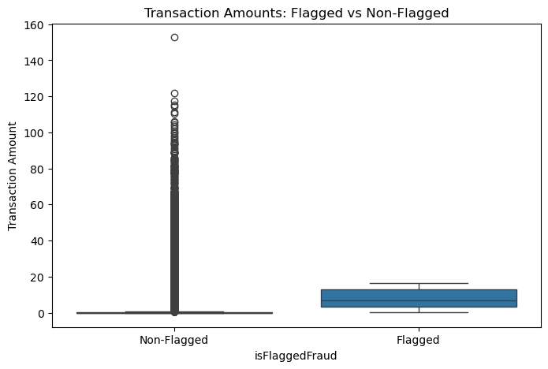
Flagged Transactions: Mean = $4.86M; Median = $4.23M.
Non-flagged transactions: Mean = $179K; Median = $74K.
Statistical Significance: p-value = 2.21e-11 (highly significant)
Conclusion: Higher transaction amounts are more likely to be flagged.

Slide 12
Flagged Fraudulent analysis

Slide 13
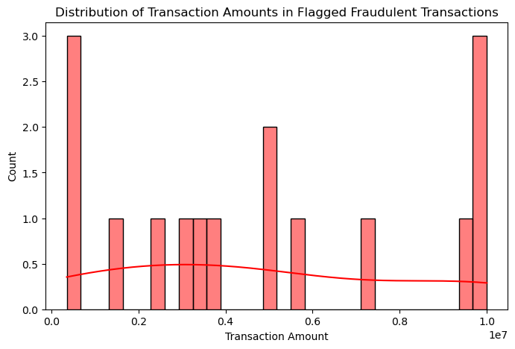
Mean transaction amount: $4.86M
Median: $4.23M
Destination Account Balance (Post-Transaction): Always $0.
Findings:
Fraudulent transactions typically involve large amounts.
Destination accounts are often drained to zero.

Slide 14
Summary

Slide 15
Fraud is highly correlated with transaction amount.
TRANSFER and CASH_OUT transactions have the highest fraud.
Flagging is biased toward high-value transactions.
All flagged transactions were fraudulent, making statistical tests ineffective.
Machine learning could improve fraud detection accuracy.

Slide 16
Implications for fraud detection

Slide 17
Current fraud detection systems rely heavily on transaction amount.
Smaller fraudulent transactions may go undetected.
Machine-learning based fraud detection should incorporate:
Transaction frequency
Time of transaction
Destination account behavior.

Slide 18
Limitations & future work

Slide 19
Limitations:
Data does not include flagged non-fraudulent transactions
Model may not generalize to real-world scenarios.
Future Work:
Improve fraud detection models by adding more transaction features.
Develop real-time fraud detection systems using machine learning.
Test on a larger dataset with more diverse fraud cases.

Slide 20
Conclusion

Slide 21
Fraud detection remains a major challenge in financial security.
This study highlights the importance of transaction amount and balance changes.
Recommendations:
Expand fraud detection beyond just transaction amount.
Use AI-driven fraud detection models.
Implement real-time fraud monitoring.

Slide 22
REFERENCES
Kaggle dataset: https://www.kaggle.com/datasets/jainilcoder/online-payment-fraud-detection
Github Repository: https://github.com/jveronicaback/EDAOnlineFraudDetection

Slide 23
THANK you

