Slide 2


numpy
Prof. dr. ir. Jan Verwaeren

Slide 3
Lecture overview

Slide 4

contents of this lecture
Numpy arrays
  Basics of Numpy arrays
  Computation on numpy arrays: universal functions
  Aggregations
  Array broadcasting
  Comparisons, masks and boolean logic
  Fancy indexing and sorting

Slide 5
Numpy arrays

Slide 6
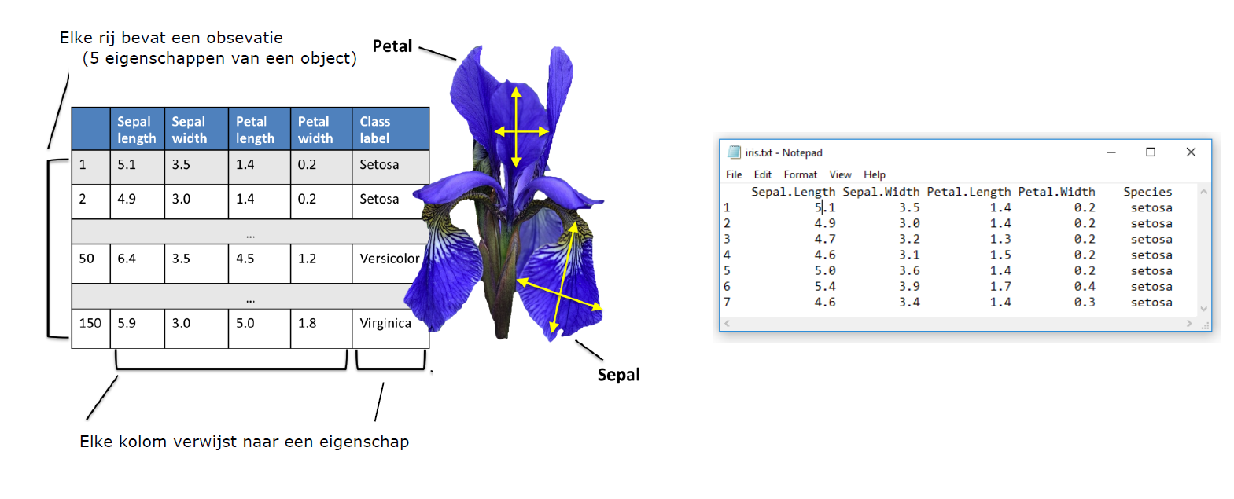
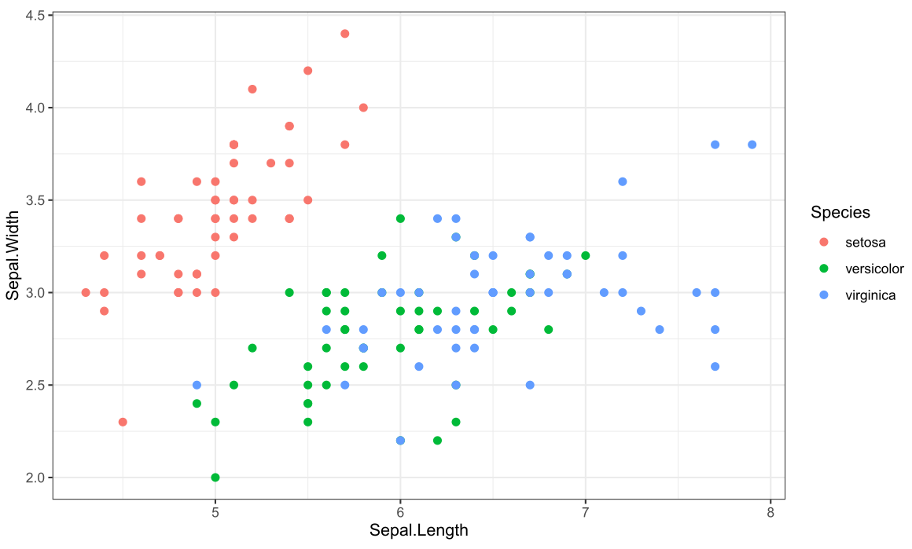
Why numpy arrays?
Can/will be stored as numpy arrays

Slide 7
The basics of numpy arrays

Slide 8
Basics of Numpy arrays
A
1 | 2 | 3
1 | 2 | 3
4 | 5 | 6
B
1D numpy array
2D numpy array
Arrays of integers
>>> import numpy as np
>>> A = np.array([1, 2, 3])
>>> B = np.array([[1, 2, 3],
[4, 5, 6]])
>>> A.dtype
dtype('int32')
>>> A # display in Python
array([1, 2, 3])
>>> B
array([[1, 2, 3],
[4, 5, 6]])

Slide 9
Basics of Numpy arrays
A
‘I’ | ‘am’ | ‘john’
‘a’ | ‘b’ | ‘c’
‘d’ | ‘e’ | ‘f’
B
1D numpy array
2D numpy array
Arrays of strings
>>> import numpy as np
>>> A = np.array(['I', 'am', 'John'])
>>> B = np.array([['a', 'b', 'c'],
['d', 'e', 'f']])
>>> A.dtype
dtype('<U4')

Slide 10
Basics of Numpy arrays
A
1,0 | 2,0 | 3,0
1,0 | 2,0 | 3,0
4,0 | 5,0 | 6,0
B
1D numpy array
2D numpy array
Arrays of floats
>>> import numpy as np
>>> A = np.array([1.0, 2.0, 3.0])
>>> B = np.array([[1.0, 2.0, 3.0],
[4.0, 5.0, 6.0]])
>>> A.dtype
dtype('float64')

Slide 11
Basics of Numpy arrays
A
True | False | False
True | False | False
True | False | True
B
1D numpy array
2D numpy array
Arrays of booleans
>>> import numpy as np
>>> A = np.array([True, False, False])
>>> B = np.array([[True, False, False],
[True, False, True]])
>>> A.dtype
dtype(‘bool')

Slide 12
Basics of Numpy arrays
Creating Numpy arrays
From Python lists
From scratch
Read from file

Slide 13
Basics of Numpy arrays
Creating Numpy arrays
From Python lists
From scratch
Read from file
See previous slides

Slide 14
Basics of Numpy arrays
Creating Numpy arrays
0,0 | 0,0 | 0,0 | 0,0 | 0,0
0,0 | 0,0 | 0,0 | 0,0 | 0,0
0,0 | 0,0 | 0,0 | 0,0 | 0,0
From Python lists
From scratch
Read from file
A
0,23 | 0,36 | 0,78
0,33 | 0,11 | 0,65
0,98 | 0,45 | 0,48
D
B
0 | 2 | 4 | 6 | 8
C
0 | 0,25 | 0,5 | 0,75 | 1
>>> A = np.zeros((3, 5), dtype = 'float’) # 3 rows, 5 columns of zeros
>>> B = np.arange(0, 10, 2) # from 0 to (just not) 10 in steps of 2
>>> C = np.linspace(0, 1, 5) # 5 equally spaced between 0 and 1
>>> D = np.random.random((3, 3)) # 3 by 3 matrix of random numbers in [0, 1]

Slide 15
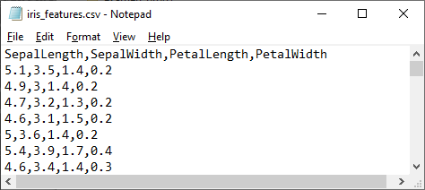
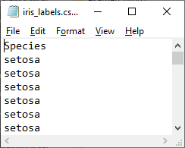
Basics of Numpy arrays
Creating Numpy arrays
5,1 | 3,5 | 1,4 | 0,2
4,9 | 3,0 | 1,4 | 0,2
… | … | … | …
… | … | … | …
… | … | … | …
setosa
setosa
…
…
virginica
From Python lists
From scratch
Read from file
X
Y
>>> import os
>>> os.chdir("c:/temp/files")
>>> X = np.loadtxt("iris_features.csv",
delimiter = ",",
skiprows = 1)
>>> Y = np.loadtxt("iris_labels.csv", delimiter = ",",
skiprows = 1,
dtype = str) # mandatory

Slide 16
Basics of Numpy arrays
Creating Numpy arrays
5,1 | 3,5 | 1,4 | 0,2
4,9 | 3,0 | 1,4 | 0,2
… | … | … | …
… | … | … | …
… | … | … | …
setosa
setosa
…
…
virginica
From Python lists
From scratch
Read from file
X
Y
>>> X
array([[5.1, 3.5, 1.4, 0.2],
[4.9, 3. , 1.4, 0.2],
[4.7, 3.2, 1.3, 0.2],
[4.6, 3.1, 1.5, 0.2],
[5. , 3.6, 1.4, 0.2],
[5.4, 3.9, 1.7, 0.4],
[4.6, 3.4, 1.4, 0.3], …
>>> import os
>>> os.chdir("c:/temp/files")
>>> X = np.loadtxt("iris_features.csv",
delimiter = ",",
skiprows = 1)
>>> Y = np.loadtxt("iris_labels.csv", delimiter = ",",
skiprows = 1,
dtype = str)
>>> Y
array(['setosa', 'setosa', 'setosa', 'setosa', 'setosa', 'setosa', 'setosa', 'setosa', 'setosa’, … ]

Slide 17
Basics of Numpy arrays
Question: Load the files iris_features.csv and iris_labels.csv into memory as two numpy arrays (X for features and Y for labels) using Google Colab.
Question: What is the data type of X and Y ?

Slide 18
Basics of Numpy arrays
Data manipulation in Python ~ Numpy array manipulation
Attributes of arrays: determining the size, shape, memory consumption, and data types of arrays
Indexing of arrays: getting and setting the value of individual array elements
Slicing of arrays: getting and setting smaller subarrays within a larger array
[Reshaping of arrays: changing the shape of a given array]
[Joining and splitting of arrays: combining multiple arrays into one, and splitting one array into many]

Slide 19
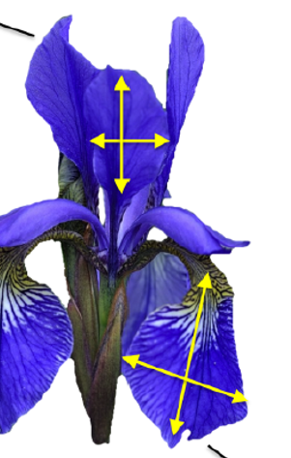
Attributes of arrays
1D array (Y)
2D array (X)
3D array
Axis 1
(direction along the columns)
5,1 | 3,5 | 1,4 | 0,2
4,9 | 3,0 | 1,4 | 0,2
… | … | … | …
… | … | … | …
… | … | … | …
Axis 2
4,1 | 2,6 | 1,4 | 0,2
4,9 | 3,0 | 1,4 | 0,2
… | … | … | …
… | … | … | …
… | … | … | …
6,5 | 1,5 | 3,5 | 2,4
4,9 | 3,0 | 1,4 | 0,2
… | … | … | …
… | … | … | …
… | … | … | …
setosa | setosa | … | virginica
Axis 0
(direction along the rows)
5,1 | 3,5 | 1,4 | 0,2
4,9 | 3,0 | 1,4 | 0,2
… | … | … | …
… | … | … | …
… | … | … | …
>>> Y.ndim # get nr of dimensions
1
>>> X.ndim
2
>>> Y.shape # get shape -> result is allways tuple
(150,)
>>> X.shape
(150, 4)
>>> Y.dtype # get dtype
dtype('<U10')
>>> X.dtype
dtype('float64')

Slide 20
Array indexing
1D array (Y)
2D array (X)
5,1 | 3,5 | 1,4 | 0,2
4,9 | 3,0 | 1,4 | 0,2
… | … | … | …
… | … | … | …
… | … | … | …
setosa | setosa | … | virginica
Y[1] -> numpy.str_ ~ str
X[1, 2] -> numpy.float64 ~ float
>>> Y[1] # square brackets with positive integer index
‘setosa’
>>> X[1, 2] # square brackets with positive integer indices
1.4
>>> Y[-1] # negative index -> index backward from the end of axis
‘virginica’
>>> X[1, -1] # negative index -> index backward from the end of axis
0.2

Slide 21
Array indexing: changing values
1D array (Y)
2D array (X)
5,1 | 3,5 | 1,4 | 0,2
4,9 | 3,0 | 1,4 | 0,2
… | … | … | …
… | … | … | …
… | … | … | …
some_string
some_float
setosa | setosa | … | virginica
Y[1] = some_string
X[1, 2] = some_float
>>> Y[1] = 'hello'
>>> Y
array(['setosa', 'hello', 'setosa’,…
>>> X[1, 2] = 9.9
>>> X
array([[5.1, 3.5, 1.4, 0.2],
[4.9, 3. , 9.9, 0.2],…
>>> X[1, 2] = 'hello'
---------------------------------------------------------------------------
ValueError Traceback (most recent call last)
Cell In [29], line 4
1 Y[1] = "hello"
3 X[1, 2] = 9.9
----> 4 X[1, 2] = 'hallo’
ValueError: could not convert string to float: 'hallo'

Slide 22
Array indexing: Array slicing
1D array (Y)
2D array (X)
5,1 | 3,5 | 1,4 | 0,2
4,9 | 3,0 | 1,4 | 0,2
… | … | … | …
… | … | … | …
… | … | … | …
setosa | setosa | … | virginica
Y[0:2] -> 1D array VIEW
Change view == change original !!
X[0:2, 1:4] -> 2D array VIEW
>>> Y[0:2]
array(['setosa', 'setosa'], dtype = '<U10')
>>> X[0:2, 1:4]
array([[3.5, 1.4, 0.2],
[3. , 1.4, 0.2]])

Slide 23
Array indexing: Array slicing
1D array (Y)
Y[2:] -> 1D array VIEW
setosa | setosa | … | virginica
Y[:2] -> 1D array VIEW
>>> Y[:2]
array(['setosa', 'setosa'], dtype = '<U10')
>>> Y[2:]
array(['setosa', 'setosa', 'setosa', 'setosa', 'setosa’, …], dtype = '<U10’)

Slide 24
Array indexing: Array slicing
2D array (X)
5,1 | 3,5 | 1,4 | 0,2
4,9 | 3,0 | 1,4 | 0,2
… | … | … | …
… | … | … | …
… | … | … | …
X[1, :] -> 1D array VIEW of 2nd row
X[:, 2] -> 1D array VIEW of 3rd column
>>> X[1, :] # extract one row
array([4.9, 3. , 1.4, 0.2])
>>> X[:, 2] # extract one column
array([1.4, 1.4, 1.3, 1.5, 1.4, 1.7, 1.4, 1.5, 1.4, 1.5, 1.5, 1.6, 1.4, 1.1, 1.2, 1.5, 1.3, 1.4, 1.7, 1.5, …

Slide 25
Array indexing: Array slicing
2D array (X)
Start
Stop
Step
5,1 | 3,5 | 1,4 | 0,2
4,9 | 3,0 | 1,4 | 0,2
… | … | … | …
… | … | … | …
… | … | … | …
X[0:150:2, 0:4:2]
-> 2D array VIEW with
odd row/col combinations
>>> X[0:150:2, 0:4:2]
array([[5.1, 1.4],
[4.7, 1.3],
[5. , 1.4],
[4.6, 1.4],
[4.4, 1.4],
[5.4, 1.5],
…

Slide 26
Array indexing: changing multiple values
5,1 | 3,5 | 1,4 | 0,2
4,9 | 3,0 | 1,4 | 0,2
… | … | … | …
… | … | … | …
… | … | … | …
X[0, 1:3] = 10
5,1 | 10 | 10 | 0,2
4,9 | 1 | 2 | 3
… | … | … | …
… | … | … | …
… | … | … | …
X[1, 1:4] = [1, 2, 3]
>>> X[0, 1:3] = 10 # same value
>>> X[1, 1:4] = [1, 2, 3] # different value
>>> X
array([[ 5.1, 10. , 10. , 0.2],
[ 4.9, 1. , 2. , 3. ],
[ 4.7, 3.2, 1.3, 0.2],
…

Slide 27
Array indexing: copying arrays
5,1 | 3,5 | 1,4 | 0,2
4,9 | 3,0 | 1,4 | 0,2
… | … | … | …
… | … | … | …
… | … | … | …
5,1 | 3,5 | 1,4 | 0,2
4,9 | 3,0 | 1,4 | 0,2
… | … | … | …
… | … | … | …
… | … | … | …
A = X[0:2, 0:3]
B = X[0:2, 0:3].copy()
Change A == Change X
Change B ≠ Change X

Slide 28

Basics of Numpy arrays
Question: Five entries in the iris dataset have a value of 0.1. Find these entries and update the dataset by replacing those values with 0.2.
Question: The setosa species has the unique property that the length of its sepals (1st column) are more than two times the length of its petals (3rd column). For the remaining species the opposite holds.
Write a program that does the following check:
Sepal_length > 2 * petal_length $⇔$ species is ‘setosa’

Slide 29
Basics of numpy: hidden topics
The following topics are ‘hidden’ slides
  Array reshaping np.reshape
  Extending arrays np.concatenate
1 | 2 | 3 | 4
5 | 6 | 7 | 8
1 | 2 | 3 | 4
5 | 6 | 7 | 8
9 | 10 | 11 | 12
5,1 | 3,5 | 1,4 | 0,2
4,9 | 3,0 | 1,4 | 0,2
… | … | … | …
… | … | … | …
… | … | … | …
1 | 2 | 3 | 4 | 5 | 6
7 | 8 | 9 | 10 | 11 | 12
Reshaping
extending

Slide 30
Array indexing: reshaping arrays
A = np.arange(1, 13) -> 1D array
1 | 2 | 3 | 4 | 5 | 6 | 7 | 8 | 9 | 10 | 11 | 12
A.reshape((6, 2))
1 | 2
3 | 4
5 | 6
7 | 8
9 | 10
11 | 12
A.reshape((3, 4))
A.reshape((2, 6))
1 | 2 | 3 | 4
5 | 6 | 7 | 8
9 | 10 | 11 | 12
1 | 2 | 3 | 4 | 5 | 6
7 | 8 | 9 | 10 | 11 | 12
A.reshape(1, 12)-> 2D array
1 | 2 | 3 | 4 | 5 | 6 | 7 | 8 | 9 | 10 | 11 | 12

Slide 31
Array indexing: reshaping arrays
A = np.arange(1, 13) -> 1D array
1 | 2 | 3 | 4 | 5 | 6 | 7 | 8 | 9 | 10 | 11 | 12
A.reshape((6, -1))
1 | 2
3 | 4
5 | 6
7 | 8
9 | 10
11 | 12
A.reshape((3, -1))
A.reshape((2, -1))
1 | 2 | 3 | 4
5 | 6 | 7 | 8
9 | 10 | 11 | 12
1 | 2 | 3 | 4 | 5 | 6
7 | 8 | 9 | 10 | 11 | 12
A.reshape(1, -1)-> 2D array
1 | 2 | 3 | 4 | 5 | 6 | 7 | 8 | 9 | 10 | 11 | 12

Slide 32
Array indexing: reshaping arrays
A = np.arange(1, 13) -> 1D array
1 | 2 | 3 | 4 | 5 | 6 | 7 | 8 | 9 | 10 | 11 | 12
A.reshape((6, 2), order = ‘F’)
A.reshape((3, 4), order = ‘F’)
A.reshape((2, 6), order = ‘F’)
1 | 7
2 | 8
3 | 9
4 | 10
5 | 11
6 | 12
1 | 4 | 7 | 10
2 | 5 | 8 | 11
3 | 6 | 9 | 12
1 | 3 | 5 | 7 | 9 | 11
2 | 4 | 6 | 8 | 10 | 12
A.reshape(1, 12, order = ‘F’)-> 2D array
1 | 2 | 3 | 4 | 5 | 6 | 7 | 8 | 9 | 10 | 11 | 12

Slide 33
Array indexing: concatenating arrays
1D array (Y)
2D array (X)
1 | 2 | 3 | 4
5 | 6 | 7 | 8
5,1 | 3,5 | 1,4 | 0,2
4,9 | 3,0 | 1,4 | 0,2
… | … | … | …
… | … | … | …
… | … | … | …
new | new
setosa | setosa | … | virginica
>>> X_extra = np.array([[1, 2, 3, 4], [5, 6, 7, 8]])
>>> X_new = np.concatenate([X_extra, X])
>>> X_new
array([[1. , 2. , 3. , 4. ],
[5. , 6. , 7. , 8. ],
[5.1, 3.5, 1.4, 0.2],
[4.9, 3. , 1.4, 0.2], …
>>> Y_extra = np.array(['new', 'new’])
>>> Y_new = np.concatenate([Y_extra, Y])

Slide 34
Array indexing: concatenating arrays
2D array (X)
5,1 | 3,5 | 1,4 | 0,2 | 5,1
4,9 | 3,0 | 1,4 | 0,2 | 4,9
… | … | … | … | …
… | … | … | … | …
… | … | … | … | …
Copy of 1st column added to X
>>> np.concatenate((X, X[:,0].reshape(-1, 1)), axis = 1)
array([[5.1, 3.5, 1.4, 0.2, 5.1],
[4.9, 3. , 1.4, 0.2, 4.9],
[4.7, 3.2, 1.3, 0.2, 4.7],
[4.6, 3.1, 1.5, 0.2, 4.6],
[5. , 3.6, 1.4, 0.2, 5. ],
…

Slide 35
Basics of Numpy arrays
Question: We have a hypothetical flower with sepal lengths and widths (1.0, 2.0, 3.0, 4.0).
Add this new line:
  At the end of the iris array X
  After the third versicolor flower you encounter in X (when starting to count from the first row downwards).

Slide 36
ComputationS on numpy arrays

Slide 37
Numpy universal functions
A universal function (or associated operator) (or ufunc for short) is a function that operates on ndarrays in an element-by-element fashion, supporting array broadcasting, type casting, and several other standard features. That is, a ufunc is a “vectorized” wrapper for a function that takes a fixed number of specific inputs and produces a fixed number of specific outputs. – Numpy docs
5,1 | 3,5 | 1,4 | 0,2
4,9 | 3,0 | 1,4 | 0,2
… | … | … | …
… | … | … | …
… | … | … | …
Square 2nd column: for-loop
Square 2nd column: vectorized/ufunc
>>> A = np.zeros((150, 1))
>>> for i in range(150):
A[i] = X[i,1]**2
>>> B = X[:,1]**2
>>> B = np.power(X[:,1], 2)
12,25
9,0
…
…
…

Slide 38
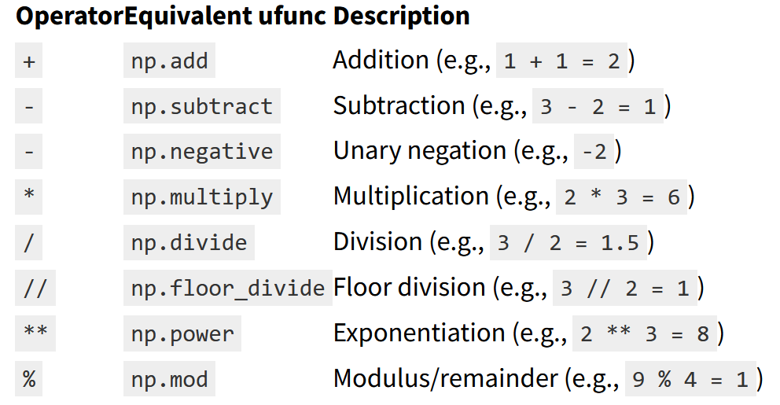
Exploring numpy ufuncs
5,1 | 3,5 | 1,4 | 0,2
4,9 | 3,0 | 1,4 | 0,2
… | … | … | …
… | … | … | …
… | … | … | …
Classes of ufuncs
  Array arithmetic: adding, multiplying … elementwise
  Absolute value function, Trigonometric functions, Exponents and logarithms
8,5
8,0
…
…
…
X[:,1] + 5
4,9
4,4
…
…
…
X[:,1] + X[:,2]
>>> X[:,1] + 5 # short for np.add(X[:,1], 5)
array([8.5, 8. , 8.2, 8.1, 8.6, …
>>> X[:,1] + X[:,2] # short for np.add(X[:,1], X[:,2])
array([4.9, 4.4, 4.5, 4.6, 5. , …
>>> X[:,1] – 2 # subtract
>>> X[:,1] * 2 # multiply
>>> X[:,1] / 2 # divide
>>> X[:,1] ** 2 # square

Slide 39
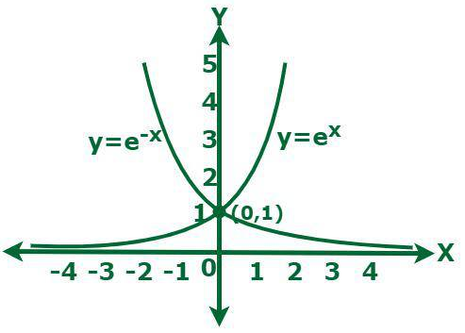
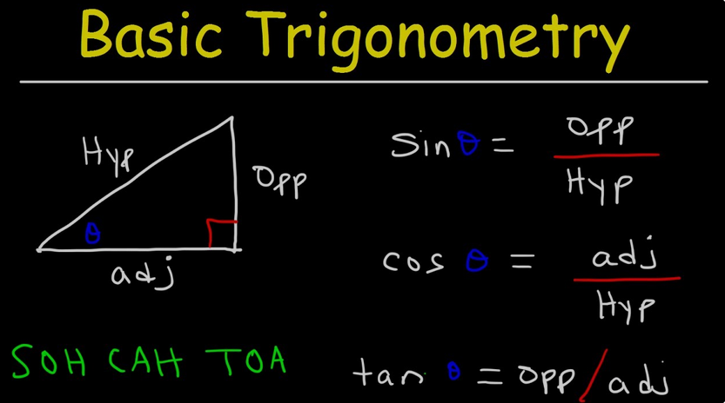
Exploring numpy ufuncs
5,1 | 3,5 | 1,4 | 0,2
4,9 | 3,0 | 1,4 | 0,2
… | … | … | …
… | … | … | …
… | … | … | …
Classes of ufuncs
  Array arithmetic: adding, multiplying … elementwise
  Absolute value function, Trigonometric functions, Exponents and logarithms
abs, sin, cos, exp, log, arcsin, …
>>> a = np.array([-1, 0.5, 1.25, 2.0])
>>> np.abs(a) # absolute value of each element
array([1. , 0.5 , 1.25, 2. ])
>>> np.sin(a) # sine of each element (angle assumed in radians)
>>> np.cos(a) # cosine of each element (angle assumed in radians)
>>> np.exp(a) # exponential function: e^a
>>> np.log(a) # natural logarithm (ln(a))
array([ nan, -0.69314718, 0.22314355, 0.69314718])

Slide 40

Exploring numpy ufuncs
Question: An (ellopsoidal) approximation of the leaf area of a flower can be computed using the following formula:
leaf area = $\frac{π}{4} H W$
In this formula, H is the height of a leaf and W its width.
Use this formula to compute the leaf areas of the sepals and the petals and add them as two new columns to X.

Slide 41
Aggregations & broadcasting

Slide 42
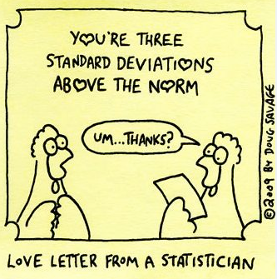
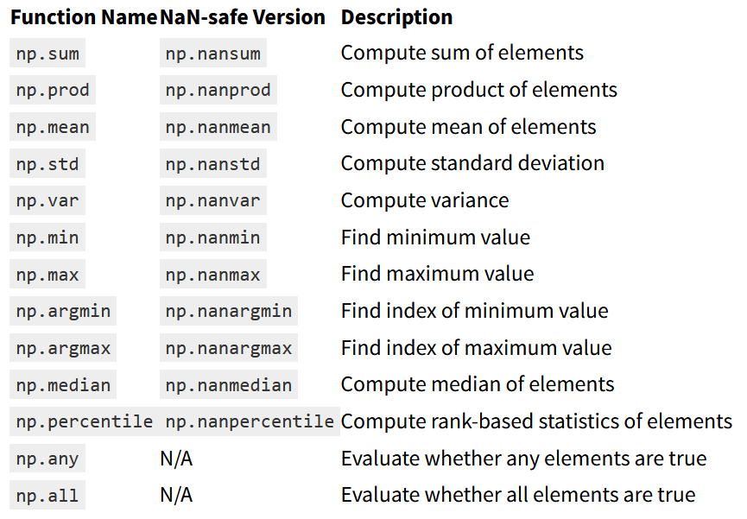
Aggregations: min, max, etc.
Aggregation:
  Summarizing values in array
  Most summary statistics: Sum, product, median, min, max, quantiles etc.
  Multidimensional aggregates

Slide 43
Aggregations: min, max, etc.
Aggregation:
  Summarizing values in array
  Most summary statistics: Sum, product, median, min, max, quantiles etc.
  Multidimensional aggregates
X.mean() -> mean of all values in X
2,55
2,37
…
…
…
5,1 | 3,5 | 1,4 | 0,2
4,9 | 3,0 | 1,4 | 0,2
… | … | … | …
… | … | … | …
… | … | … | …
X.mean(axis = 1)
-> row-wise mean
(aggregate 1-st axis)
5,84 | 3,06 | 3,75 | 1,20
X.mean(axis = 0) -> column-wise mean
(aggregate 0-th axis)
>>> X.mean(axis = 0)
array([5.84333333, 3.05733333, 3.758 , 1.19933333]) # 1D array with shape -> (4,)
>>> X.mean(axis = 1)
array([2.55 , 2.375, 2.35 , 2.35 , 2.55 , … # 1D array with shape -> (150,)

Slide 44
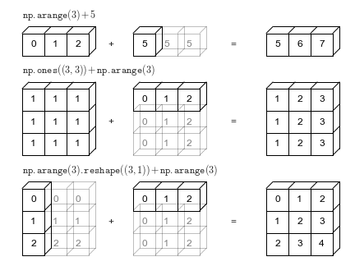

broadcasting
Broadcasting is simply a set of rules for applying binary ufuncs (e.g., addition, subtraction, multiplication, etc.)
on arrays of different sizes.
Combined with aggregation -> interesting for
data array transformations (e.g. standardizing per column)
5,1 | 3,5 | 1,4 | 0,2
4,9 | 3,0 | 1,4 | 0,2
… | … | … | …
… | … | … | …
… | … | … | …
$$\frac{X −\overline{X}}{s}$$
>>> X_standardized = (X - X.mean(axis = 0)) / X.std(axis=0)
# 2D array with shape -> (150,4)
[[-9.00681170e-01 1.01900435e+00 -1.34022653e+00 -1.31544430e+00]
[-1.14301691e+00 -1.31979479e-01 -1.34022653e+00 -1.31544430e+00]
[-1.38535265e+00 3.28414053e-01 -1.39706395e+00 -1.31544430e+00]
…

Slide 45
Exploring numpy ufuncs
Question: Remove the row that corresponds to the leaf with the largest sepal length from the dataset. (optional: np.delete)
Question: Row-centering is a transformation where the mean of a row is subtracted from each value of that row.
Use row-centering to tranform X into a new array X_transformed.

Slide 46
Comparisons, masks and boolean logic

Slide 47
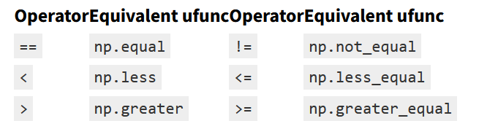
Comparisons, masks and boolean logic
Comparison operators: <, >, ==, !=, <=, >=
Example: count number of flowers with short sepals
5,1 | 3,5 | 1,4 | 0,2
4,9 | 3,0 | 1,4 | 0,2
… | … | … | …
… | … | … | …
… | … | … | …
False
True
…
…
…
A = X[:,0] < 5
A.sum()
22
>>> A = X[:,0] < 5
>>> A
array([False, True, True, True, False, False, ...
>>> np.sum(A)
22

Slide 48
Comparisons, masks and boolean logic
Comparison operators: <, >, ==, !=, <=, >=
>>> A = np.arange(1, 10).reshape((3,3))
>>> A >= 5 # elements that are greater than or equal to 5
array([[False, False, False],
[False, True, True],
[ True, True, True]]) # 2D array of Booleans
>>> A % 3 == 0 # remainder after division by 3 equals zero
array([[False, False, True],
[False, False, True],
[False, False, True]]) # 2D array of Booleans
A
1 | 2 | 3
4 | 5 | 6
7 | 8 | 9

Slide 49
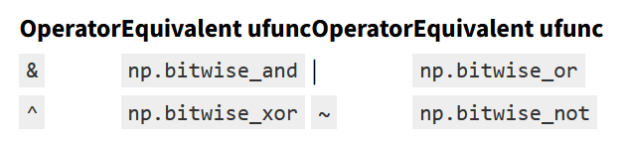
Comparisons, masks and boolean logic
Boolean operators: &, |, ~ (and for completeness ^ but less important)
False | False | False
False | False | True
False | True | False
A > 5
&: Both conditions
should hold
(A > 5) & (A % 2 == 0)
False | False | False
False | False | True
True | True | True
A
1 | 2 | 3
4 | 5 | 6
7 | 8 | 9
False | True | False
True | False | True
True | True | True
(A > 5) | (A % 2 == 0)
|: at least one
should hold
A % 2 == 0
False | True | False
True | False | True
False | True | False
False | True | False
True | False | False
False | False | False
~(A > 5) & (A % 2 == 0)
~: condition should
not hold

Slide 50
Comparisons, masks and boolean logic
Boolean operators: &, |, ~ (and for completeness ^ but less important)
5,1 | 3,5 | 1,4 | 0,2
4,9 | 3,0 | 1,4 | 0,2
… | … | … | …
… | … | … | …
… | … | … | …
Short sepals (< 5) AND short (< 1.5) petals ?
>>> (X[:,0] < 5) & (X[:,2] < 1.5)
array([False, True, True, False, False, …
>>> np.sum((X[:,0] < 5) & (X[:,2] < 1.5))
13

Slide 51
Comparisons, masks and boolean logic
Boolean masks (logical indexing): select data using logical expressions
A
A % 2 == 0
A[A % 2 == 0]
1 | 2 | 3
4 | 5 | 6
7 | 8 | 9
False | True | False
True | False | True
False | True | False
2 | 4 | 6 | 8
(returns copy, no view)
>>> A[A % 2 == 0]
array([2, 4, 6, 8])
>>> A[(A > 5) | (A % 2 == 0)]
array([2, 4, 6, 7, 8, 9])

Slide 52
Comparisons, masks and boolean logic
Boolean masks (logical indexing): select data using logical expressions
A
A % 2 == 0
A[A % 2 == 0]
1 | 2 | 3
4 | 5 | 6
7 | 8 | 9
False | True | False
True | False | True
False | True | False
2 | 4 | 6 | 8
(returns copy, no view)
Can be used to change data as well:
1 | 0 | 3
0 | 5 | 0
7 | 0 | 9
A[A % 2 == 0] = 0
>>> A[A % 2 == 0] = 0

Slide 53
Comparisons, masks and boolean logic
Boolean masks (logical/boolean indexing): select data using logical expressions
First column should be odd
Select rows for which this holds
A
A[:,0] % 2 == 1
A[A[:,0] % 2 == 1, :]
1 | 2 | 3
4 | 5 | 6
7 | 8 | 9
True
False
True
1 | 2 | 3
7 | 8 | 9
>>> A[A[:,0] % 2 == 1, :]
array([[1, 2, 3],
[7, 8, 9]])
>>> mask = A[:,0] % 2 == 1 # using an intermediate variable for readability
>>> A[mask, :]

Slide 54
Comparisons, masks and boolean logic
Computing summary statistics on subset of data
Some examples
  Compute average sepal length of all ‘short’ sepals ( < 5 )
  Compute average sepal length of all ‘setosa’ flowers
  Compute standard deviation of all variables for ‘setosa’ flowers
5,1 | 3,5 | 1,4 | 0,2
4,9 | 3,0 | 1,4 | 0,2
… | … | … | …
… | … | … | …
… | … | … | …
>>> mask = X[:,0] < 5
>>> np.mean(X[mask, 0])
4.690909090909091
>>> mask = Y == 'setosa'
>>> np.mean(X[mask, 0])
5.006
>>> mask = Y == 'setosa'
>>> np.std(X[mask, :], axis = 0)
array([0.34894699, 0.37525458, 0.17191859, 0.10432641])

Slide 55
Fancy indexing and sorting

Slide 56
Fancy indexing and sorting
Fancy indexing == passing an array of indices
B
>>> idx = [1, 2, 4]
>>> B[idx]
>>> array([8, 7, 1])
5 | 8 | 7 | 3 | 1 | 2
A
1 | 2 | 3
4 | 5 | 6
7 | 8 | 9
>>> rowidx = [1, 2, 2]
>>> colidx = [0, 0, 1]
>>> A[rowidx, colidx]
array([4, 7, 8])
Can be combined with slicing:
1 | 2 | 3
4 | 5 | 6
7 | 8 | 9
>>> rowidx = [0, 2]
>>> A[rowidx, :]
array([[1, 2, 3],
[7, 8, 9]])

Slide 57
Fancy indexing and sorting
Application in DS: select 60 random flowers
5,1 | 3,5 | 1,4 | 0,2
4,9 | 3,0 | 1,4 | 0,2
… | … | … | …
… | … | … | …
… | … | … | …
>>> rand = np.random.RandomState(1)
>>> rowidx = rand.choice(150, 60, replace = False)
>>> X[rowidx, :]
array([[5.8, 4. , 1.2, 0.2],
[5.1, 2.5, 3. , 1.1],
[6.6, 3. , 4.4, 1.4],
[5.4, 3.9, 1.3, 0.4],
…
Create random generator with seed 1
Randomly choose 60 values between 0 and 150 without repacement

Slide 58
Fancy indexing and sorting
Sorting
B
5 | 8 | 7 | 3 | 1 | 2
np.sort(B) -> sort ascending
1 | 2 | 3 | 5 | 7 | 8
np.argsort(B) -> indices sorted elements
4 | 5 | 3 | 0 | 3 | 1

Slide 59
Fancy indexing and sorting
Application: Sorting rows of a 2D array on a column
5,1 | 3,5 | 1,4 | 0,2
4,9 | 3,0 | 1,4 | 0,2
… | … | … | …
… | … | … | …
… | … | … | …
>>> idx = np.argsort(X[:,1])
>>> X[idx, :]
array([[5. , 2. , 3.5, 1. ],
[6. , 2.2, 4. , 1. ],
[6. , 2.2, 5. , 1.5],
[6.2, 2.2, 4.5, 1.5],
[4.5, 2.3, 1.3, 0.3],
…

Slide 60
PART II:
DS applications of numpy

Slide 61
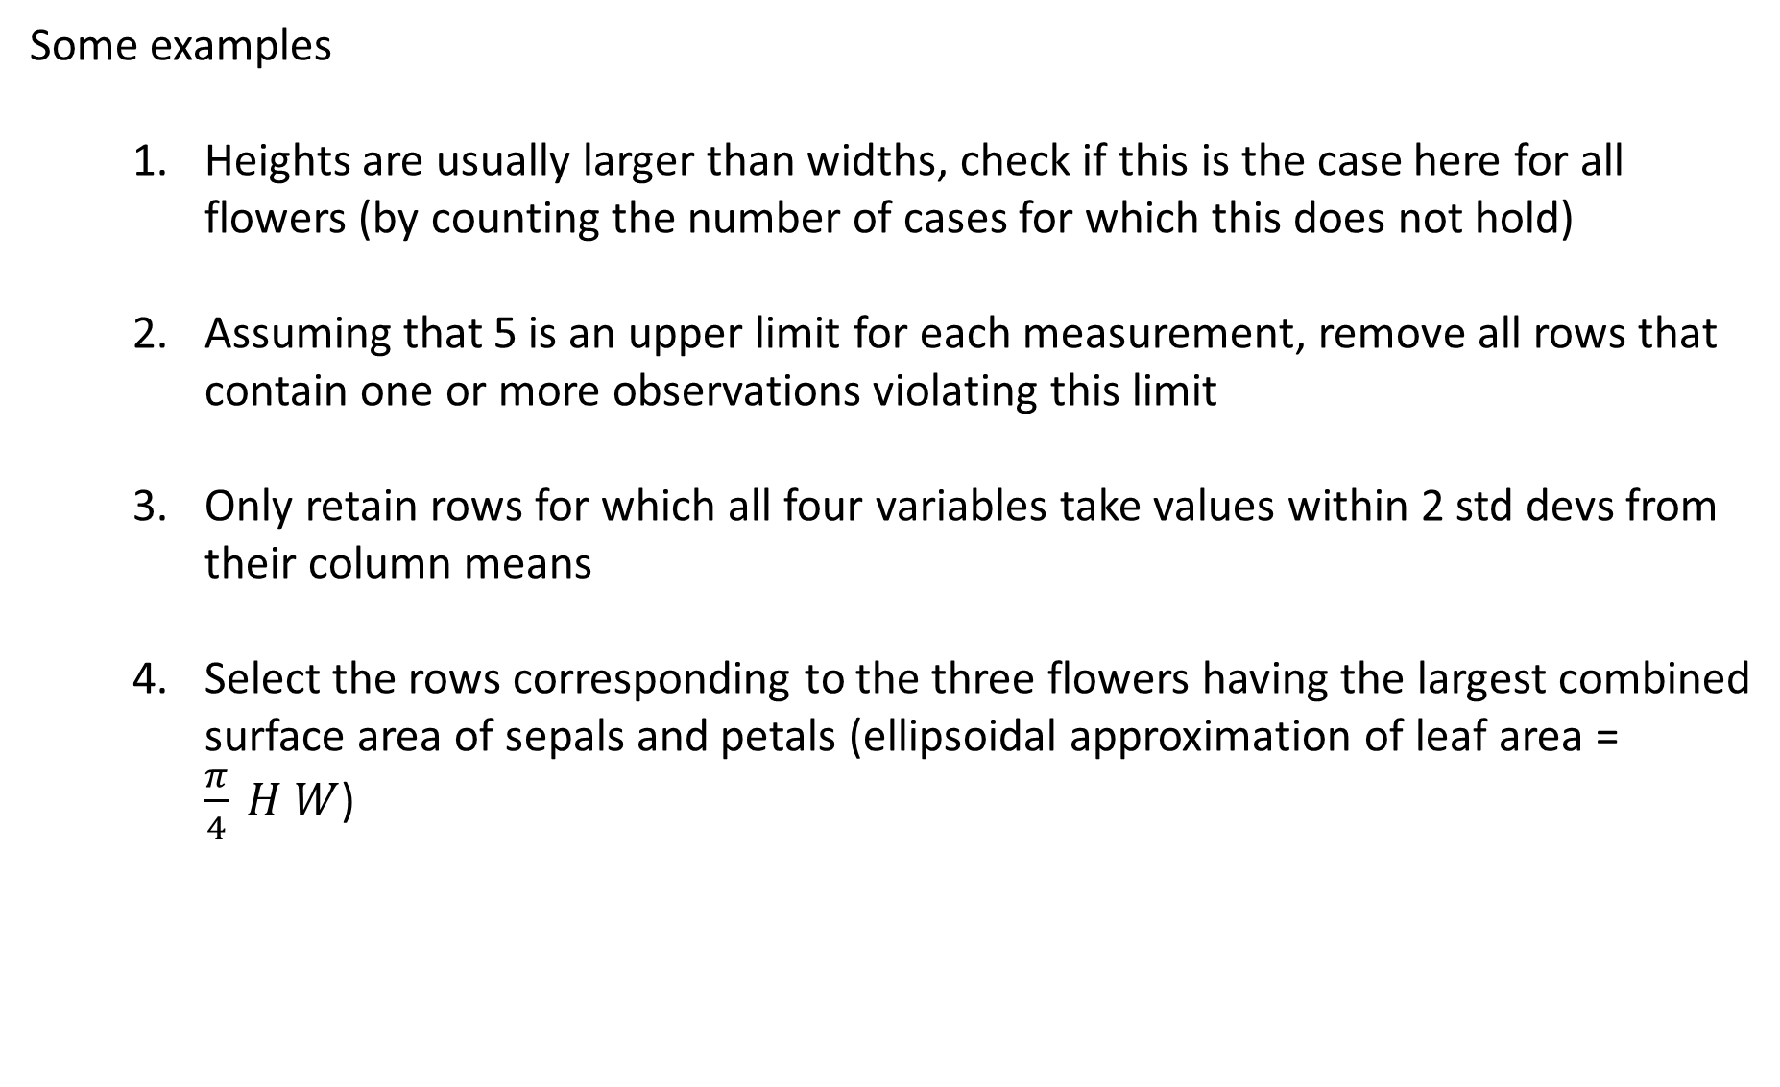
Examples of data preparation
Some examples
  Heights are usually larger than widths, check if this is the case here for all flowers (by counting the number of cases for which this does not hold)
  Assuming that 5 is an upper limit for each measurement, remove all rows that contain one or more observations violating this limit
  Only retain rows for which all four variables take values within 2 std devs from their column means
  Select the rows corresponding to the three flowers having the largest combined surface area of sepals and petals (ellipsoidal approximation of leaf area = $\frac{π}{4} H W$)
5,1 | 3,5 | 1,4 | 0,2
4,9 | 3,0 | 1,4 | 0,2
… | … | … | …
… | … | … | …
… | … | … | …
Note: for some of these examples, using np.all or np.any makes life easier.
as an exercise, try with and without using them.

Slide 62
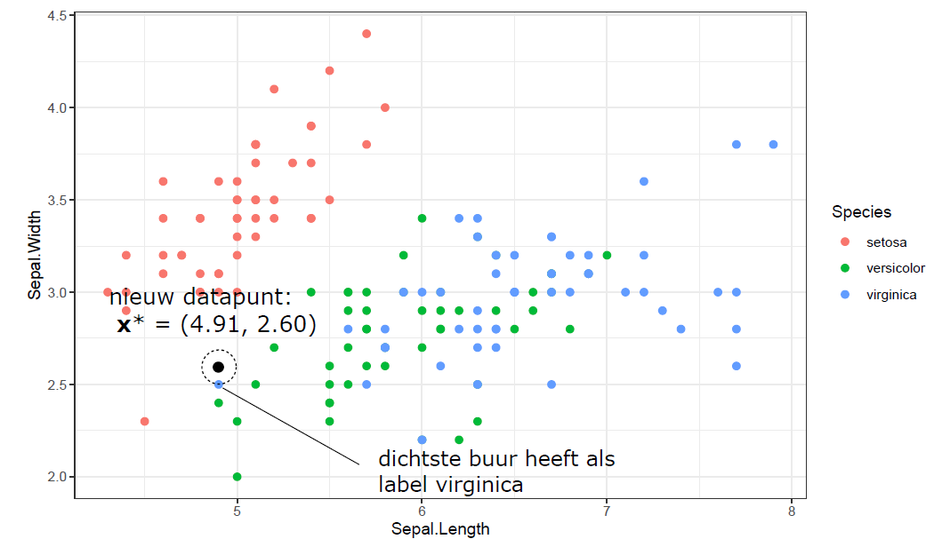
1NN
5,1 | 3,5
4,9 | 3,0
… | …
… | …
… | …
Nearest neighbor
Question: Implement a script in which a user can insert values for SL and SW. The script should return the predicted species using the 1NN approach.
1NN classification algorithm (applied to iris dataset)
  Input: (SL, SW) of a new iris flower with unknown species
  Ouput: species of most similar flower (~prediction)
Question: Did you consider scaling the data?

Slide 63



Prof. dr. Ir. Jan Verwaeren
VAKGROEP DATA-ANALYSE EN WISKUNDIGE MODELLERING
E Jan.Verwaeren@ugent.be www.ugent.be
Universiteit Gent
@ugent
@ugent
Ghent University

