Slide 2
Crash course python
Prof. dr. ir. Jan Verwaeren

Slide 3

Lecture overview
Day 1 (half a day)
About the teacher
Why programming?
Getting started with Python: executing Python programs
Python: Working with numbers
Python: Data types
Control flow (conditional execution and loops (start))
Day 2 (half a day)
Control flow (continued)
IO
Lists
Scientific Python (Numpy and Matplotlib)

Slide 4
About the teacher

Slide 5
Why programming? (why this course)

Slide 6
Executing Python code

Slide 7
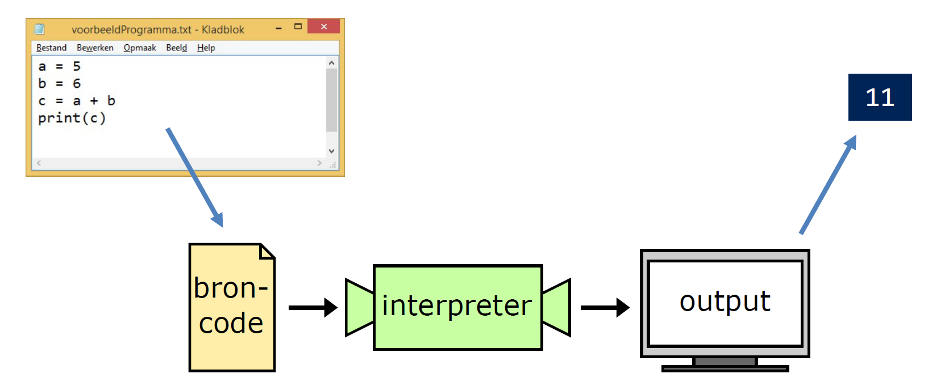

Computer program & source code
Source
code
Computer program: a set of instructions that tells a computer what to do.

Slide 8

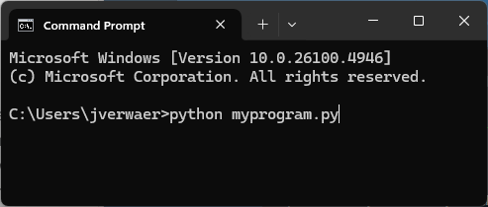




Executing a program
INTERACTIVE
NON-INTERACTIVE
REPL environment
Interactive shell (IPython)
Notebook
Batch-program
Running a script
LOCAL
REMOTE

Slide 9
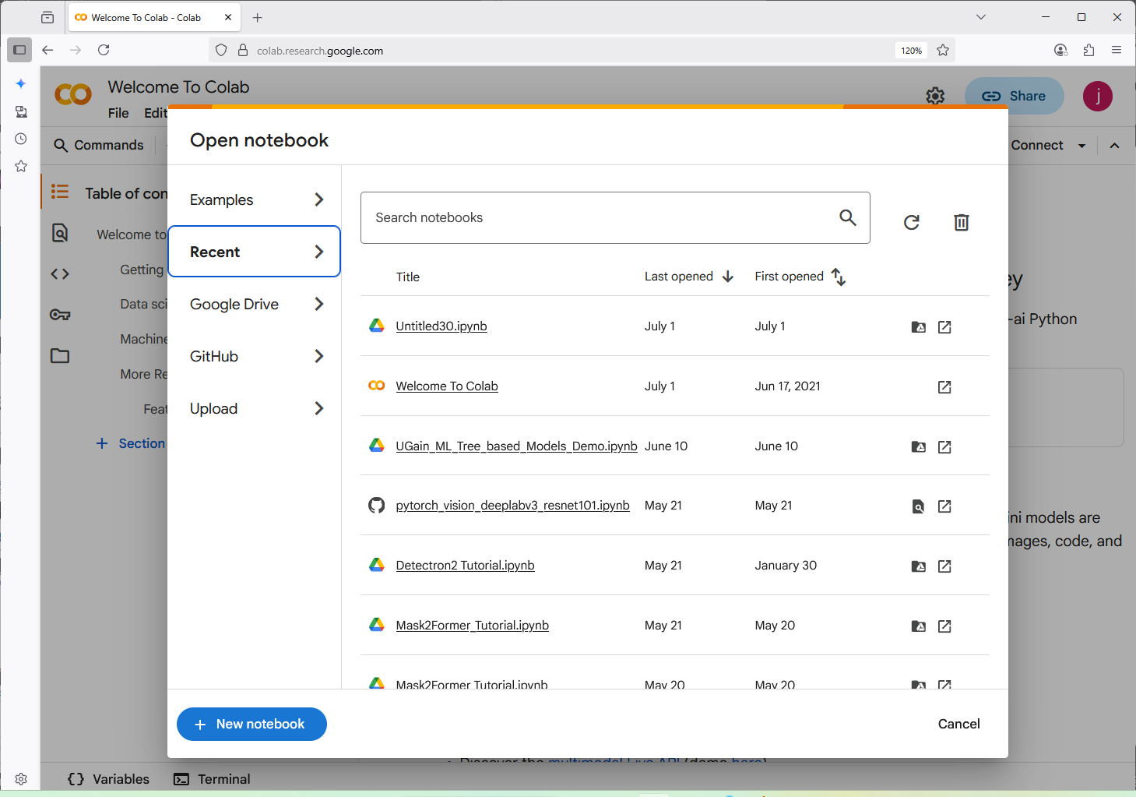
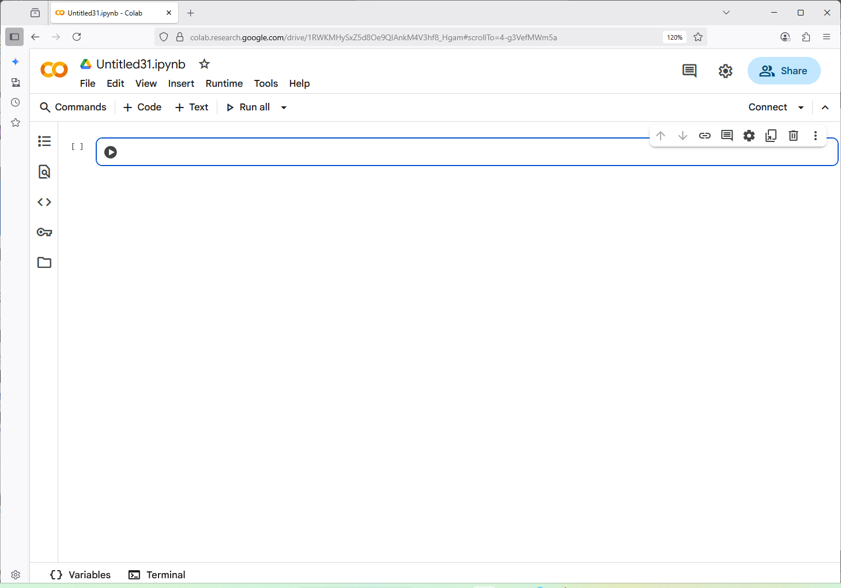
This class: google Colab
https://colab.research.google.com/

Slide 10
Python: working with numbers

Slide 11
Numeric types
Working with int’s
Names / variebles (name space)
Objects (memory)
>>> a = 5
>>> b = 6
>>> c = a + b
>>> print(c)
11
reference
int
a
5
int
b
6
int
c
11

Slide 12
Numeric types
Working with int’s
Names / variebles (name space)
Objects (memory)
>>> a = 5
>>> b = 6
>>> c = a + b
>>> print(c)
11
reference
int
a
5
int
b
6
int
c
11
float
Working with float’s
x
1.1
y
>>> x = 1.1
>>> y = x
>>> z = x * y
>>> print(z)
1.2100000000000002
float
z
1.2100000000000002

Slide 13
Computing with numbers: operators
>>> a = 5
>>> b = 6
>>> a + b
11
>>> a - b
-1
>>> a * b
30
>>> a / b
0.8333333333333334 # (result is float)
>>> a ** b # exponentiation
15625
>>> a // b # floor division
0
>>> a % b # remainder
5
Question: Let a be a duration in seconds (for instance a = 3725). This is equivalent to 1h 2min 5sec. Write a small program that automates this conversion and creates three variabeles
h = …
m = …
s = …

Slide 14
built-in functions
The built-in function max computes the maximum of two (or more) numbers
>>> a = 2.5
>>> b = 3.6
>>> c = max(a, b)
>>> c
3.6
new_variabele = functionName (first_argument, second_argument )
Terminology & syntax:
a and b are called the arguments of the function call
Arguments are passed between brackets and comma-separated
The resulting value is called the return value

Slide 15
built-in functions
The built-in function round rounds a number (up to a specfied number of decimal places)
>>> a = 2.51
>>> b = round(a)
>>> b
3
new_variabele = functionName (first_argument)
Variants on basic usage:
Supply a literal as an argument
Round accepts a variable number of arguments -> more info help(round)
>>> round(2.51)
3
>>> round(2.51, 1)
2.5

Slide 16
built-in functions
The built-in function print prints objects to an output device (the default is the screen)
>>> a = 2.5
>>> b = 3.6
>>> print(a, b)
2.5 3.6
Print in interactive mode:
In interactive mode: output of last expression is print to screen automatically
Any (intermediate) output should be explicitly printed

Slide 17
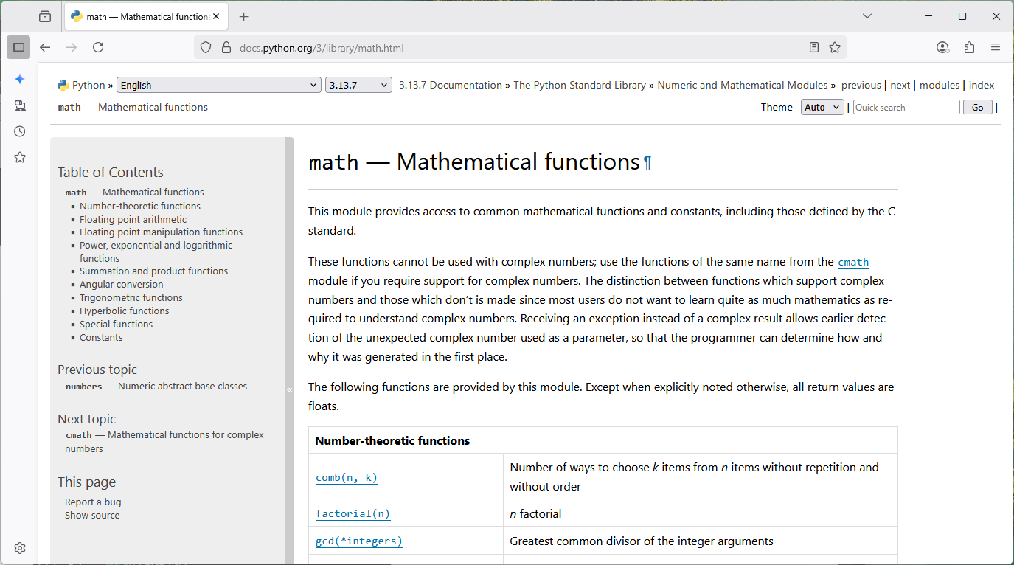
Modules (& the math module)
Most functionality in Python is provided through packages & modules:
A module is a file containing Python code that can be imported into other programs
A package is a collection of related modules that jointly implement a set of functionality
Standard-library modules vs. third-party modules
The math module is key module that implements a variety of mathematical functions
>>> import math
>>> a = 2.5
>>> b1 = math.sqrt(a)
>>> b2 = math.sin(a)
>>> b3 = math.cos(a)
>>> b4 = math.exp(a)
>>> b4
12.182493960703473
https://docs.python.org/

Slide 18
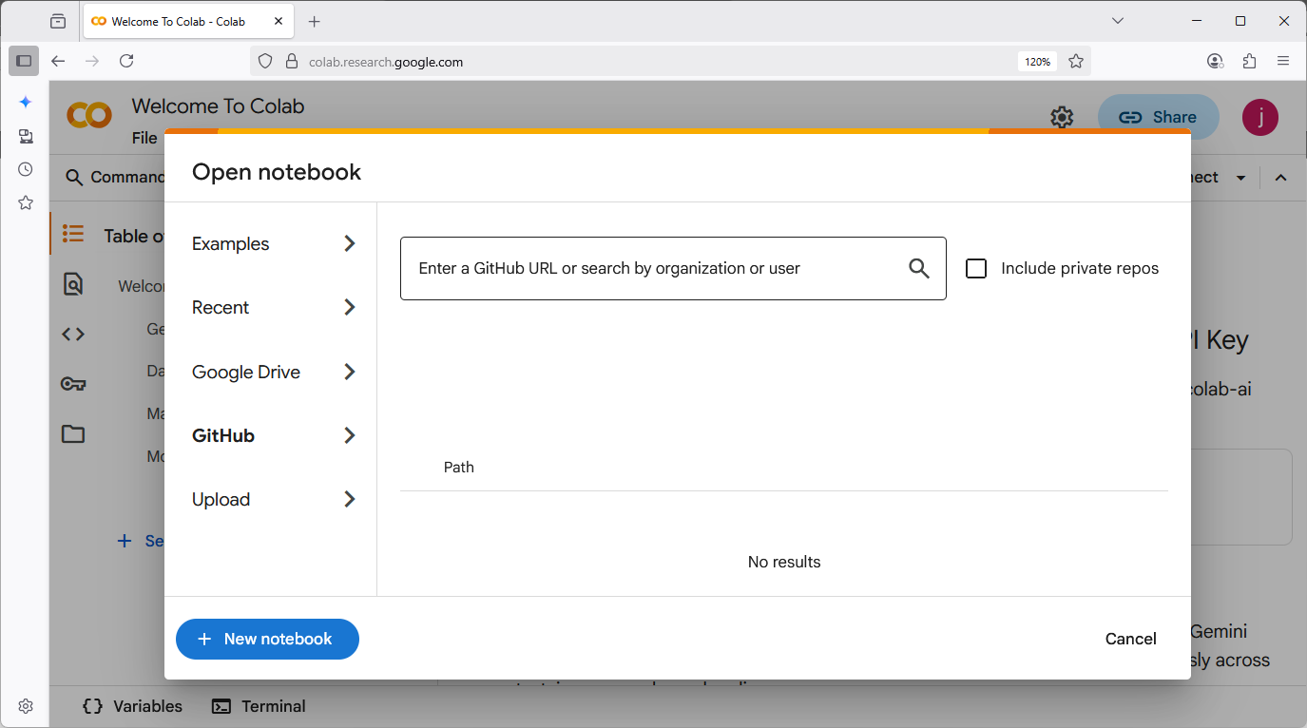
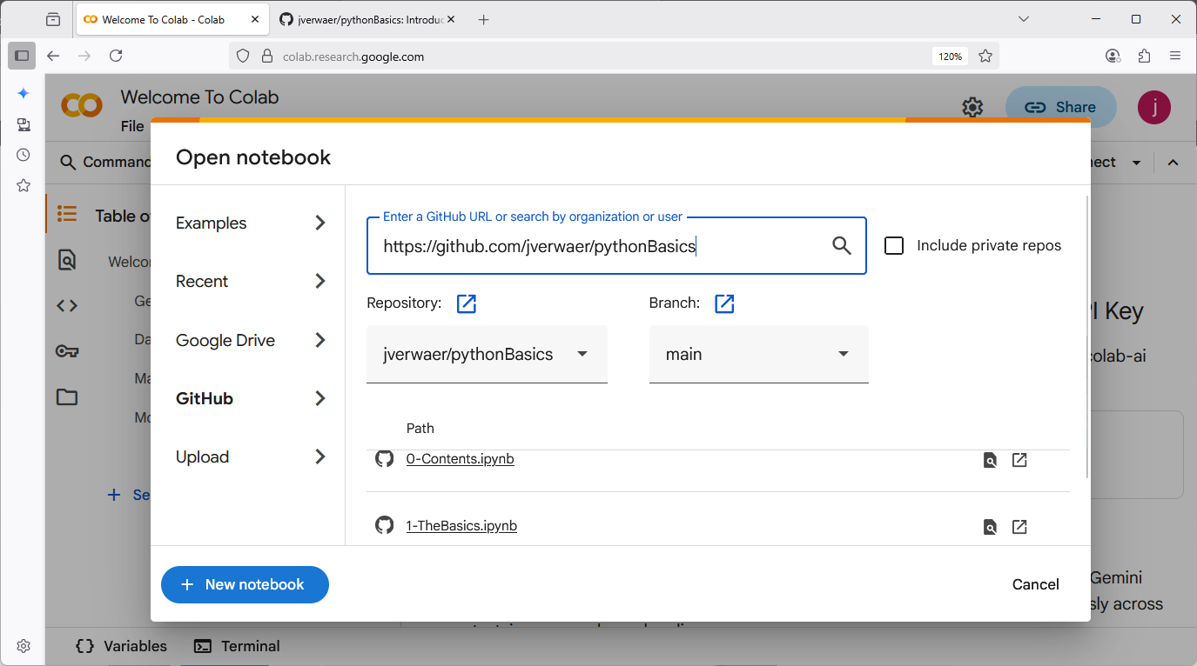
Time for some practice
https://github.com/jverwaer/pythonBasics
1- TheBasics.ipynb

Slide 19
Python: data types (logicals and strings)

Slide 20
What are Data types
Determine how are data stored in computer memory
0000 0 … 0001 1011
>>> a = 27
>>> b = 2.1
0100 0 … 1100 1101
~30 bits (but variable-size)
binary number respresentation
Signed
Datatype: int (at least 28 bytes)
64 bits (fixed size)
IEEE754 standard
Signed, rounding errors
Datatype: float (24 bytes)
Determine what operations are supported
0000 0 … 0001 1011
>>> a = 27
>>> b = 2.1
0100 0 … 1100 1101
Arithmetic operators
Relational operators
Bitwise operators
Arithmetic operators
Relational operators

Slide 21
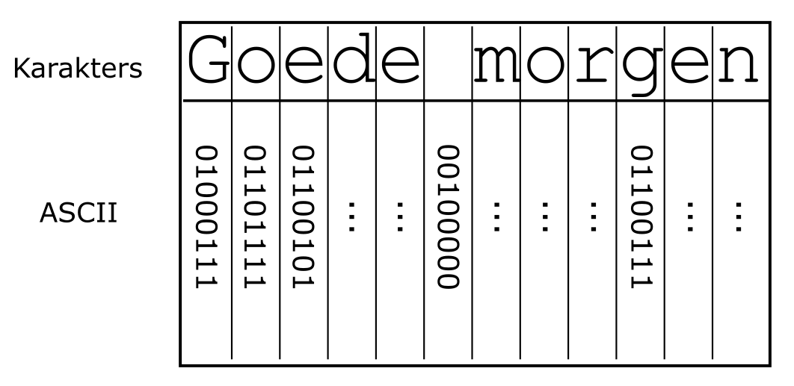
Strings (str)
A data type for textual data: a sequence of characters (~ storage in computer memory)
>>> a = 'Goede morgen'
UTF-8
Strings can be indexed (~operations that are defined)
>>> a = 'Bacillus anthracis’
>>> b = a[6]
>>> print(b)
u
B | a | c | i | l | l | u | s |  | a | n | t | h | r | a | c | i | s
0 | 1 | 2 | 3 | 4 | 5 | 6 | 7 | 8 | 9 | 10 | 11 | 12 | 13 | 14 | 15 | 16 | 17
Index
Starts at 0
Index for each character

Slide 22
String indexing
B | a | c | i | l | l | u | s |  | a | n | t | h | r | a | c | i | s
0 | 1 | 2 | 3 | 4 | 5 | 6 | 7 | 8 | 9 | 10 | 11 | 12 | 13 | 14 | 15 | 16 | 17
Index
Starts at 0
Index for each character
>>> a = 'Bacillus anthracis’
>>> b = a[6]
>>> print(b)
u
>>> c = a[4:12]
>>> print(c)
llus ant
Names / variebles (name space)
Objects (memory)
reference
str
a
Bacillus anthracis
str
b
u
str
c
llus ant

Slide 23
String indexing (continued)
B | a | c | i | l | l | u | s |  | a | n | t | h | r | a | c | i | s
0 | 1 | 2 | 3 | 4 | 5 | 6 | 7 | 8 | 9 | 10 | 11 | 12 | 13 | 14 | 15 | 16 | 17
Index
Starts at 0
Index for each character
>>> a = 'Bacillus anthracis’
>>> a[4:12:2]
lu n
>>> a[:4]
Baci
>>> a[12:]
hracis
a[int1:int2:step]
a[:int2]
a[int1:]

Slide 24
String operators
B | a | c | i | l | l | u | s |  | a | n | t | h | r | a | c | i | s
0 | 1 | 2 | 3 | 4 | 5 | 6 | 7 | 8 | 9 | 10 | 11 | 12 | 13 | 14 | 15 | 16 | 17
Index
Starts at 0
Index for each character
>>> a = 'Bacillus anthracis’
>>> a[4:12:2]
lu n
>>> a[:4]
Baci
>>> a[12:]
hracis
a[int1:int2:step]
a[:int2]
a[int1:]

Slide 25
string methods
B | a | c | i | l | l | u | s |  | a | n | t | h | r | a | c | i | s
0 | 1 | 2 | 3 | 4 | 5 | 6 | 7 | 8 | 9 | 10 | 11 | 12 | 13 | 14 | 15 | 16 | 17
Index
Starts at 0
Index for each character
>>> a.__len__() # or shorter: len(a)
18
>>> a.count('ci’)
2
>>> a.replace('s', 'X’)
BacilluX anthraciX
>>> a.find('s’)
7
>>> a[9:].capitalize()
Anthracis
Count substrings
Note:
Creates new object -> original string stays intact
Replace substring
Find index substring
Full list:
https://www.w3schools.com/python/python_ref_string.asp
Capitalize sring

Slide 26
illustration
Question: Write a program that extracts the genus from (any) given species name and prints it to the screen.
Implement this for x = ‘Bacillus anthracis’
Make your code more generic: make it work for any species
B | a | c | i | l | l | u | s |  | a | n | t | h | r | a | c | i | s
0 | 1 | 2 | 3 | 4 | 5 | 6 | 7 | 8 | 9 | 10 | 11 | 12 | 13 | 14 | 15 | 16 | 17
Index
Starts at 0
Index for each character

Slide 27
String opertors
The operators + and * have different functionality
>>> x = ’hello’
>>> y = ’John’
>>> x = ’2.1’
>>> y = 2.1
>>> x + y
’helloJohn’
>>> x * 5
’hellohellohellohellohello’
Concatenation
>>> x * 2
’2.12.1’
>>> y * 2
4.2
Duplication

Slide 28
illustration
Question: Print the string ‘joeoeoeoeoeoeoeoeoeoeoeoeoeoeoeoeoeoeoeoeoeoeoeoeoeoeoeoeoeoeoeoeoeoeoeoeoeoeoeoeoeoeoeoeoeoeoeoeoeoeoeoeoeoepie’ on the screen (about 50 times an oe)

Slide 29
Type casting
Integer
Double floating point
int()
float()
String
str()
>>> a = 27.5
>>> int(a)
27
>>> a = 27.5
>>> str(a)
‘27.5’
>>> a = ’5000’
>>> float(a)
5000.0
>>> a = ’hello’
>>> int(a)
<ValueError>

Slide 30
Booleans (bool)
Assessing relationships between objects (mostly equality and order)
>>> a = 5 > 2 # logical expression => read: 5 greater than 2
>>> b = 5 == 6 # logical expression => read: 5 equal to 6
>>> print(a)
true
>>> type(a)
bool
>>> print(b)
false
>>> type(b)
bool
Relational operators
5 > 2 # greater than
5 >= 2 # greater than or equal to
5 < 2 # less than
5 <= 2 # less than or equal to
5 == 2 # equal to
5 != 2 # not equal to

Slide 31
Booleans (bool)
Relational operators on strings
>>> 'egg' < 'elephant’
true
>>> 'egg’ == 'elephant’
false
Question: What is the output of the following logical expressions?
‘2’ * 4 < ‘7’
8 % 2 == 0

Slide 32
Booleans (bool)
The ‘is part of’ relationship: the in operator on strings
>>> s = 'bananas'
>>> 'an' in s
true
>>> 't' in s
false
Logical operators: and, or, not
>>> s = 'bananas'
>>> ('an' in s) and (5 < 2) # logical conjunction (both operands true <==> true)
false
>>> ('an' in s) or (5 < 2) # logical disjunction (at least one operand true <==> true)
true
>>> not ('an' in s) # negation (flips the truth value of its operand)
false

Slide 33
Time for some practice
https://github.com/jverwaer/pythonBasics
BasicDataTypes

Slide 34
Control flow: conditional executoin and loops

Slide 35
IF/else-statement
If/else: a condition (logical expression) determines what code will be executed
number = 10
if number > 0:
print(number, 'is positive')
else:
print(number, 'is negative')
print("That's it for now")
Condition: logical expression
If-suite (exectuted if condition is true)
else-suite (exectuted if condition is false)
Not part of if/else (always executed)
10 is positive
That's it for now

Slide 36
While-loops
while: a condition (logical expression) determines how many times code we be executed
a = 5
while a < 10:
a = a + 1
print(a)
print("That's it for now")
Condition: logical expression
while-suite (exectuted repeatedly untill condition becomes false)
6
7
8
9
10
That's it for now

Slide 37
for-loops
For: iterate over a sequence of values (Pythonic term: an iterable)
for a in range(5, 9):
print(a)
for char in "okay":
print(char)
5
6
7
8
o
k
a
y
A bit more challenging examples
total = 0
for a in range(0, 10):
if a % 2 == 0:
total = total + a
print(total)
res = ''
for char in "okay people":
if not char == 'e':
res = res + char
print(res)
20
okay popl

Slide 38
Time for some practice
https://github.com/jverwaer/pythonBasics
ControlStructures

Slide 39
File I/O

Slide 40
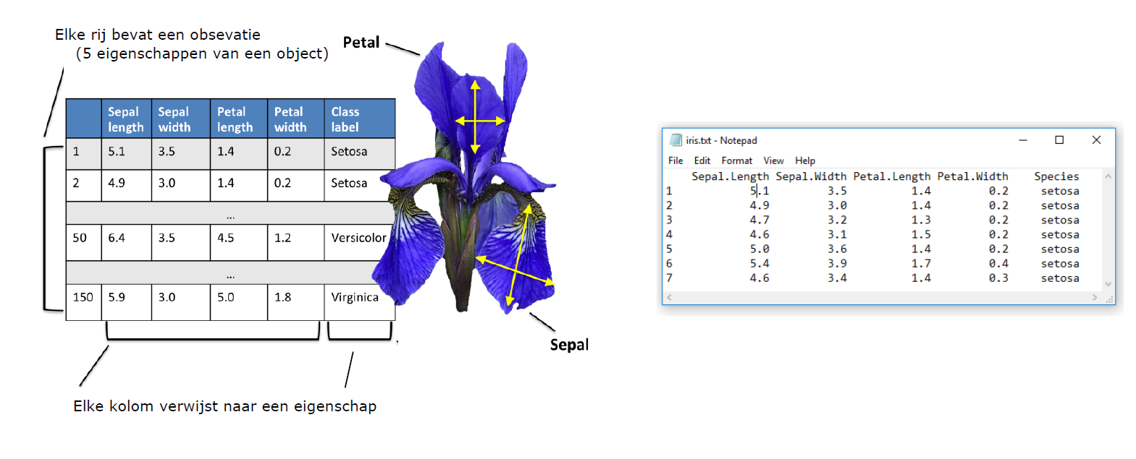
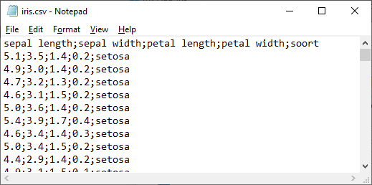
The iris dataset

Slide 41
Reading from files
To read a file, you need the path to it (or a url in case of online data)
STEP 1: create connection to file with open(…, mode = ‘r’)
STEP 2: read line by line using for loop
STEP 3: close connection with .close()
>>> f = open(‘files/iris.csv', 'r') # (relative path)
>>> for L in f:
print(L[:3])
f.close()
Sep
5.1
4.9
4.7
…

Slide 42
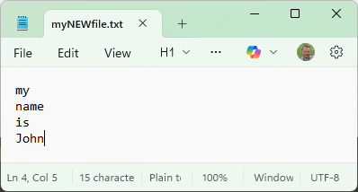
Writing to files
To write to a file, you need the path to it (or a url in case of online data)
STEP 1: create connection to file with open(…, mode = ‘w’)
STEP 2: write line by line using print(…, file = f)
STEP 3: close connection with .close()
>>> f = open(‘files/myNEWfile.csv', ‘w') # (relative path)
>>> print(’my’, file=f)
>>> print(’name’, file=f)
>>> print(’is’, file=f)
>>> print(’John’, file=f)
>>> f.close()

Slide 43
Time for some practice
https://github.com/jverwaer/pythonBasics
FileI-O

Slide 44
lists

Slide 45
lists: container type
Properties of lists:
Heterogeneous container object
Sequence type: indexing/slicing cfr. Strings
Mutable: can change after creation
Global name space
Objects (memory)
L
list
>>> L = [‘He', 'Ne', 'Ar’]
>>> print(L)
['he', 'Ne', 'Ar’]
[ • , • , • ]
str
He
str
Ne
str
Ar
List
[‘He', 'Ne', 'Ar']
Index
0
1
2

Slide 46
lists: container type
Properties of lists:
Heterogeneous container object
Sequence type: indexing/slicing cfr. Strings
Mutable: can change after creation
Global name space
Objects (memory)
L
list
>>> L = [‘He', 'Ne', 'Ar’]
>>> print(L)
['he', 'Ne', 'Ar’]
[ • , • , • ]
first_gas
str
He
str
selection
Ne
str
Ar
list
[ • , • ]
List
[‘He', 'Ne', 'Ar']
Index
0
1
2
>>> first_gas = L[0]
>>> selection = L[0:2]
>>> print(selection)
['he', 'Ne’]
Indexing
Slicing

Slide 47
lists: mutable
Global name space
Objects (memory)
Changing an existing list
list
L
[ • , • , • ]
>>> L = [‘He', 'Ne', 'Ar’]
>>> print(L)
['he', 'Ne', 'Ar’]
str
He
str
Ne
str
Ar

Slide 48


lists: mutable
Global name space
Objects (memory)
Changing an existing list
list
L
[ • , • , • ]
>>> L = [‘He', 'Ne', 'Ar’]
>>> print(L)
['he', 'Ne', 'Ar’]
str
He
str
Ne
str
Ar
str
Ra
str
Xe
>>> L[0] = 'Ra'
>>> L[1:3] = ['Xe', ‘H']
Change one
str
H
Change more

Slide 49
lists: mutable
Global name space
Objects (memory)
Changing an existing list
list
L
[ • , • , • ]
>>> L = [‘He', 'Ne', 'Ar’]
>>> print(L)
['he', 'Ne', 'Ar’]
str
He
str
Ne
str
Ar
str
Ra
str
Xe
>>> L[0] = 'Ra'
>>> L[1:3] = ['Xe', ‘H']
Change one
str
H
Change more
Effect of aliasing
Global name space
Objects (memory)
L
list
>>> L = [‘He', 'Ne', 'Ar’]
>>> K = L
[ • , • , • ]
K
str
He
str
Ne
str
M
Ar
>>> L[0] = 'Ra' >>> print(K)
>>>[‘Ra', 'Ne', 'Ar’]
str
Ra
[ • , • , • ]
>>> M = L.copy()

Slide 50
lists: methods
Appending elements to a list: append
>>> L = ['He', 'Ne', 'Ar']
>>> L.append('Xe’)
>>> print(L)
['He', 'Ne', 'Ar', 'Xe’]
>>> M = []
>>> M.append('Xe’)
>>> M.append(‘Ne’)
>>> print(M)
[‘Xe', 'Ne’]
Update list by
adding an element
Finding the index of an element (first occurence): index
>>> L = ['He', 'Ne', 'Ar', 'Xe']
>>> L.index('Ne’)
1
The string-method split (a sting method but popular way to transform string into list)
>>> s = 'Monday, Tuesday, Wednesday, Thursday and Friday'
>>> L = s.split(',')
>>> print(L)
['Monday', ' Tuesday', ' Wednesday', ' Thursday and Friday']

Slide 51
Nested lists and (multi-level) indexing
Indexing at multiple levels
>>> L = ['He', 'Ne', 'Ar', 'Xe']
>>> L[2][1]
'r'
Creating a nested list (a list of lists)
>>> A = [[1, 2, 3], ['one', 'two', 'three']]
>>> len(A)
2
Indexing at multiple levels
>>> A[1][2]
‘three’

Slide 52
Working with LISTS
Question: Consider the following list of strings:
L = [‘Salmonella’, ‘Bacillus’, ‘Pseudomonas’]
Add the string ‘Staphylococcus’ to L
Replace the second entry of L with its capitalized version
Use L to create a the following string (using one line of code)
‘Salmonella Bacillus Pseudomonas Staphylococcus’

Slide 53
Time for some practice
https://github.com/jverwaer/pythonBasics
Lists

Slide 54
dictionaries

Slide 55
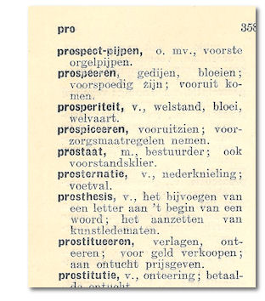
Dictionaries
Similar to the dictionary you are familiar with from language courses
key
value
Similar to a list that is indexed by a key in stead of an integer
>>> noble = {'He': 2, 'Ne': 10, 'Ar': 18}
>>> print(noble)
{'He': 2, 'Ne': 10, 'Ar': 18}
>>> noble['Ne’]
10

Slide 56



Prof. dr. Ir. Jan Verwaeren VAKGROEP DATA-ANALYSE EN WISKUNDIGE MODELLERING E Jan.Verwaeren@ugent.be www.ugent.be
Universiteit Gent @ugent
@ugent Ghent University

