Slide 1
Revelate.co
The Enterprise Control Plane
From governed data to governed decisions
A product & technology thesis for Revelate — beginning with AI governance
July 2026 · Companion to the Strategic Concept Proposal (V2) · DRAFT — For Discussion

Slide 2
IF YOU READ ONE PAGE
The thesis, in five lines
The opportunity we see. Enterprises are about to spend on governing AI the way they spent a decade governing data — and Revelate already owns the engine that does it.
The reframe. Not an AI feature bolted on. Revelate positioning itself as the neutral control plane for how AI touches enterprise data — governance today, decisions tomorrow.
The moat. Governance enforced in the request path, across clouds and tenants — a position few vendors can credibly match.
The plan. Build in three value-first stages with five engineers. Prove the wedge before scaling. Let validated revenue fund the pace.
The prize. A second budget (risk & compliance), a second revenue stream (the governance plane), a stickier, higher-NRR, higher-valuation company.
DRAFT — For Discussion Purposes Only
Revelate.co

Slide 3
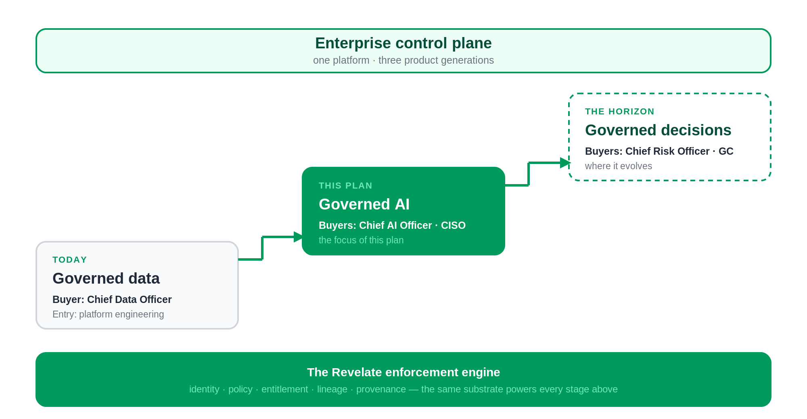
THE ARC
One platform, three product generations
DRAFT — For Discussion Purposes Only
Revelate.co

Slide 4
SECTION 2
Why now — the business case, not the regulatory one
Four business curves are bending at once — and governance spend follows all four.
AI adoption is exploding
AI spend is exploding
models and agents put in front of proprietary data
budgets created faster than the controls to govern them
AI failures are exploding
Audit expectations are exploding
wrong answers, leaked data, unexplainable decisions
proof of how AI reached an answer is now demanded
Why now for Revelate: the hard part is already built. Revelate spent years assembling the enforcement substrate — entitlements, policy, lineage — that most entrants are only now trying to stand up. The market has finally caught up to capabilities the platform already has.
DRAFT — For Discussion Purposes Only
Revelate.co

Slide 5
SECTION 3
Five beliefs that drive this roadmap
1. Governance must be enforcement, not documentation. Value accrues to the layer that enforces in the request path — not the one that describes.
2. Policy should be data-centric, not model-centric. Models churn; data and its rules persist. Bind policy to data and every model inherits it.
3. AI identity will matter as much as human identity. An agent that queries data is a principal — authenticate, authorise, and audit it.
4. Data lineage becomes decision lineage. The audit object of the future is the decision, not the query.
5. Neutral, cross-cloud enforcement compounds as AI fragments. A neutral broker gains value precisely as enterprises go multi-model and multi-cloud.
DRAFT — For Discussion Purposes Only
Revelate.co

Slide 6
SECTION 3.1
What we will deliberately not do
Strategy is as much what you exclude. Five things are explicitly out of scope.
✕
Build our own foundation model — we govern models; we do not compete with them
✕
Compete with the cloud data platforms — we sit above Snowflake and Databricks, not against them
✕
Replace GRC platforms — we feed them evidence; they keep the workflow
✕
Replace data catalogs — we enforce where they describe, and integrate rather than displace
✕
Be single-cloud — neutrality across clouds is the entire point
DRAFT — For Discussion Purposes Only
Revelate.co

Slide 7
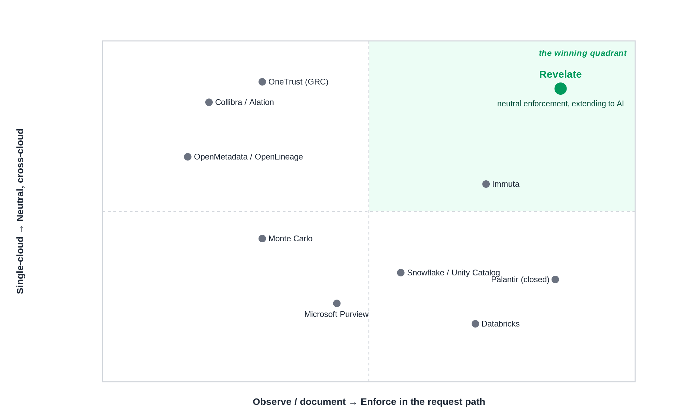
SECTION 4
Why existing vendors cannot own this
The synthesis: Revelate holds a differentiated position — one few vendors can credibly match — combining a live, cross-cloud, multi-tenant enforcement engine with an AI-governance overlay on top of it.
DRAFT — For Discussion Purposes Only
Revelate.co

Slide 8
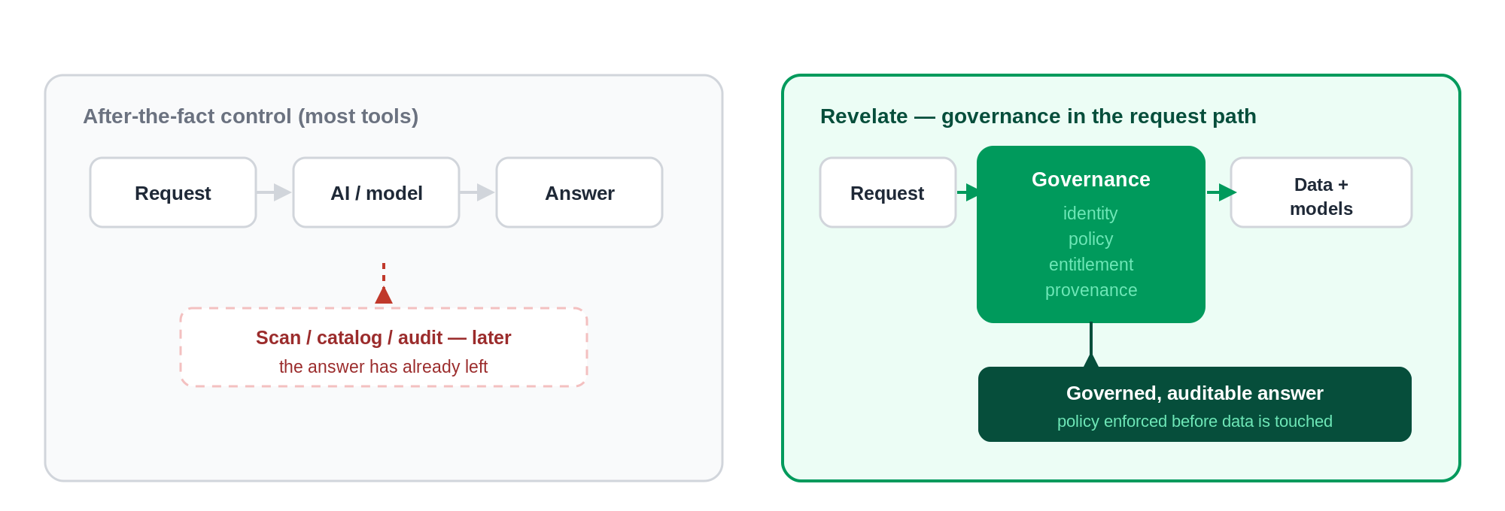
SECTION 5
The architectural bet — governance in the request path
Put policy on the data and enforce it at the gateway every request must pass through. Model-centric governance is the wrong abstraction; correctness should not depend on which model is calling.
DRAFT — For Discussion Purposes Only
Revelate.co

Slide 9
SECTION 6
What we build — the executive problem each piece removes
Track A — the AI platform
Track B — the governance overlay
Governed AI gateway “We can’t safely let AI touch production data.”
AI access + provenance “We can’t prove how an answer was produced.”
Interrogation layer “Users can’t get answers without an analyst.”
Policy & guardrails “PII and residency leak through AI.”
Telemetry & reliability “We can’t see what AI did, or trust the data.”
Inventory & attestation “Audits are manual, slow, and frightening.”
DRAFT — For Discussion Purposes Only
Revelate.co

Slide 10
SECTION 7
The staged plan — value-first, both tracks emerging
STAGE 1
STAGE 2
STAGE 3
Governed, auditable AI access
Auditable answers, repeatable
The enterprise AI control tower
Proof: an agent answers on governed data, entitlements enforced, full audit trail.
Build: gateway, telemetry, access + provenance seed.
GTM: 2–3 FS/healthcare design partners.
Proof: self-serve governed interrogation; first paid conversions; ISO 42001 readiness.
Build: interrogation, guardrails, policy enforcement.
GTM: convert to paid; add CRO/CISO; GRC design.
Proof: governance sold as a plane; attestation used in a real audit; insurance live.
Build: reliability, inventory/risk registry, attestation.
GTM: partner-led scale; marketplace co-sell.
DRAFT — For Discussion Purposes Only
Revelate.co

Slide 11
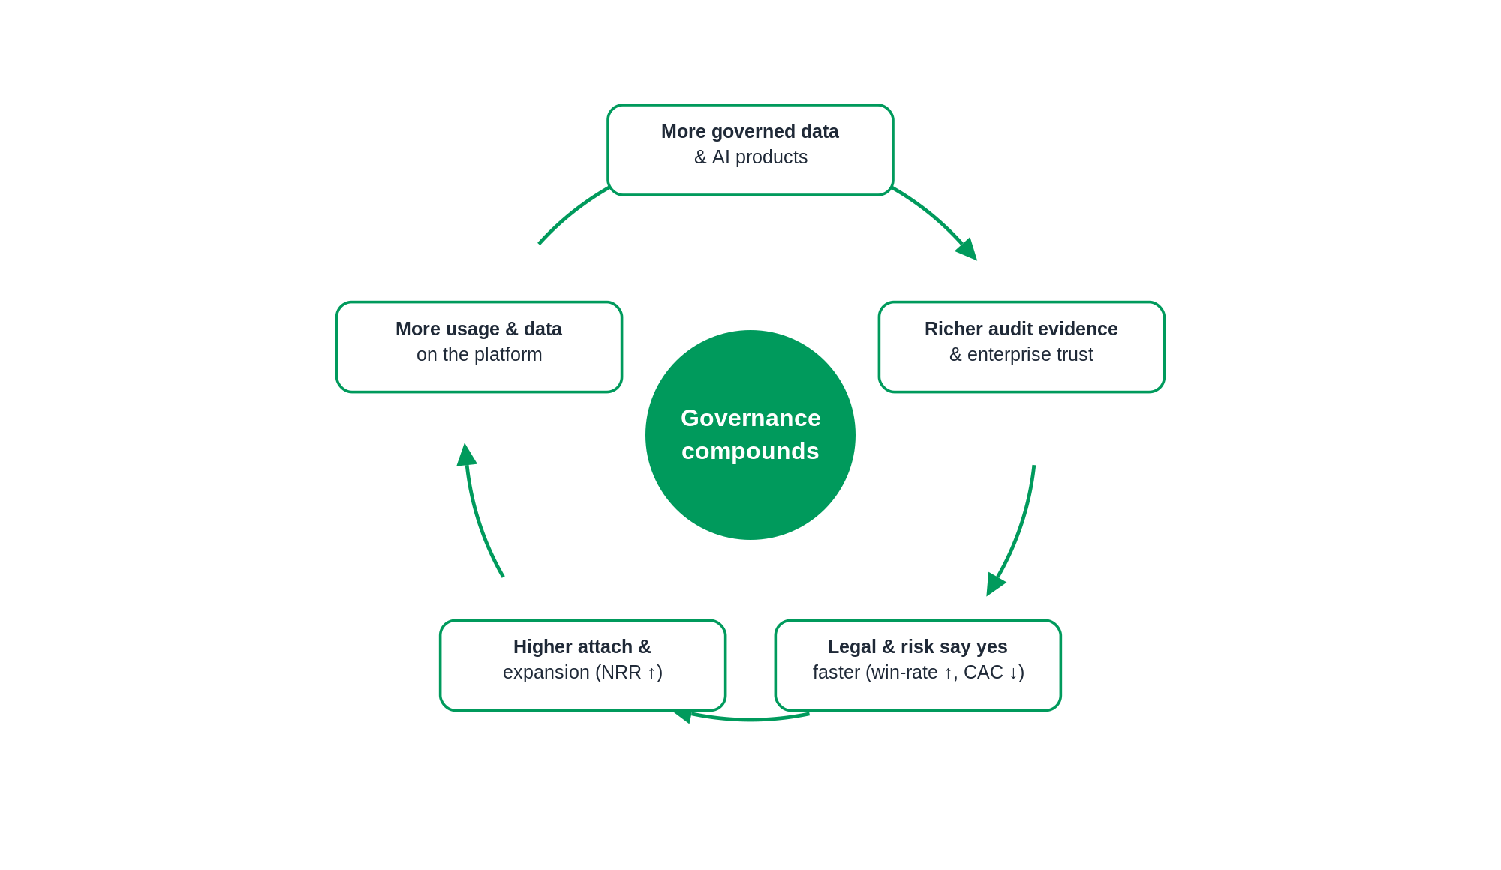
SECTION 8
The economic model — a compounding flywheel
New revenue line ACV ↑ (a second budget pool)
Consumption expansion NRR ↑ (usage-led)
Stickiness Gross retention ↑
Faster legal sign-off Win-rate ↑, CAC ↓
Services → software Gross margin ↑
Illustrative targets to validate: governance attach 40–60%, ACV 1.5–2x where it attaches, NRR toward 130%+.
DRAFT — For Discussion Purposes Only
Revelate.co

Slide 12
SECTION 9
The self-funding growth model
Speed is bought with validated revenue, not headcount added ahead of proof. Each gate opens only on evidence.
Gate | Evidence required to open it | What it unlocks
Baseline | Today’s team of five | Funds Stage 1 and the start of Stage 2
Gate 1 — Demand | 2–3 design partners actively using governed AI access, willing to pay | +1–2 engineers
Gate 2 — Revenue | First paid conversions; governance attach at a premium; incremental-ARR threshold | +2–3 engineers to parallelise Stage 3
Gate 3 — Scale | Partner-sourced pipeline; validated second revenue stream | Scale the team; open further verticals
DRAFT — For Discussion Purposes Only
Revelate.co

Slide 13
SECTION 10
Markets & buyers expand together
Industry | AI-governance wedge | Enters
Financial services | Model risk lineage; credit, AML, trading | Stage 1
Healthcare & life sci | PHI; clinical/FDA provenance; consent | Stage 1
Insurance | Underwriting/claims fairness (NAIC) | Stage 2
Media & advertising | Content provenance; training-data rights | Stage 3
Energy & utilities | Critical-infra; safety-critical audit | Stage 3
As the mandate grows, so does who signs:
Platform eng + CDO
→
Chief AI Officer + CISO
→
Chief Risk Officer
→
General Counsel
DRAFT — For Discussion Purposes Only
Revelate.co

Slide 14
SECTION 11
Partnerships escalate with the build
Partner type | Role | Activates
Cloud platforms | Snowflake, Databricks, AWS, GCP, Azure — neutral co-sell & marketplace | Stage 1 → 3
GRC platforms | OneTrust, ServiceNow, Archer — Revelate as the evidence layer | Stage 2 → 3
Advisory / SI | Big 4 & responsible-AI boutiques — ISO 42001 readiness, validation | Stage 2 → 3
Certification & audit | Bodies & auditors — audit-ready attestation; Revelate’s own ISO 42001 | Stage 2
Model & semantic | Anthropic; Cube/dbt — governed access, Revelate as broker | Stage 1 → 3
DRAFT — For Discussion Purposes Only
Revelate.co

Slide 15
Revelate.co
An executive thesis, backed by an executable plan.
Five engineers are enough to prove the wedge; validated revenue buys the pace of everything after.
Confident in the vision · specific about the moat · disciplined about the resourcing.
A note on intent — this illustrates how I approach product strategy by connecting market evolution, architecture, execution sequencing, and business economics into one coherent plan. It is not a recommendation to pursue every element immediately.

