Slide 1
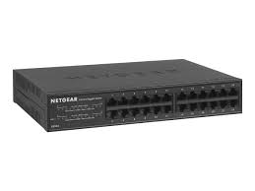

Fieldbus
Load Cell Subsystem
ATI Toolchanger
High speed network switch
Pneumatic Subsystem
Robot Controller
Laser scan subsystem
Computer

Slide 2
Notes
Most of the subsystems have either ether cat or ethernet built in, so I used that communication system as the base. Since the pneumatic systems don’t seem to have an ethernet port we would need to add ADCs and DACs with ethernet connection to send over and receive the low-level information.
Since the Pneumatic system is meant to hold the sheets of metal while the arm forms it into the correct shape, it only needs to be activated before and after the robotic system moves. I would move it onto a different system.
Every other system helps the robotic arm move and read either how much pressure the arm is imposing(load cell) or reading how much it has deformed the sheet(laser scanner) or to switch the different size ends for the different requirements in the formation of the sheet(ATI toolchanger)

Slide 3
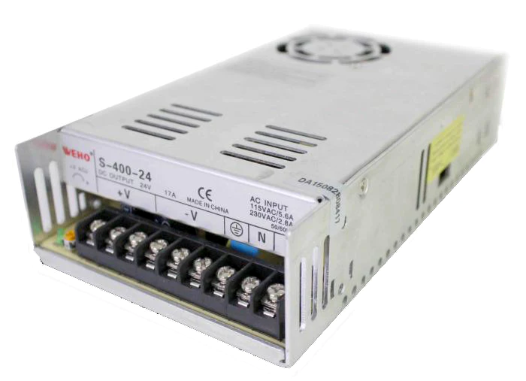
Power system
Power Rail + Overcurrent protection
Load Cell Subsystem
ATI Toolchanger
Laser scan subsystem
Robot Controller
Pneumatic Subsystem
120VAC

Slide 4
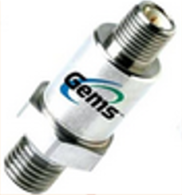
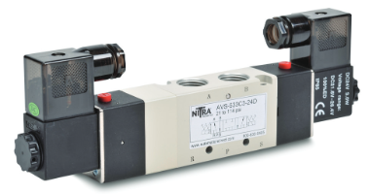

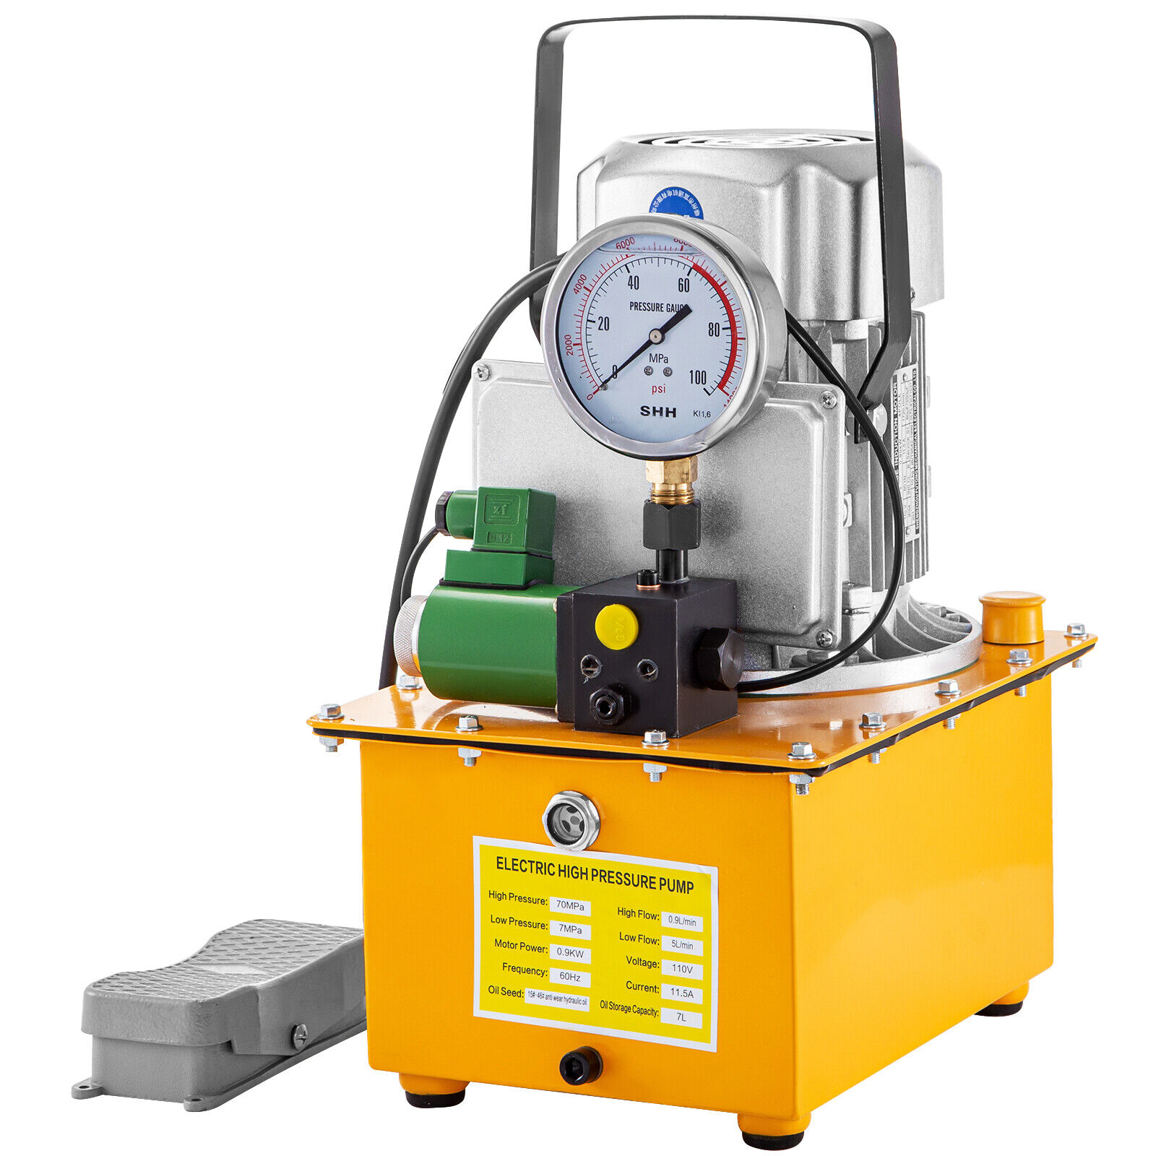
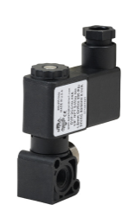
Pneumatic Subsystem
M12 connector
Low-High
Differential
Wire
ADC to ethernet reader
Ethernet
Both controllers are to be determined
NITRA Pneumatic Solenoid Valve
AVS+AC0-5322+AC0-24D
Digital Controller
Ethernet
DIN 11mm connector
Digital control wire
24VDC
VEVOR Electric Hydraulic Pump
120 VAC

Slide 5
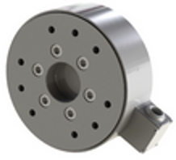
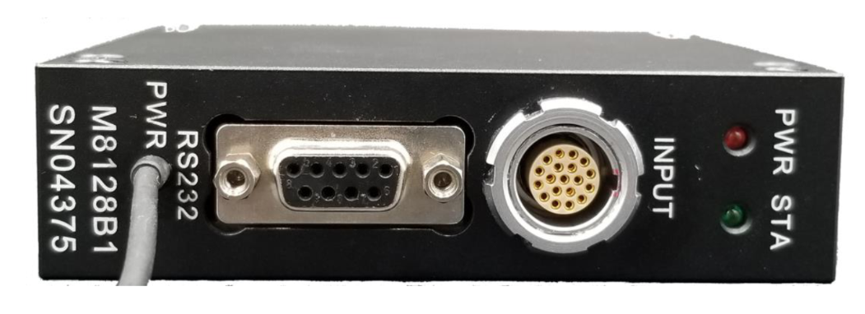
Load Cell Subsystem
Sunrise Instruments Load Cell
M4347D
Sunrise Instruments Control Box
M8128
EEG 2K.316.CCC
DB9 Connector
24 Volts
Ethernet

Slide 6
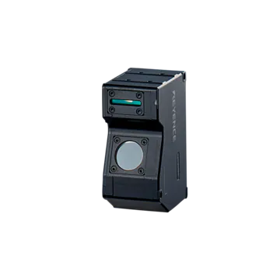
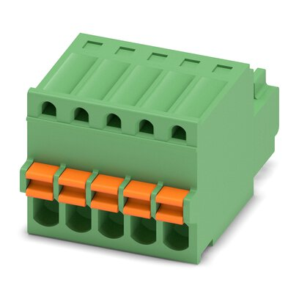
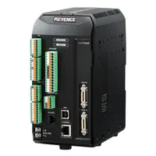
Laser scan subsystem
Controller LJ-V700
Keyence laser scanner
LJ-V7000
Head cable
FK-MC 0.5
24 Volts
Ethernet

Slide 7
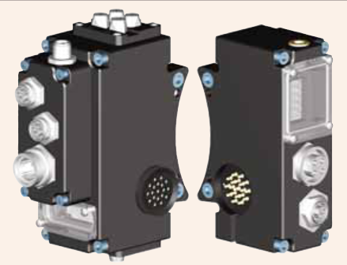
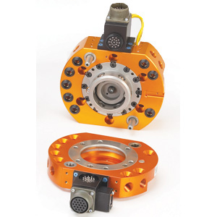
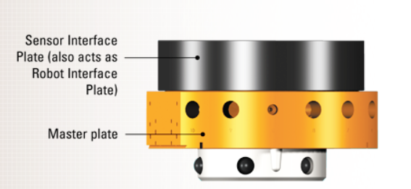
ATI Toolchanger
ATI Toolchanger
QC+AC0-150
DK8 master and DK4 tool ethernet modules
ATI Sensor Interface Plate System
SIP
MD12 Connector
MD12 Connector
Up to 600 Volts
Ethernet

Slide 8
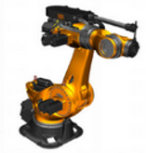
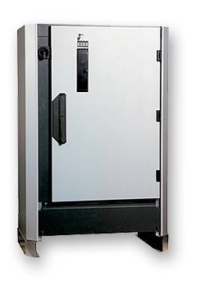
Robot Controller
KR C2 controller
Control cables
Ethernet

