Slide 1
Predicting Total World Box Office Gross
Using Web-scraping and Regression

Slide 2
Can we predict the World Box Office before release?

Slide 3
Film Stack
Script
Genre
Directors
Budget
Theaters
World Gross
Domestic
Opening

Slide 4
Film Stack
Script
Genre
Directors
Budget
Theaters
World Gross
Domestic
Opening

Slide 5



Data Collection
Web-scraping

Slide 6
Scraped Features
Title Release Date Director Genres Country Language MPAA Rating IMDB Rating Runtime No. of Theaters Worldwide Box Office

Slide 7
Numerical Data

Slide 8
Cleaning and Transforming
Adjust for inflation
Log gross values

Slide 9
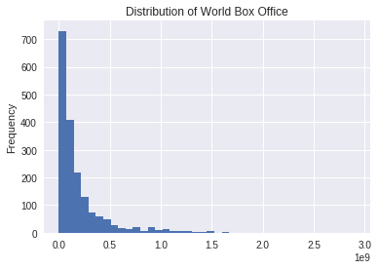
World Box Office Distribution

Slide 10
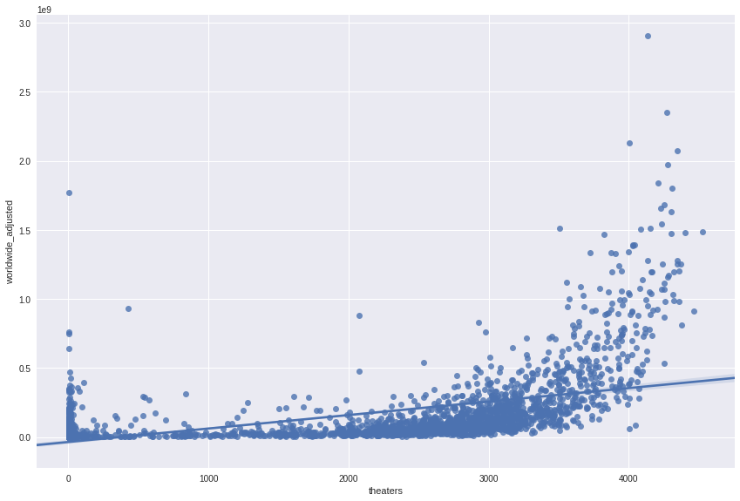
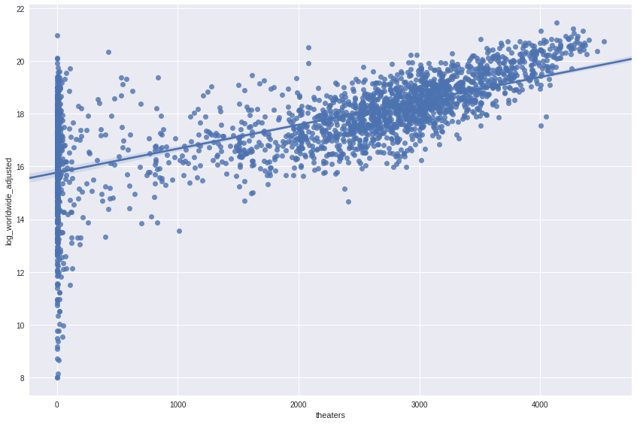
Theaters vs Worldwide Gross

Slide 11
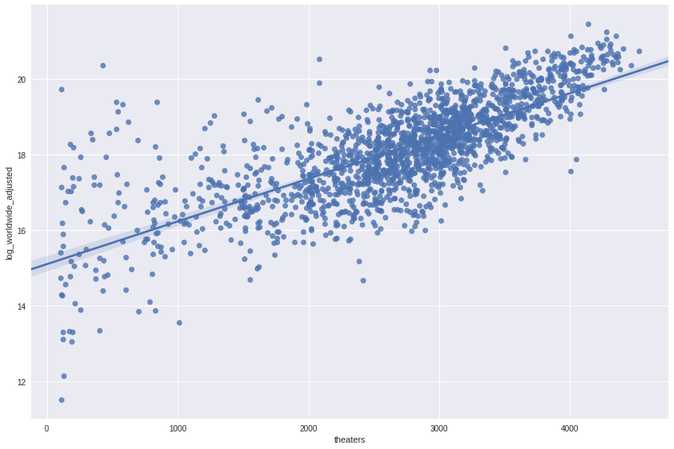
Theaters vs Worldwide Gross (Log)
Low theater counts removed

Slide 12
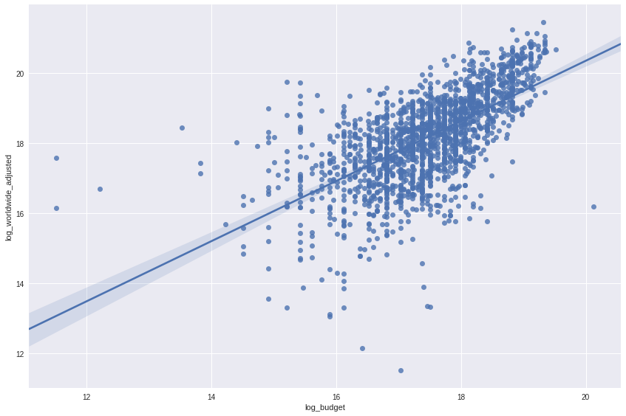
Other numerical features
Budget

Slide 13
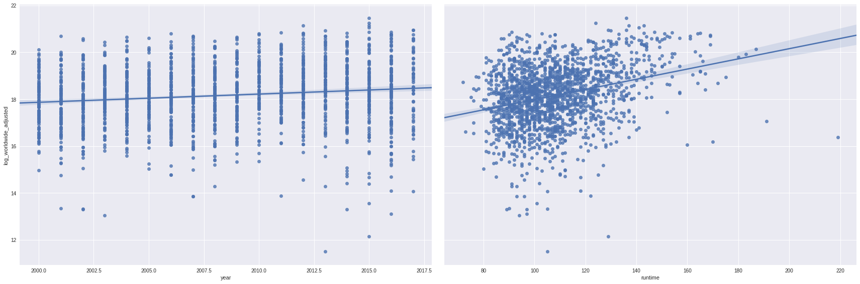
Year and Runtime vs Worldwide Gross (Log)
Year
Runtime

Slide 14
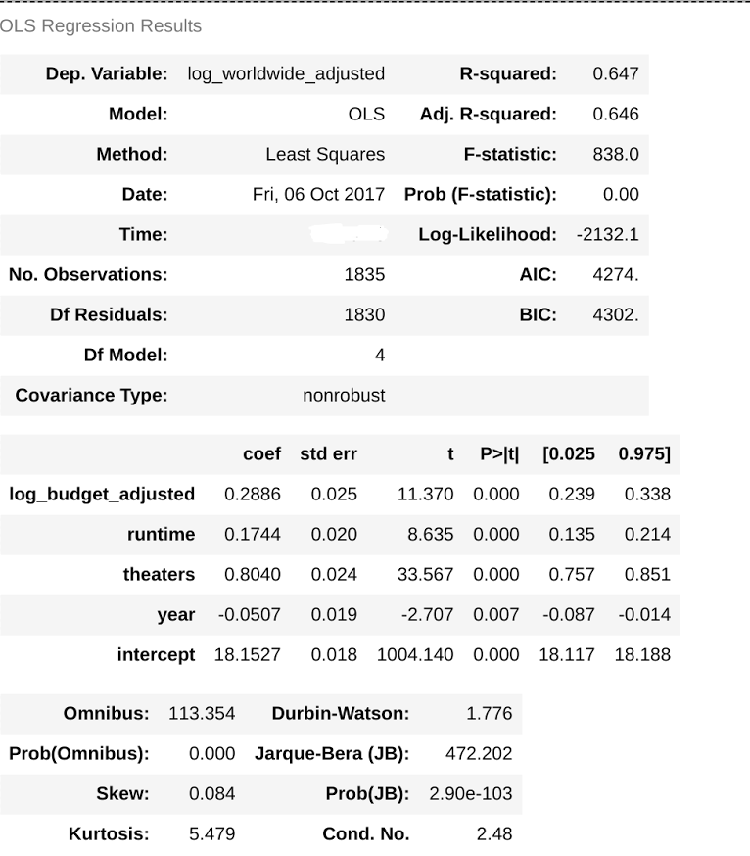
Linear Regression Model with Numericals
All four variables are significant

Slide 15
Linear Regression Model with Numericals
All four variables are significant
All four variables are significant
Theaters has the largest effect

Slide 16
Linear Regression Model with Numericals
All four variables are significant
All four variables are significant
Theaters has the largest effect
Can we get a better r-squared?
0.647
Mean-squared error: 0.598

Slide 17
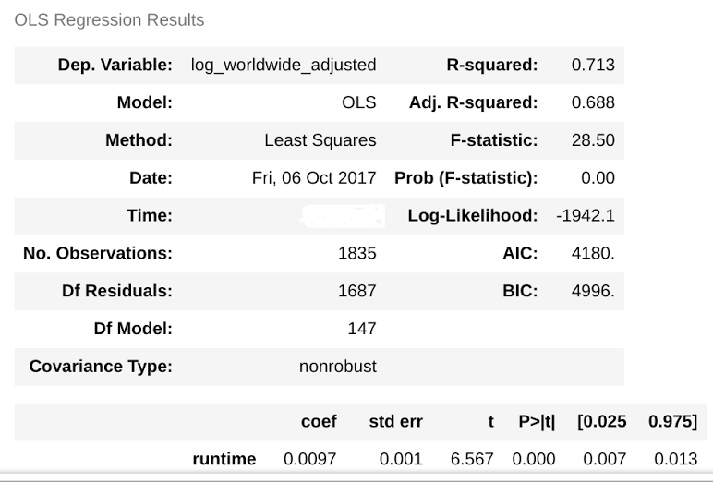
Categoricals
Genre|Month|MPAA|Country Director

Slide 18
Categoricals
Genre|Month|MPAA|Country Director
R-squared = 0.713 (0.647) Mean-Square-Error = 0.486 (0.598)

Slide 19
Categoricals
Genre|Month|MPAA|Country Director
Will this lead to overfitting?
R-squared = 0.713 (0.647) Mean-Square-Error = 0.486 (0.598)

Slide 20
Testing for Overfitting
Using Train/Test (0.7/0.3) splits
Using KFold Cross-Validation
Average r-squared: 0.643
Average mean-square-error: 0.604
Average r-squared: 0.503
Average mean-square-error: 0.620

Slide 21
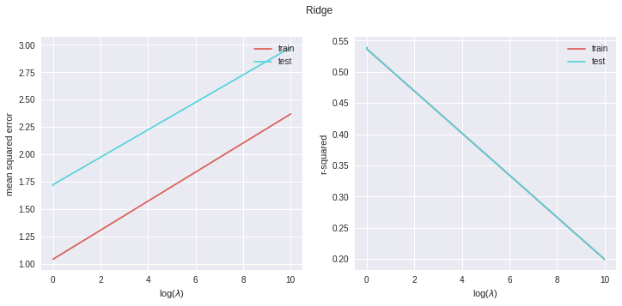
Ridge - scoring

Slide 22
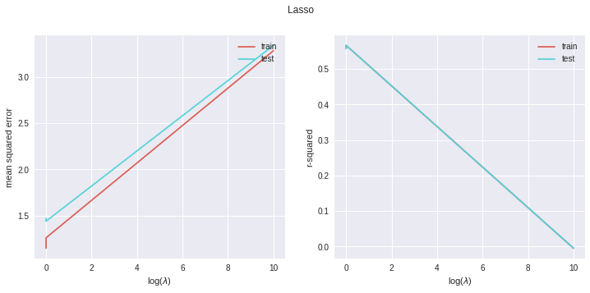
Lasso - scoring

Slide 23
P-Value Selection
Pick features that have a statistically significant correlation with our target

Slide 24
P-Value Selection
Pick features that have a statistically significant correlation with our target
67 → 42

Slide 25
P-Value Selection
Pick features that have a statistically significant correlation with our target
67 → 42
Using Train/Test (0.7/0.3) splits
Using KFold Cross-Validation
Avg-r-squared: 0.660 (0.643)
Avg mean-sqr-error: 0.577 (0.604)
Average r-squared: 0.525 (0.503)
Average mean-sqr-error: 0.592 (0.620)

Slide 26
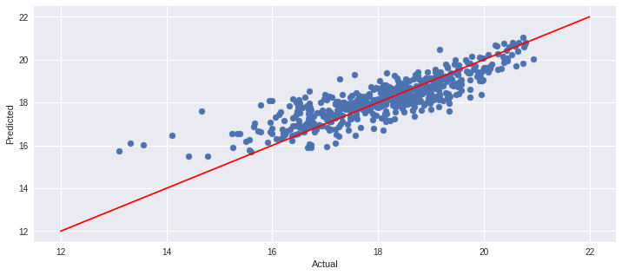
Actual Worldwide Gross (log) vs Predicted (log)

Slide 27
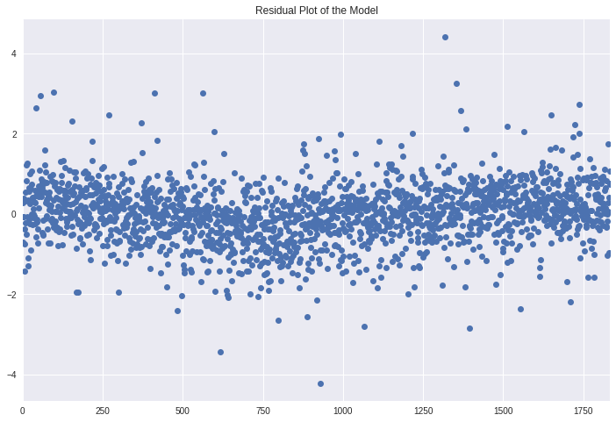
Residuals of the Model

Slide 28
Conclusion
Difficult to predict a film’s worldwide box office
Best predictor is No. of Theaters showing
More data such as franchise or whether film is based on literature

Slide 29
Thank you

Slide 30
Questions?

Slide 31
Features
'runtime 0.01', 'theaters 0.0', 'year -0.01', 'log_budget_adjusted 0.24', 'top_director 0.4', 'm_April -0.05', 'm_August 0.12', 'm_December 0.39', 'm_January 0.18', 'm_July 0.27', 'm_June 0.26', 'm_May 0.2', 'm_November 0.19', 'm_October -0.01', 'm_September -0.07', 'm_G 0.07', 'm_PG 0.01', 'm_PG-13 -0.04', 'm_R -0.04',
'g_Action -0.1', 'g_Adventure 0.06', 'g_Animation 0.19', 'g_Biography -0.02', 'g_Crime -0.07', 'g_Drama -0.0', 'g_Family -0.06', 'g_Fantasy -0.01', 'g_Horror 0.12', 'g_Music 0.05', 'g_Musical 0.12', 'g_Romance 0.05', 'g_Sci-Fi -0.05', 'g_Sport -0.43', 'd_Canada -0.4', 'd_China 0.18', 'd_Czech_Republic 0.06', 'd_Denmark -2.01',
'd_Germany -0.18', 'd_Kenya -1.39', 'd_Mexico 0.51', 'd_Panama -0.53', 'd_USA -0.22'

