Slide 1






STEMulate Academy
Where STEM meets play!
A game-based STEM learning platform for primary school students, built by Project STEMulate.
PARTNER DECK · 2026
projstemulate.com
Notes:
Hi! We're Project STEMulate. Today we'd love to introduce STEMulate Academy, our online learning platform, and explore how your organisation's students could use it.

Slide 2
WHO WE ARE
Project STEMulate
A student-initiated volunteering programme making STEM accessible to every child.
Where we've made an impact
Our mission
Founded in 2023 by Raffles Institution students, Project STEMulate runs STEM enrichment for primary schoolers from less-privileged backgrounds.
We run experiments, workshops, learning journeys and tutoring so that every child gets an equal chance to fall in love with STEM, and to break the poverty cycle.
1
Canossaville Children & Family Services
STEM enrichment sessions, May to July 2024
2
CDAC
One-off STEM workshops for children from underprivileged families
“My children enjoyed going for Project STEMulate's workshops… afterwards they did talk about wanting to have a career in science!”
— Parent of STEMulate participants
3
VIVA Foundation
Weekly 1-to-1 sessions for Children with Cancer since January 2025
STEMulate Academy · Partner Deck 2026
02

Slide 3
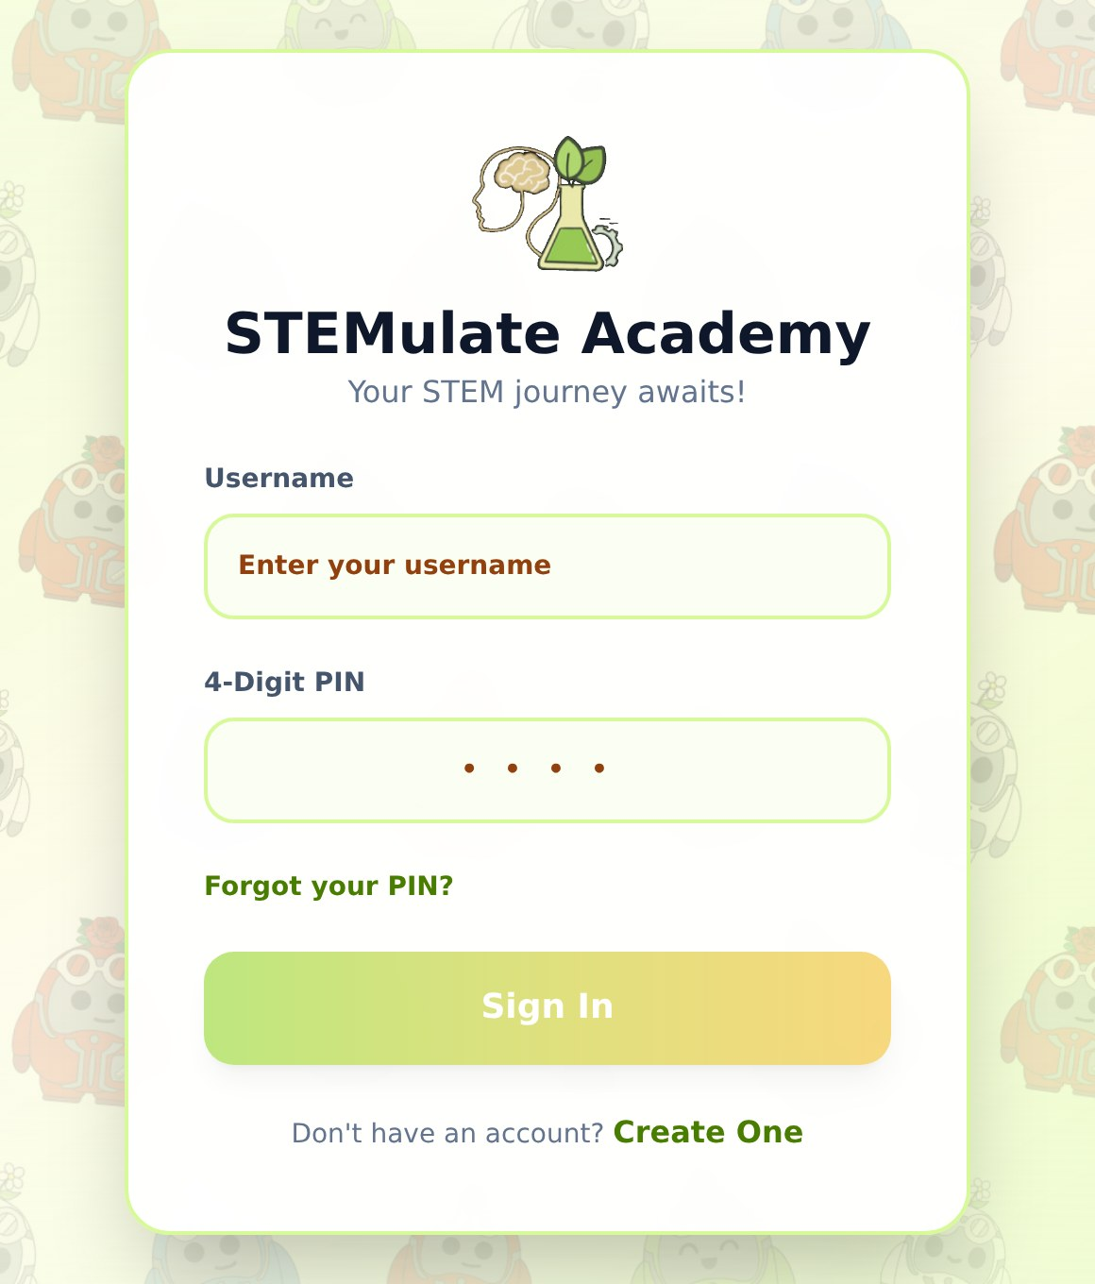
THE IDEA
Our sessions end. Curiosity shouldn't.
STEMulate Academy keeps children learning between sessions, through the games they already love.
Learn through play
Rewards for every step
Simple and safe to join
Lessons are built around Minecraft, Monopoly and Among Us, so science and maths feel like a game, not homework.
XP, Atoms, levels, badges and collectible cards give children a reason to come back, and to finish every lesson.
Children sign in with just a username and a 4-digit PIN (no email needed), and their progress is saved to their account.
The Academy's sign-in page
STEMulate Academy · Partner Deck 2026
03

Slide 4
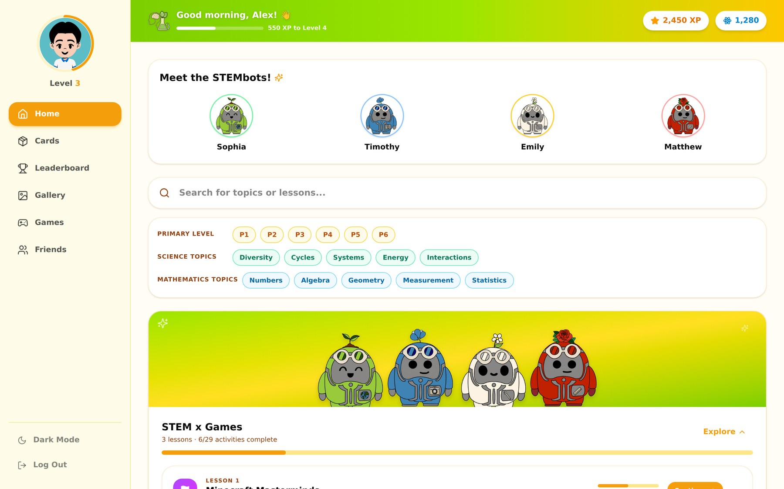
THE PLATFORM
STEMulate Academy at a glance
One cheerful dashboard for lessons, rewards, cards, games and friends.
1
XP & Atoms top bar
Always shows level progress, so every activity feels rewarding.
2
Meet the STEMbots
Four friendly guides, one for each STEM discipline.
3
Filter by level & topic
P1 to P6, plus syllabus topics like Cycles, Energy and Algebra.
4
Six tabs to explore
Home, Cards, Leaderboard, Gallery, Games and Friends, on desktop or mobile.
STEMulate Academy · Partner Deck 2026
04

Slide 5
OUR GUIDES
Meet the STEMbots!
Every lesson is narrated by four characters, one for each letter of STEM.
S
T
E
M
Sophia
Timothy
Emily
Matthew
The Scientist
The Techie
The Engineer
The Mathematician
Fun fact: Can name every layer of the Earth in under 5 seconds!
Fun fact: Built his first circuit out of a potato battery!
Fun fact: Once redesigned her own bicycle gears for a steeper hill!
Fun fact: Can do square roots faster than a calculator (he says).
STEMulate Academy · Partner Deck 2026
05

Slide 6
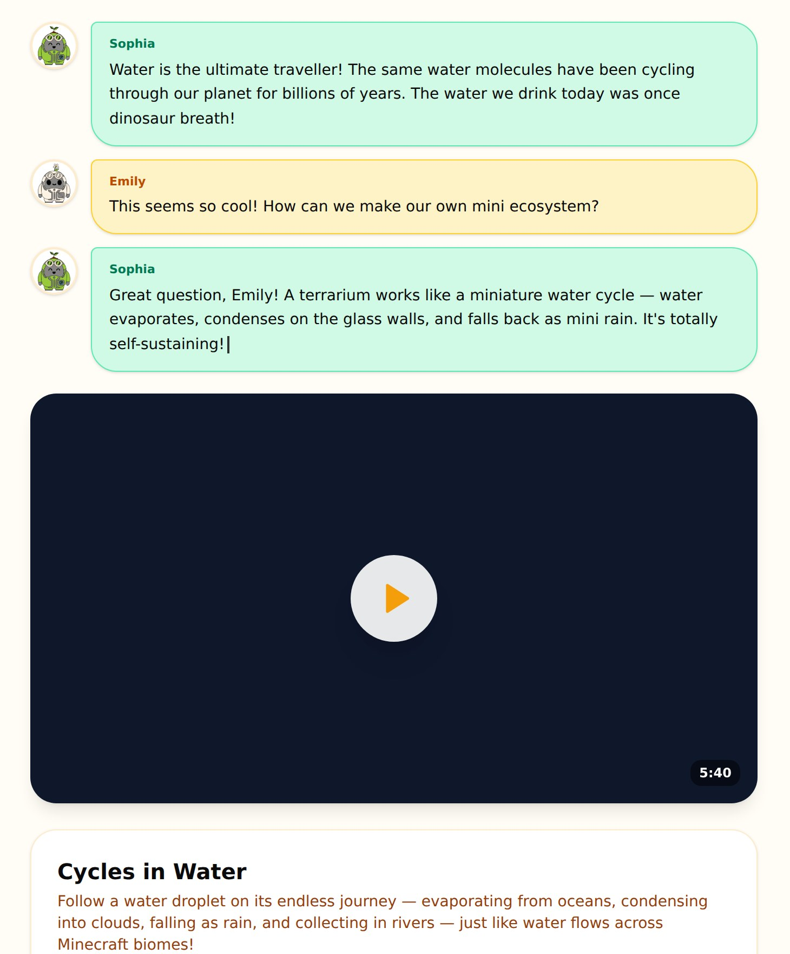
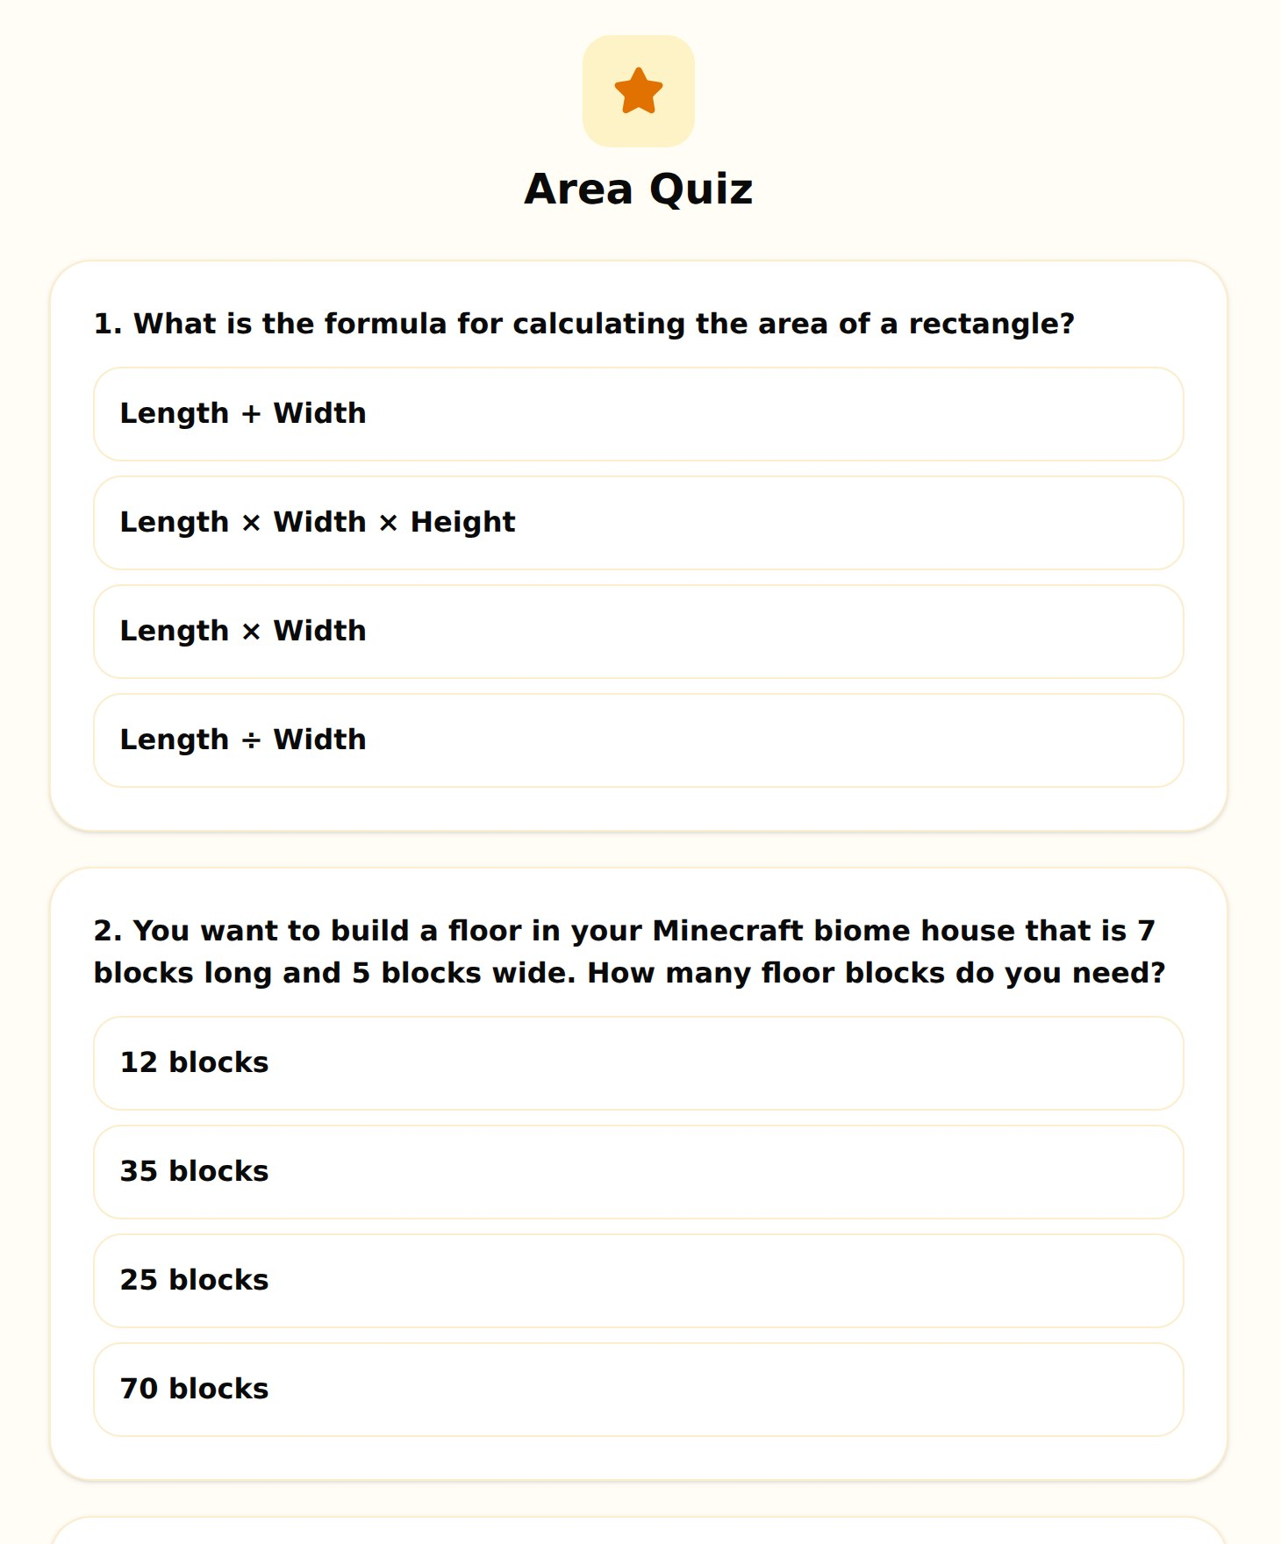
LESSON DESIGN
How every lesson works
Each lesson is a story-led journey of short activities, and every step earns rewards.
1
Intro Story
2
Video Lesson
3
Quiz
4
Game
5
Exit Card
50 Atoms
200 XP + 100 Atoms
50–100 XP + 25 Atoms
500 XP + 300 Atoms
100 XP + 50 Atoms
Built-in support
STEMbot dialogue introduces every video, quiz and game.
Instant quiz feedback explains why each answer is right.
Ask STEMbots: a help panel where children can ask questions about the lesson they're on.
Exit cards (3 things learnt, 2 facts, 1 question) build reflection habits.
STEMulate Academy · Partner Deck 2026
06

Slide 7
OUR FIRST MODULE
STEM x Games: 3 lessons, 29 activities
Primary-school science and maths, taught through three games children already play.
LESSON 1
LESSON 2
LESSON 3
Minecraft Masterminds
Mission Millionaire
Space Busters
Played through Minecraft
Played through Monopoly
Played through Among Us
Explore biomes to see how matter and water cycle, then build rooms to spec.
Manage money like a property tycoon: rent, salaries, GST and shop discounts.
Restore a spaceship's power with energy and forces, and fix its systems with BODMAS.
SCIENCE
MATHEMATICS
SCIENCE
Cycles in Matter
Cycles in Water
Decimals
Percentages, GST & Discounts
Energy
Forces
MATHEMATICS
MATHEMATICS
Area
Volume
Order of Operations (BODMAS)
P5–P6
12 activities · 2 games
P4–P6
7 activities · 1 game
P5–P6
10 activities · 2 games
9
video lessons
9
quizzes
5
games
3
intro stories
3
exit cards
STEMulate Academy · Partner Deck 2026
07

Slide 8
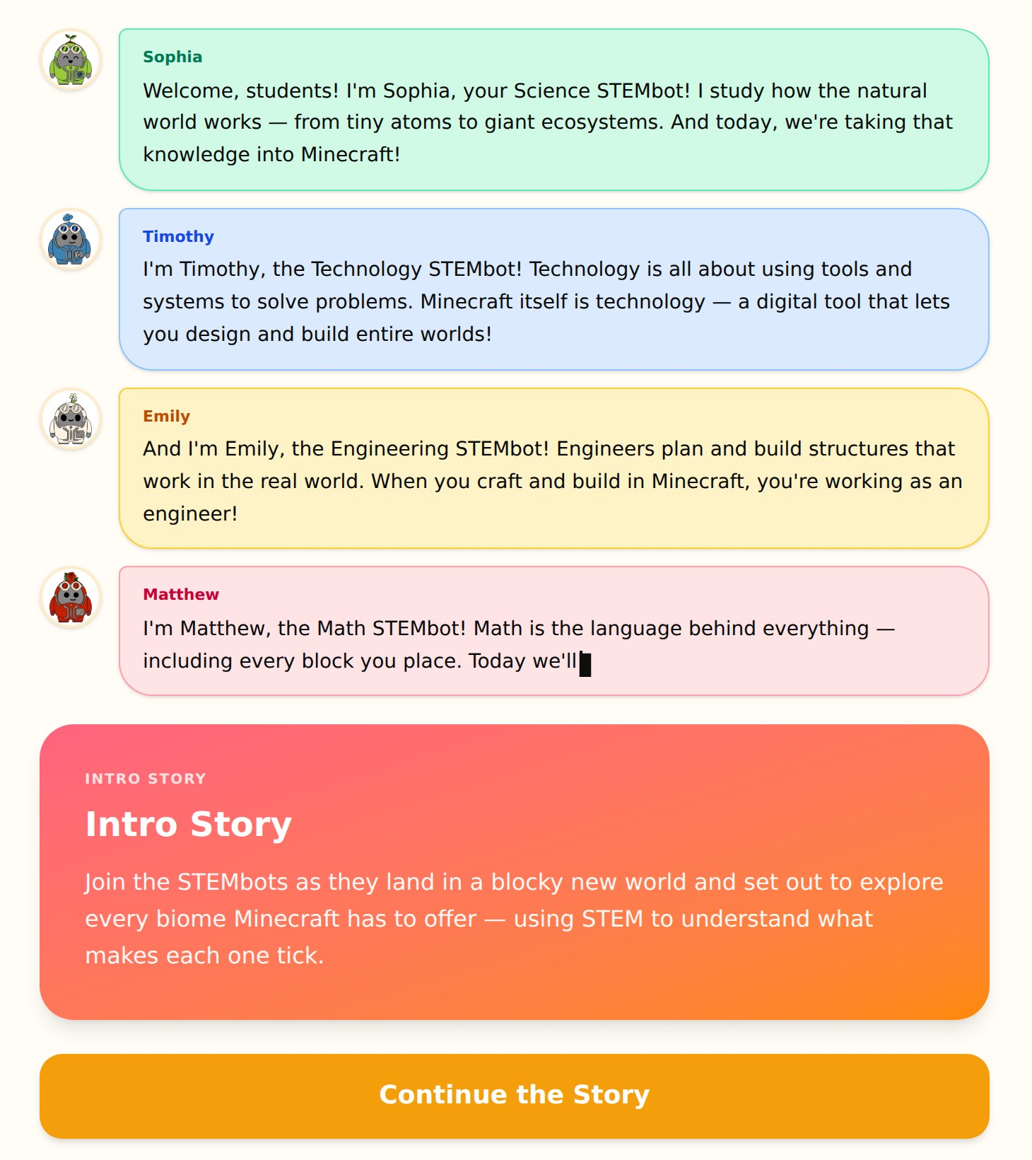
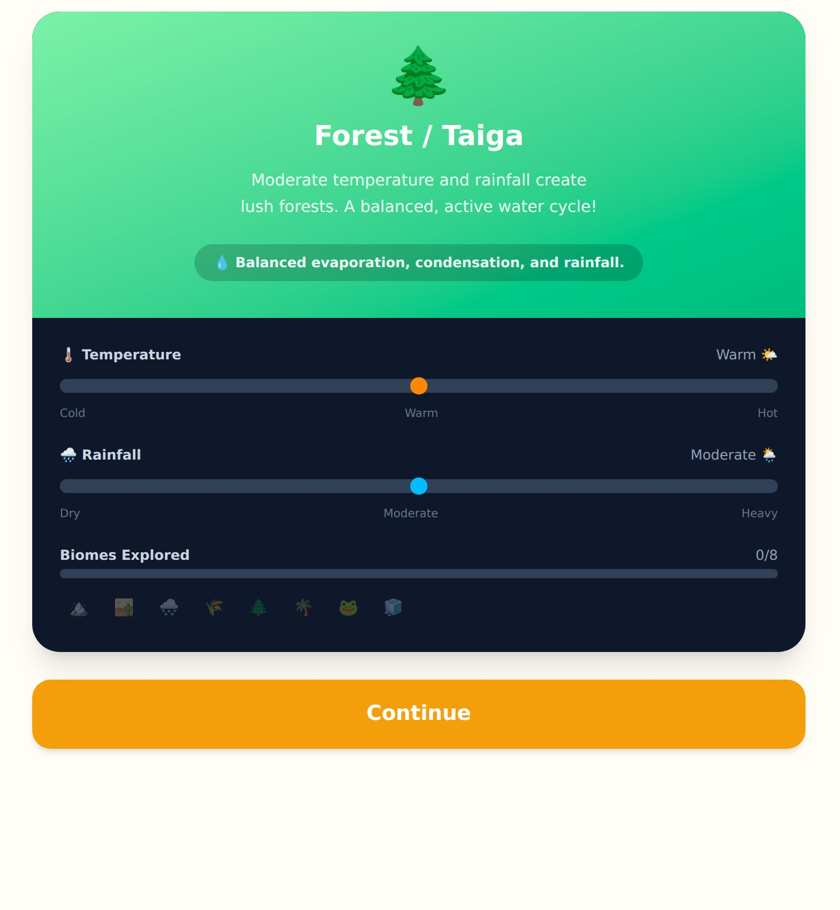
LESSON 1 · MINECRAFT
Minecraft Masterminds
Matter and water cycles, plus area and volume, through Minecraft biomes and builds.
SCIENCE
• Cycles in Matter states of matter, video + quiz
• Cycles in Water the water cycle, video + quiz
MATHEMATICS
• Area (Length × Width) video + quiz
• Volume (L × W × H) video + quiz
GAMES
• Water Cycle Biome Lab balance temperature & rainfall
• Minecraft Room Designer build rooms to spec
Sample quiz question
You want a 7 × 5 block floor in your Minecraft house. How many blocks do you need?
STEMulate Academy · Partner Deck 2026
08

Slide 9
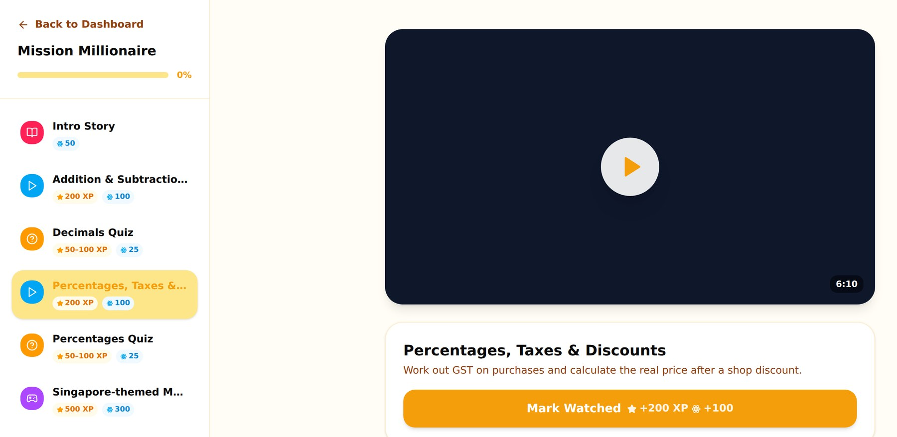
LESSON 2 · MONOPOLY
Mission Millionaire
Budgeting, GST and discounts, as Timothy helps manage a property empire at family board-game night.
MATHEMATICS
• Addition & Subtraction with Decimals P4–P5
• Percentages, Taxes & Discounts P5–P6
GAME
• Singapore-themed Monopoly budgeting in real time
PLUS
• Intro story, 2 quizzes and an exit card
Sample quiz question
An item costs $50 with a 20% discount. What's the sale price?
STEMulate Academy · Partner Deck 2026
09

Slide 10
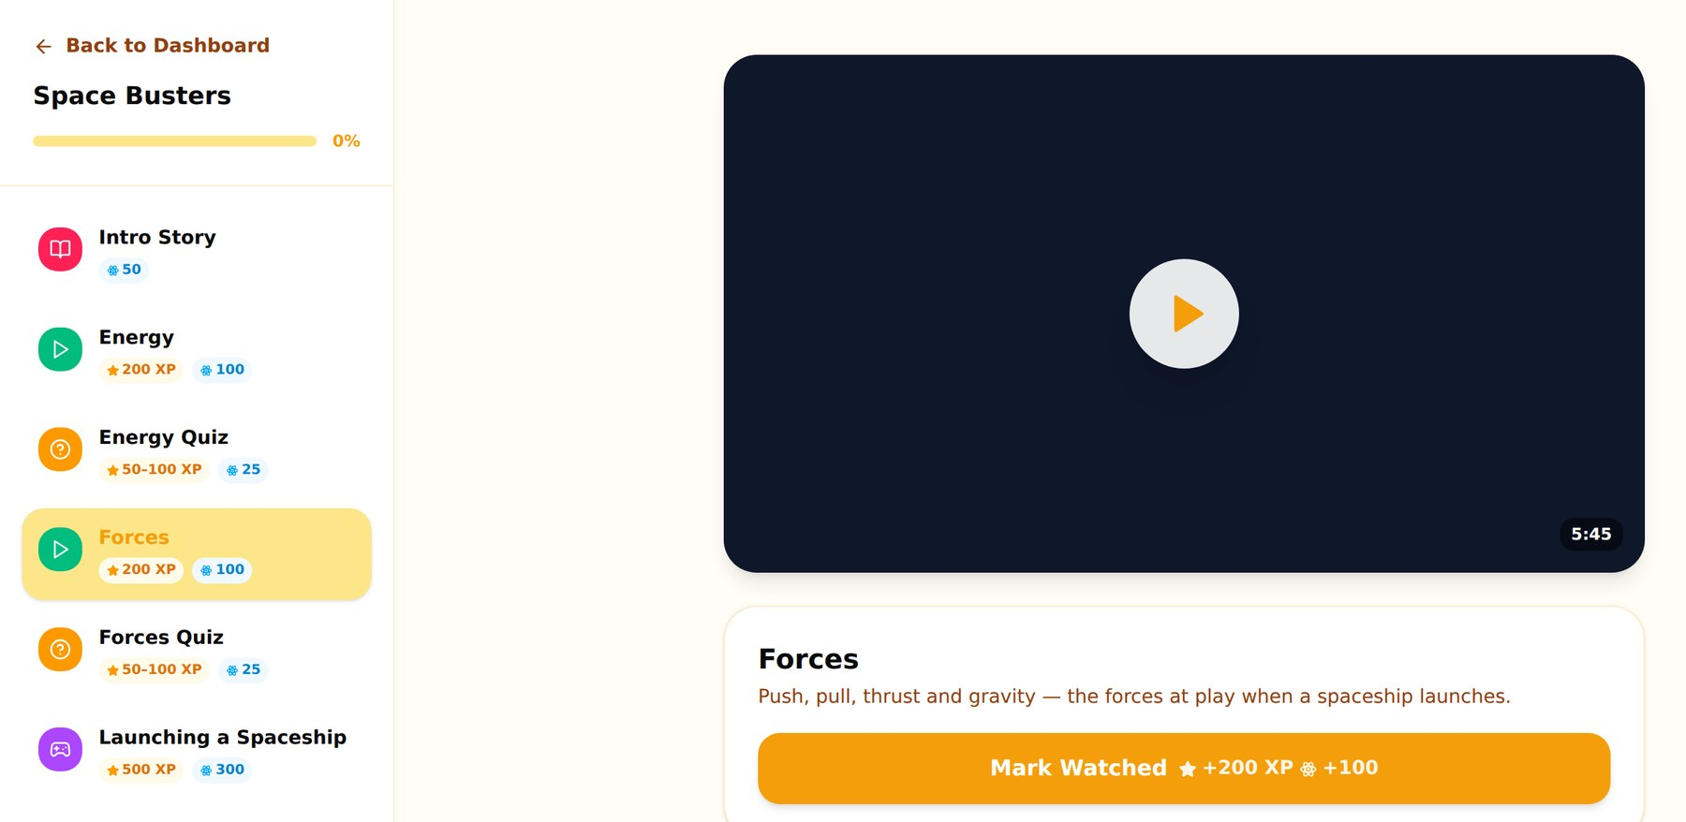
LESSON 3 · AMONG US
Space Busters
The crew's spaceship has lost power. Can students restore the engines before the impostor strikes?
SCIENCE
• Energy kinetic vs potential, P6
• Forces push, pull, thrust & gravity, P6
MATHEMATICS
• Order of Operations BODMAS, P5–P6
GAMES
• Launching a Spaceship balance energy & forces
• Among Us Tasks as BODMAS tasks as sums
Sample quiz question
What is 4 + 2 × (6 − 3)?
STEMulate Academy · Partner Deck 2026
10

Slide 11
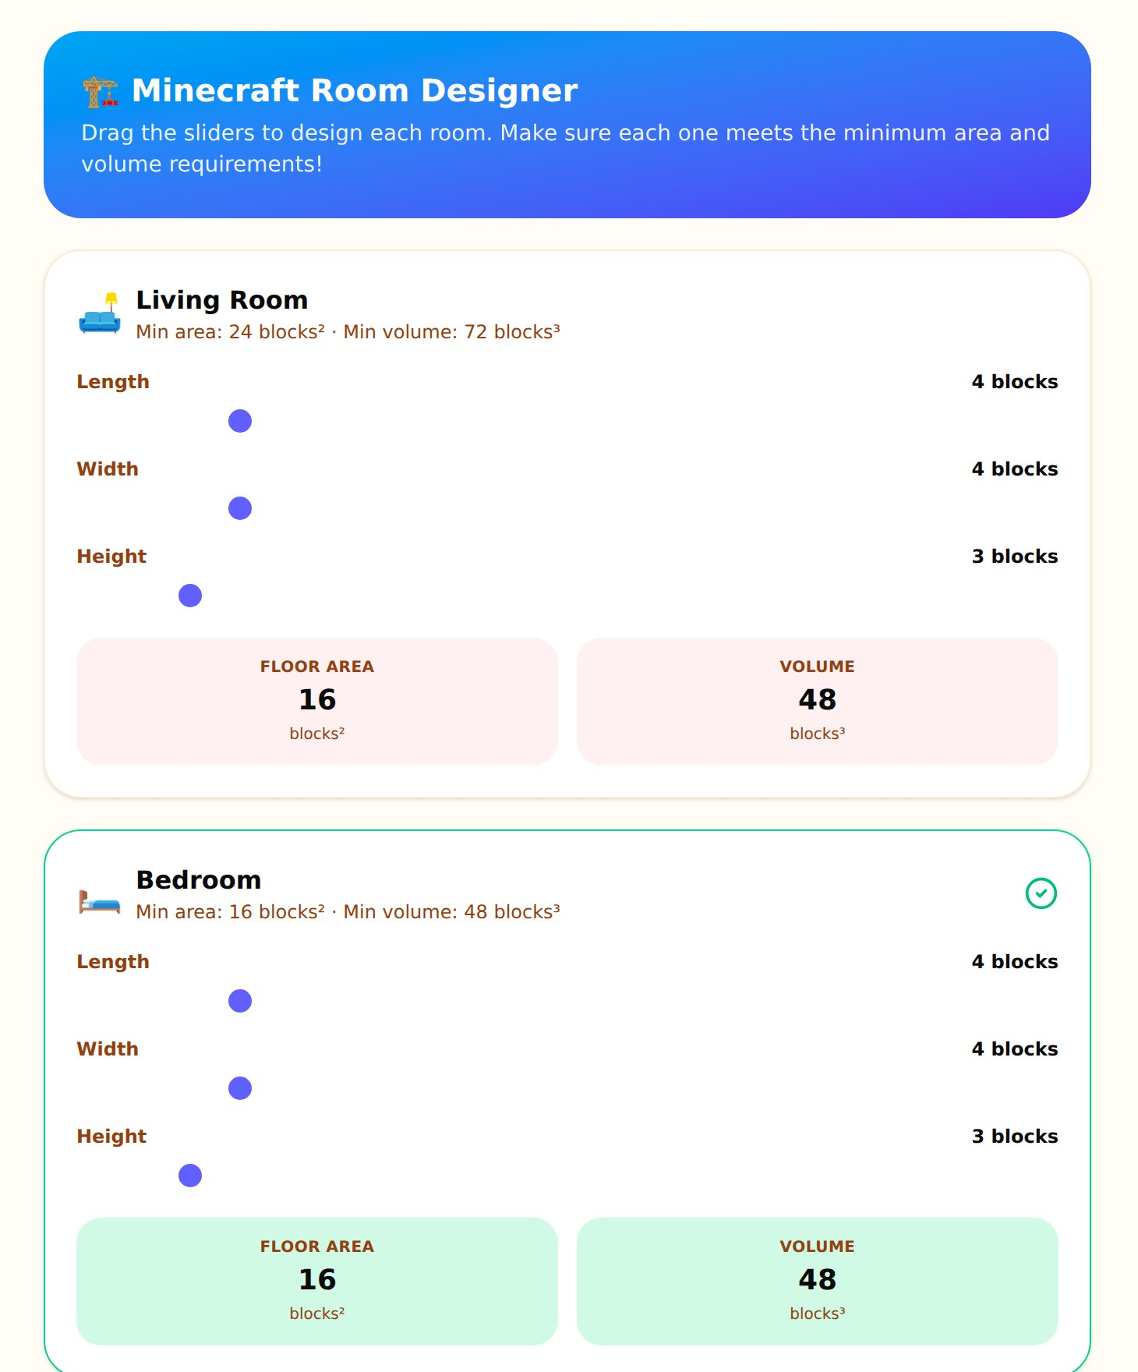
FEATURE · MINI GAMES
Hands-on games in every lesson
Children learn by doing: sliders, builds and challenges that respond in real time.
The Games tab
• Every game in one place: each lesson's games are collected on a single page.
• Unlocked by learning: a game unlocks once its lesson is completed.
• Replay for a top-up: play again anytime for +10 XP and +5 Atoms.
• Worth the most: each first-time game win earns 500 XP + 300 Atoms.
Water Cycle Biome Lab: keep a forest biome alive by balancing temperature and rainfall. Minecraft Room Designer: build rooms that meet area and volume targets.
STEMulate Academy · Partner Deck 2026
11

Slide 12
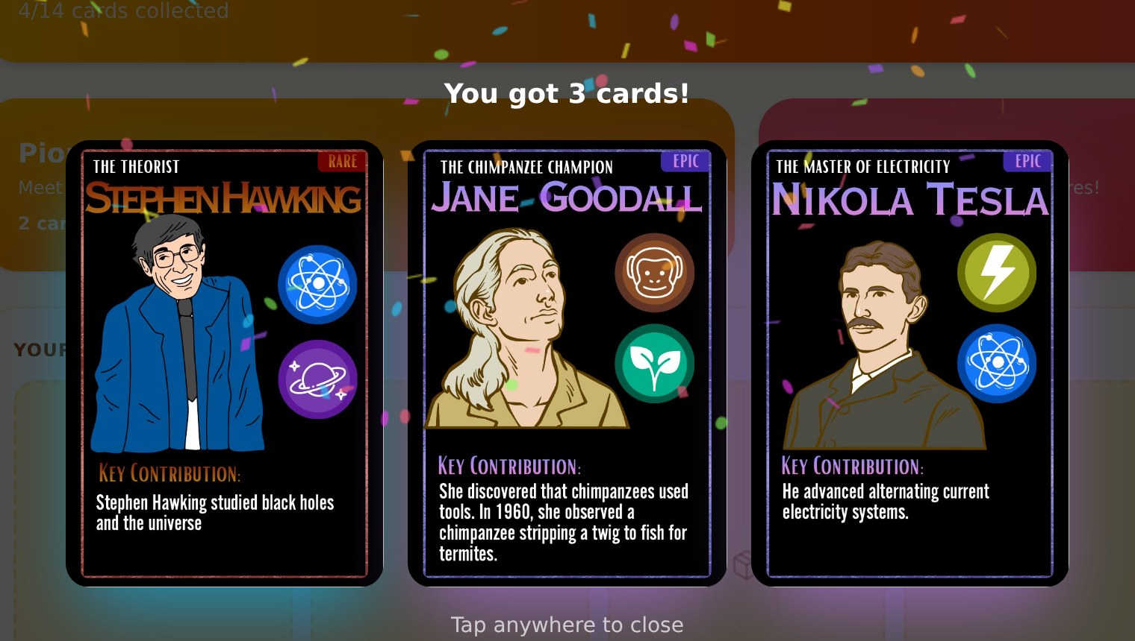
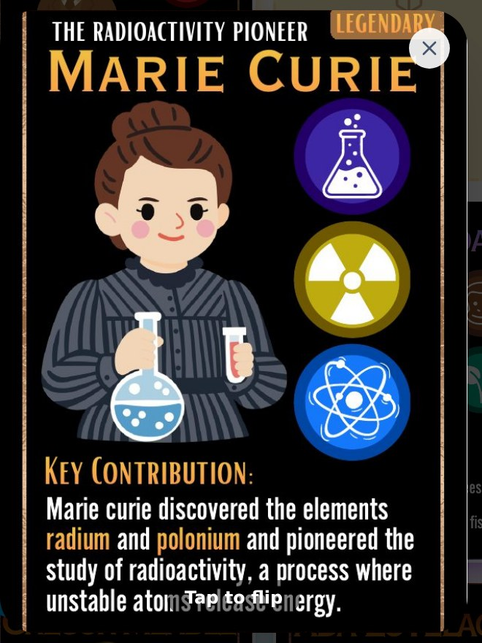
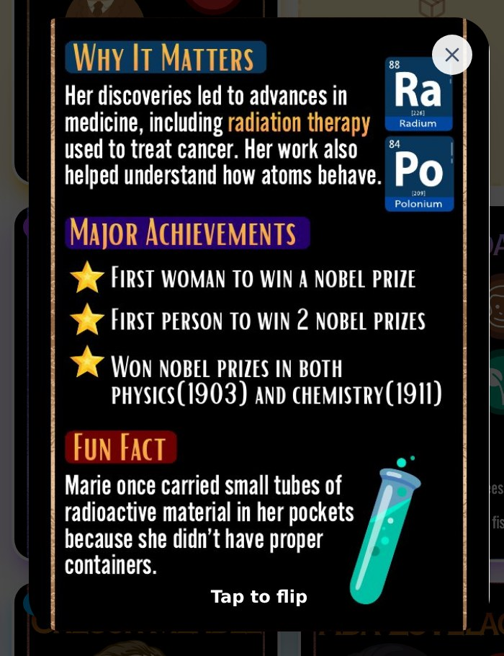
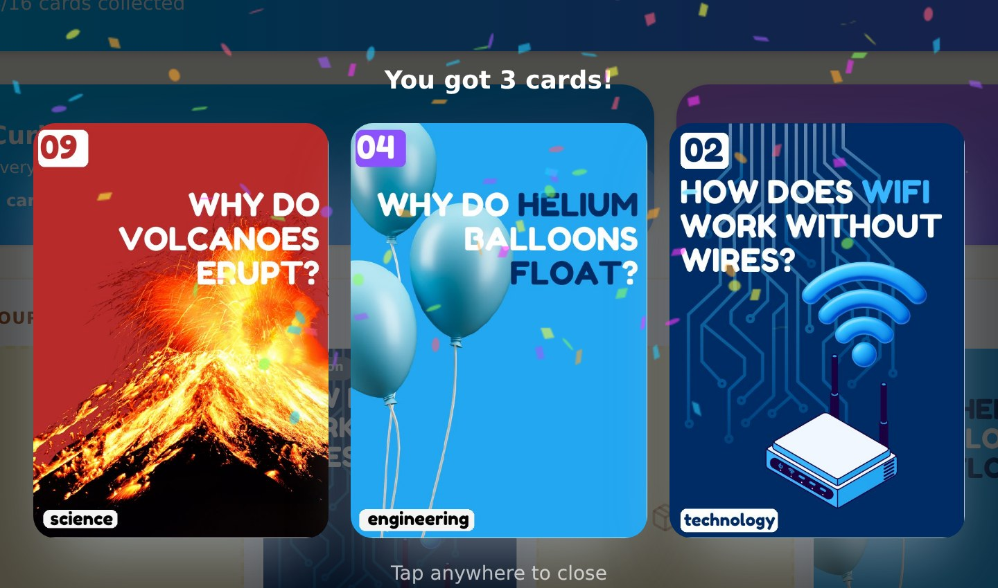
FEATURE · CARD ALBUMS
Collect 30 STEM cards
Atoms earned from lessons open card packs, and every card teaches something new.
How it works
• Spend Atoms on packs (50–150 Atoms each)
• Tap and hold to unlock, with confetti!
• Rarities: Common, Rare, Epic, Legendary
• Duplicates stack (x2, x3…) and can be traded with friends
Tap any card to flip it and learn why it matters.
Phenomena Album: 16 cards on everyday wonders, e.g. “Why do volcanoes erupt?”
Figures Album: 14 STEM heroes, from Marie Curie and Katherine Johnson to Alan Turing.
STEMulate Academy · Partner Deck 2026
12

Slide 13
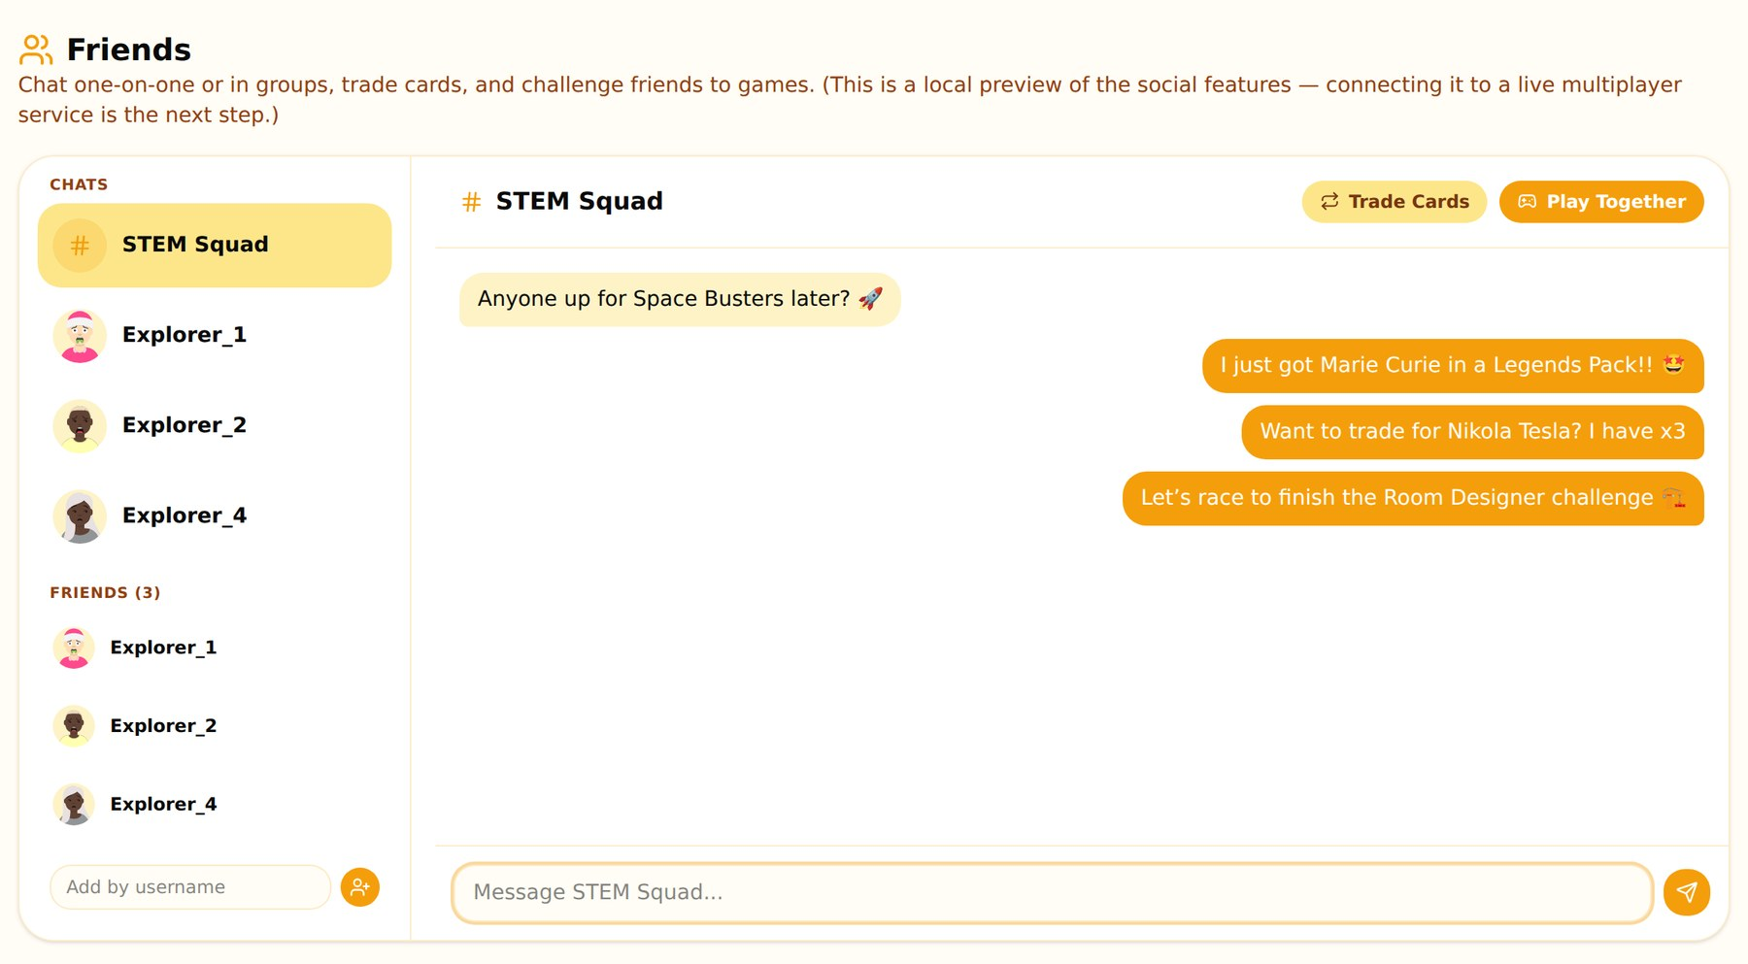
FEATURE · FRIENDS & CHATS
Learning is better with friends
A friendly, Discord-style space to chat, trade cards and team up for games.
What children can do
• Group chats (e.g. “STEM Squad”) and 1-to-1 messages
• Add friends by username, or from the leaderboard
• Trade collectible cards with friends
• Challenge friends with “Play Together”
Preview feature
The social tab works on-device today. Linking it to a live, moderated multiplayer service is our next milestone.
STEMulate Academy · Partner Deck 2026
13

Slide 14
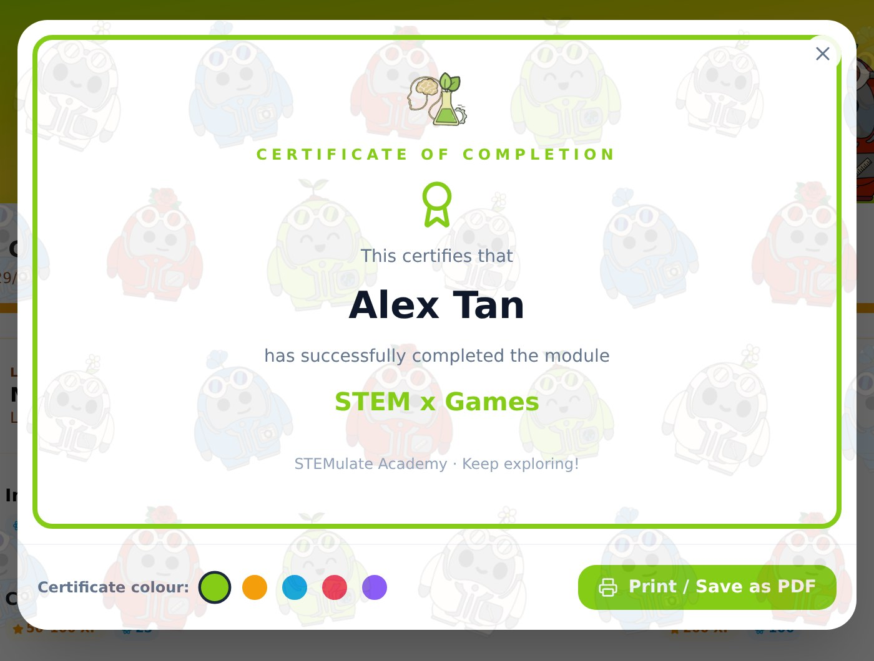
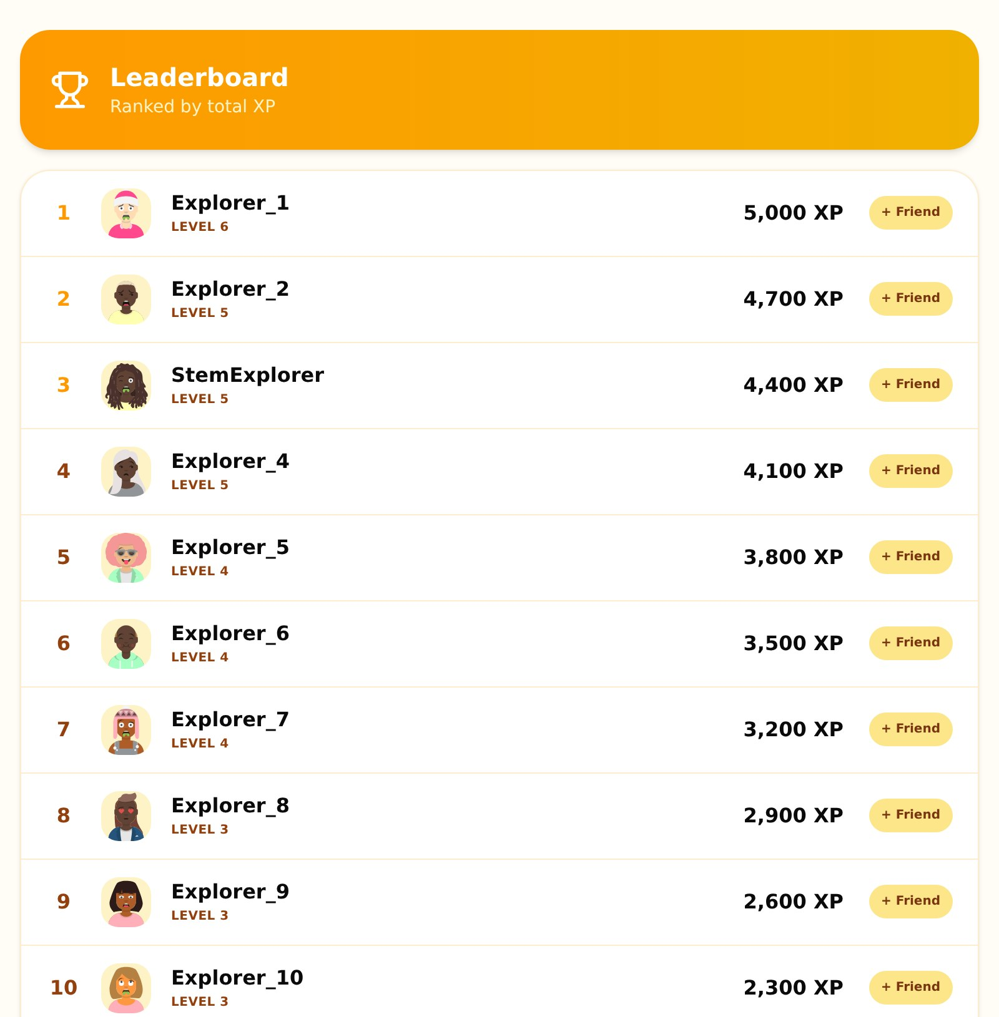
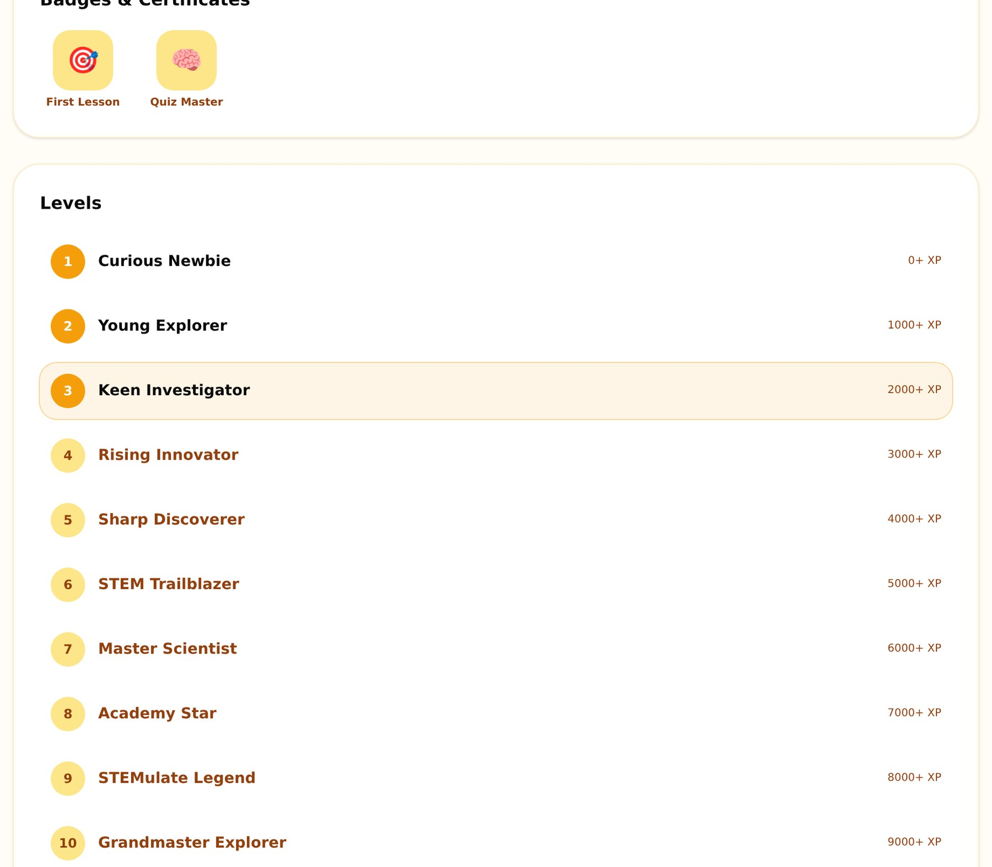
FEATURE · LEADERBOARDS & REWARDS
Friendly competition, real progress
XP turns effort into levels, rankings, badges and certificates.
Leaderboard ranks learners by total XP.
10 levels, from Curious Newbie to Grandmaster Explorer.
Certificates: finishing a module unlocks a badge and a printable certificate.
STEMulate Academy · Partner Deck 2026
14

Slide 15
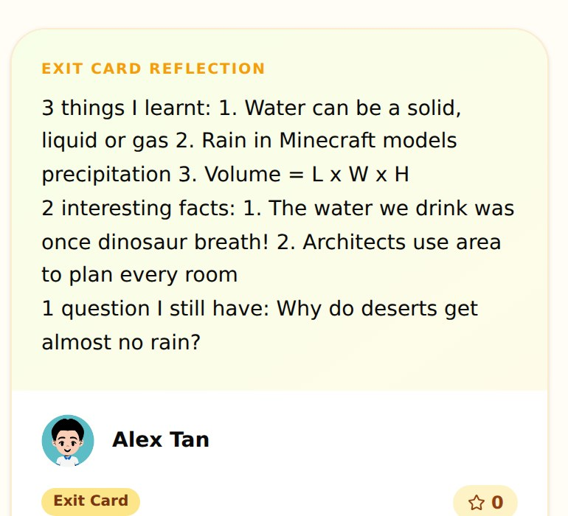
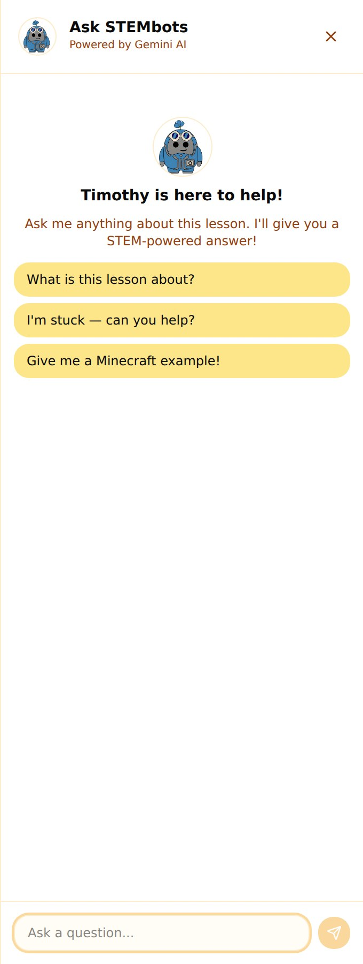
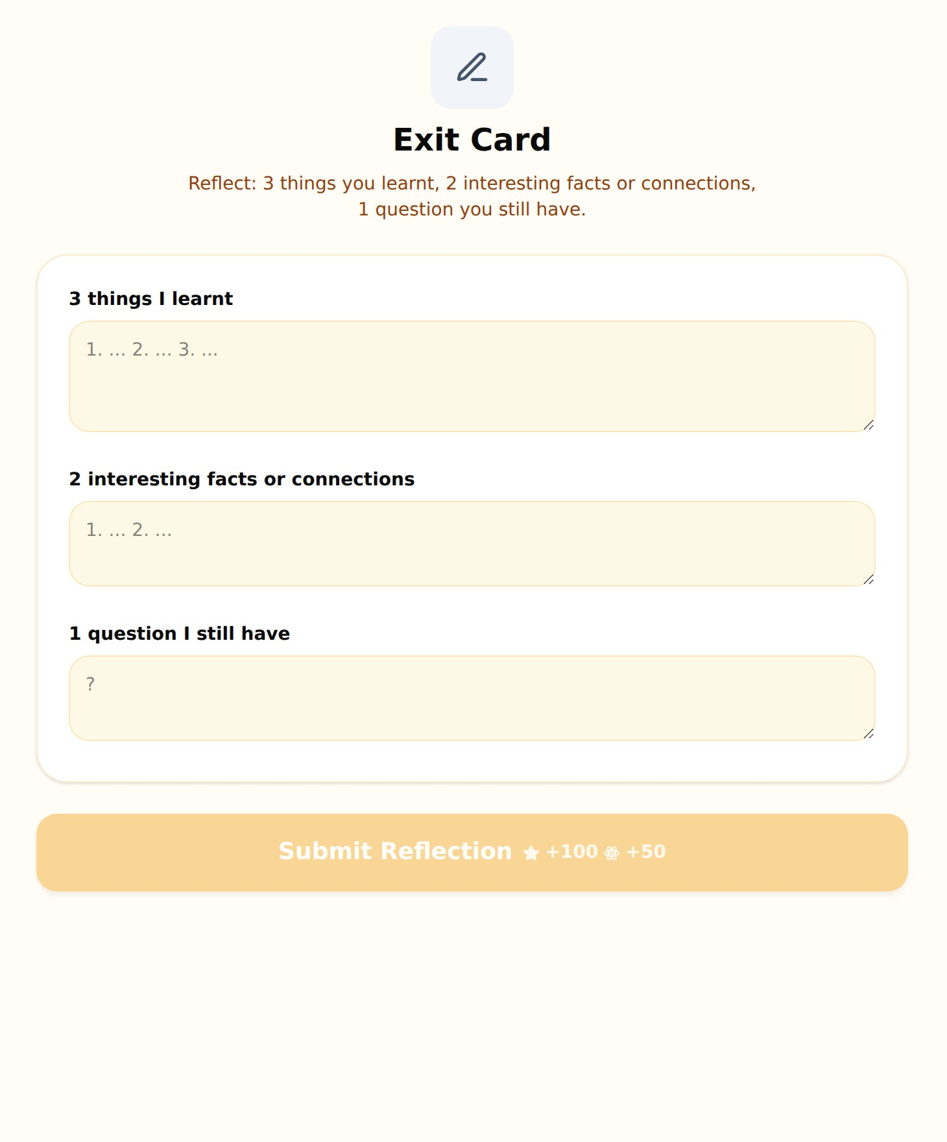
FEATURE · GALLERY & HELP
Reflect, share and ask
Children publish what they've learnt and get help without leaving the lesson.
Ask STEMbots
A help panel in every lesson. Children can type a question or tap a prompt like “I'm stuck, can you help?”, and a STEMbot replies with a short, age-appropriate answer.
Gallery: every exit-card reflection is published as a post that classmates can like.
STEMulate Academy · Partner Deck 2026
15

Slide 16
FOR PARTNER ORGANISATIONS
Designed with your centre in mind
Getting a class started takes minutes, and every child's progress is saved.
Centres already on the sign-up list
1
Child-friendly login
Username + 4-digit PIN. No email needed. PINs are securely hashed, never stored as plain text.
Brighton Connection
Caritas Singapore
CDAC
Faithacts
New Life Care Centre
2
Easy PIN recovery
Sheng Hong Student Care
VIVA Foundation
Children pick a favourite colour and subject as tap-to-choose picture blocks.
+ Others (please specify)
Children choose their centre when they create an account, so partners can see their own learners on the platform.
New centre? It can be added straight from the sign-up form.
3
Progress that sticks
Completed activities, XP and Atoms are saved to each child's account.
4
Any device
Desktop, tablet and mobile, with light and dark modes.
STEMulate Academy · Partner Deck 2026
16

Slide 17
WHAT'S NEXT
Where we're heading, together
STEM x Games is just the start. Three more modules are already on the dashboard.
How you can partner with us
STEM x Sports
STEM x Magic
STEM x Content Creation
Pilot
COMING SOON
COMING SOON
COMING SOON
Bring STEMulate Academy to a group of your students for a term.
On our roadmap
Co-run sessions
• More lessons in STEM x Games, and new modules as they're ready
• Live, moderated chat and multiplayer for the Friends tab
• Centre-level leaderboards and progress views for partners
• Continued in-person STEMulate sessions alongside the platform
Pair our volunteers' in-person workshops with the platform.
Shape it
Tell us what your children need, and we'll build it into the next modules.
STEMulate Academy · Partner Deck 2026
17

Slide 18
Let's STEMulate together!
Thank you for your time. We'd love to explore how STEMulate Academy can support your students.
projstemulate.com
Get in touch through the contact page on our website
STEMulate Academy · Partner Deck 2026
18

