Slide 1
Measuring Password Guessability
Joseph Vick

Slide 2
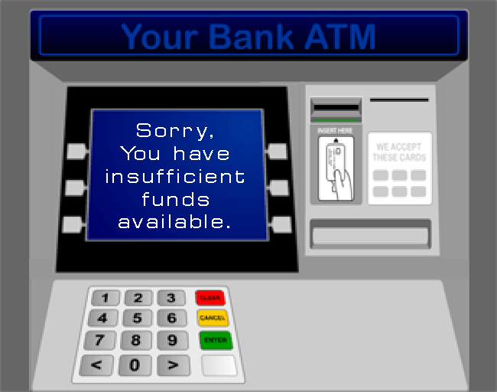
An Unfortunate Scenario
!?
How did this happen?
Weakest link in the chain

Slide 3
Serious Business
We all must take the security of our passwords more seriously

Slide 4
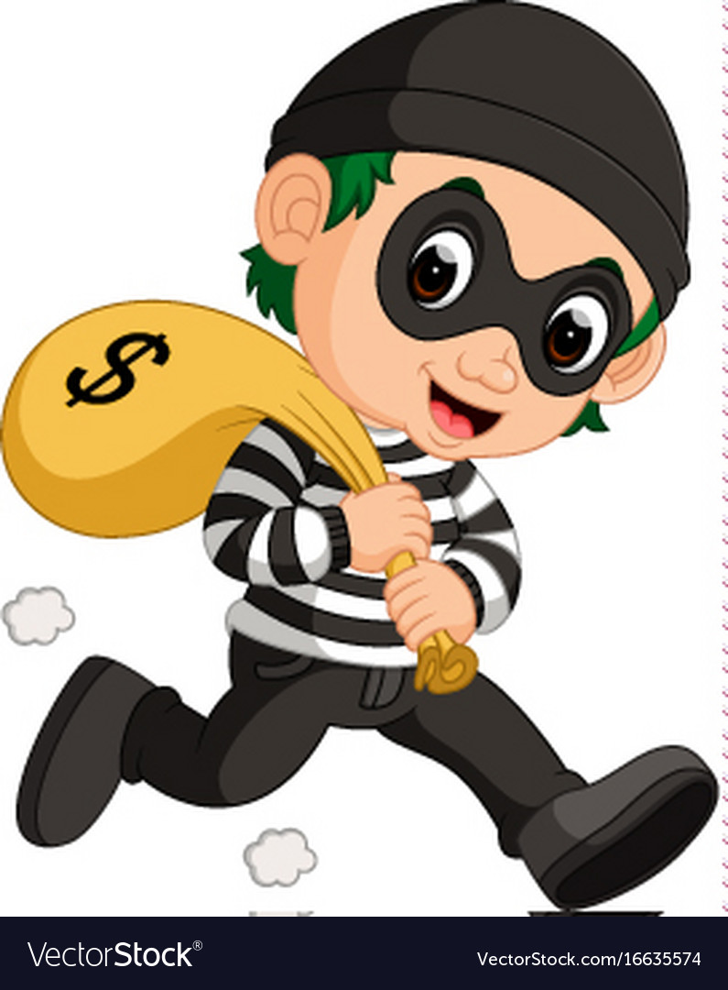
The Stakes are High
Bad actors
Loss of property/funds
Fraud
Theft

Slide 5
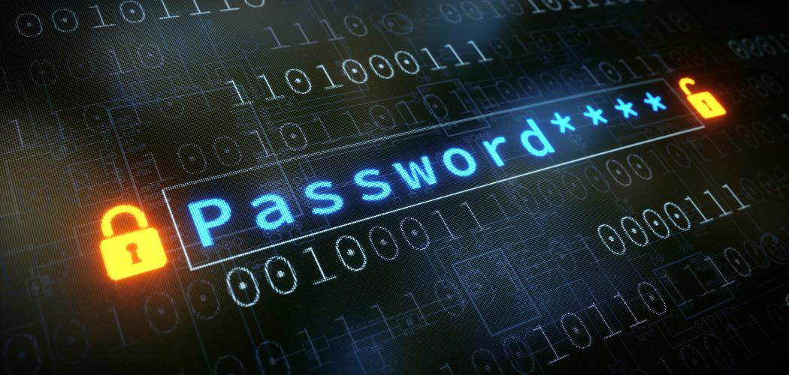
What a Hassle
Difficulty remembering passwords
Remember which password goes to which account
Remembering to periodically update old passwords

Slide 6
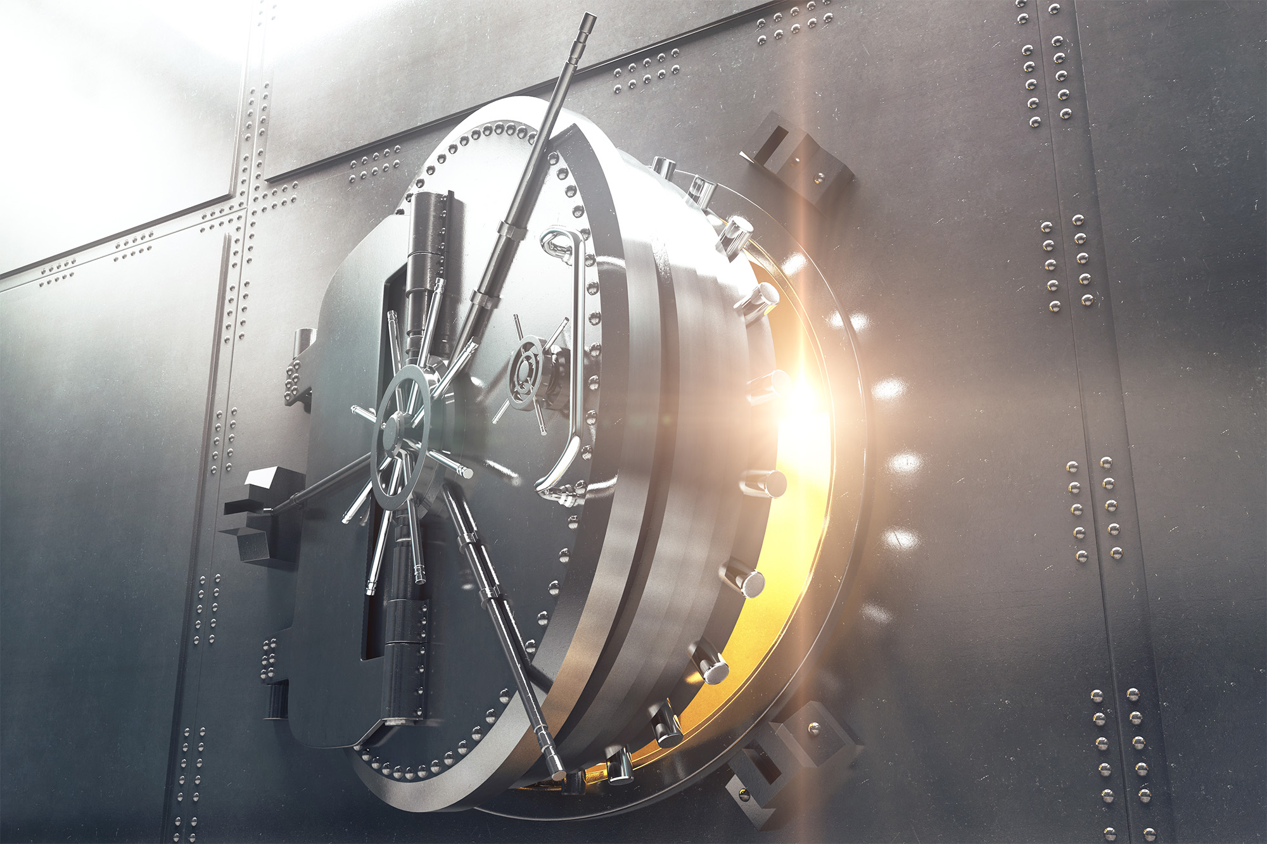
It’s Worth the Hassle
The value of information is higher than ever

Slide 7
Conclusion
Know how to set a strong password
Protect your information

Slide 8
Works Cited
https://nordpass.com/most-common-passwords-list/
https://en.wikipedia.org/wiki/Password_strength
https://www.youtube.com/watch?v=7U-RbOKanYs

