Slide 1
Mario Kart
Jose Vieitez

Slide 2
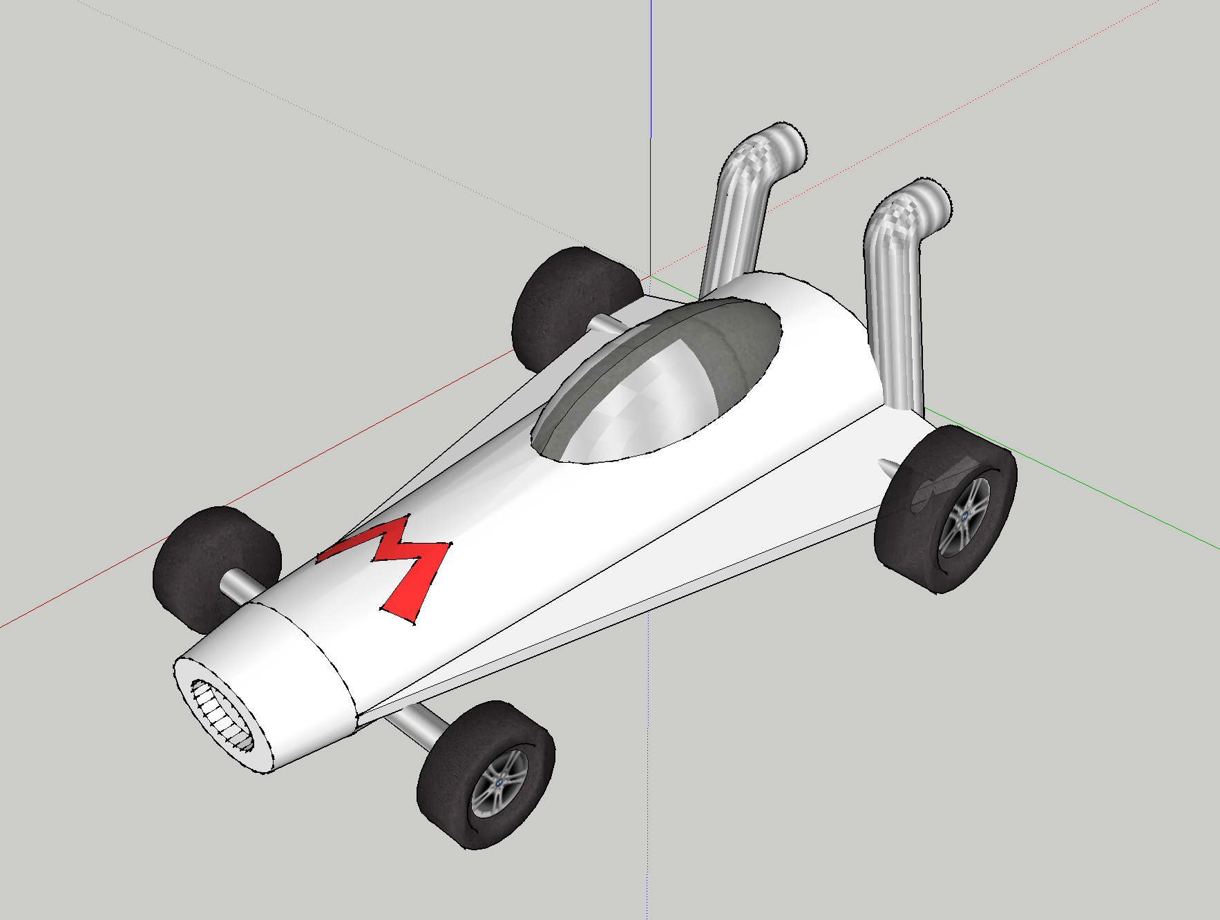
Designed Kart

Slide 3
Some Features
Motion:
took a while to do motion based on yaw the camera movement was very choppy and could not figure out why.
A fun glitch a found was that the order of my code was making the difference. I was updating the camera location, then I was updating the object location, causing it to be jumpy.

Slide 4
Background Scene
Dusted off Photoshop

Slide 5
Collisions
making it so collisions occur (walls, etc) was time consuming and found there is no very easy way except hard coding the coords without restructuring everything.

Slide 6
Lighting
Shadows and Lighting was challenging but eventually it worked

Slide 7
Cockpit MOde
Created a different View.
Was surprisingly challenging to get camera movement right, and at some angles it isn’t at 100%

