Slide 1
CISC 181
April 20, 2021
University of Delaware
By James Villemarette

Slide 2
PowerPoint Overview
some quick things
Notices
Problems I’ve noticed with lab 6 (Train)
Looking Ahead
Lab 7

Slide 3
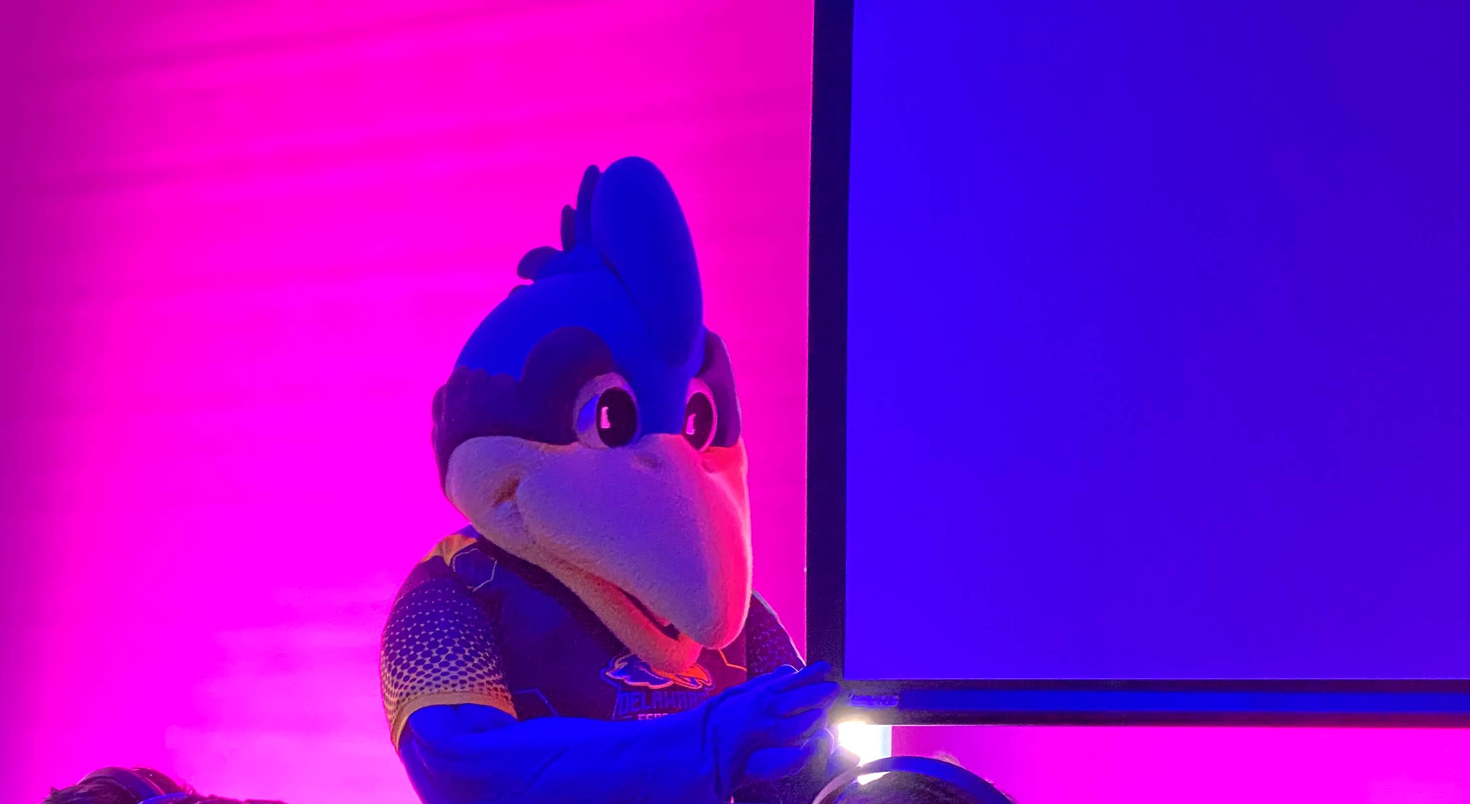
some quick things
Fun fact:
YoUDee is officially androgynous, even though it has a chicken comb >>>

Slide 4
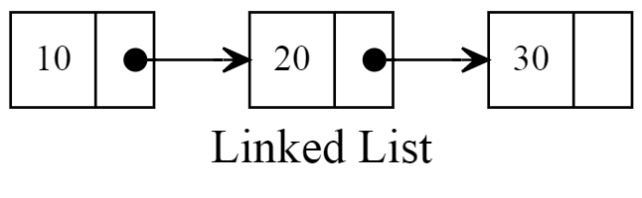
Train (Lab 6A)
The Train and TrainCar classes
It was secretly a linked list in disguise!
g
Source: RubyGuides

Slide 5
Train (Lab 6A)
Several Train methods
attachAtEnd
attachAtFront
countTrainCars
countEmptyTrainCars
totalWeight
unloadCargo
loadCargo
removeFromFront
insertCargoAfter
toString
Number of mistakes from students*
<< 4
<< 0
<< 0
<< 12
<< 0
<< 1
<< 14
<< 3
<< 6
<< 0
*of what has been graded so far

Slide 6
Train (Lab 6A)
Lab instructions
countEmptyTrainCars()
Add a method named countEmptyTrainCars that returns the total number of TrainCars that are not carrying any cargo
loadCargo()
Add a method named loadCargo that accepts a String representing a cargo type and an int representing the number of pounds of cargo. This method loads the first empty TrainCar with the cargo. If there are no empty TrainCars, a new TrainCar object is created, loaded and attached to the end of the Train (Hint – use your attachAtEnd method).
Specifics!

Slide 7
Train (Lab 6A)
Common mistakes
countEmptyTrainCars() two most common problems:
What if there’s an empty train, head = null?
Caused NullPointerException
Counted weight instead of number of empty cars.
loadCargo() three most common problems:
What if there’s an empty train, head = null?
Caused NullPointerException
Didn’t create a new train car
Didn’t actually add to empty train car

Slide 8
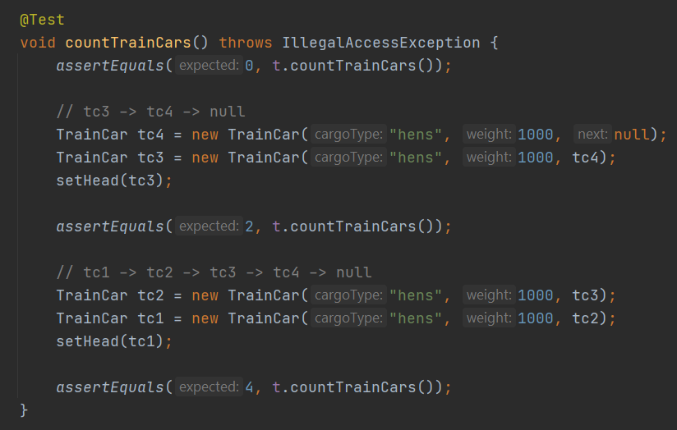
Train (Lab 6A)
The tests for this lab were specific!
They were written so that they were tested your methods individually, using Java reflections
Super secret setHead() and getHead() methods were defined using Java Reflections to manually change the private field head in an instance of your Train class.
Will cover Java Reflections in next week’s PowerPoint. Not enough time now. Do try to learn it on your own to better ingrain and appreciate it, if you can.

Slide 9
Train (Lab 6A)
countEmptyTrainCars() how it works
If the head is null, just return 0
Otherwise initialize a temp TrainCar to the value of head in Train
Initialize an integer count to 0
While the temp is not null
If the TrainCar’s weight is 0, then increase count by one
Set temp to the next TrainCar
Return count
Train
…
TrainCar head
TrainCar
…
TrainCar next
…
int weight
TrainCar
…
TrainCar next
…
int weight
TrainCar
…
TrainCar next
…
int weight
TrainCar
…
TrainCar next
…
int weight

Slide 10
Train (Lab 6A)
loadCargo() how it works
The previous slide is very explicit on how to solve countEmptyTrainCars(). Try reimplementing on your own
Use the design pattern of the previous slide to solve this method, loadCargo()
Train
…
TrainCar head
TrainCar
…
TrainCar next
…
int weight
TrainCar
…
TrainCar next
…
int weight
TrainCar
…
TrainCar next
…
int weight
TrainCar
…
TrainCar next
…
int weight

Slide 11

Looking Ahead

Slide 12
Rubric Ideals
We will try to not grade lab submissions on the same criteria/code more than once
However, a lot of the lab code is interrelated, and we may either directly or indirectly have to “grade” the same code, twice
Still, try your best, and double check that your past lab code is correct (from grades and feedback)
Contact the TAs/Wassil if you’re still running into trouble

Slide 13
Lab 7
Share code between your group!
How?
You could literally send the .java files b/w each other by email
Your entire group meets together and edits on one member’s machine
https://replit.com/
Basically Google Docs for an IDE
Or Git/GitHub
Maybe a little more advance
You will be using this in CISC 275 (and beyond!)
A free account is powerful, but you can get a student account with your .edu email

Slide 14
Accessing Objects within Objects
We’ve done this before
And do this a lot of the time
Quite a few students are being thrown off by this

Slide 15
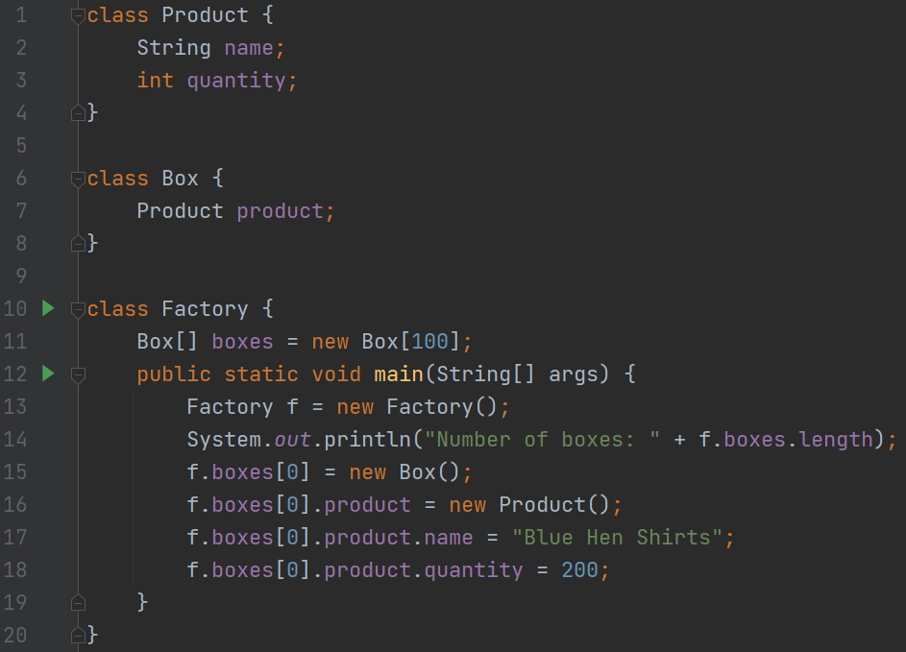
Accessing Objects within Objects
What is the data type of the first box?
Factory
Second box?
Box
Third box?
Product
Fourth box?
String
Fifth box?
int
1
2
3
4
5
Disclaimer 1: Do NOT put multiple Java classes in the same .java file. This is only done here as a concise demonstration
Disclaimer 2: Do NOT use the (default) access modifier unless the instructions say to. This is only done here as a concise demonstration.

Slide 16

that’s all :)

Slide 17
Group Time
Continue working on Lab 7 in Canvas!

