Slide 1
CISC 181
April 6, 2021
University of Delaware
By James Villemarette

Slide 2
PowerPoint Overview
some quick things
Notices
Problems I’ve noticed with lab 4
Looking Ahead
Lab 6’s Trains

Slide 3
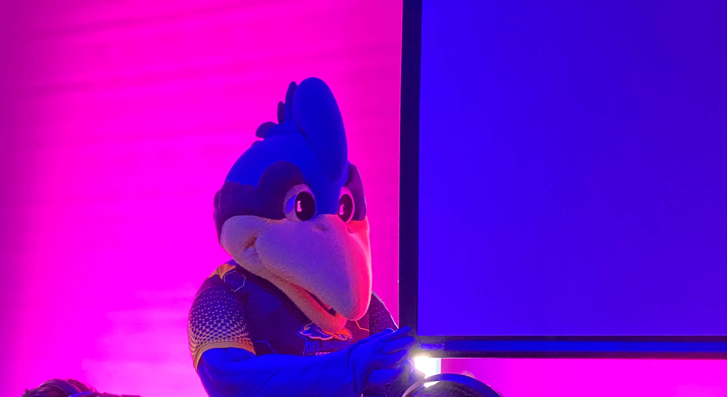
some quick things
Fun fact:
YoUDee is officially androgynous, even though it has a chicken comb >>>

Slide 4

PowerPoint Posting
These PowerPoints are uploaded to the Google Drive folder after every lab has a chance to present them

Slide 5

Office Hours
You can come and hang out in Office Hours
Work in a private breakout room, ask for help when needed
Totally fine

Slide 6
Final Withdraw Date
May 3rd is the last day that you can withdraw/audit a class
There’s NO pass-fail modified grading basis
Whatever grade you get cannot be changed into high/mid/low-pass.
Wassil and the TAs want you to succeed
Please reach out if you’re having any problems
More serious problems (medical or otherwise) require you to tell the Dean of your college
We are still flexible within our class

Slide 7
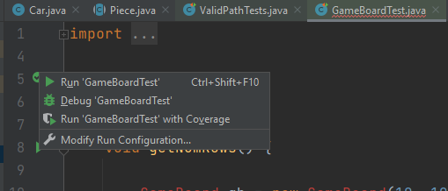
Run the Unit Tests!
The vast majority of points lost on the labs could have been saved if the student ran the unit test
It’s free to run!
Pros
Prevents lost points
Satisfaction when they pass
Cons
???
None

Slide 8

Looking Ahead

Slide 9
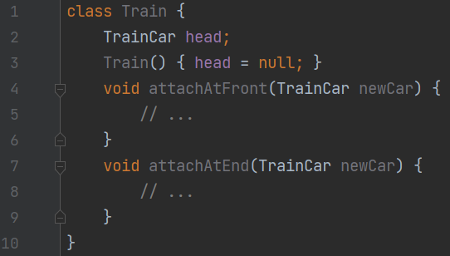
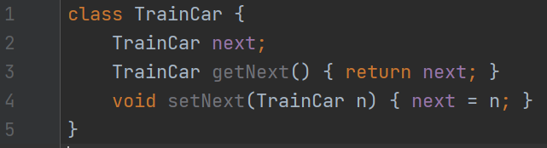
Train (Lab 6)
Train, train, trains
This is a good problem
This WILL come up in CISC 220 (Data Structures)

Slide 10
Train (Lab 6)
This is not an ArrayList (like from Lab 5)
We don’t have add(), remove(), etc
null
Train …
Train.head
TrainCar
TrainCar
TrainCar
TrainCar.next
TrainCar.next
TrainCar.next

Slide 11

that’s all :)

Slide 12
Partner Student Time
Do the Checkpoint 1 in Canvas!

