Slide 1
CISC 181
March 30, 2021
University of Delaware
By James Villemarette

Slide 2
PowerPoint Overview
some quick things
Problems I’ve noticed with lab 3

Slide 3
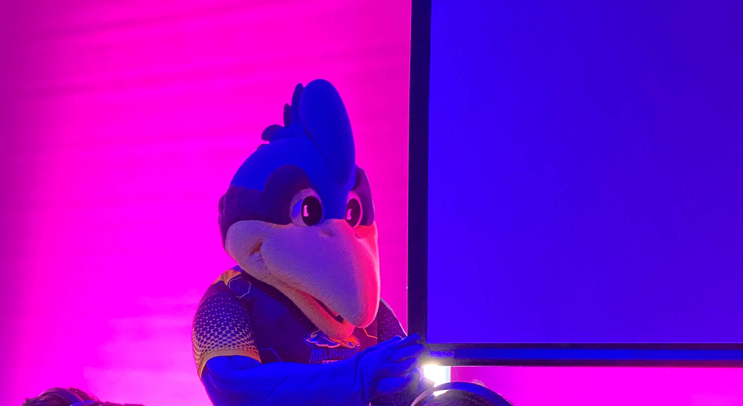
some quick things
Fun fact:
YoUDee’s pupils are shaped like Delaware >>>

Slide 4





Re-coop Day, Today
No classes, no lab
I’m posting this lab a day later so that you don’t worry about today
This PowerPoint will only recap problems that I noticed with Lab 3

Slide 5
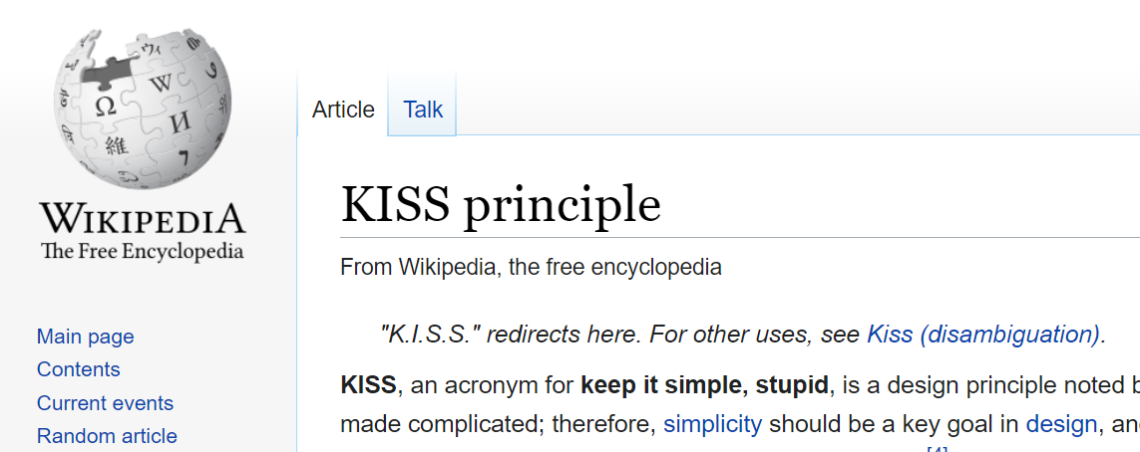
KISS
Keep It Simple, Stupid
When in doubt, keep your code as simple as possible
When solving a complex problem, start small, and add in variables, control structures (for, while, if) as necessary
Source: Wikipedia

Slide 6
int vs Int
Integer wrapper
class >>>
Integer i
int whatever = 2;
Reminder
int is the primitive data type
Int is what’s called a “wrapper class”
Non-primitive, it’s an Object
Has various helper methods
Is used when casting other non-primitive types to int
Integer.parseInt(“2”) gives us 2
Integer i = new Integer(2);
i.intValue() gives us 2
…
public int intValue()

Slide 7
print vs println
System.out.println appends a new-line character “\n” to your console output
System.out.print does NOT append “\n”
System.out.print(“hello\n”) === System.out.println(“hello”)
Remember, KISS
Use println in almost all cases unless you need to print output on the same line
Ex: Loading bar … 10% … 20% … etc

Slide 8
“is” Prefix for Booleans
The default convention is to prefix Boolean variable names with the word “is”
isAlive
isFlying
isTubular
PieceBlueHen.java
The instructions are always right!
By default, assume a Boolean variable name starts with “is” unless the instructions explicitly bold the actual variable name
isAlive notZombie
isFlying notOnGround

Slide 9

Unit Tests
More of you are running unit tests, that’s good!
You can add unit tests to make sure everything makes sense
They can be tedious
It’s annoying to find out your code may not work in places
But they’re important!
Again, testing your getters and setters can help you weed out simple problems
If a unit test fails, work your way back up from the source of the problem
Ask why your code got to a failed state.
See Rubber duck debugging

Slide 10
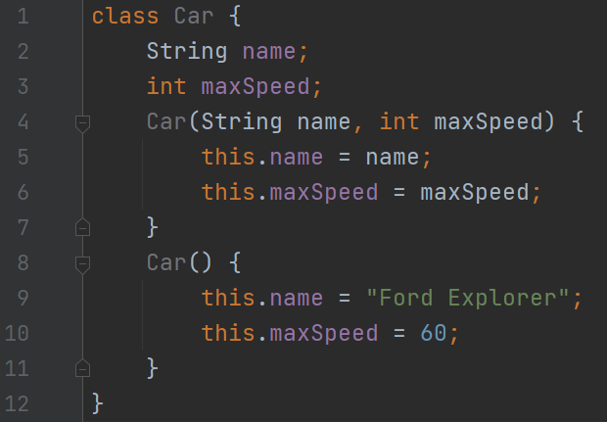
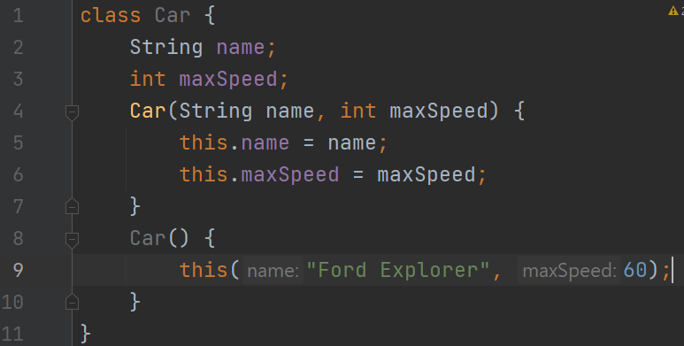
this() vs this. (part deux)
Rely on other parts of your code as much as possible
We rarely ever want to write the same code behavior, twice, three times, or more
No
Yes!

Slide 11
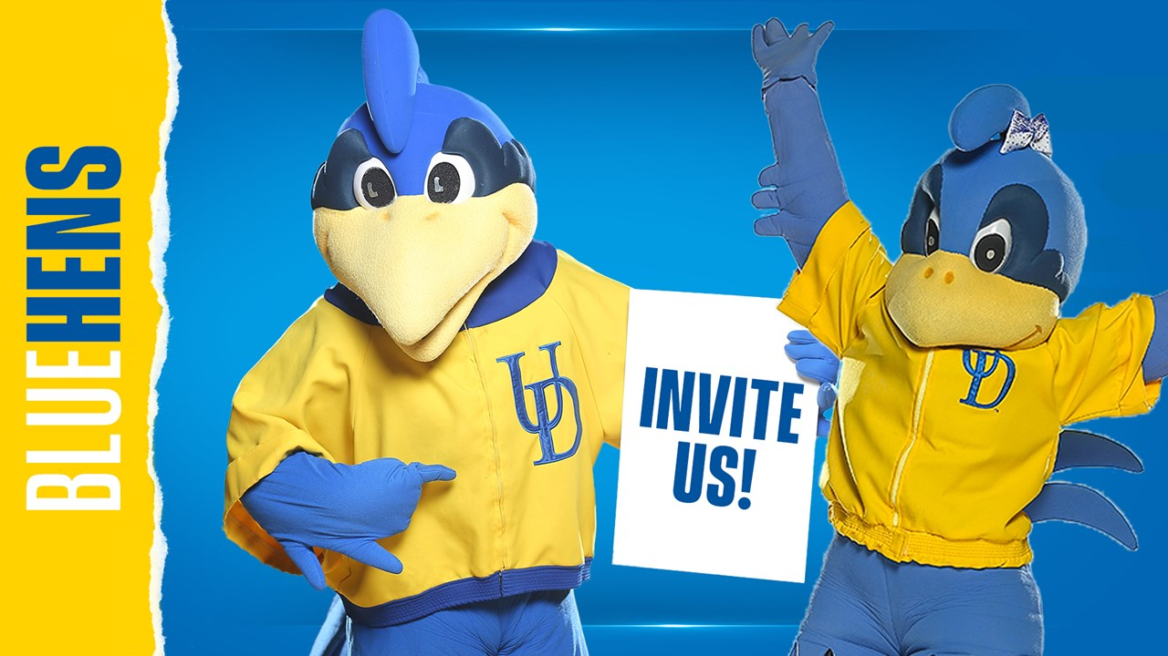
that’s all :)

