Slide 1
CISC 181
May 4, 2021
University of Delaware
By James Villemarette

Slide 2
PowerPoint Overview
some quick things
Notices
Lab 6A
Lab 6B
Lab 7
Looking Ahead
Final Project

Slide 3
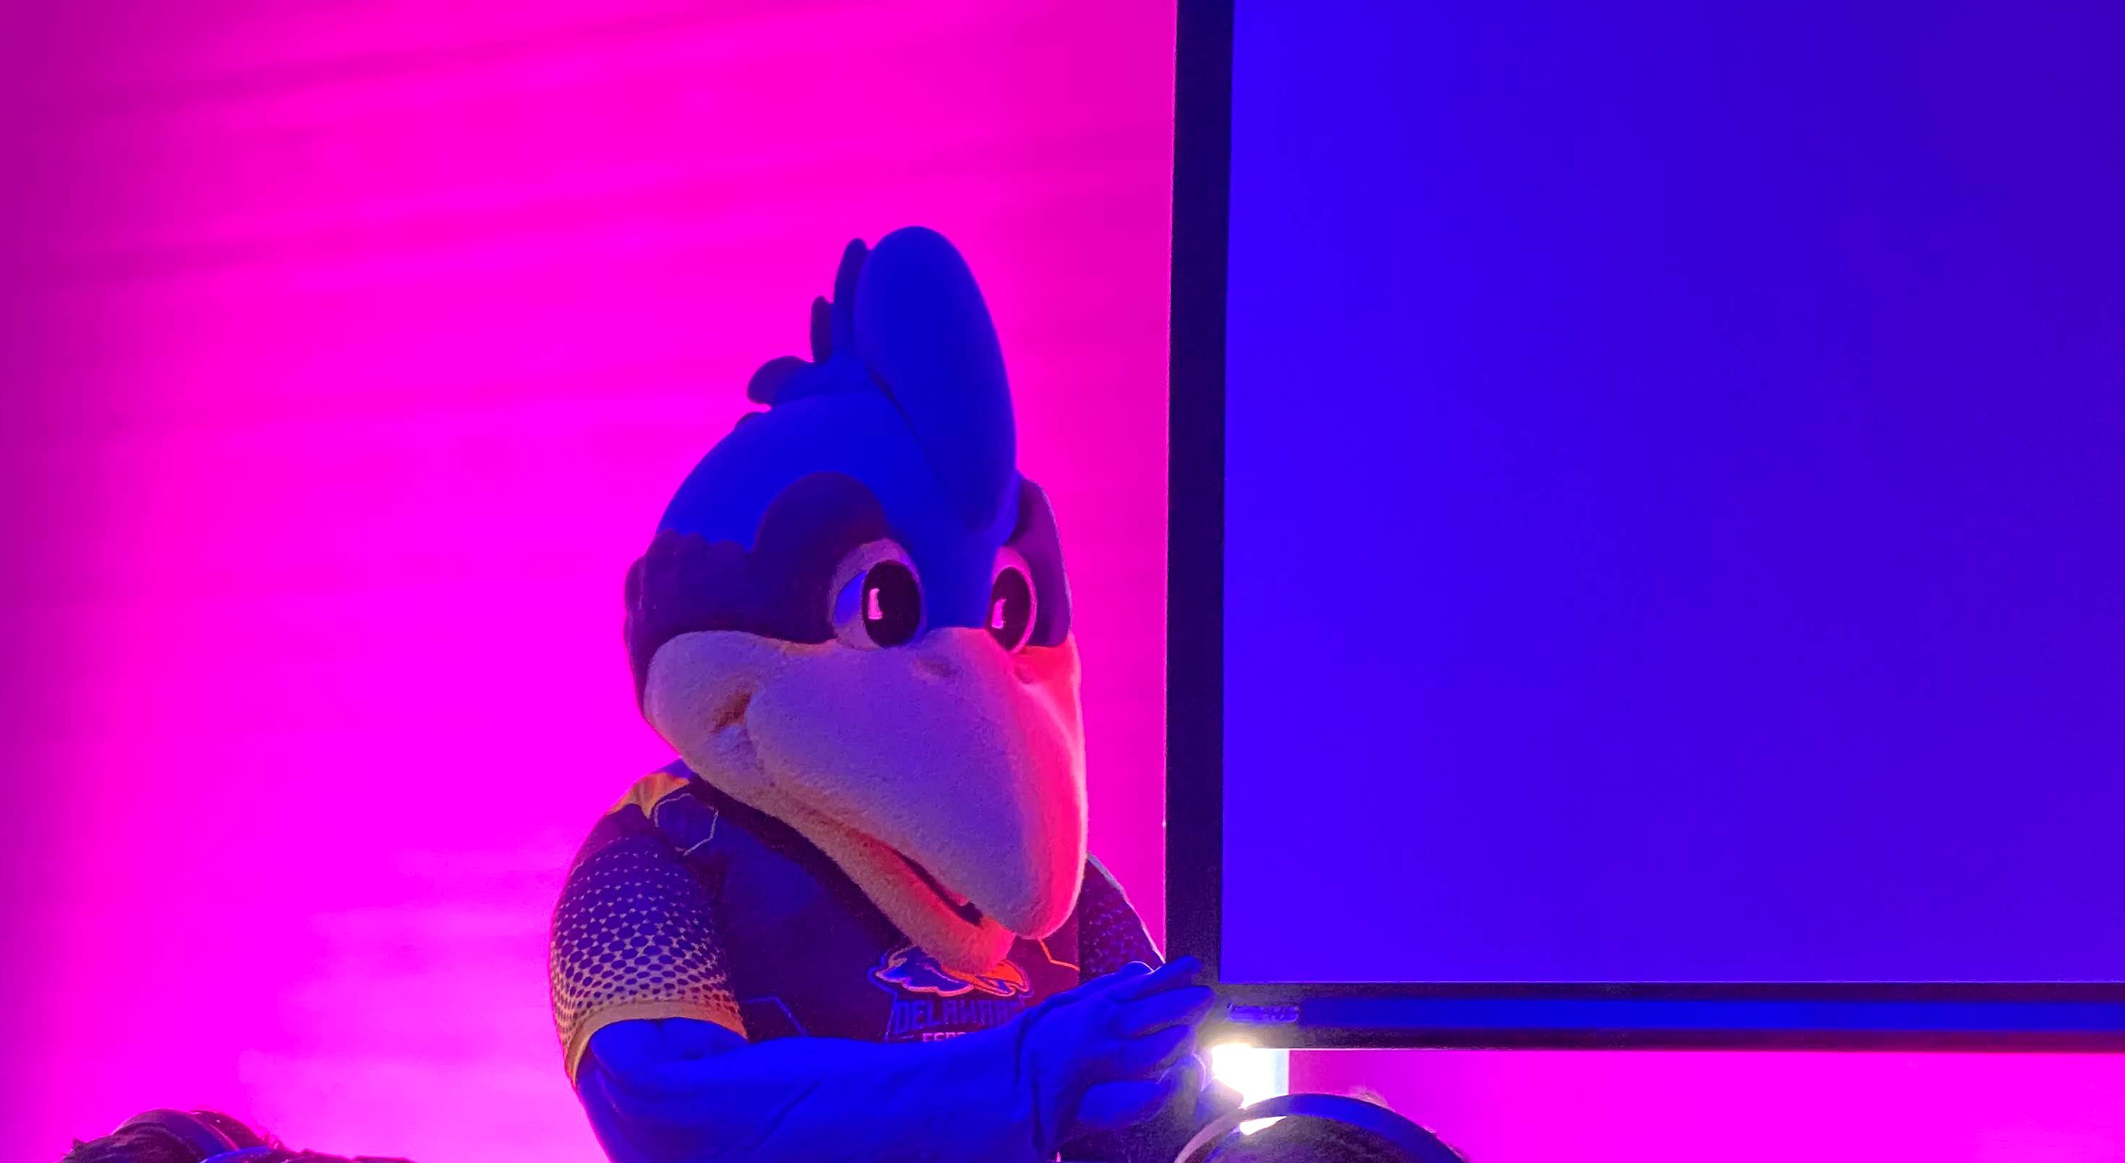
some quick things
Fun fact:
YoUDee is officially androgynous, even though it has a chicken comb >>>

Slide 4
Lab 6A Grading Revision
countEmptyTrainCars()
Add a method named countEmptyTrainCars that returns the total number of TrainCars that are not carrying any cargo
The instructions do not specify if it’s cargo weight or cargo type.
Two students asked Wassil, she said “either”
loadCargo()
Similar sort of problem
Lab 6A submissions will be retested and regraded
Please check your lab feedback and understand any errors you made, or anything you think was graded in error

Slide 5
Lab 6B problems
Always. Run. The. Provided. Unit. Test.
Most common problems
1. Did not create the right number of Lab Sessions
The length of the array of Course[] labSessions is a function of the capacity and MAX_SEATS.
2. addCourse did not sort the ArrayList
Collections.sort() after you add an element to a List.
3. Failed implement the Comparable interface in Course
This was covered in last week’s lab PowerPoint.

Slide 6
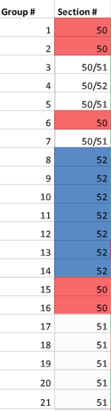
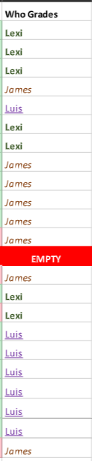
Lab 7 Grading In Progress
Long complex lab, takes time to grade
Last week’s lab PowerPoint provided a short guide on how to write a UML diagram
Please revisit it
Reminder: Lab are being graded by the TA of what lab section most of the group comes from

Slide 7

Looking Ahead

Slide 8
Checkpoint 2
Work with groups!
Less hand holding
You will have design yourselves
Use the semantics and conventions that we’ve been using throughout this semester to follow the general instructions
Checkpoint 2: Due May 10th, Monday
Checkpoint 3: Due May 18th, Tuesday

Slide 9

that’s all :)

Slide 10
Group Time
Continue working on the Final Project in breakout rooms!

