Slide 1
CISC 181
April 13, 2021
University of Delaware
By James Villemarette

Slide 2
PowerPoint Overview
some quick things
Notices
Problems I’ve noticed with lab 4 & 5
Looking Ahead
Lab 7

Slide 3
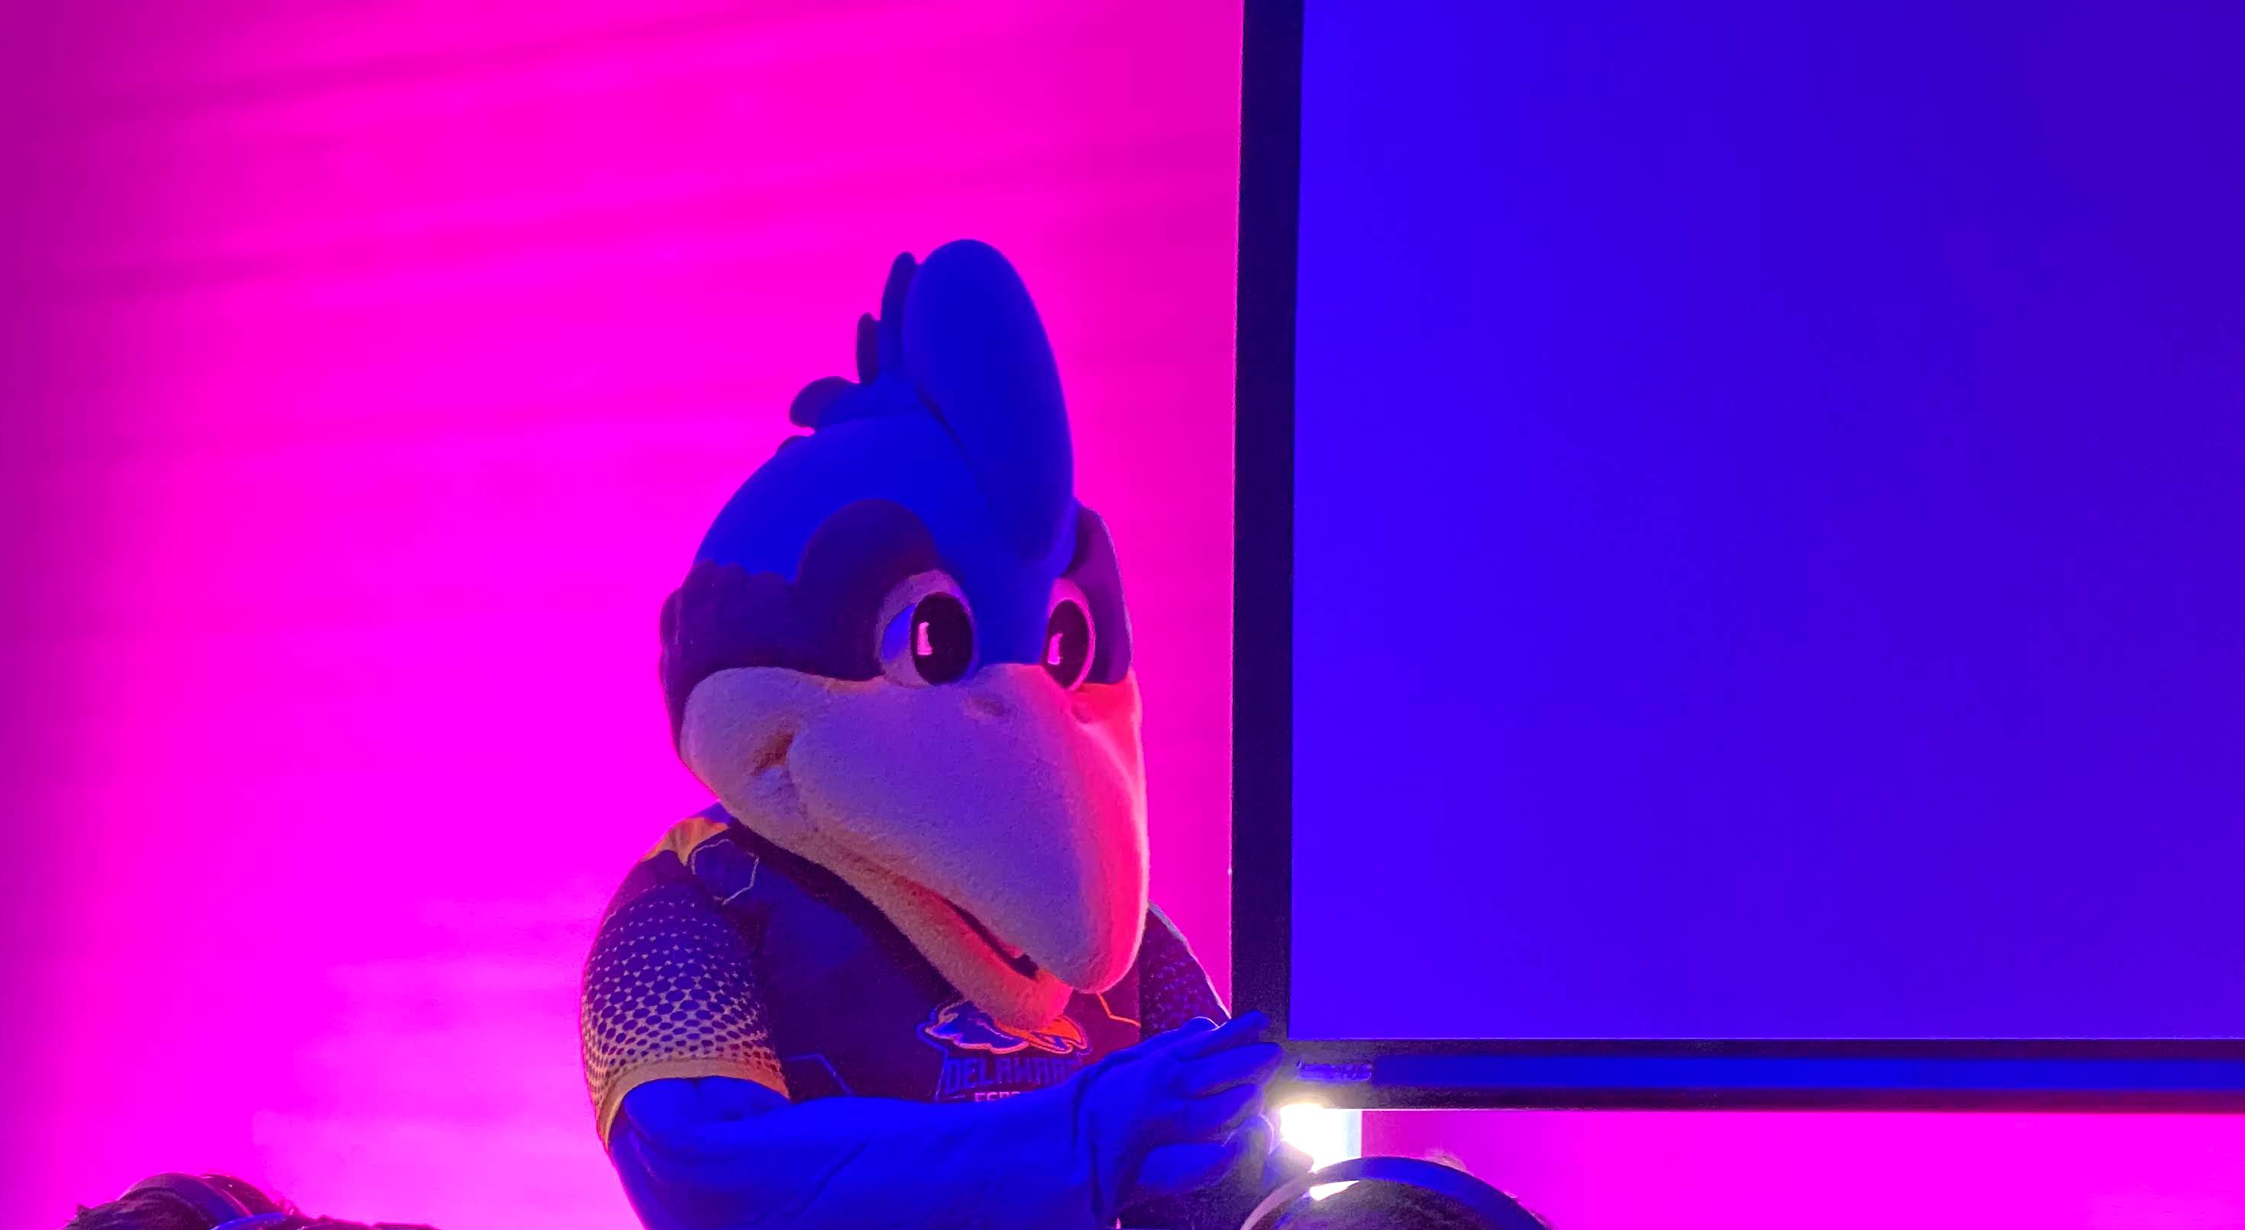
some quick things
Fun fact:
YoUDee is officially androgynous, even though it has a chicken comb >>>

Slide 4
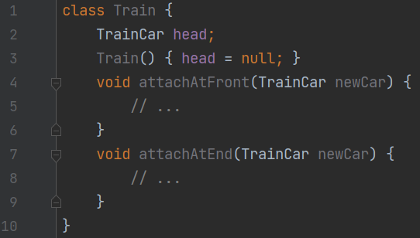
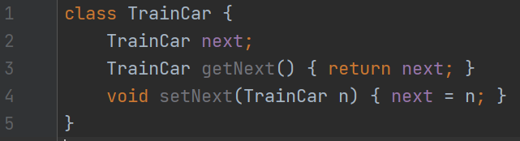
Train (Lab 6)
This will be discussed next week
Too many students have not submitted it, yet
Cannot discuss it, yet; Cannot give unfair advantage

Slide 5

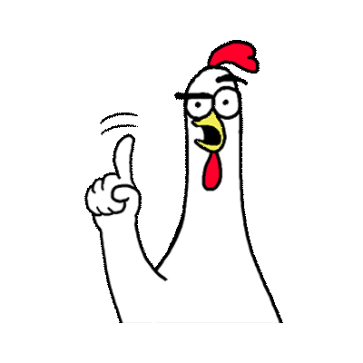
Piece Confusion
PieceUnderminer
…
+ attack(…)
Piece
…
+ befriend(…)
In the previous labs, we defined PieceBlueHen and PieceScoobyDoo to have the befriend() method
With the new super class Piece, befriend() was moved to the Piece class because its implementation was the same in the two subclasses
With the new subclass PieceUnderminer, befriend() was not in it, befriend() was moved to the interface Friendly
PieceBlueHen
…
+ befriend(…)
PieceScoobyDoo
…
+ befriend(…)
Interface
<<Friendly>>
…
+ befriend(…)

Slide 6
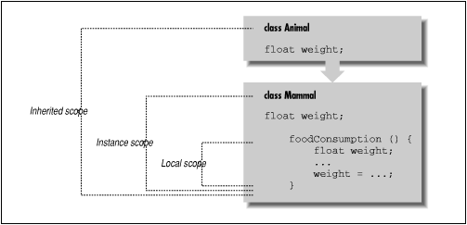
Super vs Subclass Shadowing
Similar problem with Piece Confusion (previous slide)
When you redefine a variable in a class with the same name as a variable in a super class or higher scope, you’re going to have to a bad time
Source: Exploring Java

Slide 7
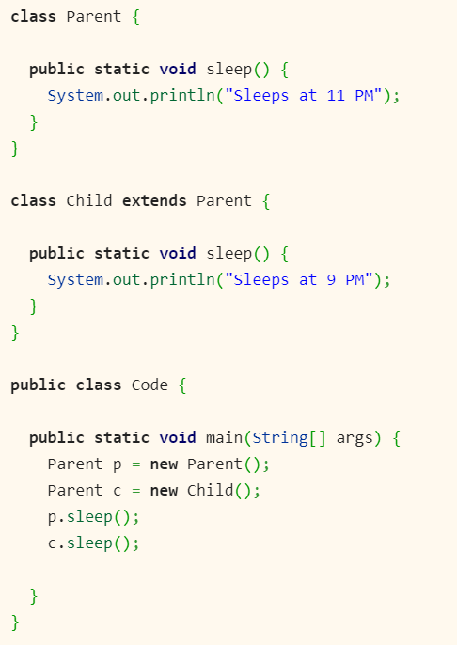
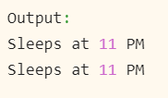
Super vs Subclass Shadowing
What does this print?
How do we avoid this?
Make sure you’re not needlessly redefined the same/similar variable. Or at least give it another name
Source: Java67.com

Slide 8
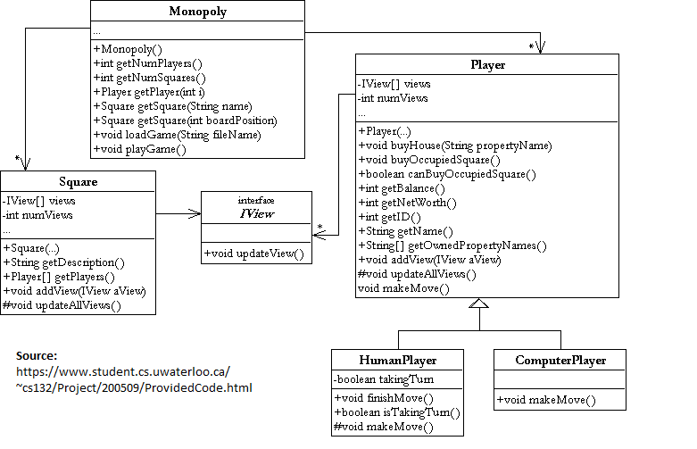
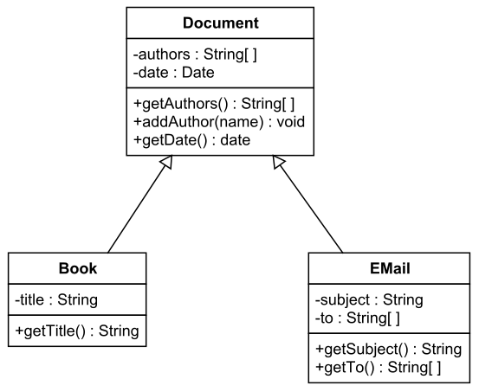
UML (Lab 5)
You need the classes and the methods defined
Yes, it’s a lot of work
But working through a problem is the best way to learn something
But also, there are many examples of them online
But most are wrong
And it can be relative (different professors have different standards/expectations)
Source: THSForrestLogan
Source:
UTSA.edu

Slide 9
Unit Test
Please write unit tests
We’re not always going to provide one
You can always check your work to make sure it’s right
Stress test it. Think of niche cases

Slide 10

Looking Ahead

Slide 11
Lab 7 Topics
2D arrays
Done that before
Inheritance
Yep
Implementing Interfaces
Uh-huh
Modeling a Game using OOP concepts
Oh my

Slide 12
Model-View-Controller (MVC)
How do code user interfaces?
Make it one big .java file?
No!
We use the “MVC design pattern”
SourceMaking’s “Design Patterns” metalist
What is it generally?
Model: Code that stores the current state.
View: Code that renders the model into visible UI elements.
Controller: Code that handles events and exchanges between the Model and the View.
This is even less standardized than UML

Slide 13
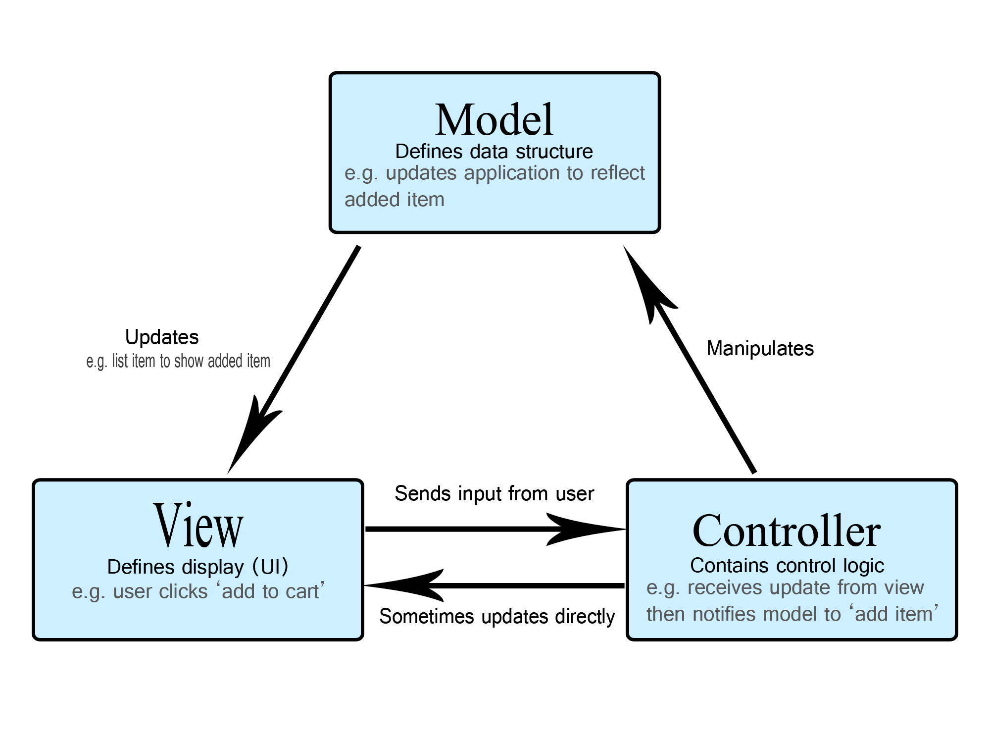

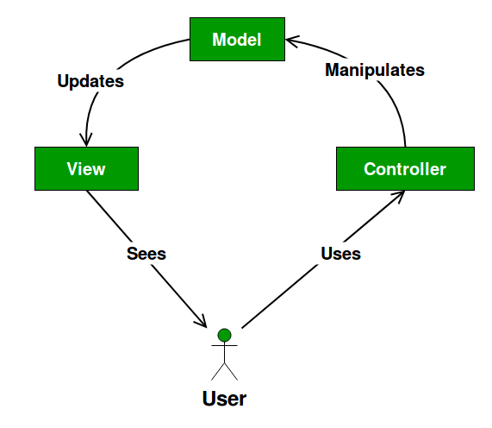
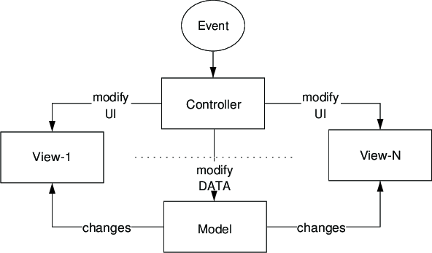
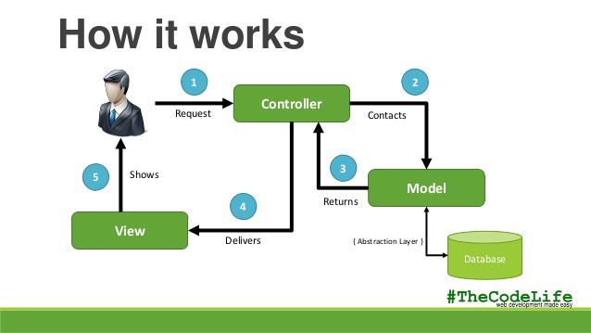
Model-View-Controller (MVC)
Source: Mozilla
Source: Wikipedia
Source: GeeksforGeeks
<< I kind of like this.
It’s not great, but it’s close to good.
Source: ResearchGate
Source: CloudBoost

Slide 14
Model-View-Controller (MVC)
Okay, those diagrams are all nice and all, but like, practically, what is it?
Relative
To the project, professor, team, company, geographic region, …
My best understanding?

Slide 15


Model-View-Controller (MVC)
Launch program
Controller
Gets variables from,
Sets variables to
Communicates with
Controller selects which View to display.
Ex: A View could be a file picker, Word Doc, preview, a video player.
View
Model
Model just stores current “state” info.
Ex: It stores the name of the user, recently opened projects, etc.
View
Model
View
Model
A view is then directly (from itself) or indirectly (through the controller) displayed back to the user, interactive.
A model can be saved to a hard disk/store device, like a .docx file. And it can be reopened.

Slide 16
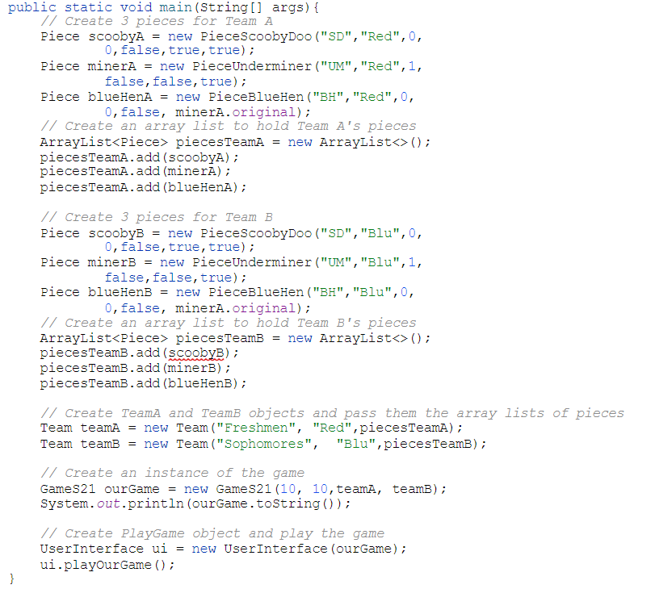
Model-View-Controller (MVC)
UserInterface.java
What is GameS21?
Most likely the Model
What is UserInterface?
Most likely the View
Where in the world is Carmen Sandiego the Controller?
It’s this main itself

Slide 17

that’s all :)

Slide 18
Group Time
Start working on Lab 7 in Canvas!

