Slide 1
CISC 181
April 27, 2021
University of Delaware
By James Villemarette

Slide 2
PowerPoint Overview
some quick things
Notices
Looking Ahead
Lab 6B

Slide 3
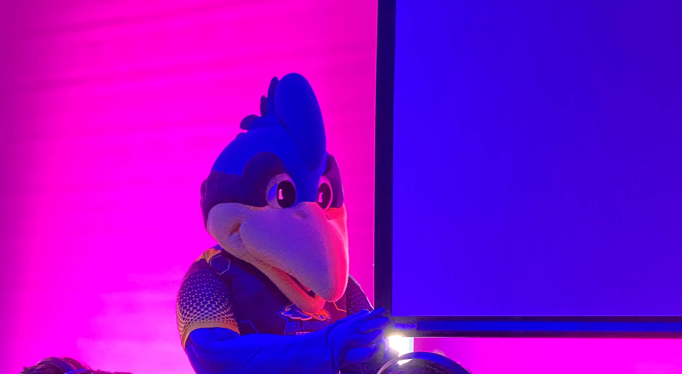
some quick things
Fun fact:
YoUDee is officially androgynous, even though it has a chicken comb >>>

Slide 4
Lab 7 Project Grading
If a lab group has students that entirely belong to one TAs lab section, then that TA will grade that lab section
If a lab group has students from two different lab sections, then if two of the students come from one TAs section, then that TA will grade that lab section
Done for consistent grading standards

Slide 5
UML Checklist (Java)
Every class is organized in a UML diagram like:
ClassName
“interface <<InterfaceName>>” if its an…interface
Ex: PieceUnderminer
Ex: interface <<Hostile>>
----------------------
Class Variables
- if its private access modifier
+ if not
variableName : variableType
Ex: - symbol : String
----------------------
Class methods
- if private, + if not
Includes constructor
Ex: + PieceUnderminer(String)
Arrows
They point to what a class extends
If PieceUnderminer (PU) extends Piece (P), then the arrow points from PU to P
This is the opposite for interfaces; If a class implements an interface, an arrow points to the class from the interface
Interface arrows are dashed
Other Notes
Some classes just don’t extend/implement, and thus should have no arrows
This is relative to class/team/job: UML diagrams have varying levels of detail. Sometimes methods specify return types with “ : type” appended

Slide 6

Looking Ahead

Slide 7
Lab 6B, What’s Happening
ArrayLists
Implementing pre-defined Object methods
Overriding methods for polymorphism
Implementing Comparable Interface

Slide 8
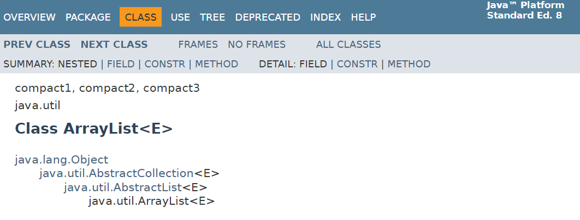
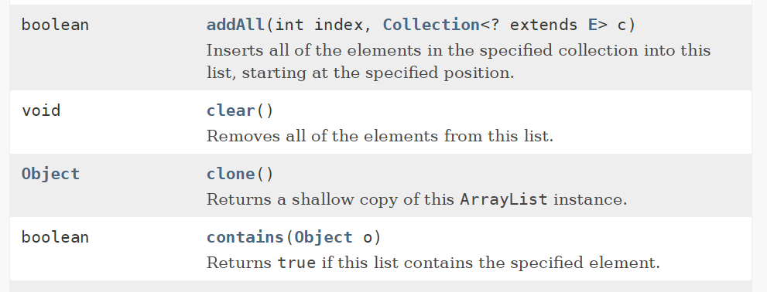
ArrayLists (Lab 6B)
Source: JavaDoc
Try getting used to referring to official documentation if you need help
I used JavaDocs about half the time I use Java
If you hover over a method in IntelliJ, it will give you
…

Slide 9
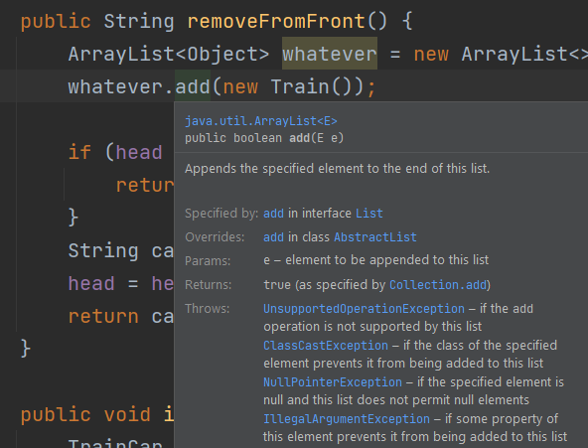
ArrayLists (Lab 6B)
Java Collections can have many finicky rules
Be sure to read the documentation if some method is not behaving as expected

Slide 10
Overriding Object (Lab 6B)
Notice from the earlier JavaDoc screenshot I showed earlier
This tree shows all the parent classes of a class >>
Again: Object is implicitly extended if a class does not extend another class

Slide 11
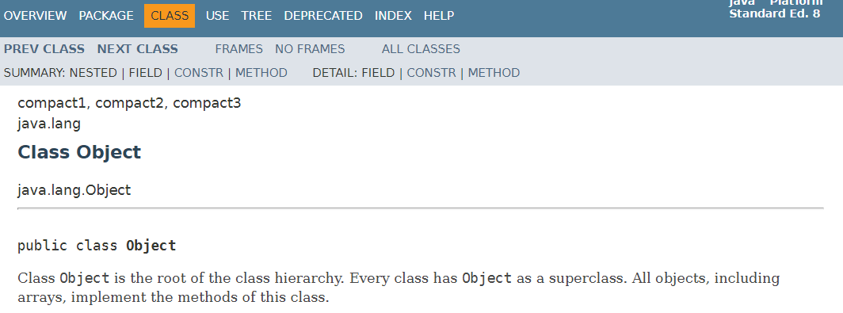
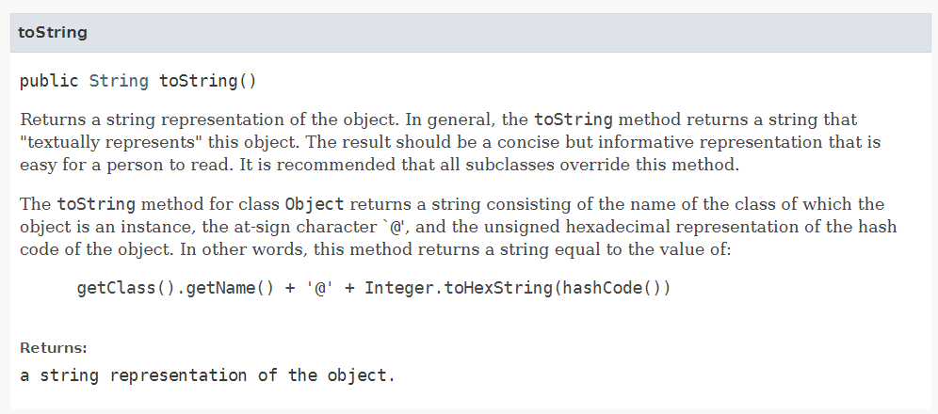
Overriding Object (Lab 6B)
Source: JavaDoc
Object class holds fundamental methods
equals()
hashCode()
toString()
And others
…

Slide 12
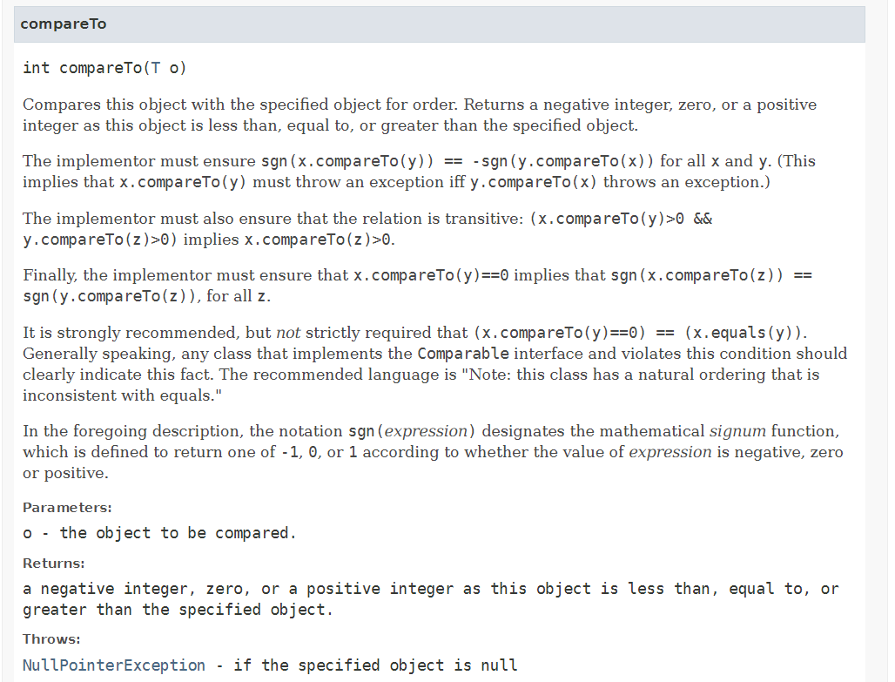
Comparable Interface (Lab 6B)
Source: JavaDoc
Sorting is an important job!
An expensive job
Read: Computationally taxing job
Java handles it pretty well (quicksort, insert sort, …)
We just need to implement Comparable and tell it where things are relationally

Slide 13

that’s all :)

Slide 14
Group Time
Continue working on Lab 6B in breakout rooms!

