Slide 1
CISC 181 – 052L
March 8, 2021
UD

Slide 2

some quick things

Slide 3
Late Policy
Can submit up until 3 days after a due date
10% penalty for each 24 hours after deadline
18 hrs after deadline = 10% penalty
24.1 hrs after deadline = 20% penalty
47.999 hrs after deadline = 20% penalty
Etc
Submitting just one or two hours after deadline may be forgiven, no late penalty.
Please don’t stay up to work though
Don’t abuse this

Slide 4
Cannot run tests unless Compile
Code will not run if it cannot compile
Code -> Compiled with Tests -> Tests class(es) are run -> Tests results reported to IDE
Need to fix all compiler errors
Syntax and language errors
Every { must have a corresponding }
Fix compiler errors (highlighted in red) as they come up

Slide 5
Please don’t share code
Sharing lab code is a no go
Honor code or plagiarism violation something
Can share Zybooks code
But only if you have a problem
No really, please try first before sharing
It’s normal to be stumped, just check what’s different in the given code

Slide 6
Setters/Getters
Also known as (AKA) accessors and mutators
Accessors
They’re really known as getters
Conventions
Prefix “get” for any non-Boolean class variable
Prefix “is” for any Boolean class variable
Mutators
They’re really known as setters
Conventions
Prefix “set” for any class variable
getBox()
getGlasses()
isOnFire()
isCool()
setName(String newName)

Slide 7
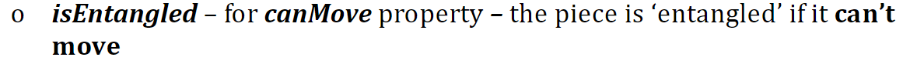
Setters/Getters
Why do we have setters/getters if we have the constructor taking in all the variables?
Sometimes, we want to update what we set (like a new name). We also want to keep variables private because we might have to do extra steps when getting/setting them.
String symbol
getSymbol()
int numScoobySnacks
getNumScoobySnacks()
boolean hidden
isHidden()
boolean canMove
isEntangled()
^method name
^variable
When in doubt: The professor is always right!

Slide 8
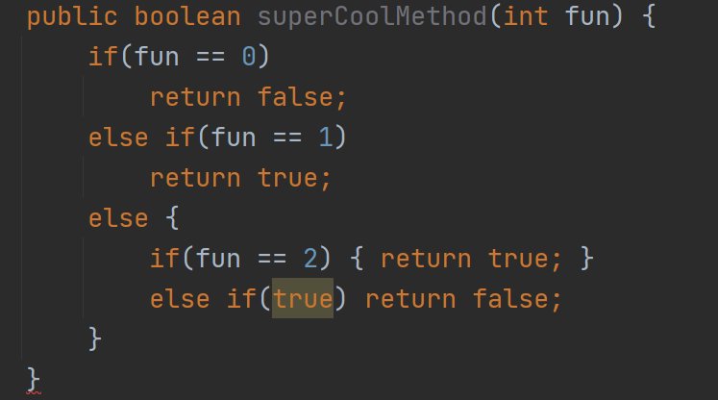
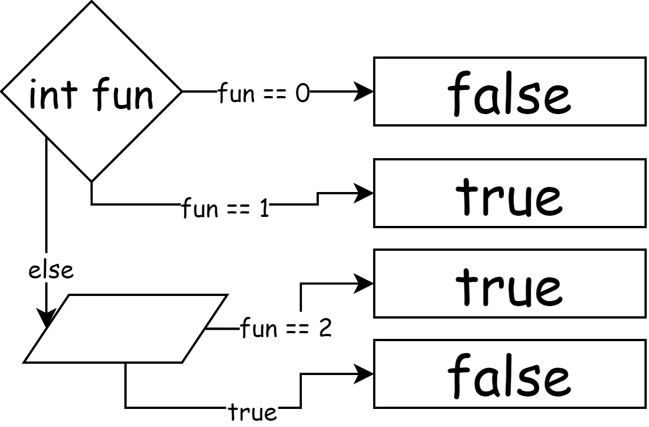
Unreachable Statements
What’s the problem?
Tree diagram
All Java knows is that there’s no return statement that’s accessible.

Slide 9
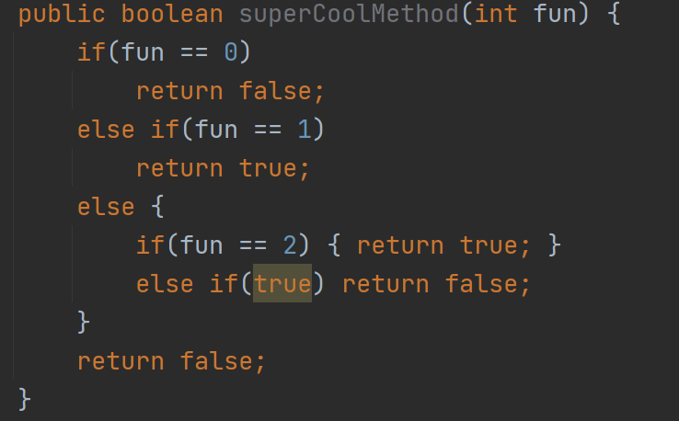
Unreachable Statements
Now that’s better!

Slide 10
Int-Double casting & division
int sum = 30;
double avg = sum / 4;
Result is 7.0, not 7.5!
Sum is an int, 4 is an int
The division happens, but then the result is implicitly cast into int, then implicitly cast into double
Solution?
double avg = (double) sum / 4;
double avg = sum / 4.0d;

Slide 11

style

Slide 12
Some Conventions
camelCase
allGoodFunctionNamesLookLikeThis
Never_use_underscores!
Methods returning Booleans usually prefixed with “is”
See slide 6
Always follow the lab directions
Don’t usually let code go more than 80 characters long on a line.
JavaDoc!

Slide 13
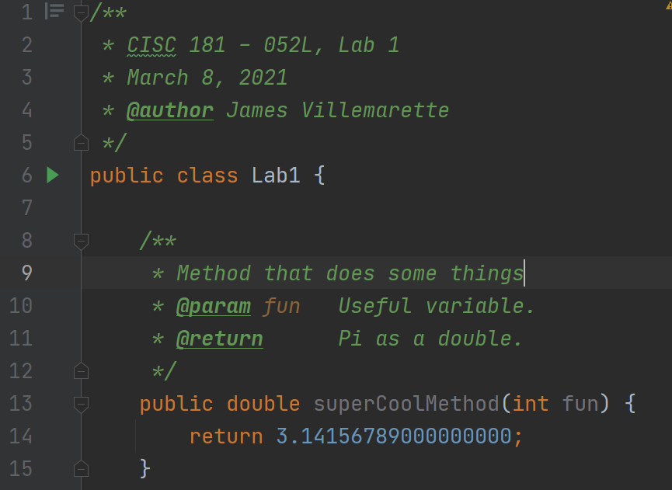
JavaDoc
These are all the annotations that you will need
Tab indentation
No need to state the types, that’s what the method signature is for
Every little bit helps

Slide 14
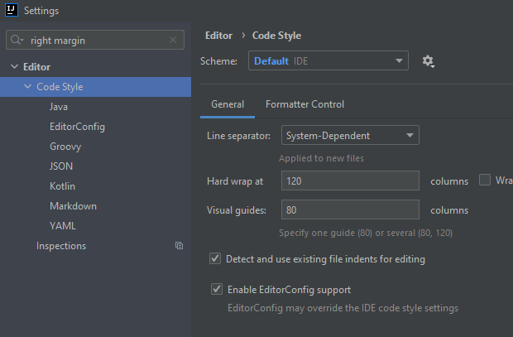
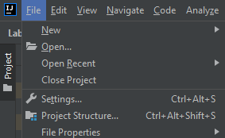
Indentation
Enabling column visual guide
Just a vertical line
80 character column limit a good rule of thumb

Slide 15
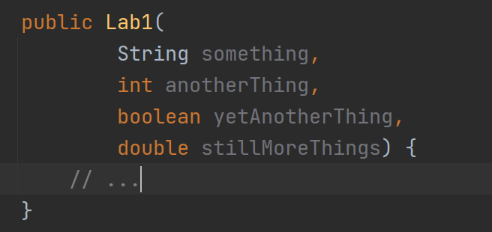
Indentation
Curly braces { and } are hard to keep track of, but it means you can format on new lines easy
More readable
Helps me grade

Slide 16
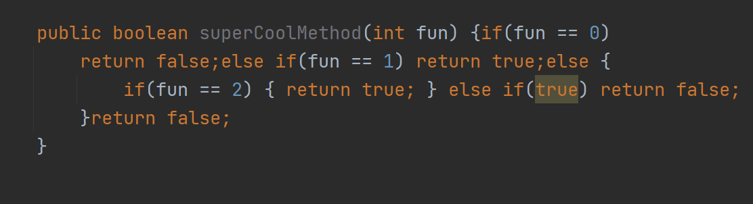
NOOOOOOOO
NOOOOOOOO
NOOOOOOOO
NOOOOOOOO
NOOOOOOOO
NOOOOOOOO
NOOOOOOOO
NOOOOOOOO

Slide 17

that’s all

