Slide 1
CISC 181
May 11, 2021
University of Delaware
By James Villemarette

Slide 2
PowerPoint Overview
some quick things
Notices on Lab 6A and 7
Looking Ahead
Final Project

Slide 3
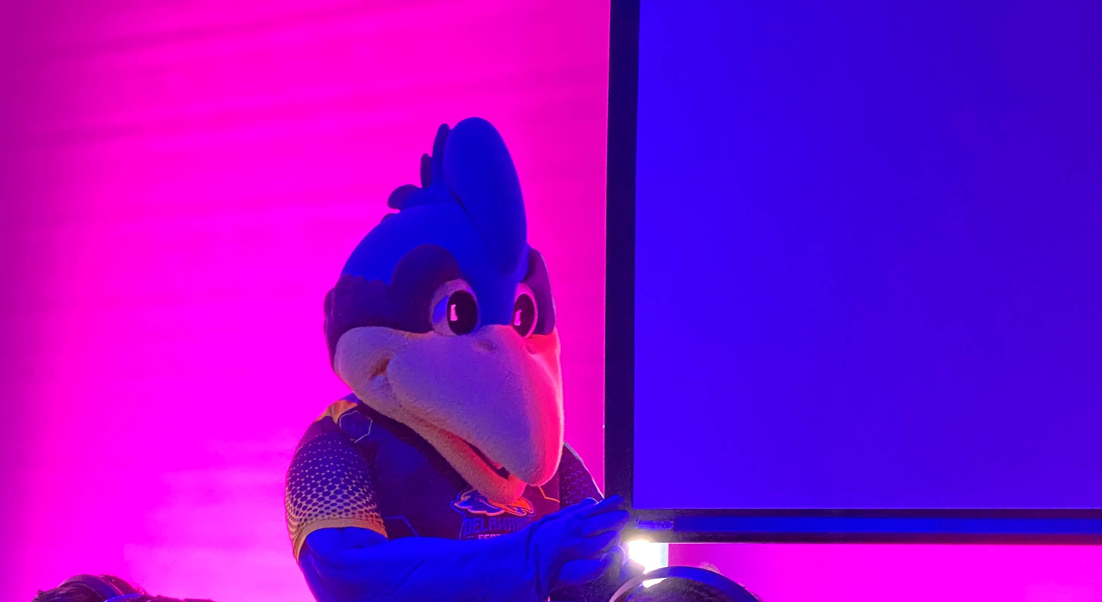
some quick things

Slide 4



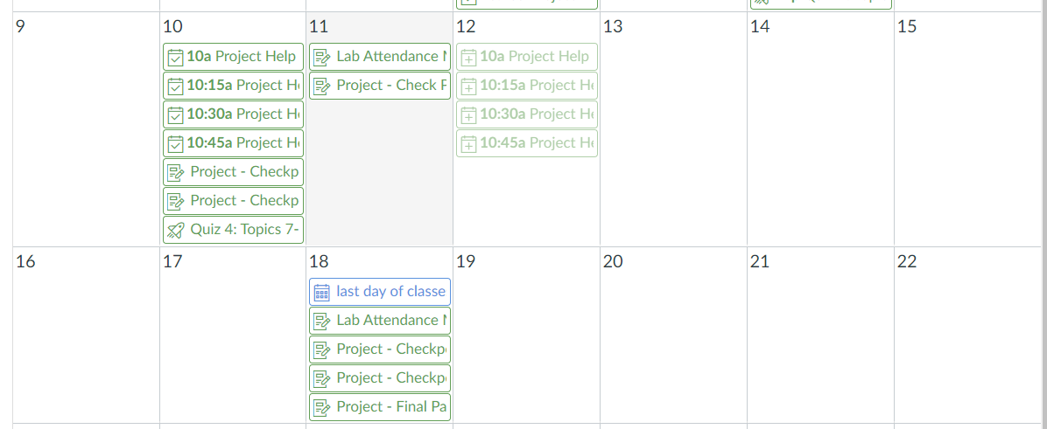


One More Week of Classes

Slide 5

Regrades & Grades
Lab 6A regraded
Most students gained 1, 2, or 3 points
Lab 7 graded for some groups
Two independent groups did not turn in
Factoring out the two 0s…
Average: 87 / 105 (82%)
SD: 9.9 points

Slide 6
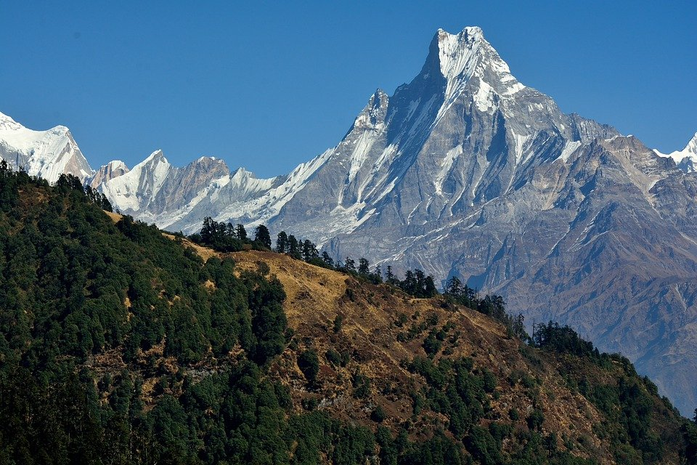
Looking Ahead

Slide 7

Final Project Notes
removePiece() and getPiece() are different methods!
What does BoardSquare.getPiece() do?
What does BoardSquare.removePiece() do?
isTurn(), changeTurn(), getCurrentTeam()
Some of these methods were just wrong
Test your full game, every action!
Half of the projects I graded: I could not move a piece as my first basic playthrough tests
It just gets the Piece
It gets the Piece, while setting the square’s Piece to null, empty to true

Slide 8
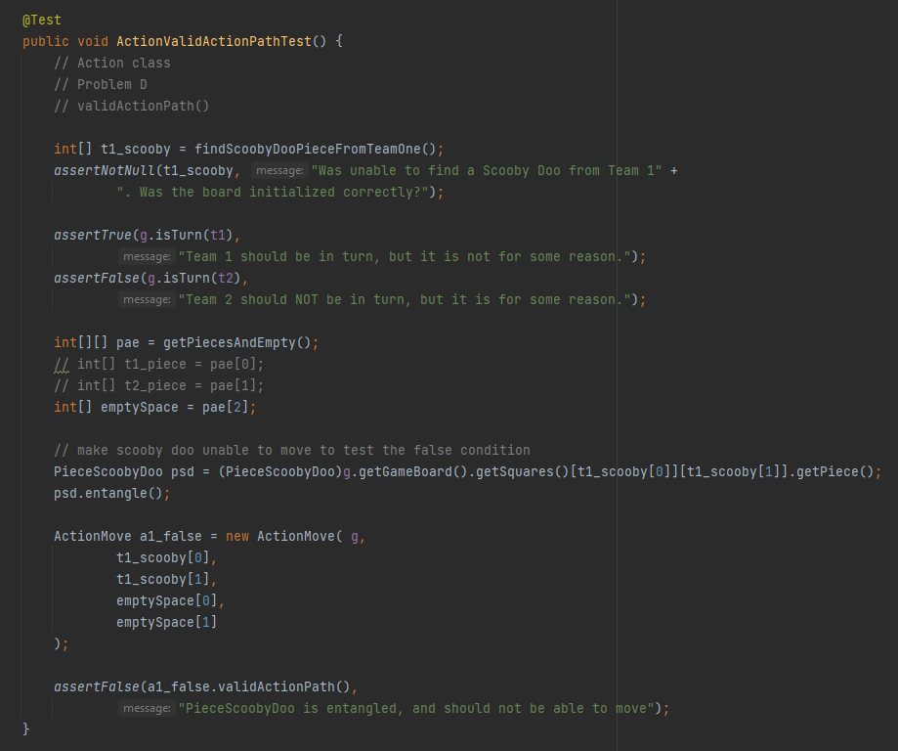
Lab 7 Unit Test Example
Lab on May 18th is optionally IF AND ONLY IF (IFF) you have submitted the final project
Please work on it before then
Reminder that the project is 40% of the final grade

Slide 9
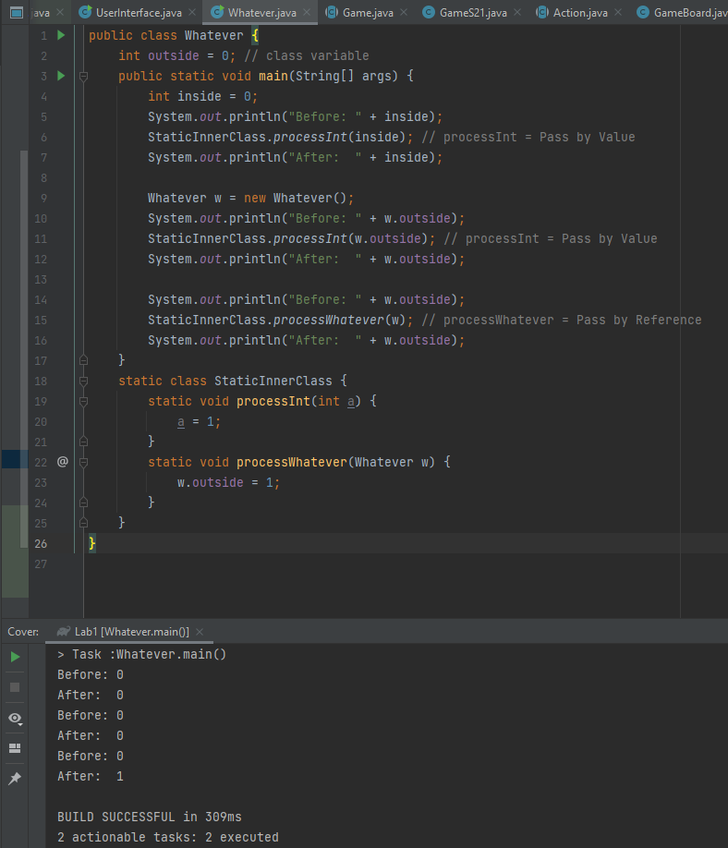
Call-by-Value
Not strictly related to the final project, but relevant to known, and for future CISC classes
This comes from a great question in the Discord
Java is ONLY call-by-value
What does that mean?
Every method call is passed a copy of the variable, never the original, never the reference
Source

Slide 10
Checkpoint 3
Work with groups!
Checkpoint 2: Due Yesterday!
Checkpoint 3: Due May 18th, Tuesday
Due in 7 days

Slide 11
Final Lab
Lab on May 18th is optionally IF AND ONLY IF (IFF) you have submitted the final project
Please work on it before then
Reminder that the project is 40% of the final grade
if(submittedLab == false)
comeToLab();

Slide 12
Course Evaluation
Opens today, May 11th
Closes on May 18th
Also 7 days from now
Please do it!
Not sure if there’s feedback for me
Is there?
I didn’t see any of it from my last semester of TA-ing, but maybe Wassil will actually share it with me.

Slide 13

that’s all :)

Slide 14
Group Time
Continue working on the Final Project in breakout rooms!

