Slide 1
Object relational impedance mismatch solved
Jukka Villstedt

Slide 2
Objects
Graph API
Relations
Graphs

Slide 7
Database as a git like immutable data structure
All database versions stay indexed
No read locks needed for consistent reads
The whole database can be threated as an immutable value
Indexes consist of highly cacheable segments
read can be scaled to multiple machines
schema is optional
any entity can have any attributes
branching and merging are possible

Slide 9
Datomic
A database server product by Cognitect
Released 2012

Slide 10
A library of Datomic like data structures
In POC stage

Slide 15
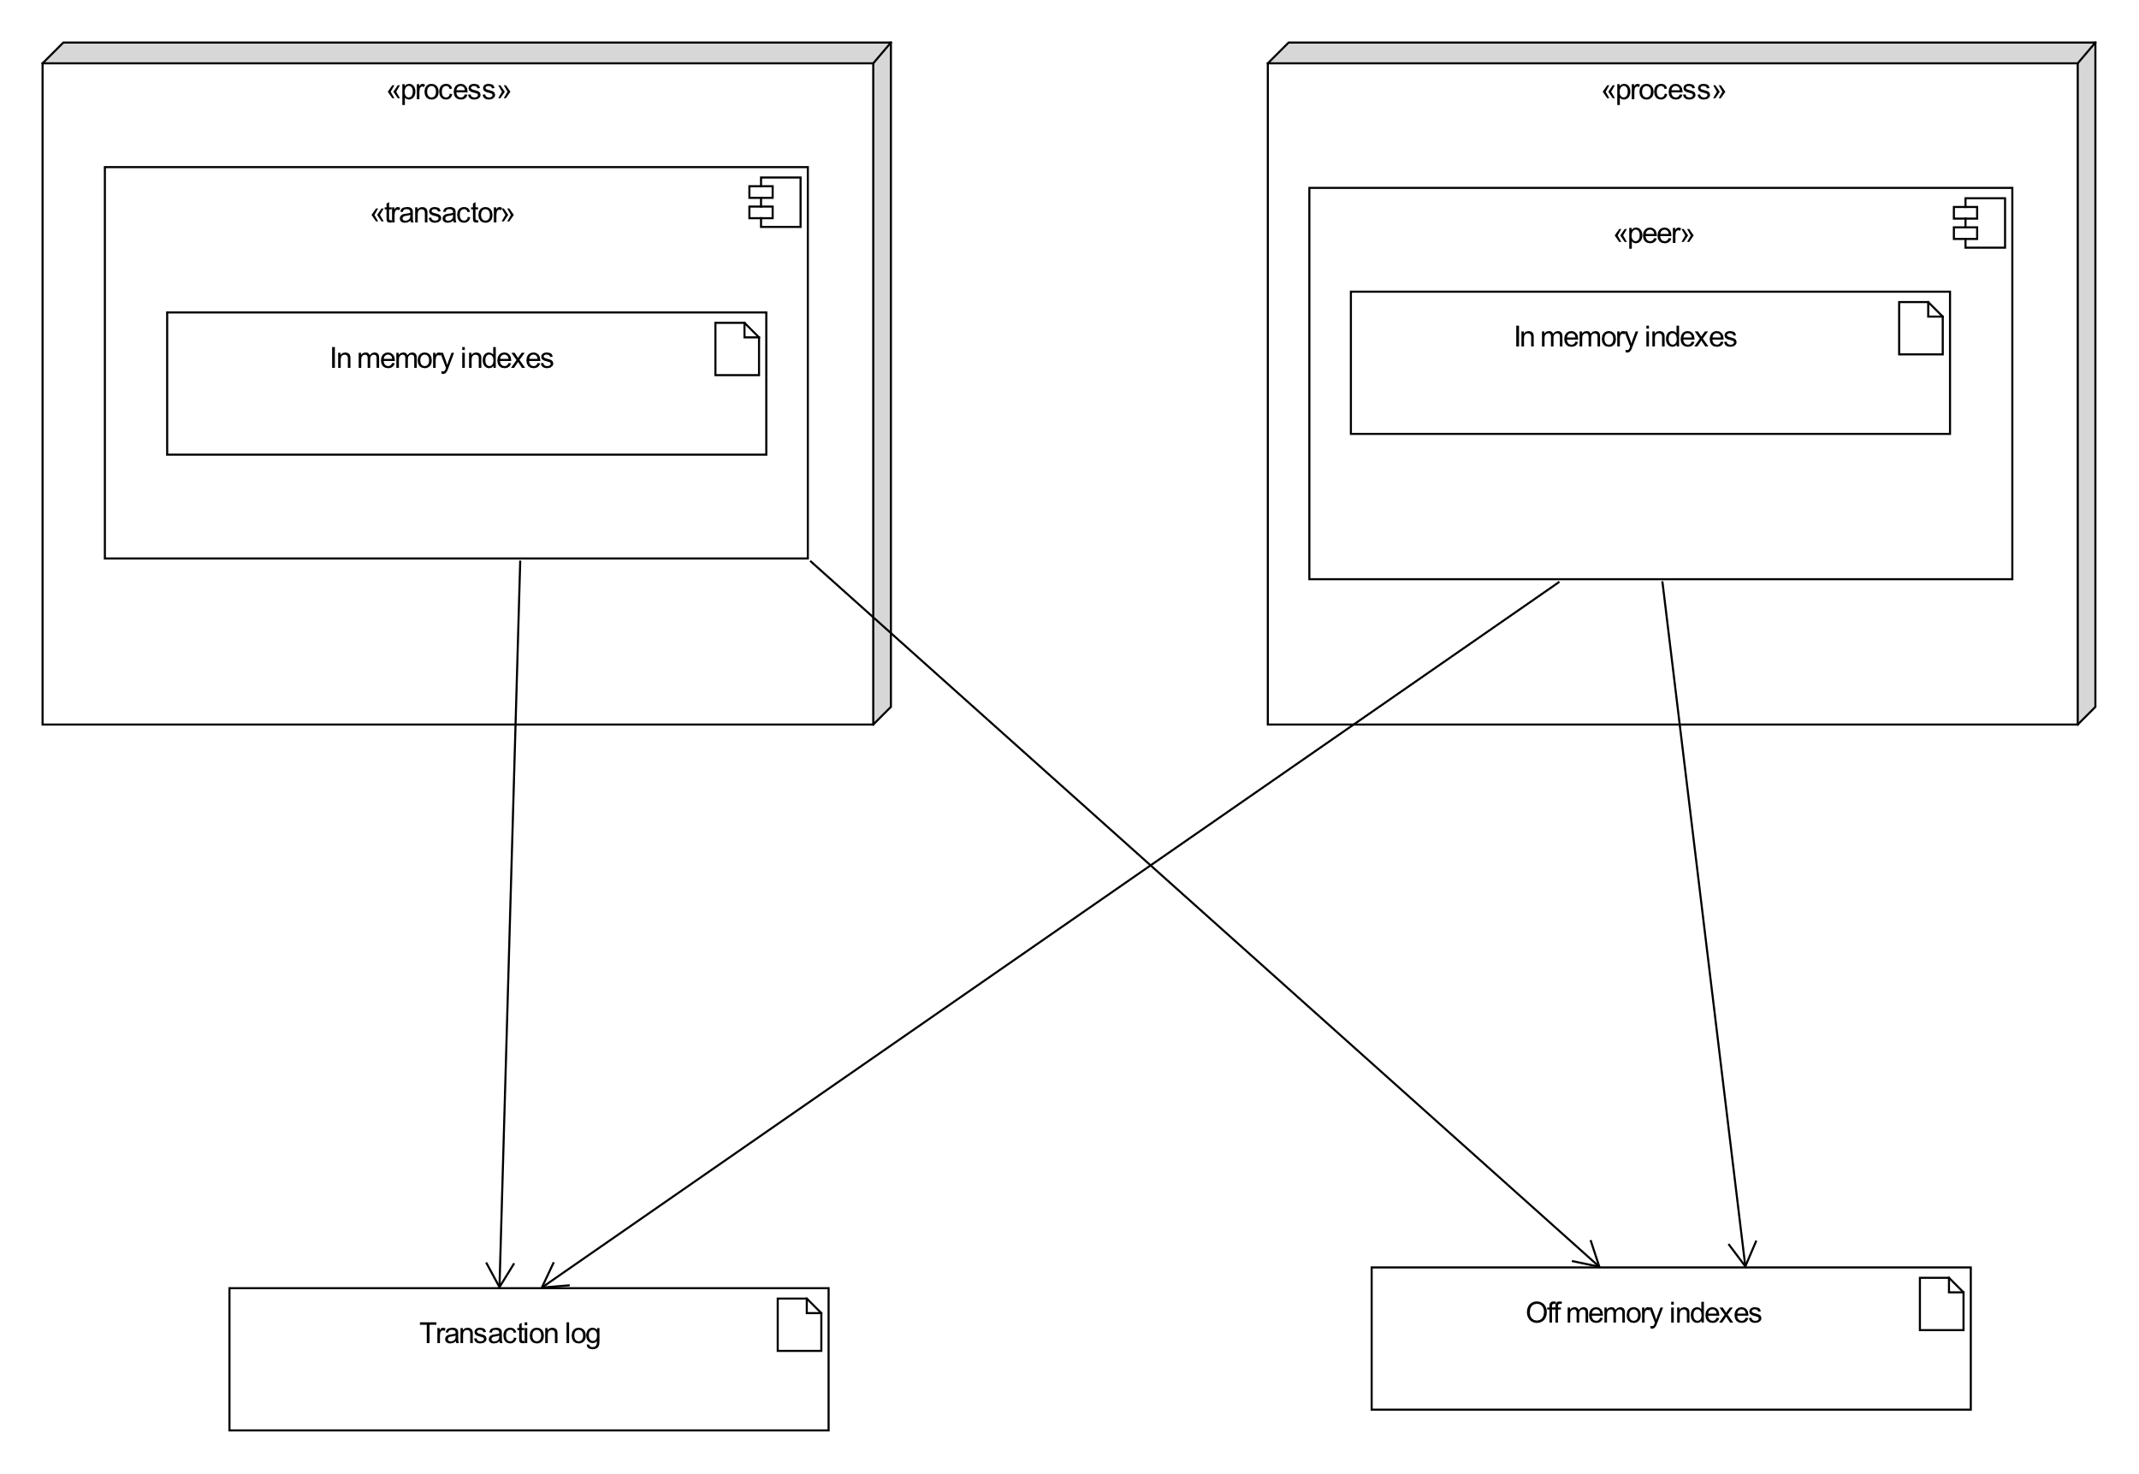
Notes:
Off memory indexes are updated only periodically
In memory indexes contain datoms that are not stored off memory
New off memory index versions share most of the b-tree nodes with the previous versions
Clients/peers maintain their own in memory indexes until a new off memory indexes are created

Slide 17
Off to the REPL we go!

