Slide 1
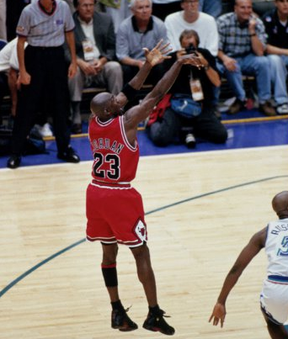
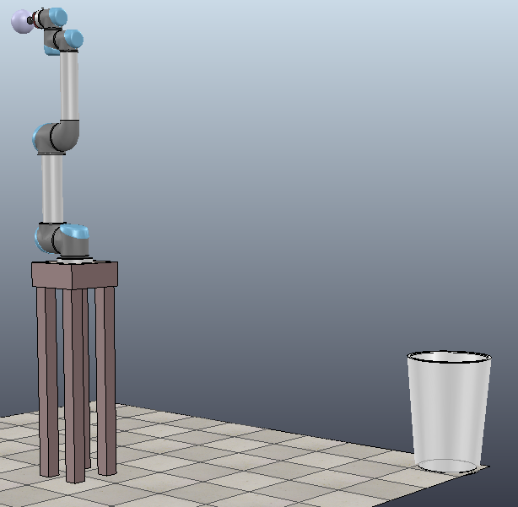
Robotic Basketball Shooter
Felipe Encinas
Nicholas O'Connell
Jeff Visk
Blaise Antico

Slide 2
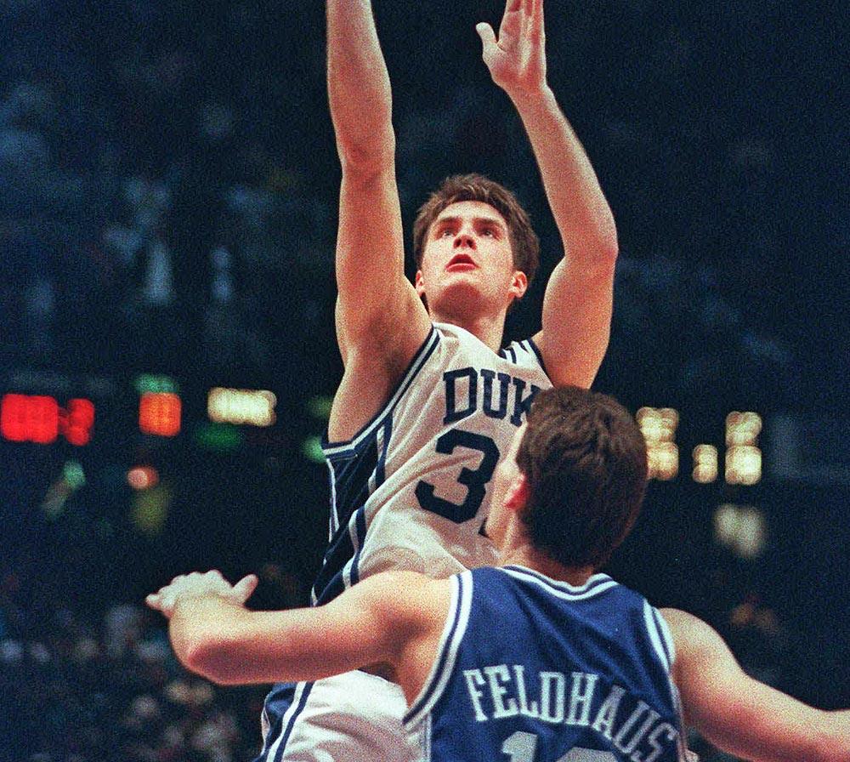

Slide 3
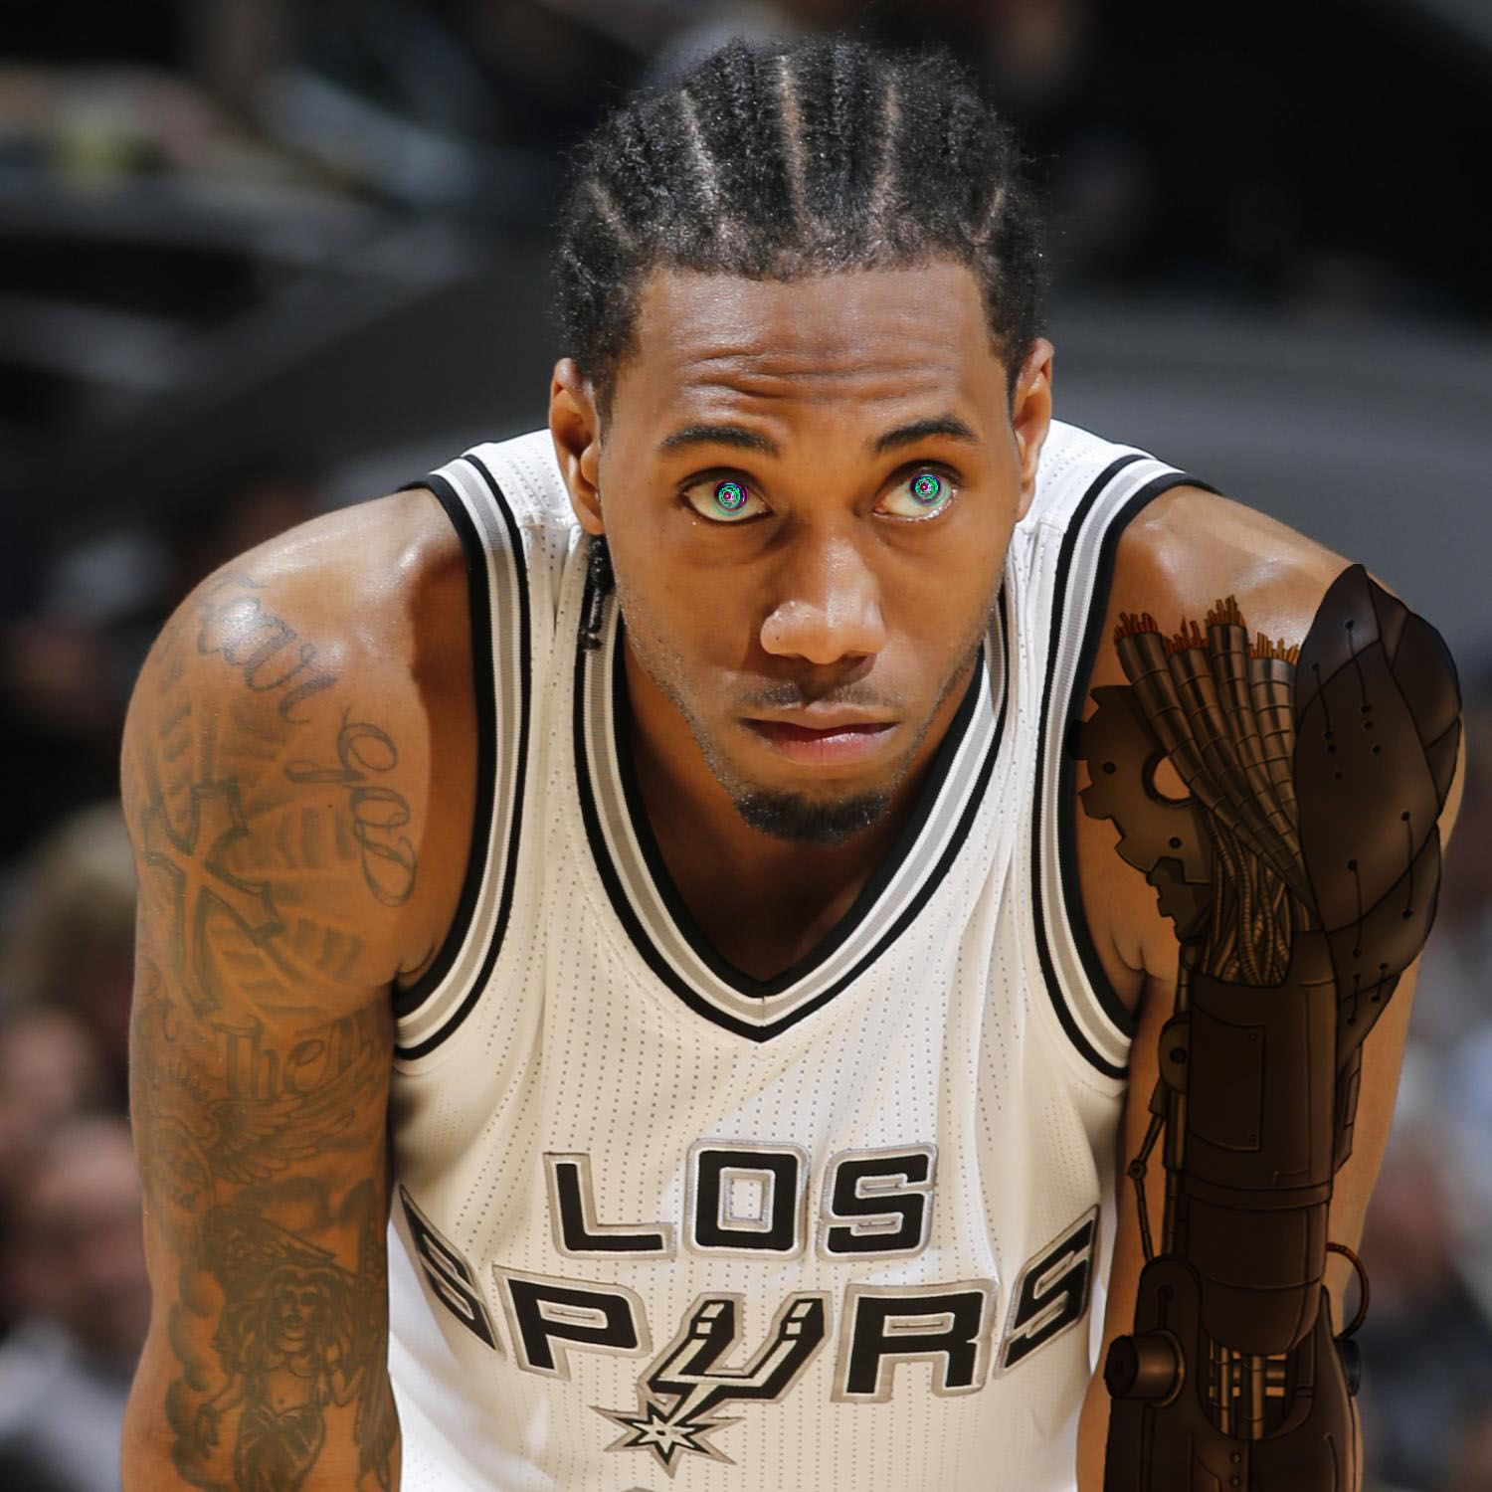

Slide 4


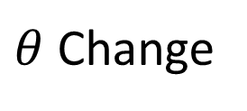
Shot Angle Adjustment by Rotation
Shot angle can change based on the hoop's location
arm
arm
$θ$ Change
hoop
hoop

Slide 5
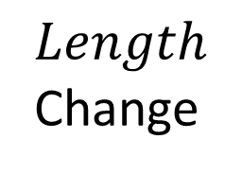
Shot Distance Adjustment by Arm
Distance of hoop accounted for by change in first links position
$Length$ Change
arm
arm
hoop
hoop

Slide 6





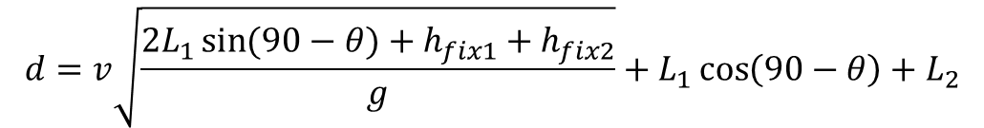

Analytical IK for theta
$$L_{2}$$
$$h= \frac{1}{2}gt^{2}$$
$$h_{fix2}$$
$$L_{1}$$
$$θ$$
$$d=v\sqrt{\frac{2L_{1}\sin{(90−θ)}+h_{fix1}+h_{fix2}}{g}}+L_{1}\cos\left(90−θ\right)+L_{2}$$
$$h_{fix1}$$
d

Slide 7
VREP Demonstration

