Slide 1
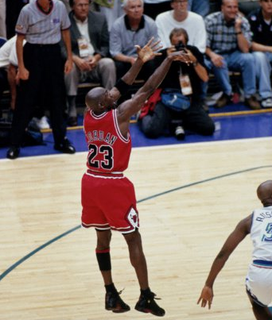
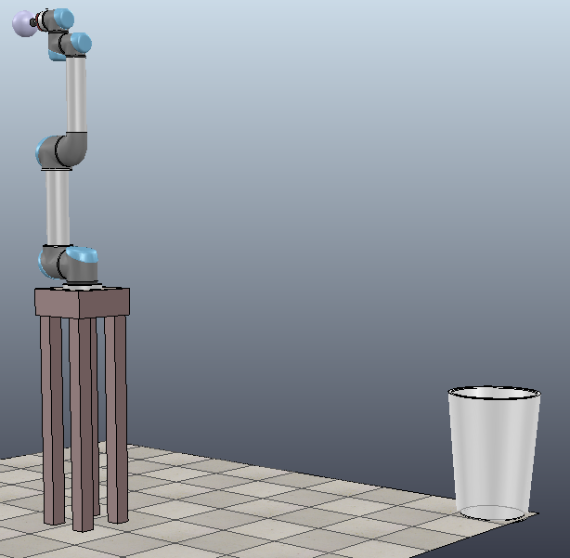
Robotic Basketball Shooter
Felipe Encinas
Nicholas O'Connell
Jeff Visk
Blaise Antico

Slide 2
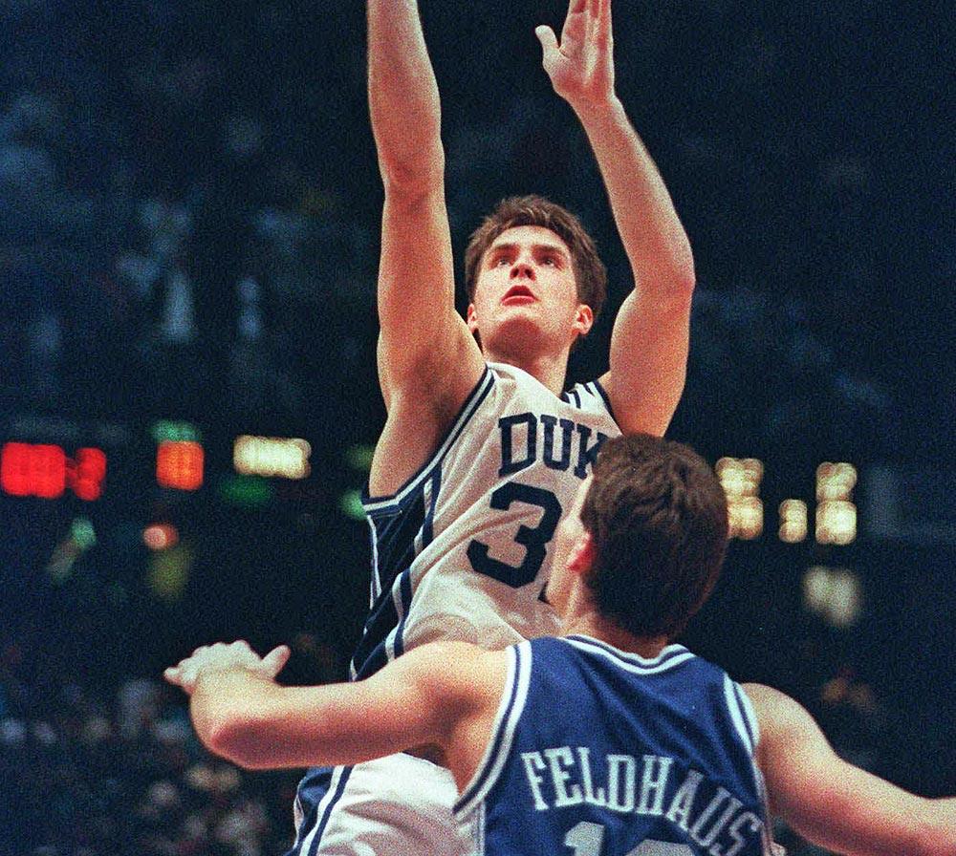

Slide 3
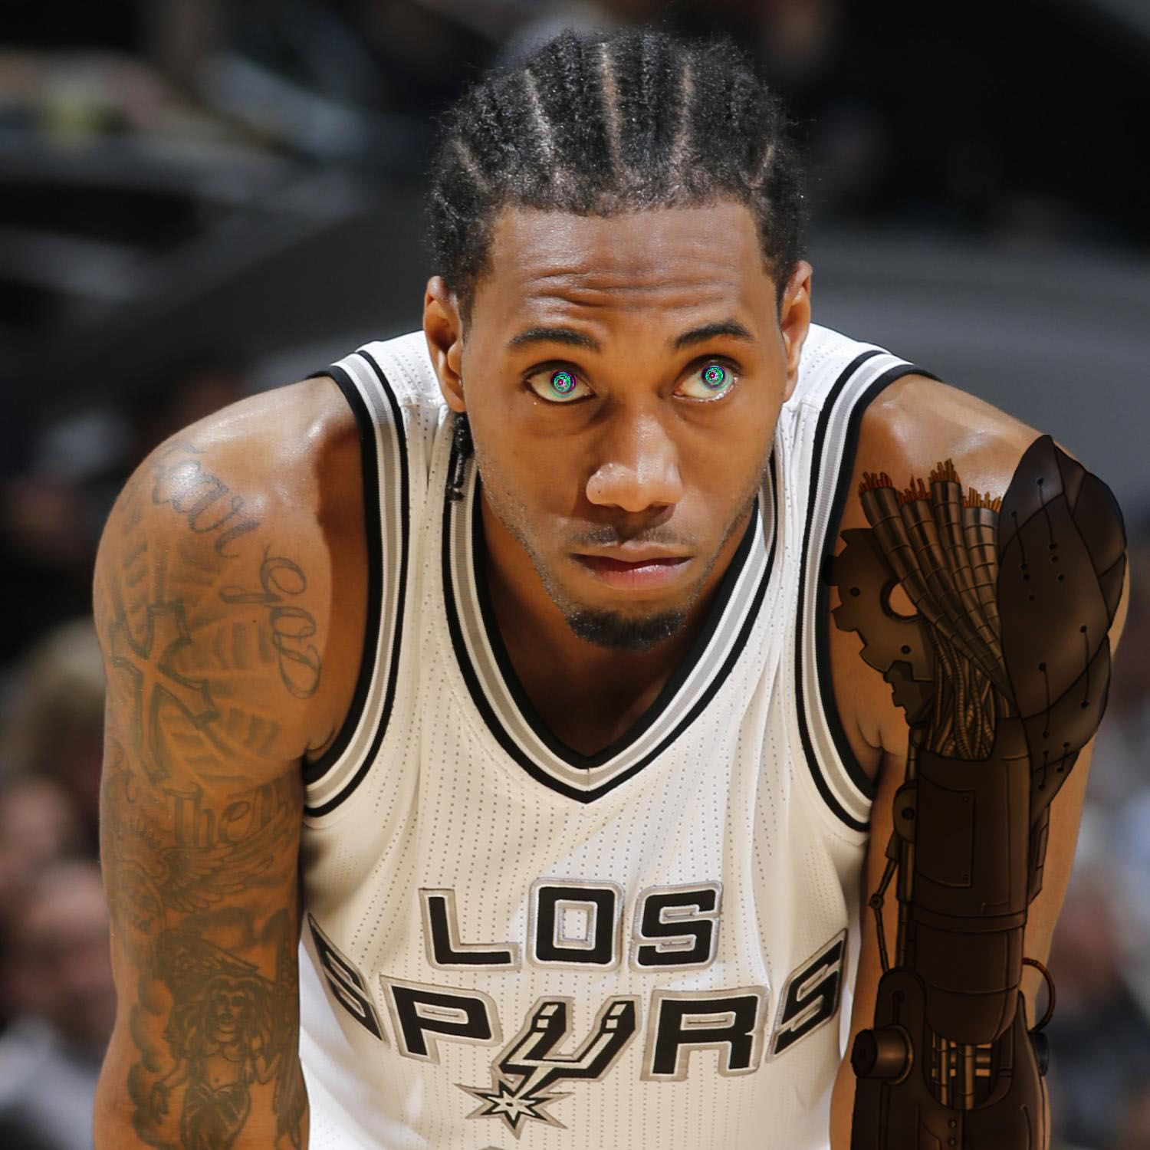

Slide 4

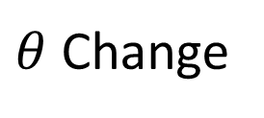
Shot Angle Adjustment by Rotation
Shot angle can change based on the hoop's location
arm
arm
$θ$ Change
hoop
hoop

Slide 5
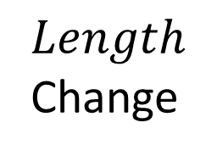
Shot Distance Adjustment by Arm
Distance of hoop accounted for by change in first links position
$Length$ Change
arm
arm
hoop
hoop

Slide 6
VREP Demonstration

