Slide 1
Jagath Vithanage
Florida International University
Coupling storm surge models with climate models, and I work as a hydrology and climate modeler. Uses WRF and ParFlow. Current storm surge models are not using sea wind when simulating tropical storms and has a profound effect on sea water intrusion and flooding. Land fall and low ground water table increase the complexicity of modeling. My research is an effort to include this compound effect using Cheyenne super computer and FIU HPC. WRF has components of serial and parallel, which may need to change the code to customize the output varibles/format. Input data are RCM and GCM with observed. Output data are in netCDF format and a single file can be of size of 10-100 GB

Slide 2
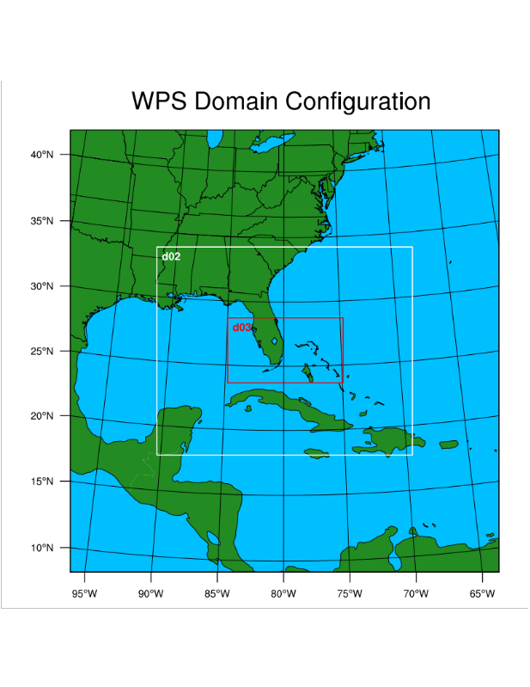
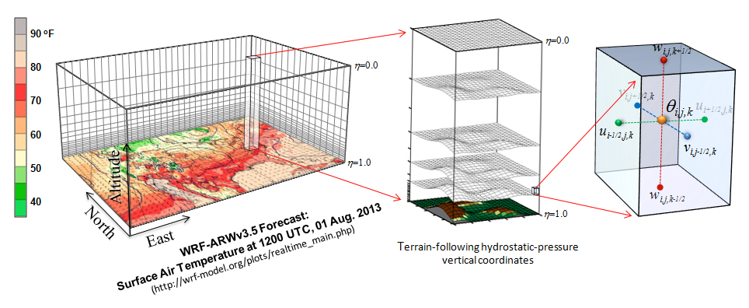
Jagath Vithanage
Florida International University
Main goals are optimization of the model efficiency after coupling the climate models with storm surge model.

Slide 3
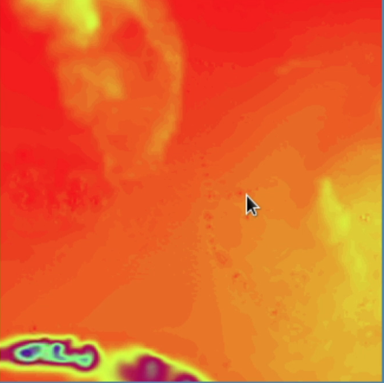
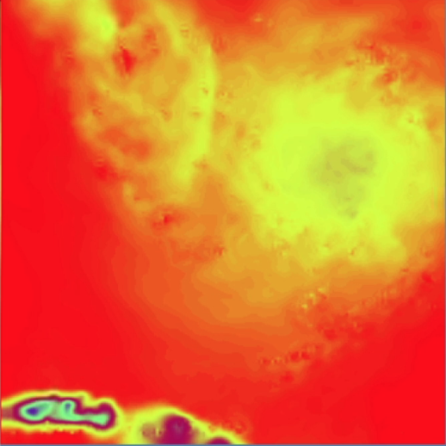
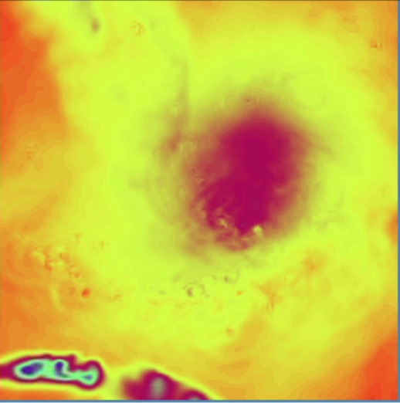
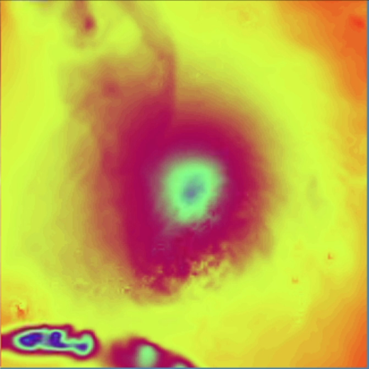
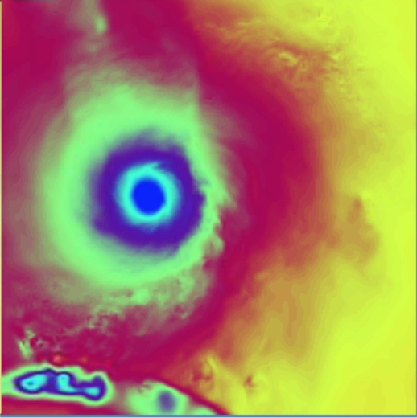
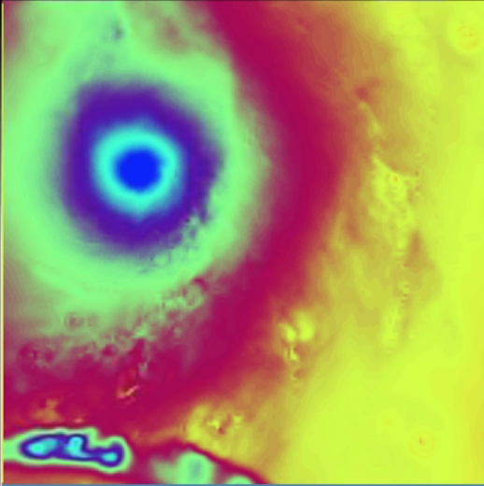
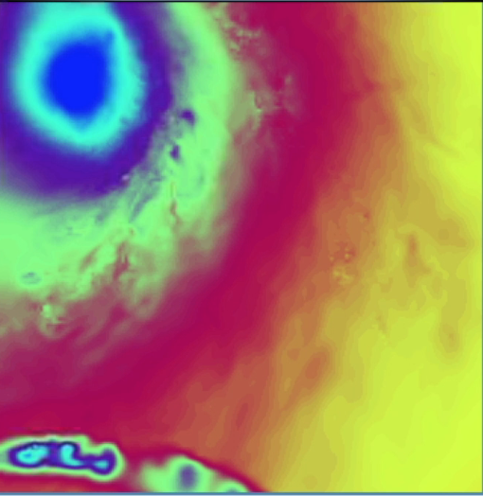
Jagath Vithanage
Florida International University

