Slide 1

丁飞
2019年11月27日

Slide 2
Outline
Convolution
Long range interactions
Self-attention
The relationship between self-attention and convolution
Fully Attentional Vision Models
Experiments

Slide 3
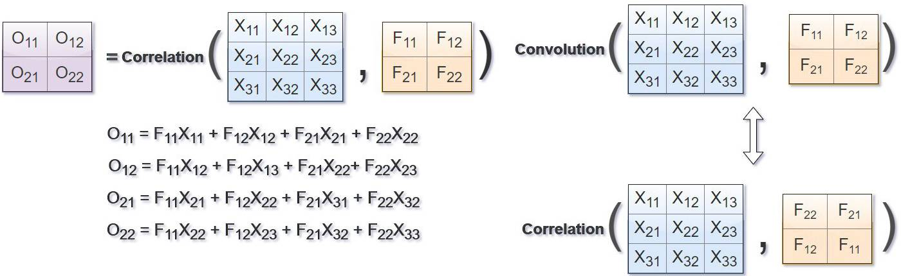
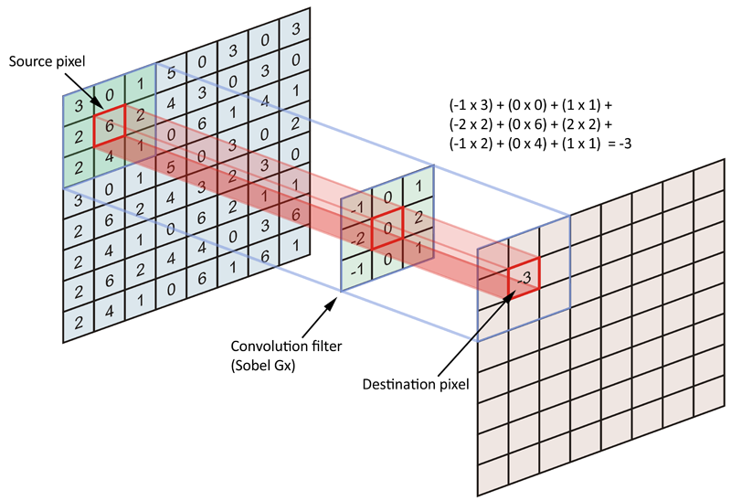
Convolution

Slide 4
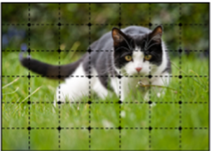

Convolution
Advantages
Translation equivariant
Parameter-efficient
Limits
local receptive fields
poor scaling properties
Fixed weights
Inception
Dilated convolution
Spatial Pyramid Pooling

Slide 5
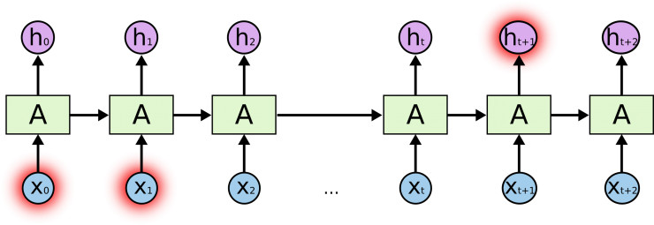
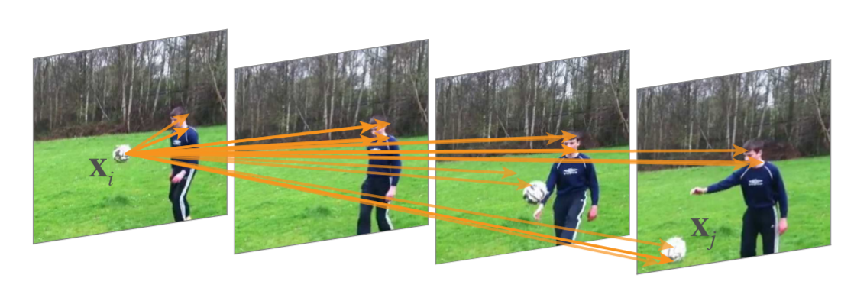
Long range interactions
RNN
I grew up in China …, (省略一万字), … speak fluent _____ .
Non-local

Slide 6
Self-attention
query
w11 | w12 | w13 | w14
w21 | w22 | w23 | w24
w31 | w32 | w33 | w34
w41 | w42 | w43 | w44
×
keys
×
O1 | O2 | O3 | O4
values
v1 | v2 | v3 | v4
O1 = w11·v1 + w21·v2 + w31·v3 +w41·v4
O2 = w12·v1 + w22·v2 + w32·v3 + w42·v4
O3 = · · ·
O4 = · · ·

Slide 7
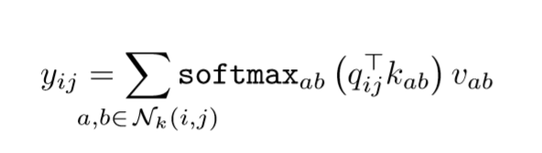
Self-attention
Advantages
Global receptive fields
Rich scaling properties
Dynamic weights
Limits
Poor memory efficiency
Permutation equivariant
It’s a leg. It’s the leg of a cat.
Convolution Self-attention

Slide 8
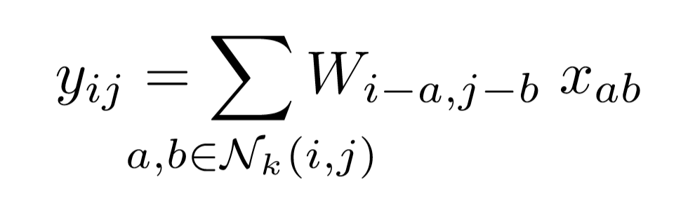
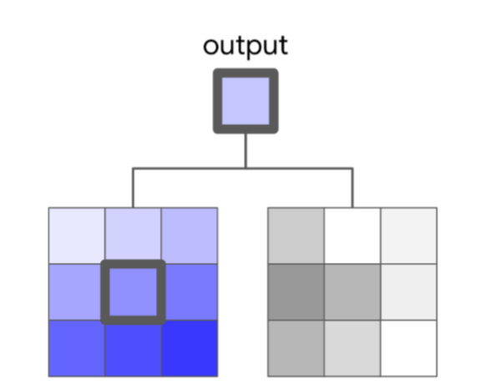
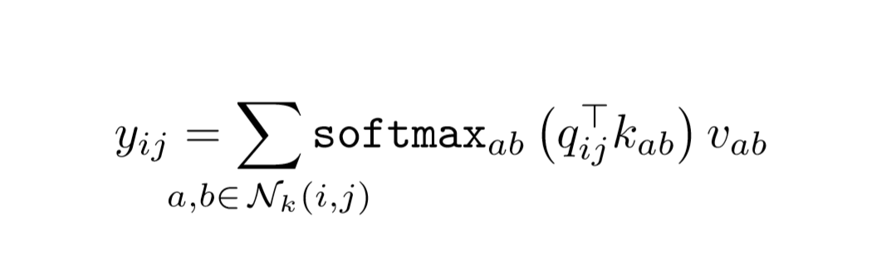
The relationship between self-attention and convolution
Convolution
Self-attention
Input Weights

Slide 9
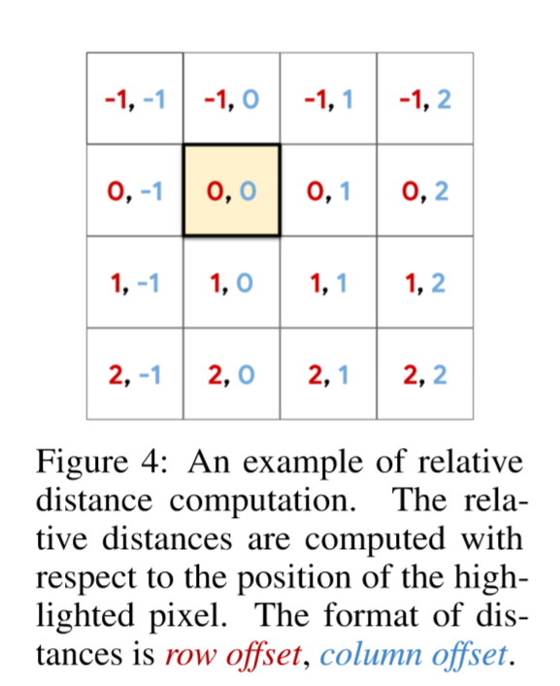
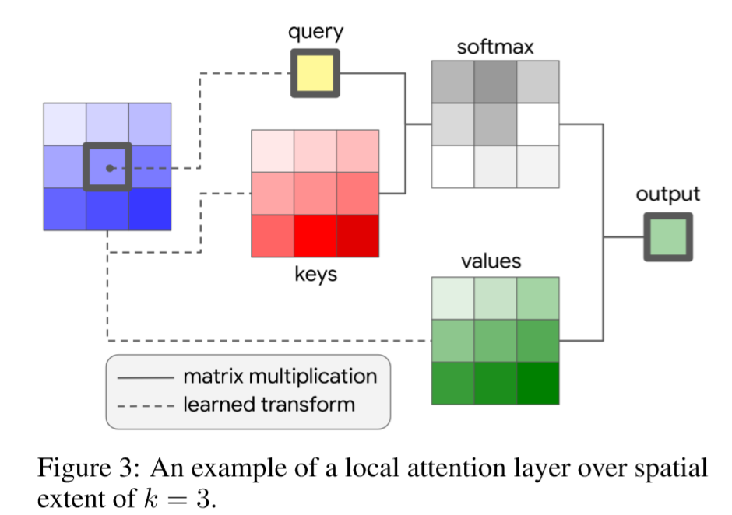
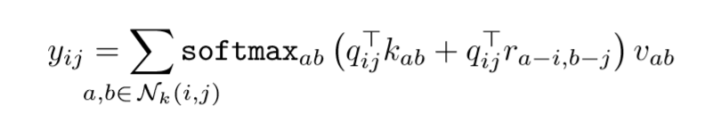
Local attention layer

Slide 10
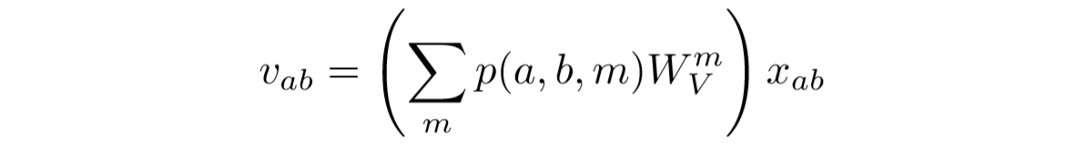
Fully Attentional Vision Models
——Replace every instance of a spatial convolution with an attention layer
Fully Attentional Resnet
Convolutional Stem → Local attention with spatially-varying linear transformation
3 x 3 spatial convolution in bottleneck block → Local attention
Max-pooling → Average pooling
Multi-Head

Slide 11
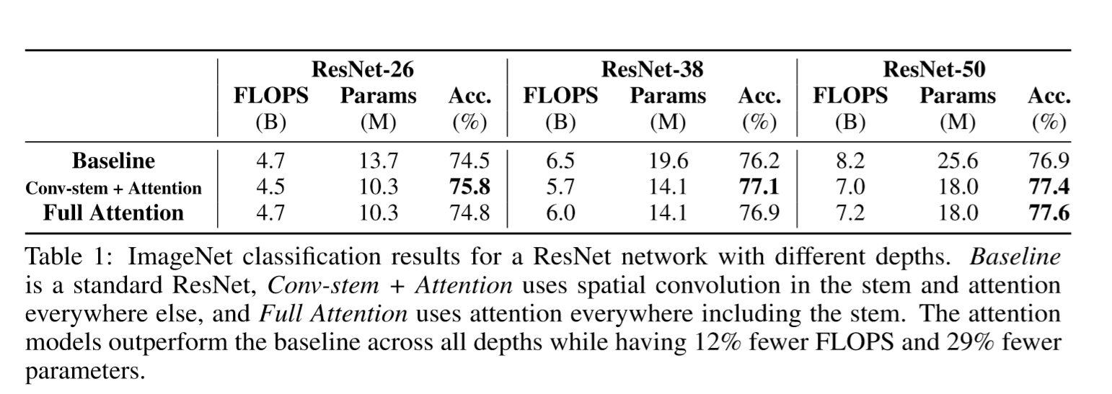
Experiments
ImageNet Classification-Depth

Slide 12
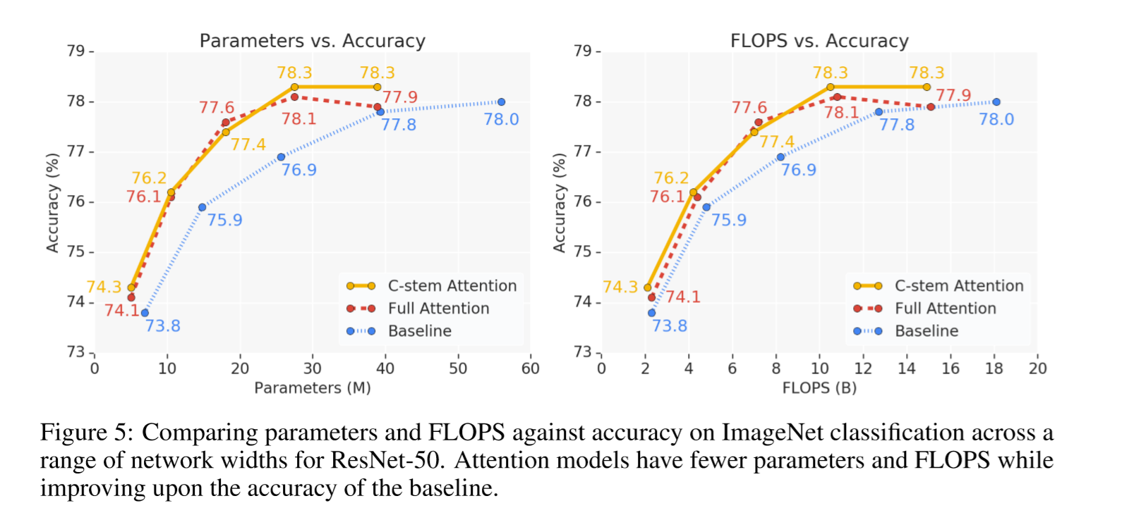
Experiments
ImageNet Classification-Width

Slide 13
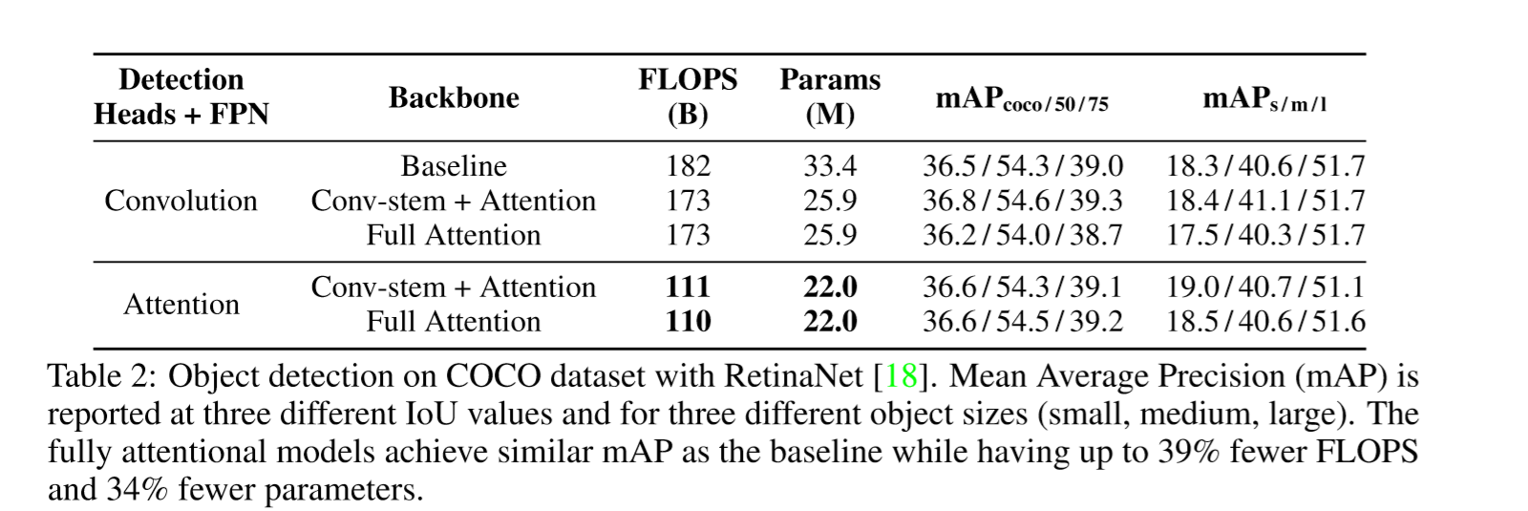
Experiments
COCO Object Detection

Slide 14
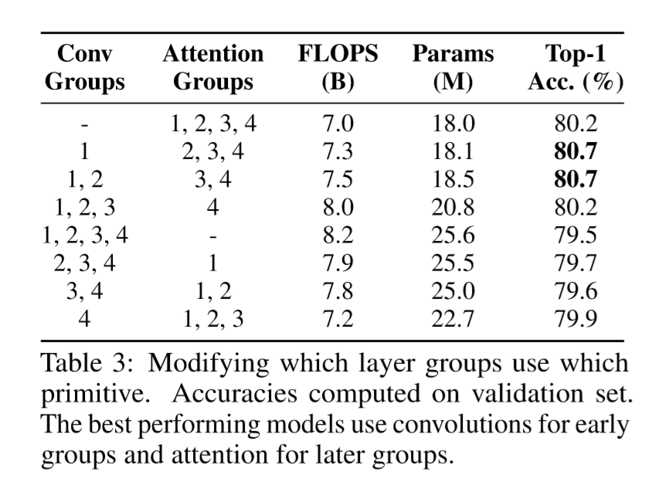
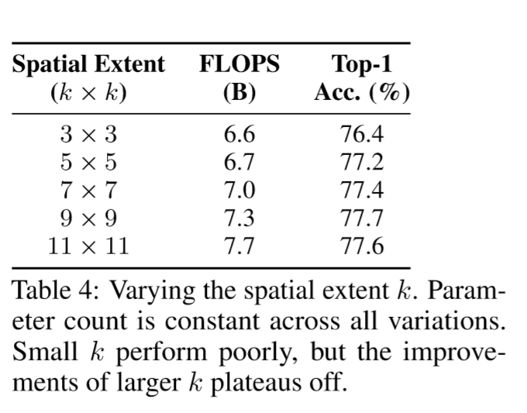
Experiments
Where is stand-alone attention most useful ? Effect of spatial extent of self-attention

Slide 15
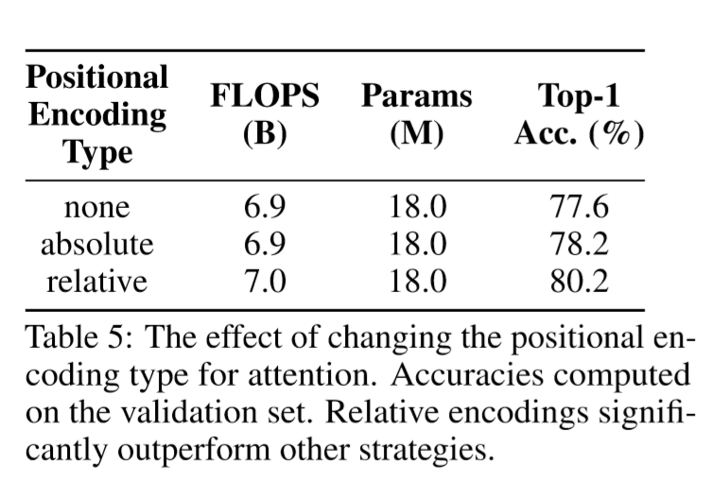
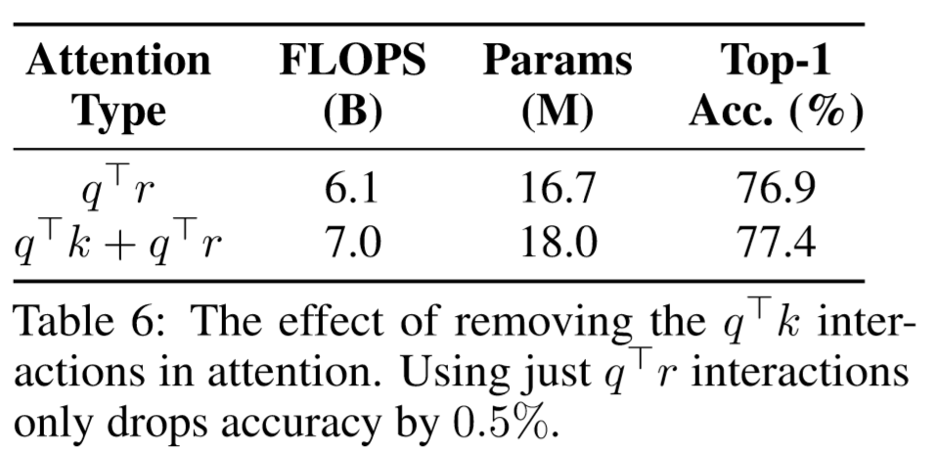
Experiments
Importance of positional information

Slide 16
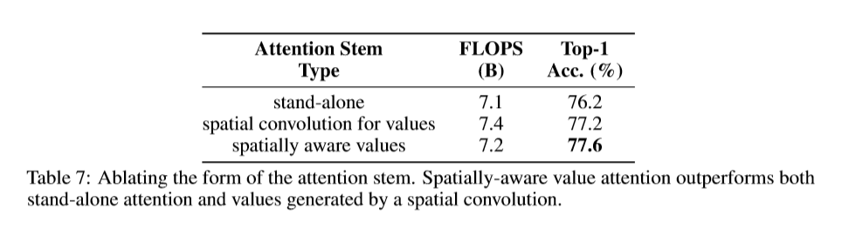
Experiments
Importance of spatially-aware attention stem

Slide 17
Thanks

