Slide 1
Introduction to Engineering Mathematics
Introduction + Course Outline
Wednesday 31 August 2022
Joris Vankerschaver

Slide 2
Welcome to Engineering Math!
Prof. Joris Vankerschaver joris.vankerschaver@ghent.ac.kr
Teaching assistants
Abiodun Ilugbusi Abiodun.ilugbusi@ghent.ac.kr
Anju Susan Anish Anjususan.anish@ghent.ac.kr
Mena Markos mena.markos@ghent.ac.kr
Negin Harandi negin.harandi@ghent.ac.kr
Welcome!
환영합니다!
Welkom!

Slide 3
Course schedule
Theory lectures:
Wednesday and Friday, 8:30-9:45am (Gh203)
Exercise sessions: on campus
Monday, 17:00-19:45 (Group A: Gh102, Group B: Gh103)
Ufora used for communication:
Announcements
Course materials
Exercises and hints

Slide 4
Course schedule
Theory sessions:
Follow along, take notes
Problem sessions:
Problem sets released on Ufora on Friday before class week
Very important that you actively work on the problem sets
Guided discussion and walkthrough during class session
Extra problems, sample exams will also be made available

Slide 5
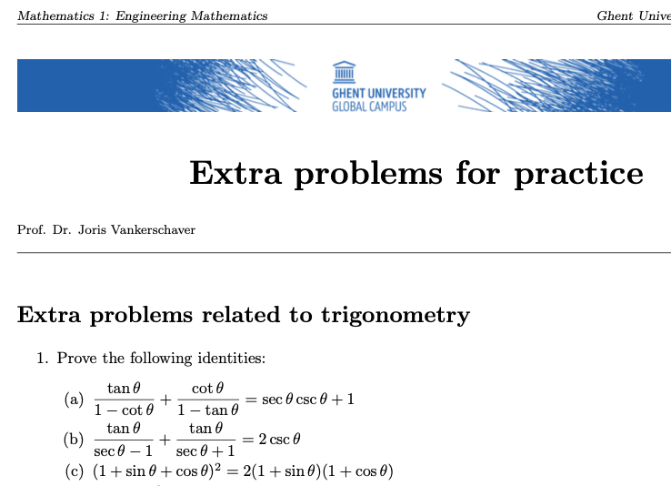
“Extra Problems”
Problems that are not covered during practical sessions …
… but that are more in line with exam questions.
Available on Ufora, updated periodically

Slide 6
Examination and grading
Evaluation form | Percentage of grade
Class participation | 5%
Quizzes (3 in total) | 15%
Exam (December) | 80%
(Resit exam in February)

Slide 7
Course content
Trigonometry
Coordinate geometry
Limits and continuity
Differential calculus
Algebra
Integral calculus

Slide 8
How to study for this course?
In this course, you will learn how to apply mathematical techniques to solve practical problems.
The exam will test how well you can apply what you’ve learned to new problems.
Practice, practice, practice.
A little bit every week is better than a huge cram session at the end.
Exam questions will be different from the problem sets. Don’t memorize solutions.
Get in the habit of showing your work:
Useful to help us give you specific feedback
Partial credit on the exam
Final answer is not enough!

Slide 9
Opportunities to ask questions
During exercise sessions (in person)
Email opportunities with TAs
When asking questions, please provide context, show what you’ve tried, and ask specific questions.

Slide 10
How to ask for constructive feedback?
û
ü
Don’ts
Do’s
“I don’t understand the course. Please explain <huge topic from 3 months ago>.”
“Please send me the solution for problem X.”
“I am stuck on problem X. I have tried A, B, and C, but I cannot continue because of Y.”
“Here is my solution for problem X. Can you tell me where I went wrong?”

Slide 11
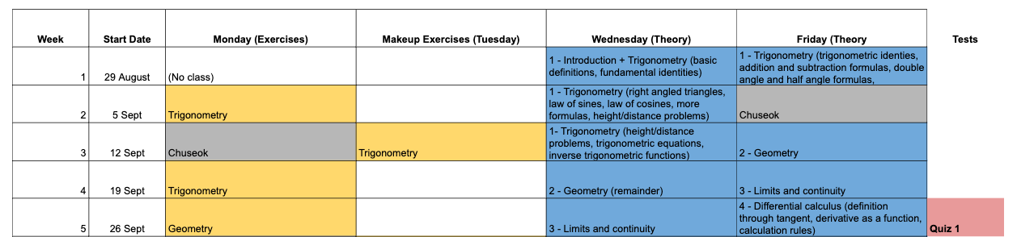
Schedule for this month

