Slide 1
Trigonometry: Height/distance, trigonometric equations, inverse trigonometric functions
Introduction to Engineering Mathematics
Joris Vankerschaver

Slide 2
Contents
Height and distance problems: solutions
Solving trigonometric equations
Inverse trigonometric functions

Slide 3
You see a town on a hillside at an angle of elevation of 30°. You walk 80 meters (horizontally, along the ground) and see the town at an angle of elevation of 60°. Find the height of the town above ground level.

Slide 4
A man lies on the ground and observes that a temple and a flagpole on that temple subtend equal angles at his eyes. If the height of the temple is 10m and that of the flagpole is 20m, find the subtended angles and the distance between the temple and the man.

Slide 5
Crown Prince Lee Chang stands on the fortress walls and overlooks an approaching zombie army. He observes a zombie under an angle of depression of 45° and shoots an arrow. One second later, he shoots an arrow at the same zombie under an angle of depression of 60°. How soon will the zombie reach the base of the wall?

Slide 6
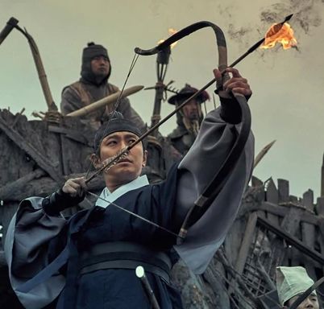

Slide 7
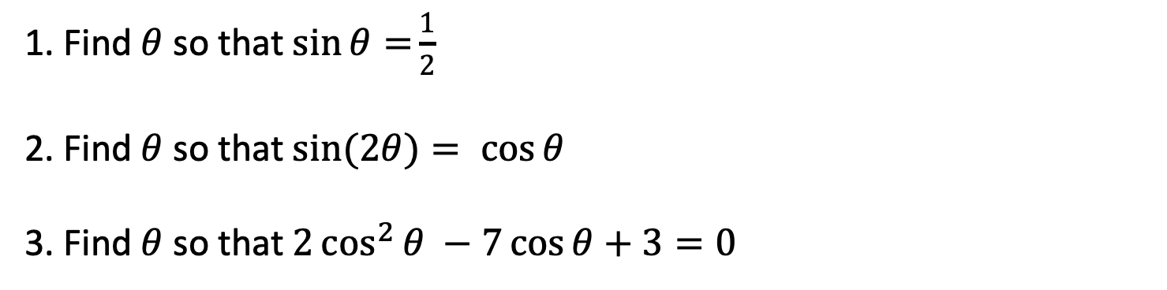
Trigonometric equations: example
1. Find $θ$ so that $\sin{θ=}\frac{1}{2}$
2. Find $θ$ so that $\sin{(2θ)}= \cos{θ}$
3. Find $θ$ so that $2\cos^{2}{θ} −7\cos{θ}+3=0$

Slide 8
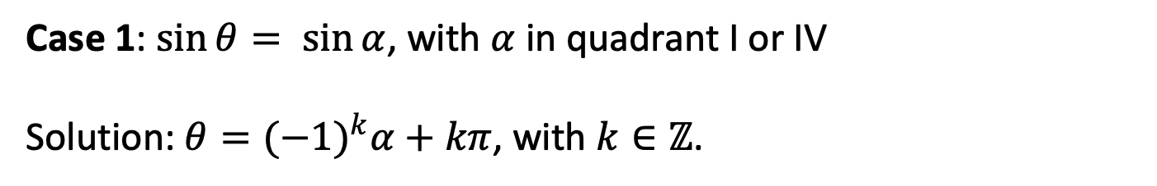
General approach
Case 1: $\sin{θ}= \sin{α}$, with $α$ in quadrant I or IV
Solution: $θ={(−1)}^{k}α+kπ$, with $k∈ℤ$.

Slide 9
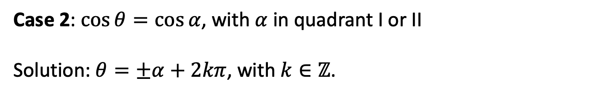
Case 2: $\cos{θ}=\cos{α}$, with $α$ in quadrant I or II
Solution: $θ=±α+2kπ$, with $k∈ℤ$.

Slide 10
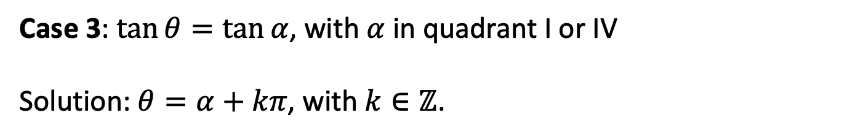
Case 3: $\tan{θ}=\tan{α}$, with $α$ in quadrant I or IV
Solution: $θ=α+kπ$, with $k∈ℤ$.

Slide 11
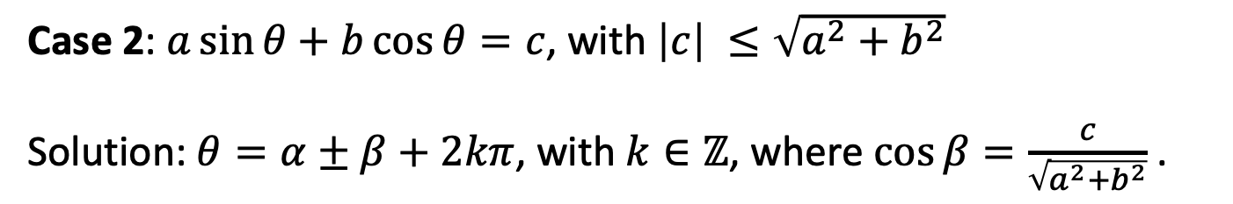
Case 2: $a\sin{θ}+b\cos{θ}=c$, with $\left|c\right| ≤\sqrt{a^{2}+b^{2}}$
Solution: $θ=α±β+2kπ$, with $k∈ℤ$, where $\cos{β=\frac{c}{\sqrt{a^{2}+b^{2}}}}$.

Slide 12
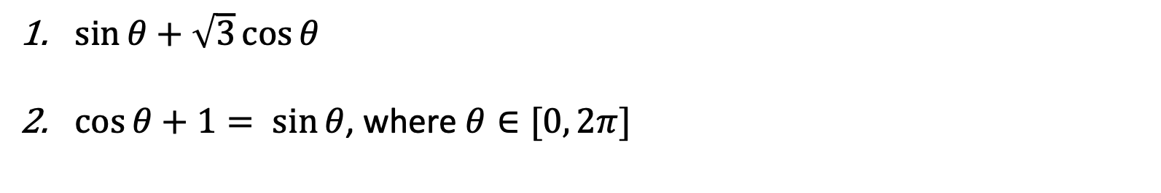
Examples
$\sin{θ+\sqrt{3}\cos{θ}}$
$\cos{θ}+1= \sin{θ}$, where $θ∈[0, 2π]$

Slide 13
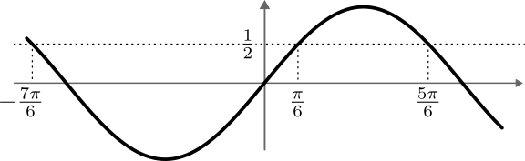
The inverse sine function
The sine function turns angles into sine values.
The inverse sine turns sine values back into angles
Problem: many values in the range correspond to the same angle!

Slide 14
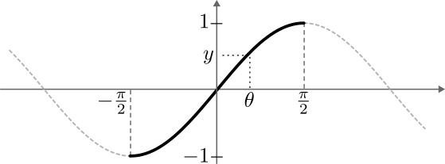
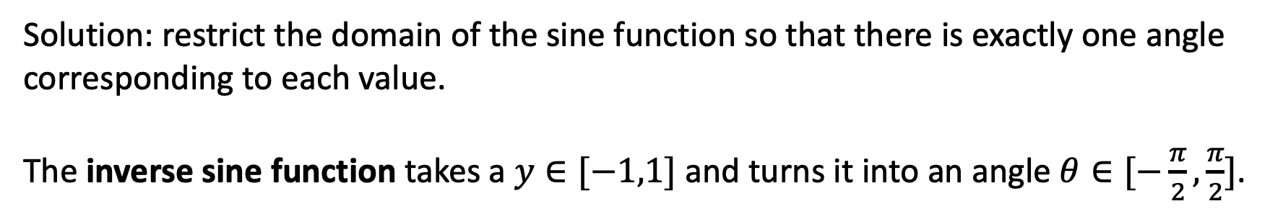
Solution: restrict the domain of the sine function so that there is exactly one angle corresponding to each value.
The inverse sine function takes a $y∈[−1,1]$ and turns it into an angle $θ∈[−\frac{π}{2},\frac{π}{2}]$.

Slide 15
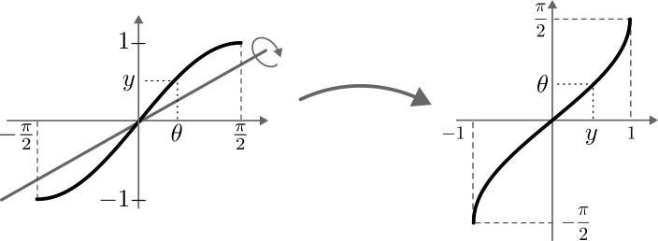
To draw the graph of the inverse sine function, we reflect the selected part of the sine function around the first bisector.

Slide 16
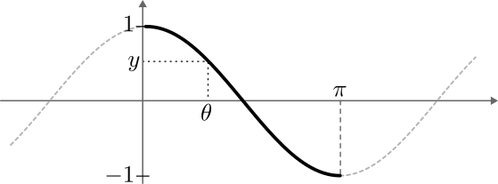
The inverse cosine function
For the inverse cosine, we restrict the cosine to the interval $\left[0, π\right]$.

Slide 17
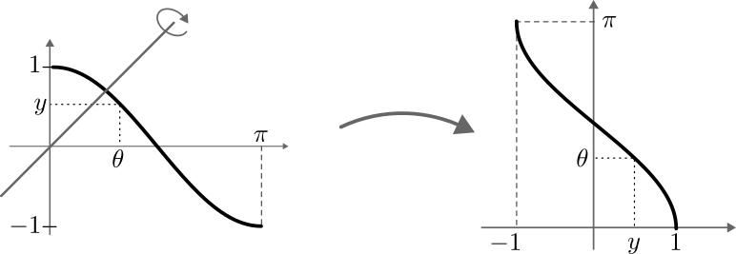
As before, we reflect the selected part of the sine function around the first bisector to draw the graph of the inverse cosine.

Slide 18
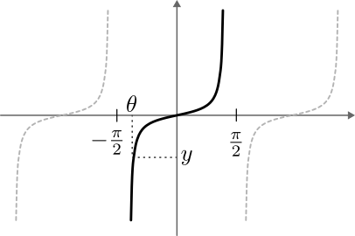
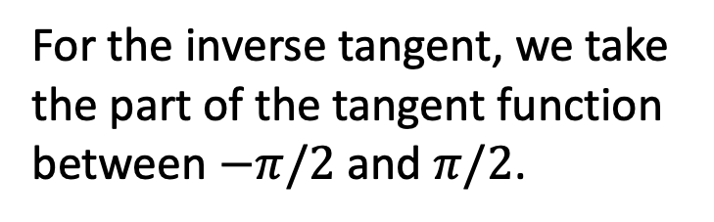
The inverse tangent function
For the inverse tangent, we take the part of the tangent function between $−π/2$ and $π/2$.

Slide 19
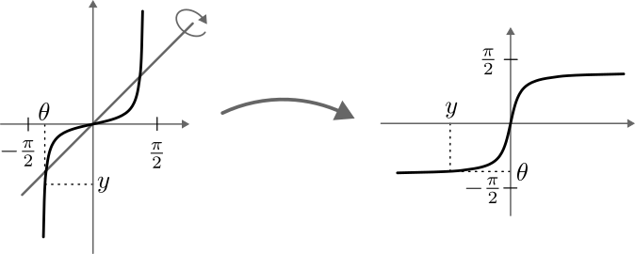
Reflect across the first bisector, and we have our inverse tangent function!

Slide 20
Examples
Simplify the following expression: $\tan\left(\sin^{−1}{\frac{2}{3}}\right)$

