Slide 1
Trigonometry: Triangle formulas, height/distance
Introduction to Engineering Mathematics
Joris Vankerschaver

Slide 2
Contents
Trigonometry in right-angled triangles
Trigonometry in general triangles
Law of sines
Law of cosines
Semi-perimeter formulas
Area formulas (Heron’s formula)
Height/distance problems

Slide 3
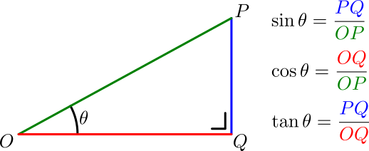
Trigonometry in right-angled triangles

Slide 4
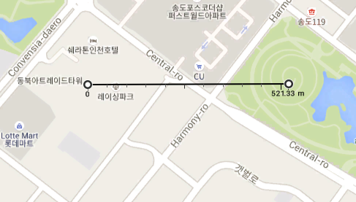
Example
A student sees the top of the Posco tower in central Songdo under an angle of 30°. Knowing that the Posco tower is approximately 300m tall, how far away is the student from the base of the tower?

Slide 5
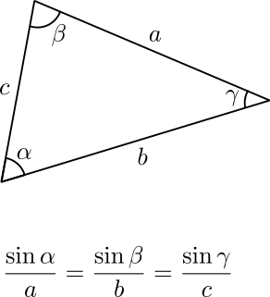
Trigonometry in general triangles: law of sines
Useful when you know
2 angles + 1 side, or
1 angle + 2 sides
and want to know the others.
Derivation: on the whiteboard (optional)

Slide 6
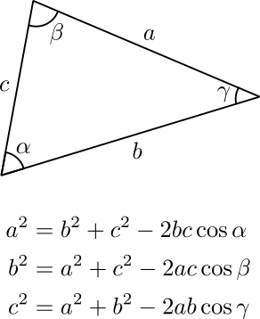
Trigonometry in general triangles: law of cosines
Useful when you know
2 sides + 1 angle in between
and want to know the other side
Derivation: on the whiteboard (optional)

Slide 7
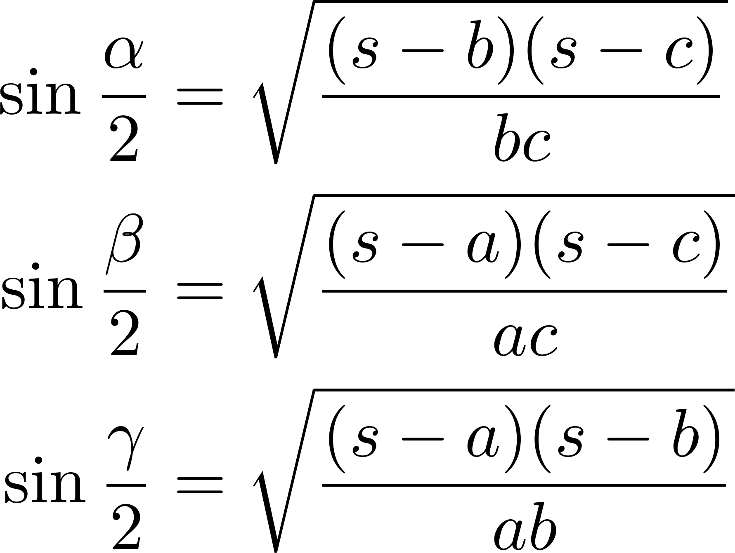
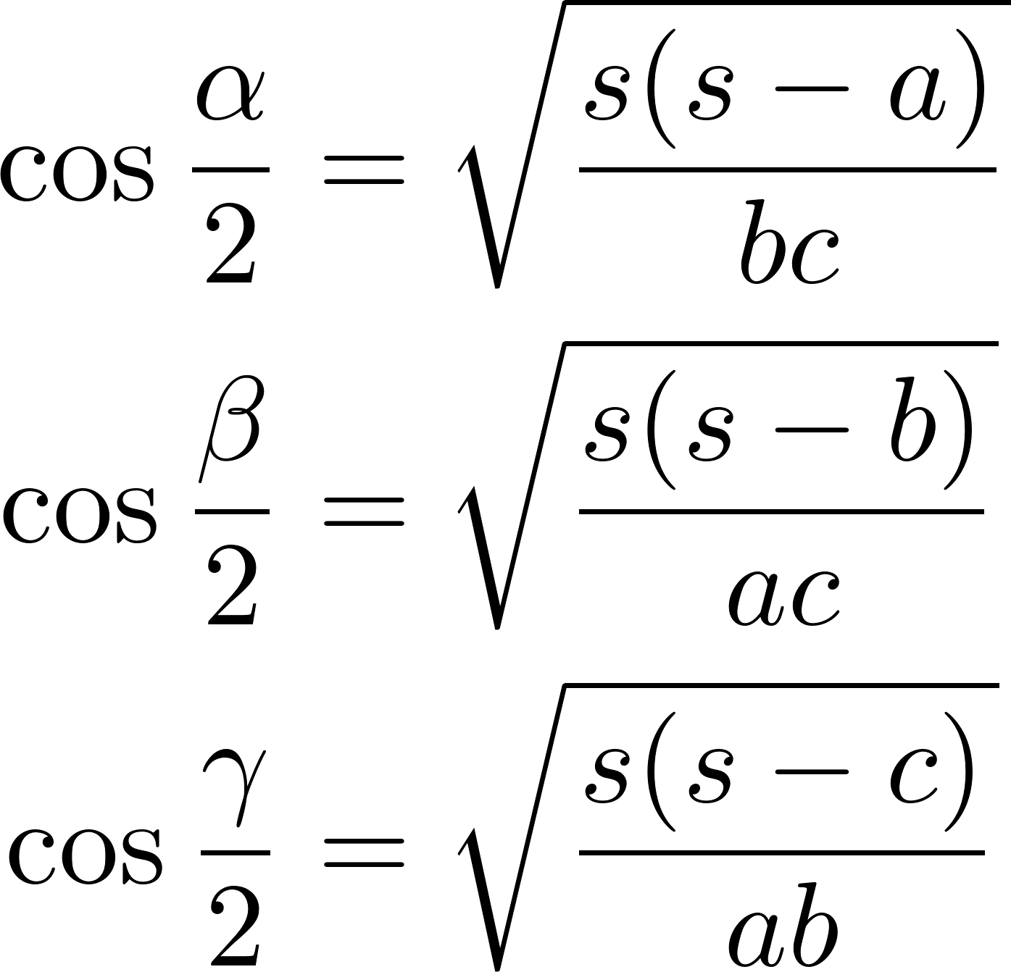
Semi-perimeter formulas
Express the sine/cosine as a function of the length of the sides + semi-perimeter.

Slide 8
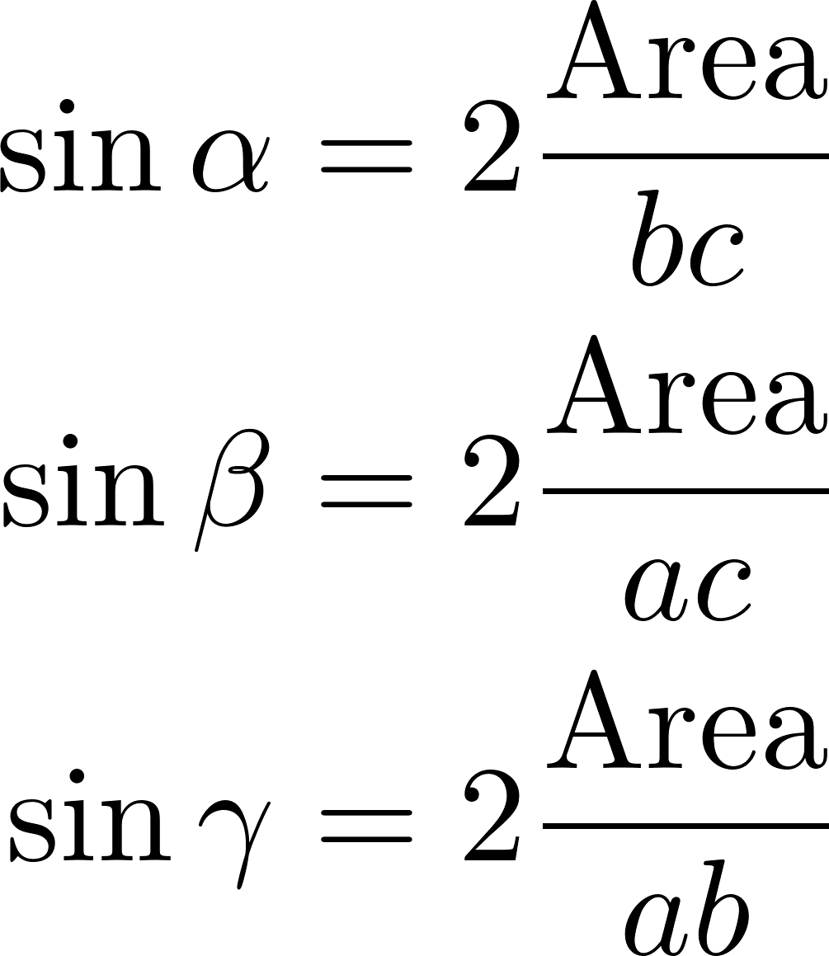
Area formulas: Heron’s formula
Expresses area as a function of the lengths of the sides
Expresses sine of angles as function of area

Slide 9
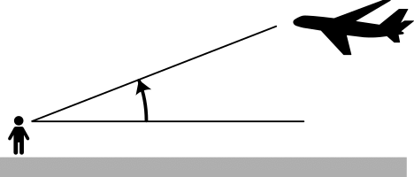
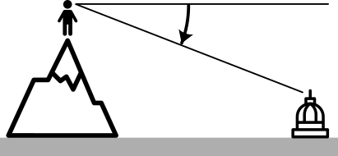
Problems in height/distance: terminology
Angle of elevation: you look up at something
Angle of depression: you look down at something

Slide 10
Example
From a plane flying vertically over a straight road, the angles of depression of 2 consecutive milestones are 45° and 60°. Find the height at which the plane is flying.

Slide 11
Problems for you to try (solution next week)
You see a town on a hillside at an angle of elevation of 30°. You walk 80 meters (horizontally, along the ground) and see the town at an angle of elevation of 60°. Find the height of the town above ground level.
A man lies on the ground and observes that a temple and a flagpole on that temple subtend equal angles at his eyes. If the height of the temple is 10m and that of the flagpole is 20m, find the subtended angles and the distance between the temple and the man.
Crown Prince Lee Chang stands on the fortress walls and overlooks an approaching zombie army. He observes a zombie under an angle of depression of 45° and shoots an arrow. One second later, he shoots an arrow at the same zombie under an angle of depression of 60°. How soon will the zombie reach the base of the wall?

