Slide 1
Trigonometry: Formulas
Introduction to Engineering Mathematics
Joris Vankerschaver

Slide 2
Overview
Basic identities
Reflection
Shift
Addition/Subtraction
Double/Half angle
Sum-to-Product
Product-to-Sum
You do not need to memorize the proofs of these identities, but you do need to
Know these identities by heart
Be able to apply them.

Slide 3
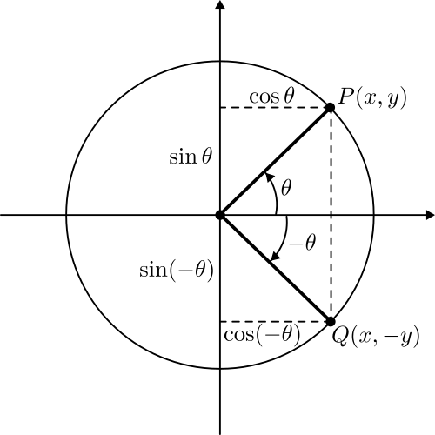

Even-odd formulas

Slide 4
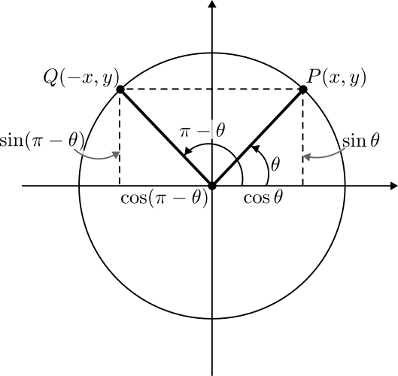
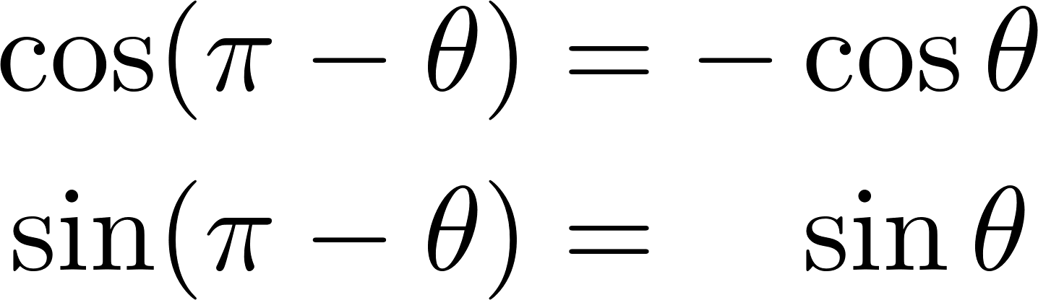
Reflection across y-axis

Slide 5
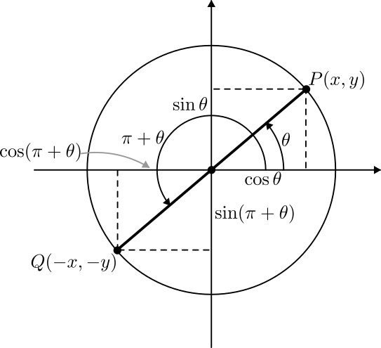
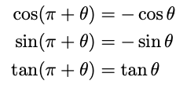

Shift formulas (shift by $π$)

Slide 6
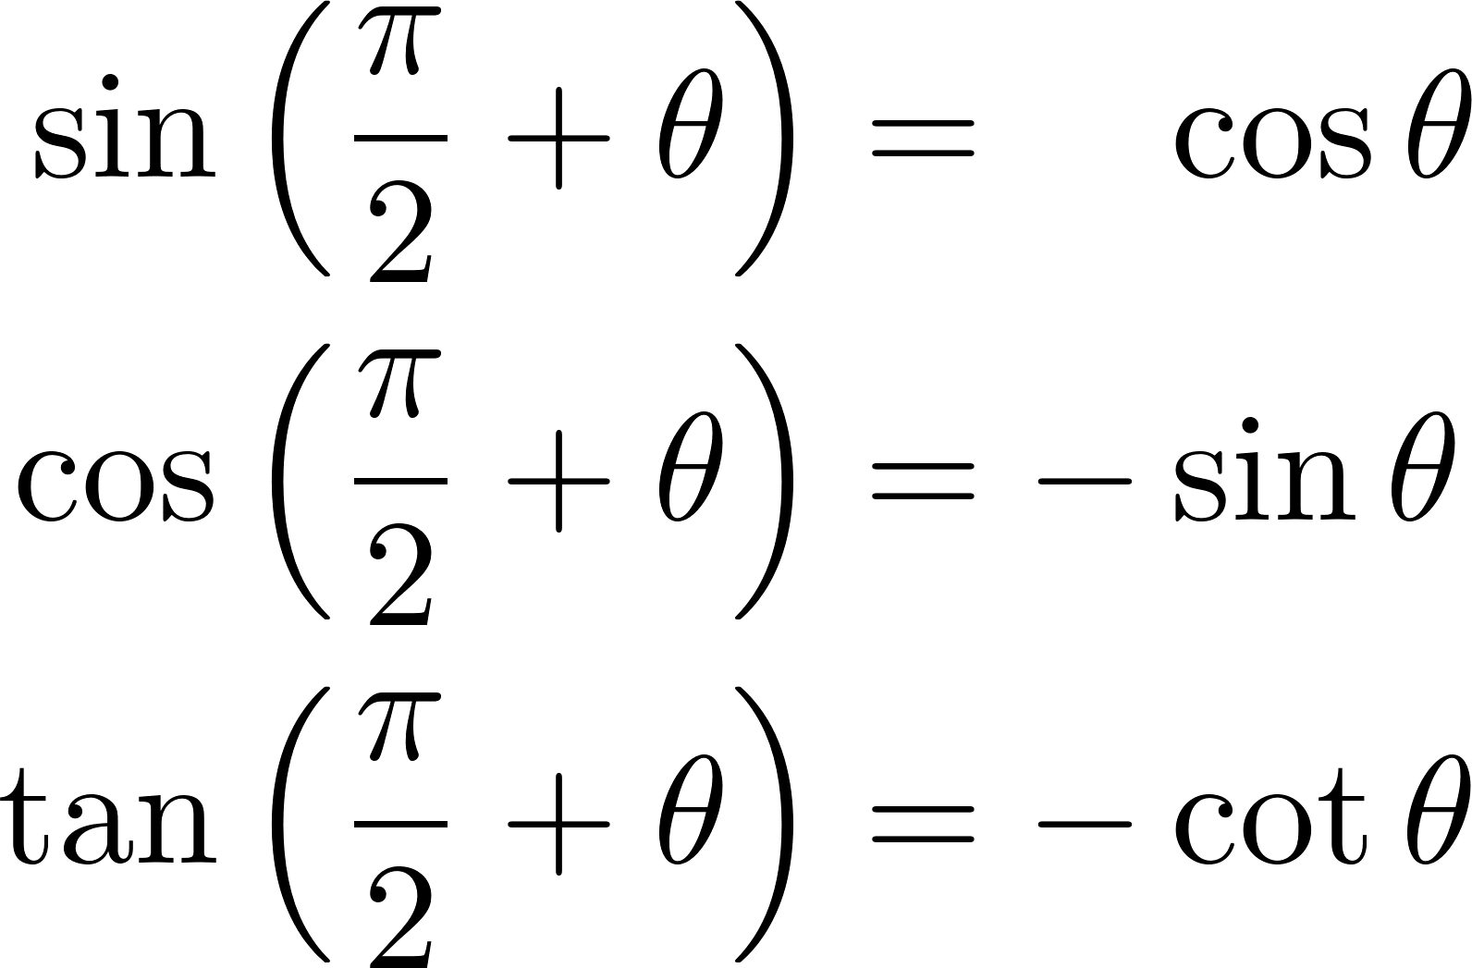
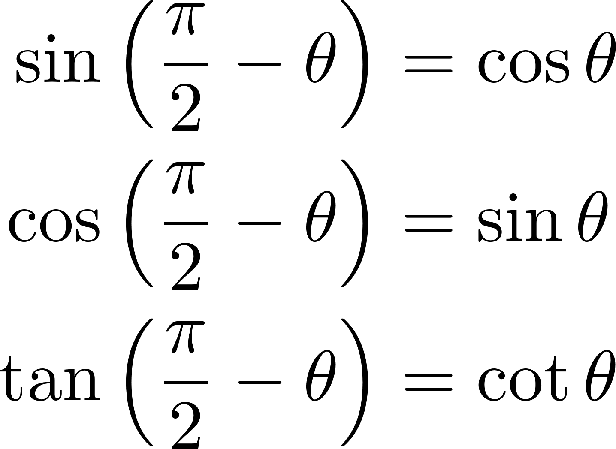


Shift formulas (shift by $\frac{π}{2}$)
By $+\frac{π}{2}$
Related

Slide 7
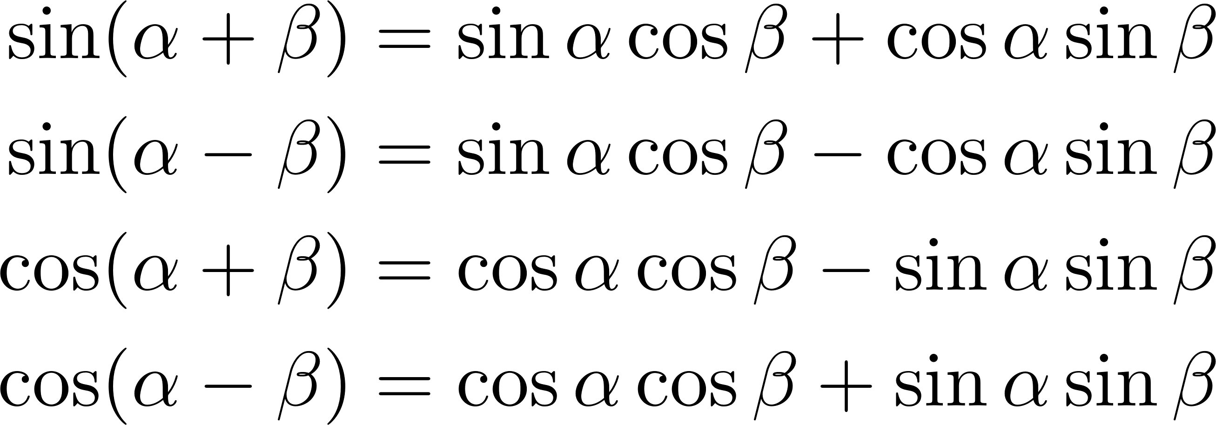
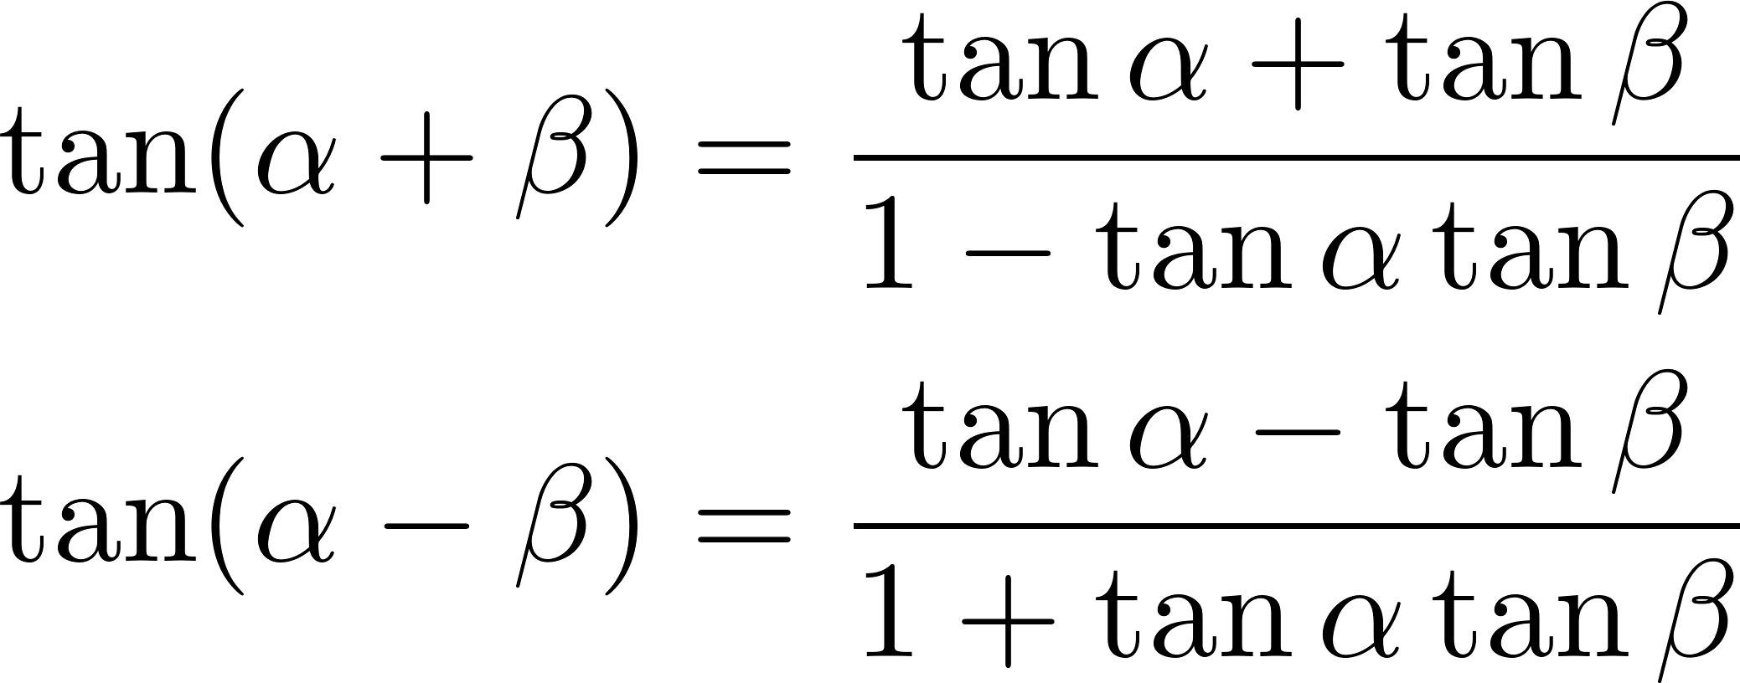
Addition/subtraction formulas

Slide 8
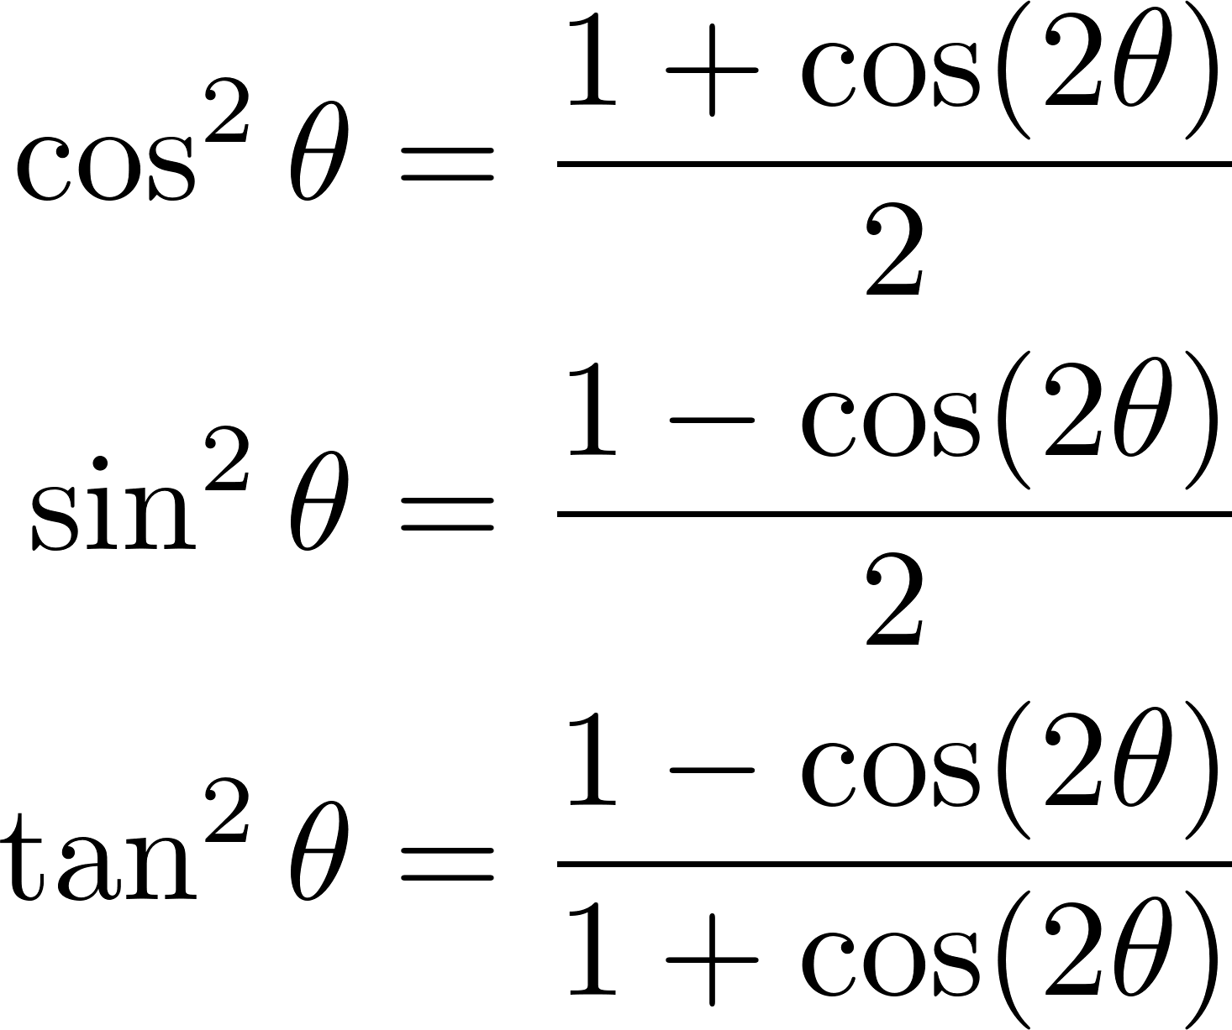
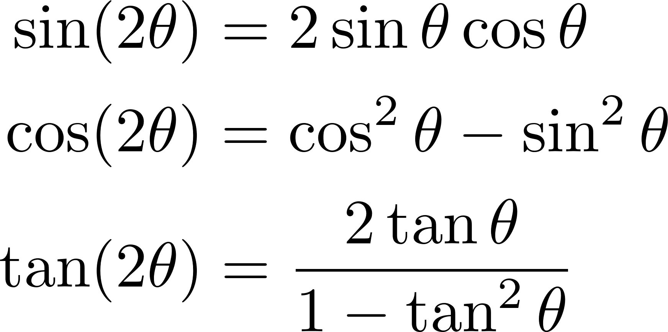
Double/half-angle formulas

Slide 9
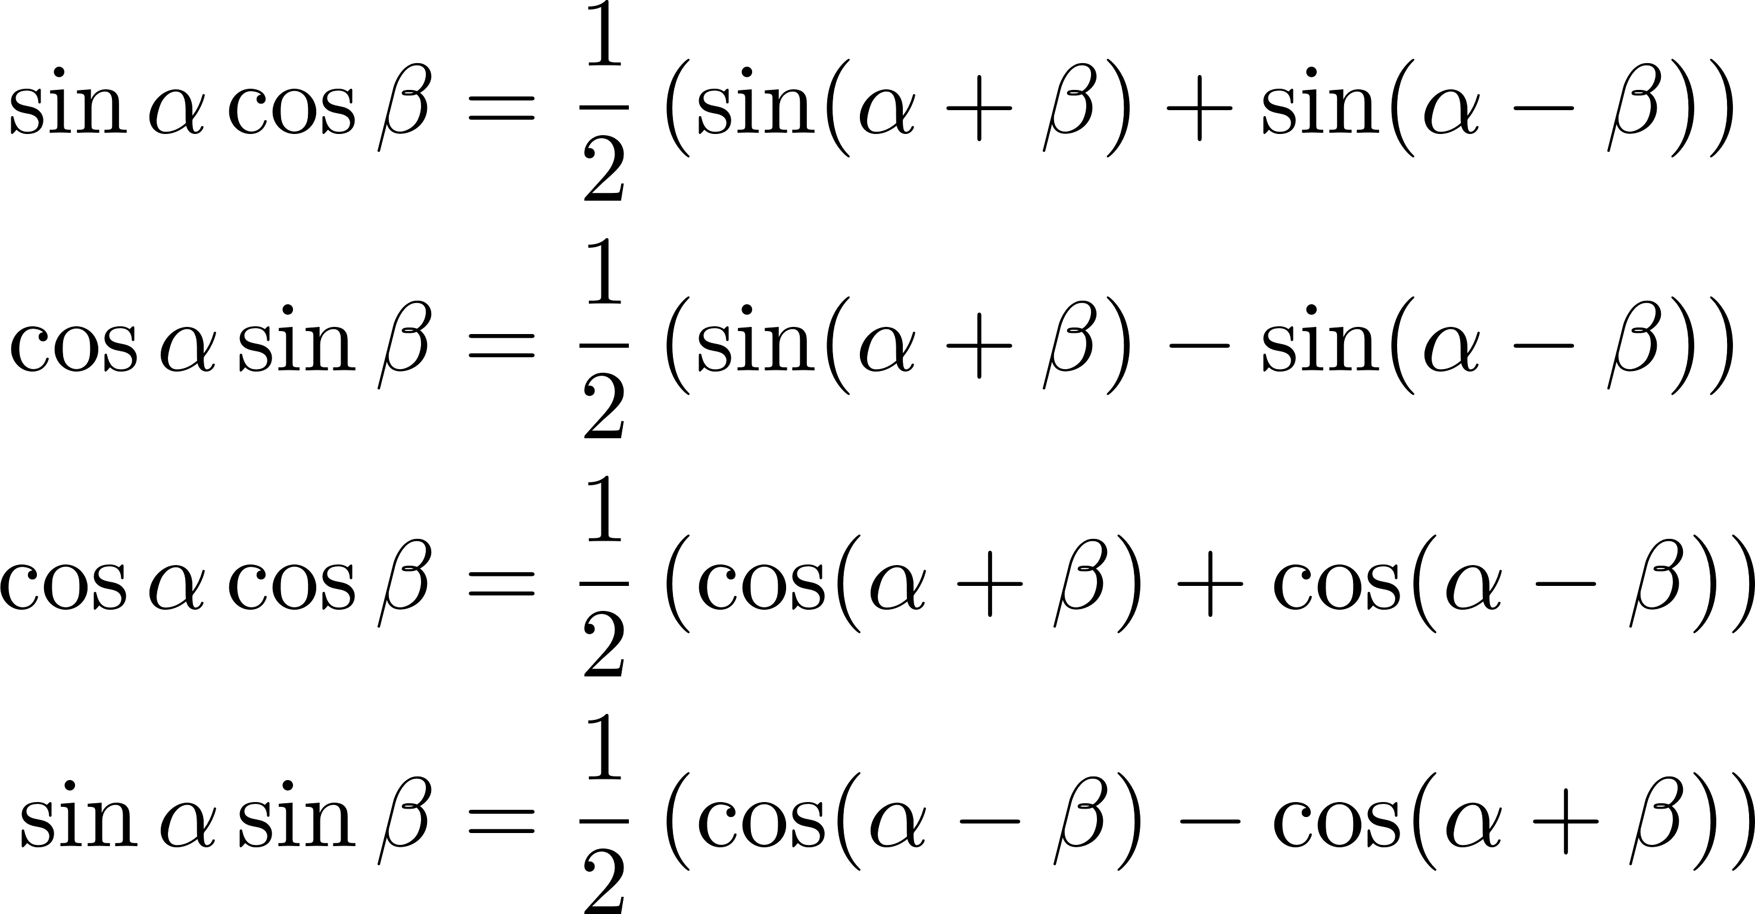
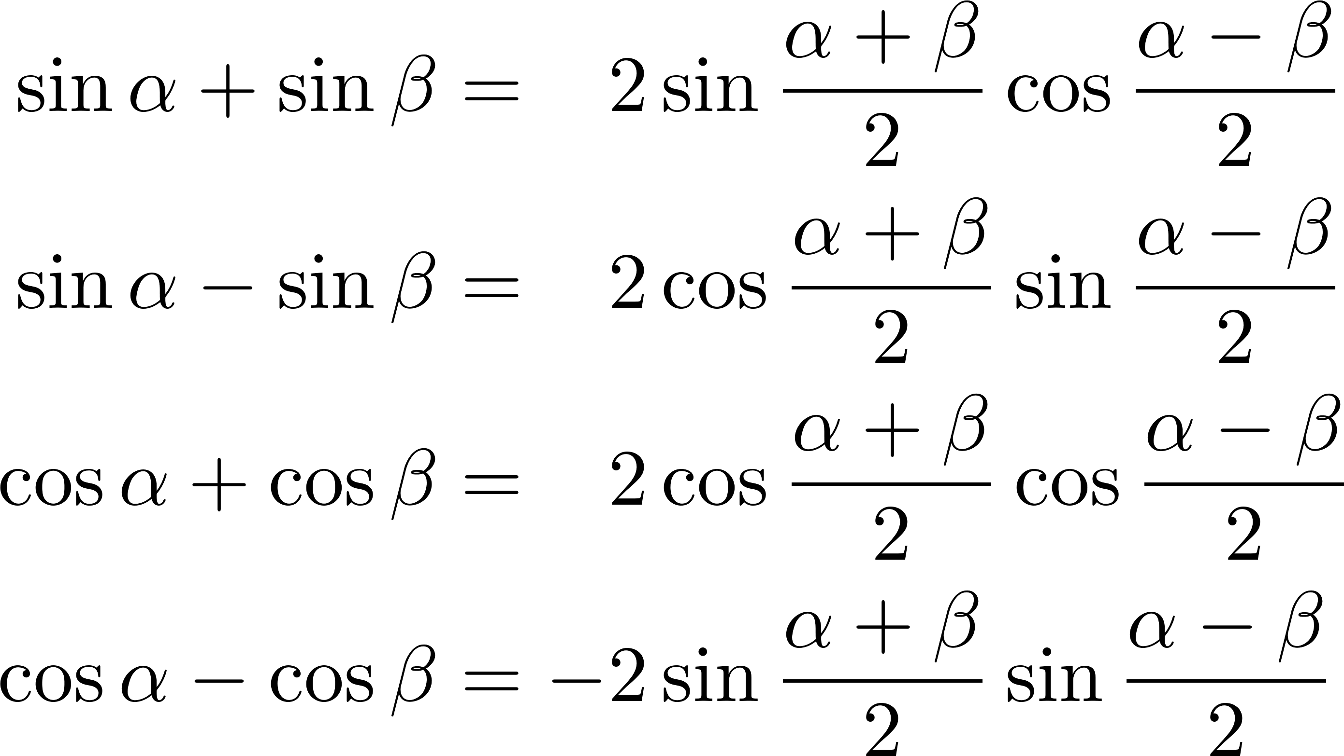
Product-to-sum/sum-to-product

Slide 10
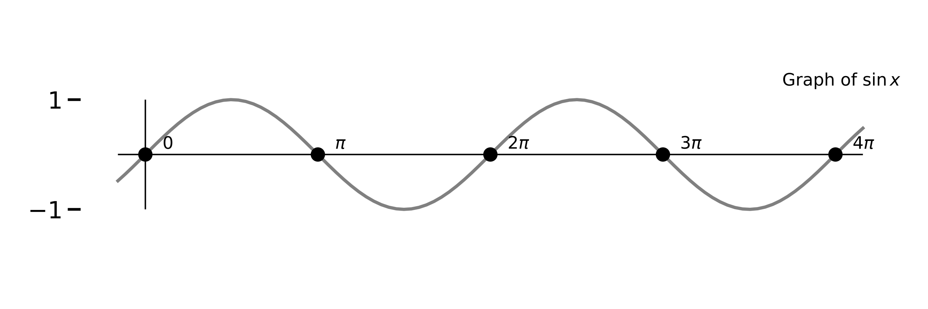
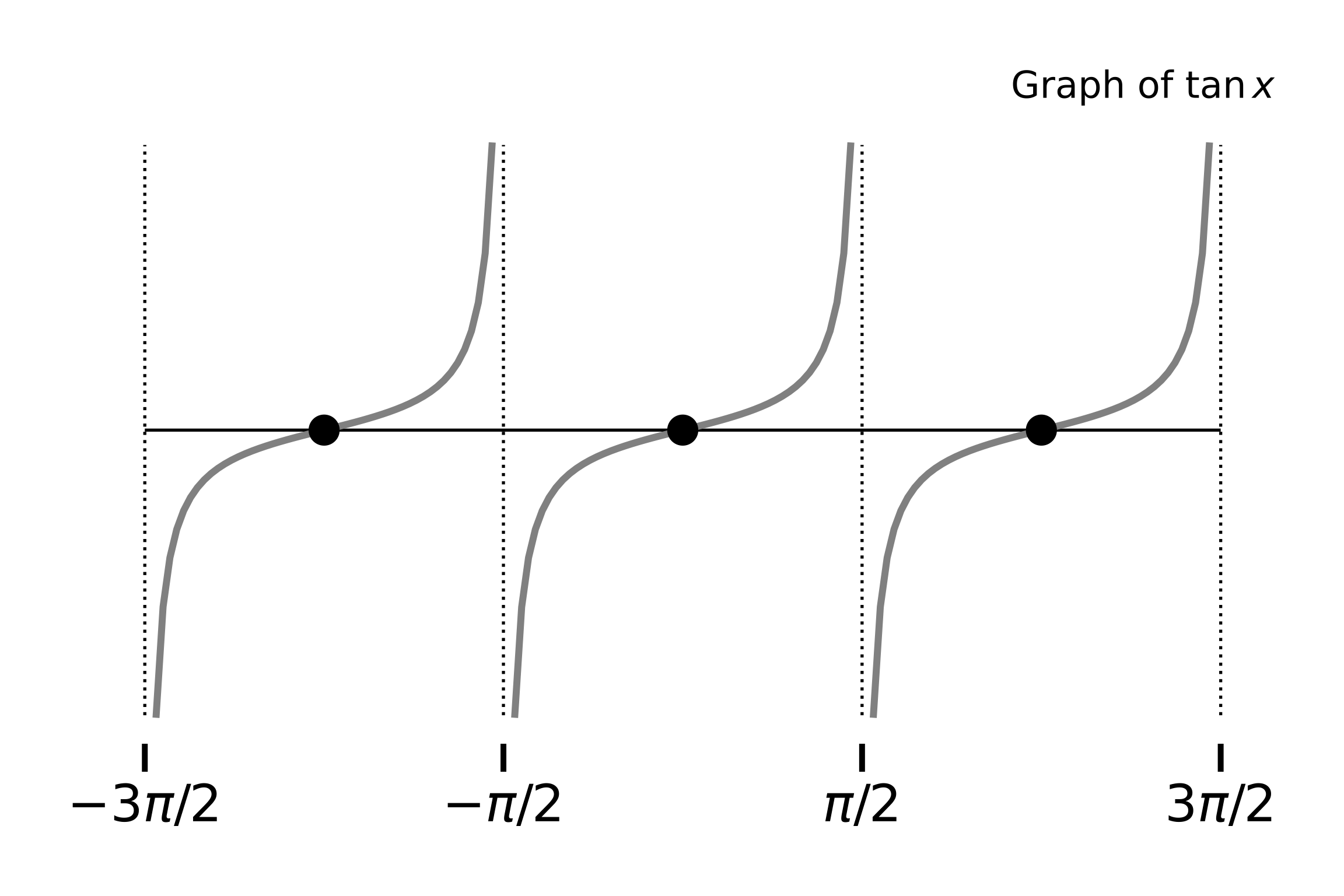
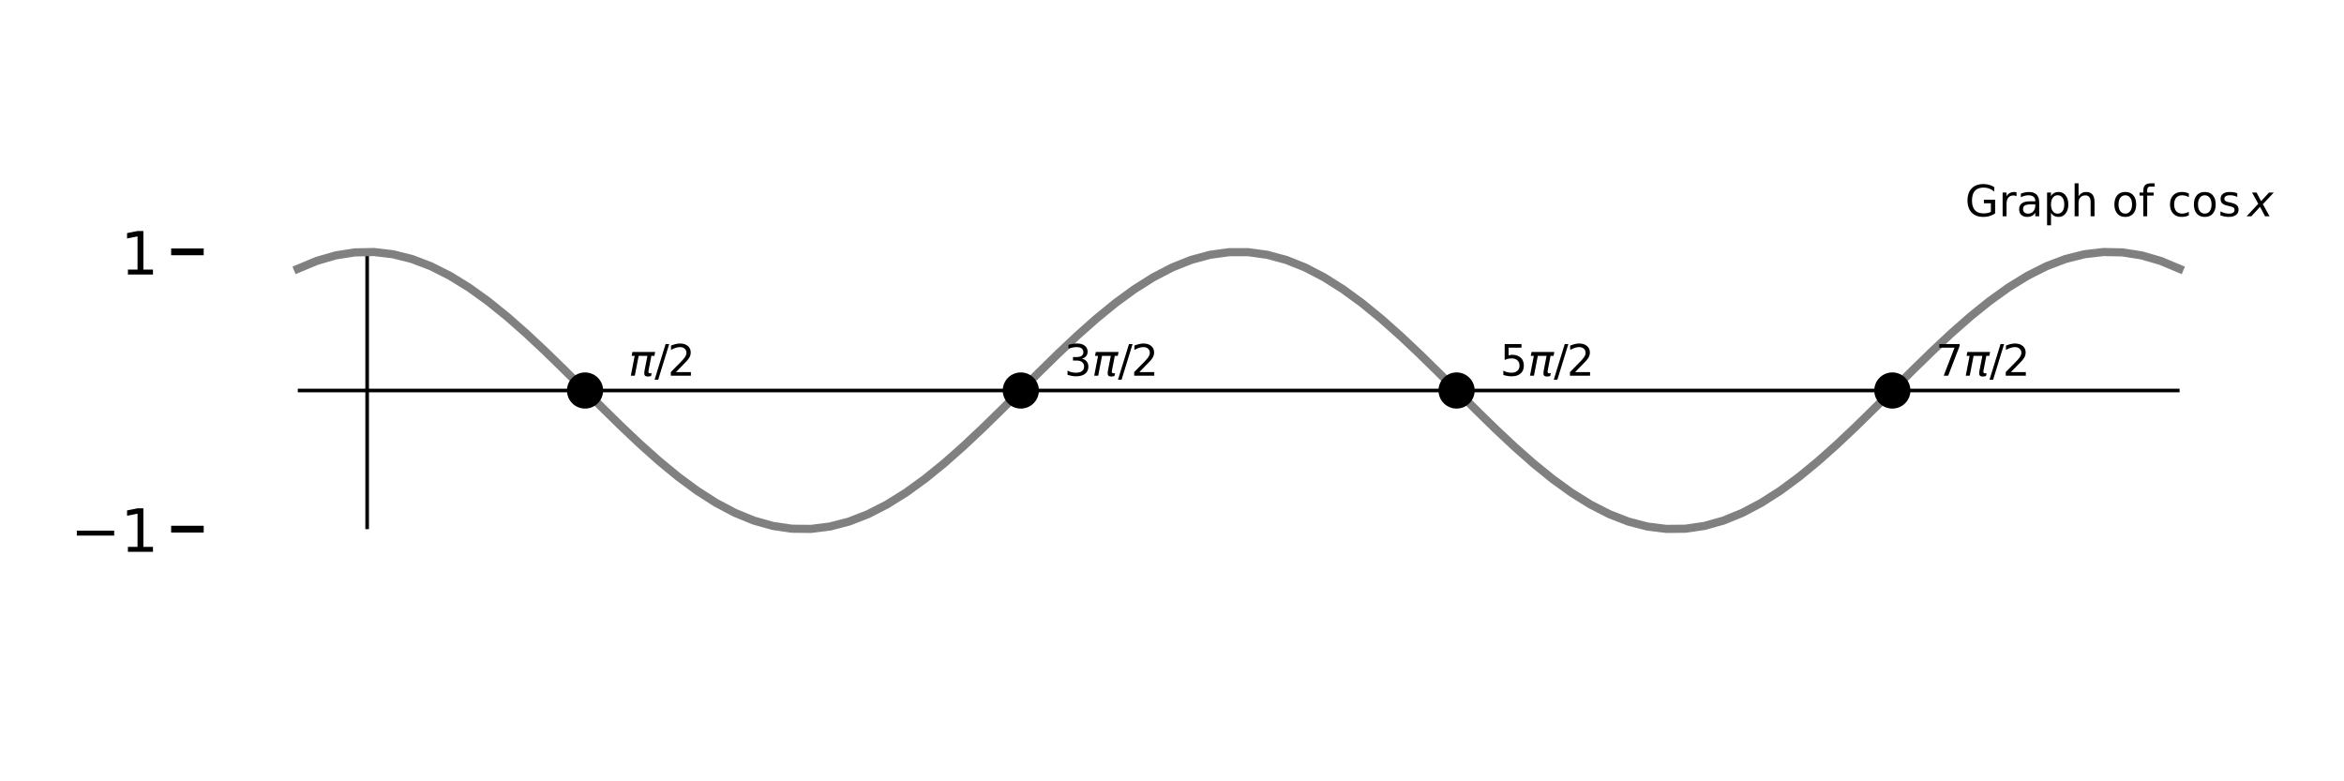
Graphs of sin/cos/tan

