Slide 1

Overview of Laravel (30 minutes)

Slide 2

PHP web application framework
Developed by Taylor Otwell,
It follows the MVC architectural pattern.

Slide 3
Model-View-Controller
Webpage
Webpage
Model (database code)
Database code
Function code
Controller (function code )
Design code
View (design code )

Slide 4
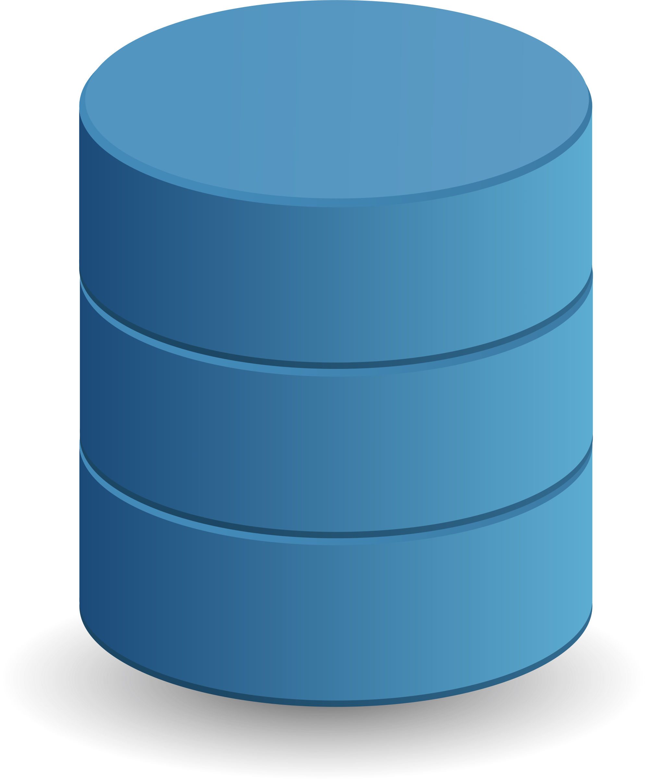
Why Choose Laravel?
Eloquent ORM for database interaction.
ORM stands Object Relational Mapping
Maps objects to database
Laravel App
Eloquent ORM
Obj 1
Obj 2
No complex SQL queries
Database
Different Database Support

Slide 5
Why Choose Laravel?
Blade templating engine for efficient views.
Layout
Home Page
Contact Page
Section 1
Menu links
Menu links
Section 2
Articles
Address Details

Slide 6
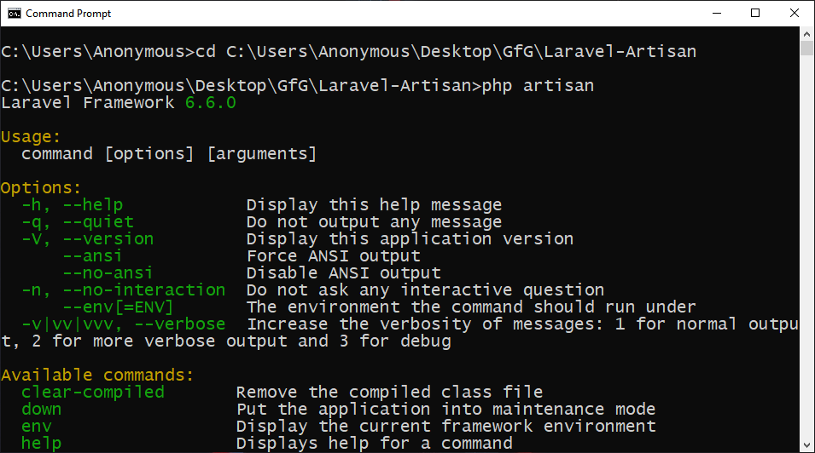
Why Choose Laravel?
Artisan CLI for faster development tasks

Slide 7
Other Features
Inbuilt Development Server – No apache required
Database Seeding – For adding Demo data
Migrations – Tracking database changes
Support for Cloud services - AWS, Email Service
Security – Testify to all your application security needs.

Slide 8


Why Choose Laravel?
Community Strength

Slide 9
PHP Project
(without framework)
Laravel Project

Slide 10
Setting Up Environment
Installing XAMP Server
Start the Apache & MySQL services

Slide 11
PHP Project
(without framework)
Create “php_student_reg” database
Create students table and insert data
Place student_reg.php file in htdocs/php_student_reg
Update database details in student_reg.php
Open http://localhost/mysite/student_reg.php

Slide 12
Setting Up Environment
Installing PHP, Composer.
Check composer and php version in CMD
Configure zip extension php.ini

Slide 13
Laravel Project
Move files to htdocs/mysite-laravel
Create users table and insert data
Place getusers.php file in htdocs/mysite
Update database details in getusers.php
Open http://localhost/mysite/getusers.php

Slide 14
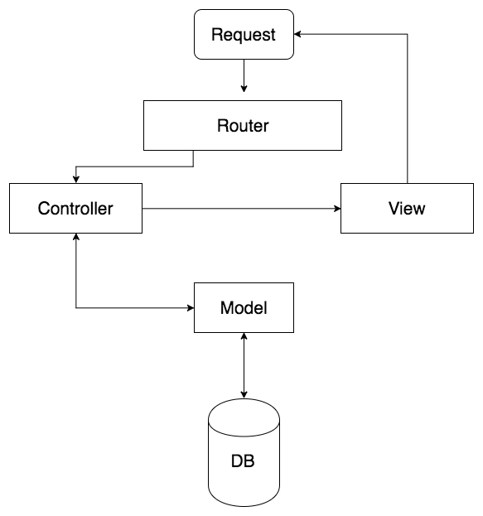
Architecture of Laravel App

Slide 15
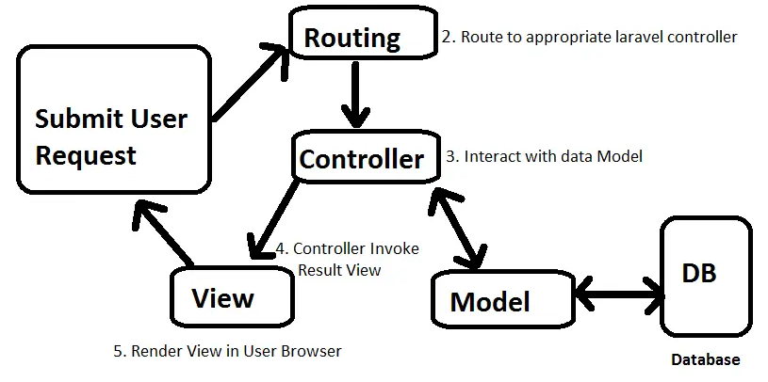
Laravel Lifecyle

Slide 16


ROUTE
Route is a way to specify how your web application should respond when a user accesses a particular URL
Request
Route

Slide 17
ROUTE
Routes declared in routes/web.php
Route
/student-form
Controller
StudentController.php
viewForm
http://127.0.0.1/student-form
Route
/add-student
Controller
StudentController.php
storeData
http://127.0.0.1/add-student

Slide 18
ROUTE METHODS
GET
Route
/student-form
Controller
StudentController.php
viewForm
http://127.0.0.1/student-form
POST
Route
/add-student
Controller
StudentController.php
storeData
http://127.0.0.1/add-student

Slide 19
REQUEST METHODS
GET
Retrieve Page or Data
POST
Submit Data
PUT
Update Data
DELETE
Delete Data

Slide 20
ROUTE URI CAN BE SAME
GET
Route
/students
Controller
StudentController.php
viewForm
http://127.0.0.1/students
POST
Route
/students
Controller
StudentController.php
storeData
http://127.0.0.1/students

Slide 21
GET ROUTE
GET
Route
/student-form
Controller
StudentController.php
viewForm
http://127.0.0.1/students
POST
Route
/students
Controller
StudentController.php
storeData
http://127.0.0.1/students

Slide 22
GET ROUTE
Laravel App
GET
Route
/student-form
Controller
StudentController.php
viewForm
http://127.0.0.1/student-form
FORM PAGE
Receives Form Page as Response

Slide 23
POST ROUTE
FORM PAGE
Laravel App
POST
Route
/add-student
Controller
StudentController.php
addStudent
Form Submitted
CSRF TOKEN
Redirects to Form Page

Slide 24
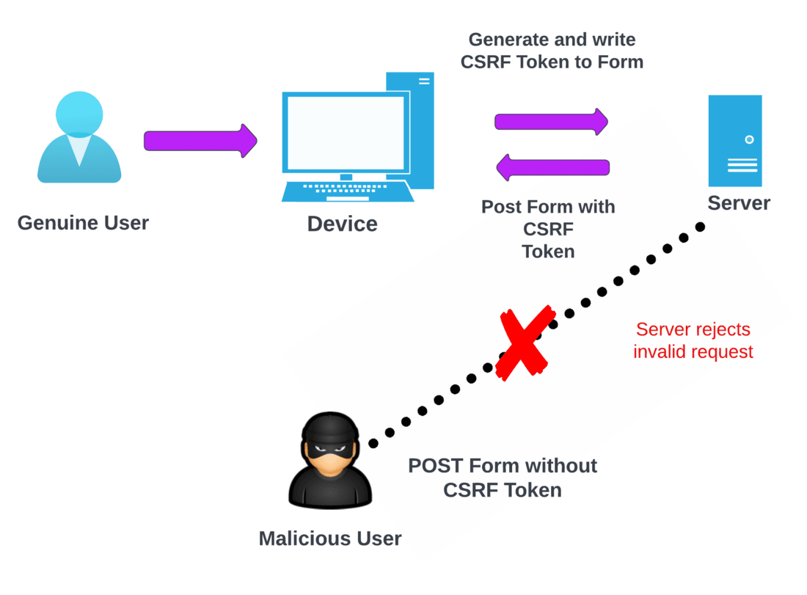
CSRF Token

Slide 25
Database Setup in Laravel

Slide 26
MIGRATION
Schema Definition: Define and version-control the structure of database tables.
Database Seeding: Populate the database with sample or default data for testing or development.
Rollback: Ability to undo or rollback database migrations in case of issues.
Database Changes in Code: Express database changes using PHP code, aligning with application code.

Slide 27
MIGRATION
Migration
Create Students Migration
Generate Database Table
Table Column Changes
Generate Students Table

Slide 28
MODEL
Model
Student Model
Eloquent ORM
Eloquent ORM
Database Table
Students Table

Slide 29
Overview of Laravel (30 minutes)
Enjoy Coding!
Thanks!

