Slide 1
CliCS - Personas
Standardizing the classification of the individuals we sell to and service.
Updates and progress
March 2026
Point: Erika Jones

Slide 2
CliCS – Personas – Why & Next Steps
The Persona classification is an extension of CliCS.
Why do we need a standardized Client and Persona Classification?
Better understand our market, opportunities, penetration rates, drivers and trends.
Operate as one firm across product lines.
Better target use cases and value propositions.
Better targeted selling, servicing, marketing.
Adjust commercial models and pricing scalers.
Streamline/self-service log-in/entitlements.
Plan
Persona data will enrich our Contact information (Salesforce)
Can be updated by user by Coverage
Zoominfo and other third-party feeds can enhance our persona information
Coverage has asked for simplified mappings for more straightforward targeting, new mappings in progress
Next Steps
Update Salesforce with values for personas, mapped based on title and other fields – pending
Simplify persona values – in progress by client segment

Slide 3
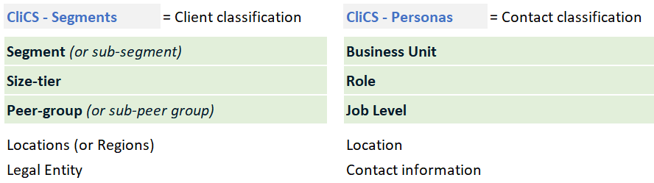
The Persona classification is an extension of CliCS
CliCS - Segments purpose is for us to operate within a single client classification structure. It classifies child accounts. It forms the bedrock for contracting (unit of sale) and pricing. It guides coverage, servicing and product management.
CliCS - Persona purpose is to classify our contacts; these individuals are all associated to a client account (and therefore to a segment).
The purpose for classifying our contacts are varied;
Enable persona-based marketing, product development, selling and servicing
Entitlement automation
Monitor product usage and client penetration
A “Persona” is defined as an individual, working in a client segment, within a Business Unit, in a Location, with a Role and a Job Level.

Slide 4
Design Principles
We selected Business Units, Roles and Job Level that we believe to be the most relevant for our products and services. For certain roles we seek granularity, for others we don’t.
We designed for flexibility. We expect that adjustments will be needed over time as we learn more about specific use cases and persona types.
We removed much discretion in definitions, but rather operate with standardized drop downs, seeking best-fit rather than matching exactly what a user may show on their business card. The free text in SF (which translated into 80,000 different roles) will be curtailed.
We use rules-based mapping to populate the personas based on Title and Job Level (using RingLead).
Designing for scale
Fit for our purpose
Foundational for persona-based commercial models
Flexible & evolutionary

Slide 5

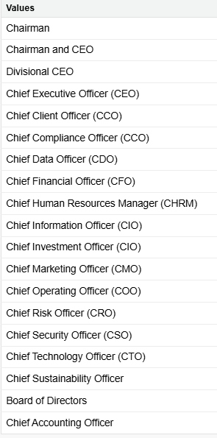
Job Levels – Core Personas
Job level
C-Suite Role
Each Persona is tagged to a standardized list of Job Levels.
Job Levels apply to any Persona, irrespective to their client segment, business unit, or location.
We seek best-fit rather than matching exactly what an individual may show on their business card.
For C-Suite roles, we seek high levels of granularity to support our SAM accounts. This can be populated by Coverage teams as needed
Job Level field is auto-populated using rules based on Title and Zoominfo Management Level (with RingLead)

Slide 6
Personas revisions - timing
Current Status
Persona list simplified and standardized
Segment leads are signing off on the new persona mapping for their segments
All picklist value changes will be made at once in Salesforce
Once picklist values are updated in Salesforce, the contact and lead fields will be populated
Segment Lead Sign-Offs
Complete
Signed off
Asset Managers
Asset Owners
Wealth Management
Corporates & Advisors
Hedge Funds
Banks & Brokerages
Exchanges & Vendors
Insurance
Next Steps: Salesforce Rollout
1 · Update values in Salesforce
Complete by Aug 1 (to be confirmed)
2 · Populate contact fields with new values
Complete by Aug 31

Slide 7
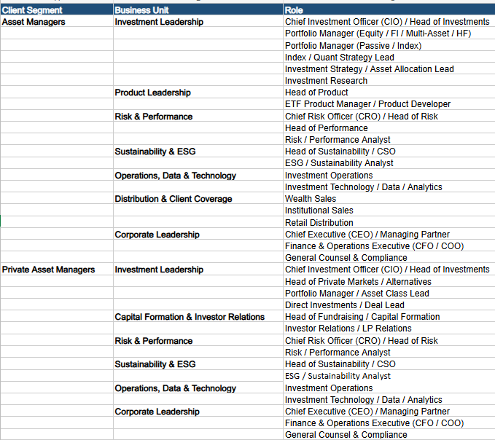
Asset Managers – Core Personas
(signed off, not yet in Salesforce)
There are many Personas where we have relevant solutions, products and services to sell.
Core personas are;
Head of Product
CIO / Head of investments
COO/Business Management
Head of Risk / CRO

Slide 8
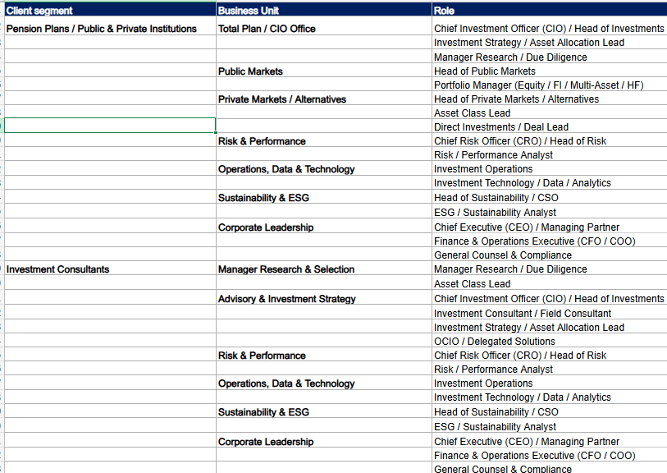
Asset Owners – Core Personas
(signed off, not yet in Salesforce)
There are many Personas where we have relevant solutions, products and services to sell.
Core personas are;
CIO / Head of Investments
Head of Public/Private Markets
Head of Asset Allocation/Portfolio Strategy
Head of Risk / CRO

Slide 9
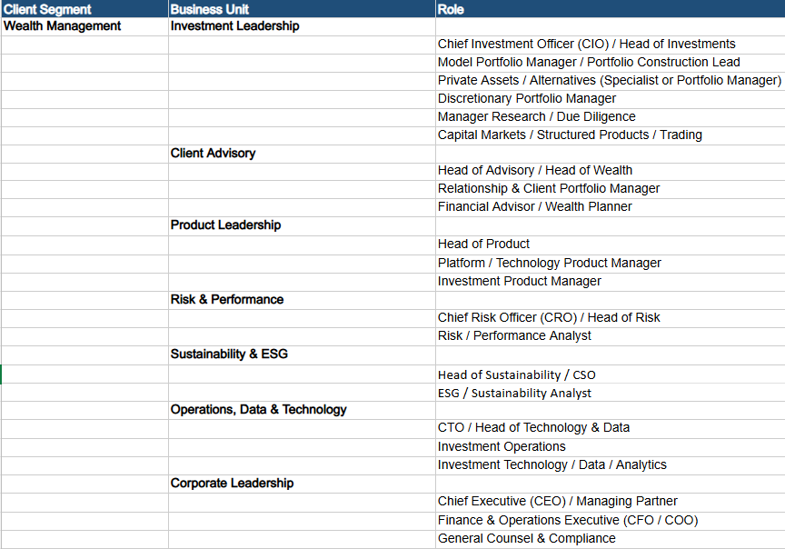
Wealth Managers – Core Personas
(signed off, not yet in Salesforce)
There are many Personas where we have relevant solutions, products and services to sell.
Core personas are;
CIO / Head of Investments
Head of Risk / CRO
Compliance

Slide 10
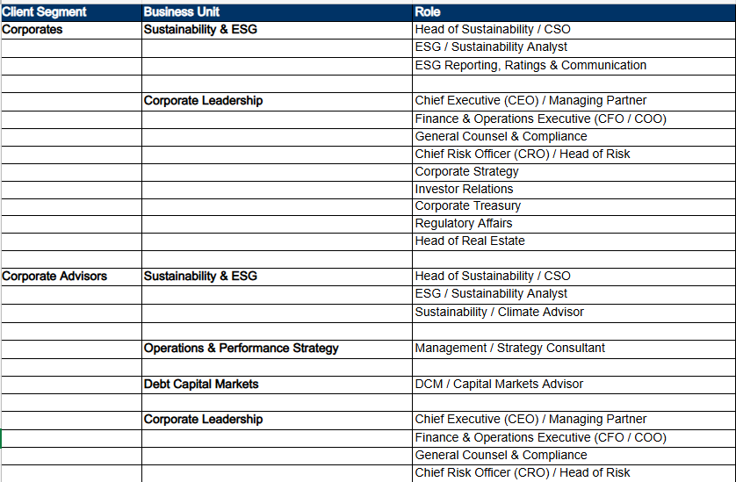
Corporates & Advisors – Core Personas
(signed off, not yet in Salesforce)
Core Personas are;
Chief Sustainability Officer / Head of Sustainability
Investor Relations
Chief Financial Officer / Head of Finance

Slide 11
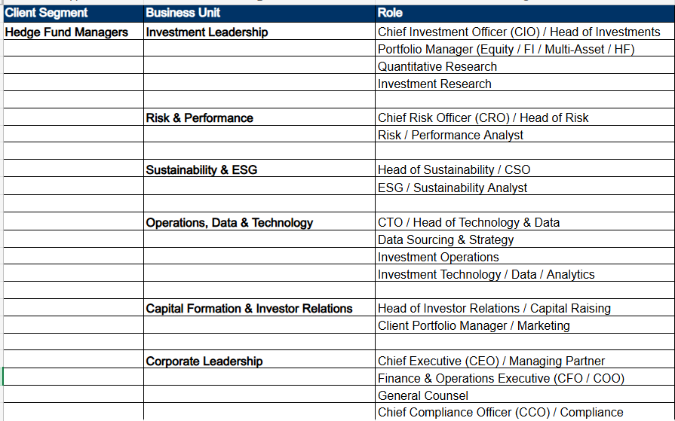
Hedge Fund Managers – Core Personas
(signed off, not yet in Salesforce)
There are many Personas where we have relevant solutions, products and services to sell.
Sellable use cases will depend on the strategies employed by the HFs or PMs
Core personas
COO
Investor Relations
CRO
Portfolio Manager
Data sourcing / procurement

Slide 12
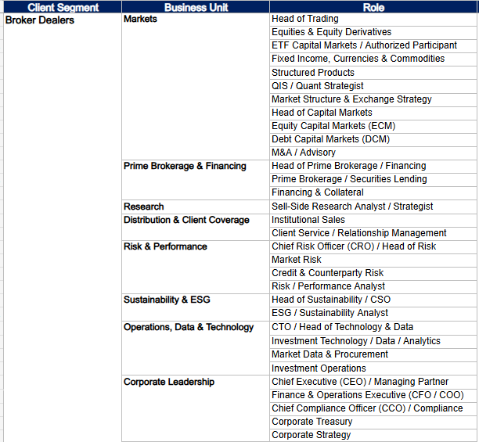
Banking & Brokerages – Core Personas (1 of 2)
(signed off, not yet in Salesforce)
This segment is complex with many Personas where we have relevant solutions, products and services to sell.
Core Personas are;
Risk
Capital Markets
Sales & Trading
Market Making
Prime Brokerage

Slide 13
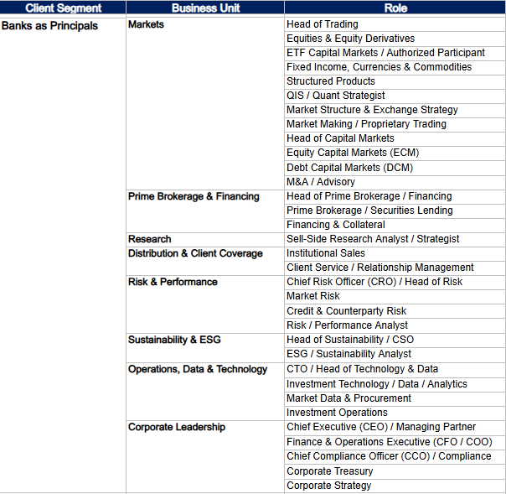
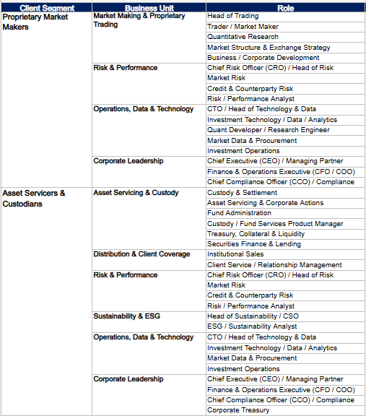
Banking & Brokerages – Core Personas (2 of 2)

Slide 14
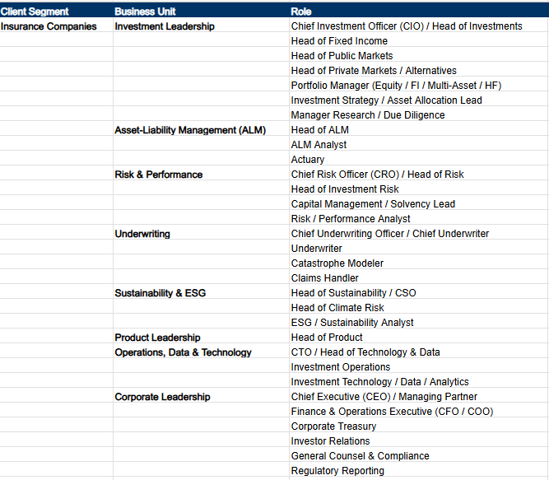
Insurance Companies – Core Personas
(signed off, not yet in Salesforce)
This is a Segment where we have limited expertise and fully fit-for-purpose products & solutions.
We have classified the Personas to the best of our current knowledge;
We expect to see changes in the persona categorization and prioritization as we gain expertise.
Core Personas are;
Asset Allocation
Risk & Performance
Sustainability Specialists
Manager Research

Slide 15
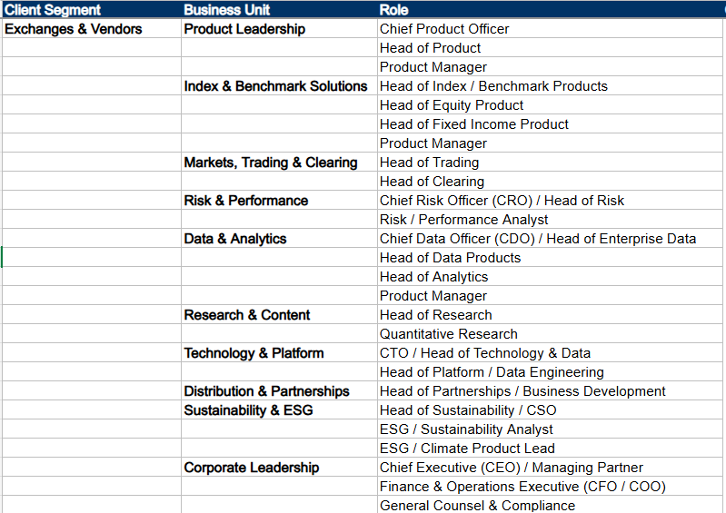
Exchanges & Vendors – Core Personas
(signed off, not yet in Salesforce)
Core Personas are;
Head of Analytics
Head of Product / Product Management
Head of Index / Benchmarked Products

Slide 16
Notice and disclaimer
This document and all of the information contained in it, including without limitation all text, data, graphs, charts (collectively, the “Information”) is the property of MSCI Inc. or its subsidiaries (collectively, “MSCI”), or MSCI’s licensors, direct or indirect suppliers or any third party involved in making or compiling any Information (collectively, with MSCI, the “Information Providers”) and is provided for informational purposes only. The Information may not be modified, reverse-engineered, reproduced or redisseminated in whole or in part without prior written permission from MSCI. All rights in the Information are reserved by MSCI and/or its Information Providers.
The Information may not be used to create derivative works or to verify or correct other data or information. For example (but without limitation), the Information may not be used to create indexes, databases, risk models, analytics, software, or in connection with the issuing, offering, sponsoring, managing or marketing of any securities, portfolios, financial products or other investment vehicles utilizing or based on, linked to, tracking or otherwise derived from the Information or any other MSCI data, information, products or services.
The user of the Information assumes the entire risk of any use it may make or permit to be made of the Information. NONE OF THE INFORMATION PROVIDERS MAKES ANY EXPRESS OR IMPLIED WARRANTIES OR REPRESENTATIONS WITH RESPECT TO THE INFORMATION (OR THE RESULTS TO BE OBTAINED BY THE USE THEREOF), AND TO THE MAXIMUM EXTENT PERMITTED BY APPLICABLE LAW, EACH INFORMATION PROVIDER EXPRESSLY DISCLAIMS ALL IMPLIED WARRANTIES (INCLUDING, WITHOUT LIMITATION, ANY IMPLIED WARRANTIES OF ORIGINALITY, ACCURACY, TIMELINESS, NON-INFRINGEMENT, COMPLETENESS, MERCHANTABILITY AND FITNESS FOR A PARTICULAR PURPOSE) WITH RESPECT TO ANY OF THE INFORMATION.
Without limiting any of the foregoing and to the maximum extent permitted by applicable law, in no event shall any Information Provider have any liability regarding any of the Information for any direct, indirect, special, punitive, consequential (including lost profits) or any other damages even if notified of the possibility of such damages. The foregoing shall not exclude or limit any liability that may not by applicable law be excluded or limited, including without limitation (as applicable), any liability for death or personal injury to the extent that such injury results from the negligence or willful default of itself, its servants, agents or sub-contractors.
Information containing any historical information, data or analysis should not be taken as an indication or guarantee of any future performance, analysis, forecast or prediction. Past performance does not guarantee future results.
The Information should not be relied on and is not a substitute for the skill, judgment and experience of the user, its management, employees, advisors and/or clients when making investment and other business decisions. All Information is impersonal and not tailored to the needs of any person, entity or group of persons.
None of the Information constitutes an offer to sell (or a solicitation of an offer to buy), any security, financial product or other investment vehicle or any trading strategy.
It is not possible to invest directly in an index. Exposure to an asset class or trading strategy or other category represented by an index is only available through third party investable instruments (if any) based on that index. MSCI does not issue, sponsor, endorse, market, offer, review or otherwise express any opinion regarding any fund, ETF, derivative or other security, investment, financial product or trading strategy that is based on, linked to or seeks to provide an investment return related to the performance of any MSCI index (collectively, “Index Linked Investments”). MSCI makes no assurance that any Index Linked Investments will accurately track index performance or provide positive investment returns. MSCI Inc. is not an investment adviser or fiduciary and MSCI makes no representation regarding the advisability of investing in any Index Linked Investments.
Index returns do not represent the results of actual trading of investible assets/securities. MSCI maintains and calculates indexes, but does not manage actual assets. Index returns do not reflect payment of any sales charges or fees an investor may pay to purchase the securities underlying the index or Index Linked Investments. The imposition of these fees and charges would cause the performance of an Index Linked Investment to be different than the MSCI index performance.
The Information may contain back tested data. Back-tested performance is not actual performance, but is hypothetical. There are frequently material differences between back tested performance results and actual results subsequently achieved by any investment strategy.
Constituents of MSCI equity indexes are listed companies, which are included in or excluded from the indexes according to the application of the relevant index methodologies. Accordingly, constituents in MSCI equity indexes may include MSCI Inc., clients of MSCI or suppliers to MSCI. Inclusion of a security within an MSCI index is not a recommendation by MSCI to buy, sell, or hold such security, nor is it considered to be investment advice.
Data and information produced by various affiliates of MSCI Inc., including MSCI ESG Research LLC and Barra LLC, may be used in calculating certain MSCI indexes. More information can be found in the relevant index methodologies on www.msci.com.
MSCI receives compensation in connection with licensing its indexes to third parties. MSCI Inc.’s revenue includes fees based on assets in Index Linked Investments. Information can be found in MSCI Inc.’s company filings on the Investor Relations section of www.msci.com.
MSCI ESG Research LLC is a Registered Investment Adviser under the Investment Advisers Act of 1940 and a subsidiary of MSCI Inc. Except with respect to any applicable products or services from MSCI ESG Research, neither MSCI nor any of its products or services recommends, endorses, approves or otherwise expresses any opinion regarding any issuer, securities, financial products or instruments or trading strategies and MSCI’s products or services are not intended to constitute investment advice or a recommendation to make (or refrain from making) any kind of investment decision and may not be relied on as such. Issuers mentioned or included in any MSCI ESG Research materials may include MSCI Inc., clients of MSCI or suppliers to MSCI, and may also purchase research or other products or services from MSCI ESG Research. MSCI ESG Research materials, including materials utilized in any MSCI ESG Indexes or other products, have not been submitted to, nor received approval from, the United States Securities and Exchange Commission or any other regulatory body.
Any use of or access to products, services or information of MSCI requires a license from MSCI. MSCI, Barra, RiskMetrics, IPD and other MSCI brands and product names are the trademarks, service marks, or registered trademarks of MSCI or its subsidiaries in the United States and other jurisdictions. The Global Industry Classification Standard (GICS) was developed by and is the exclusive property of MSCI and Standard & Poor’s. “Global Industry Classification Standard (GICS)” is a service mark of MSCI and Standard & Poor’s.
Privacy notice: For information about how MSCI collects and uses personal data, please refer to our Privacy Notice at https://www.msci.com/privacy-pledge.

