Slide 1

Public Key Chain Distributing Public Keys with Blockchain
PKC
Jeremy
Alan
Aneesh
Hank
Solomon
Lou

Slide 2

Problem
1.
Distributing public keys securely is very difficult.
2.
Existing solutions:
Public Key Infrastructure (S/MIME)
Key signing party (OpenPGP)

Slide 3
Solution
Public Key Chain
Distributed
Verified
Building a distributed public key infrastructure with blockchain.
Ease-of-use
Scalable

Slide 4
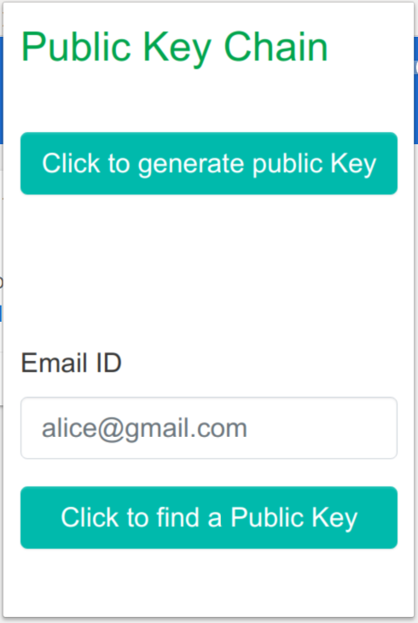
Simple User Interface

Slide 5




Publishing and Verification Process
1
2
Client
plugin
3
5
Blockchain
4

