Slide 1
Question generation
Team ID: 5
Project Advisor:
Dr./Ms./Mr.<Full Name>/ <Designation> / <Dept>
S.No | Reg.No | Name of the Student | Section
1 | BL.EN.U4CSE19044 | G.vignesh | CSE A
2 | BL.EN.U4CSE19056 | J.Kapardhi | CSE A
3 | BL.EN.U4CSE19070 | K.Syam sai | CSE A

Slide 2
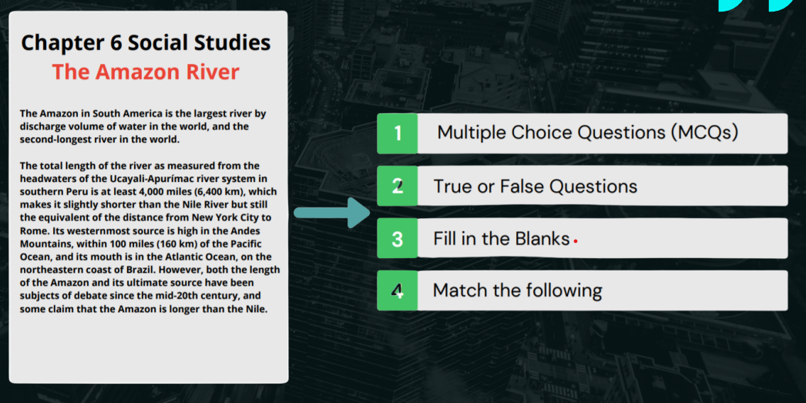
Introduction
Question generation is the process of automatically generating a different types of questions from statement. It involves using Bert,wordnet.

Slide 3
Motivation
There are many potential applications for question generation , such as preparing exam paper without repeating questions and make work easy of question generating. Ultimately, the goal is to provide a richer, more accessible experience for all users.

Slide 4
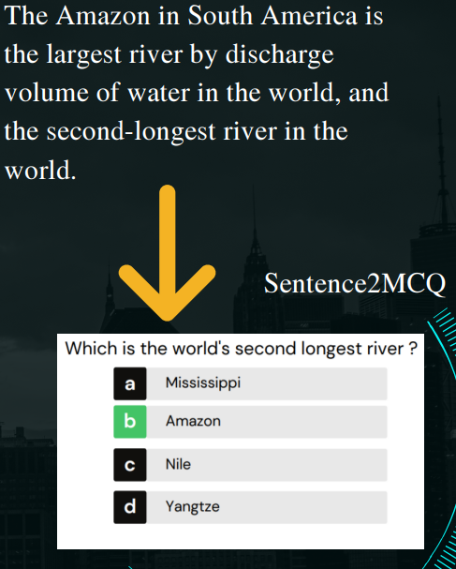
Problem Definition
As we all know question paper generation is a tedious job we can automate this process using natural language processing

Slide 5
Gaps and Challenges
One of the main challenges in image captioning is the difficulty of learning pytorch models.
Another challenge is to find the hyponyms and co hyponyms to create the distractors for the correct option.
Another challenge is to learning about the transformation and deep learning in it .
Finally, question generating needs to generate questions in different types.

Slide 6
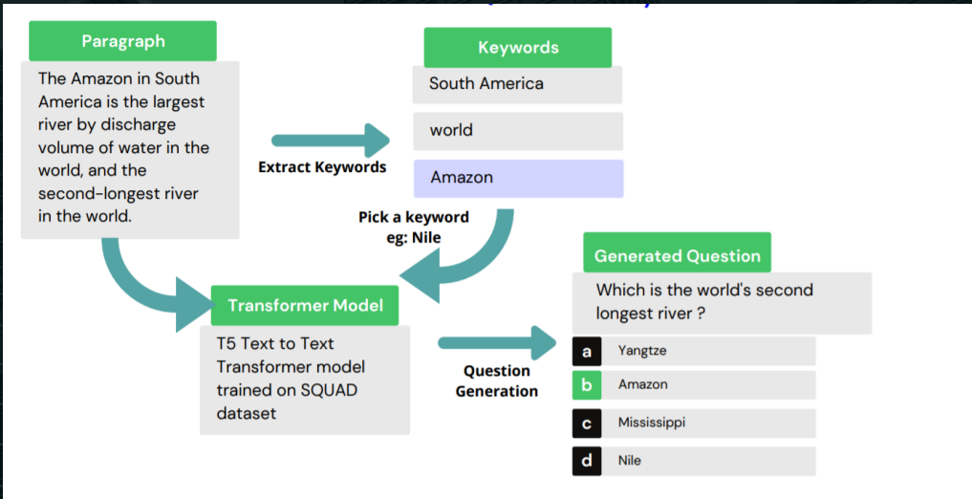
System Design
ER / DFD / UML / System Architecture
* Expected any diagram

Slide 7
System Specifications
Streamlit – Front end
Python 3.7 – Backend
Tensorflow 2.9 – Backend
Keras 2.7 – Backend
Pytorch -Backend
Windows 10 - OS
Tesla p100 GPU and K80 GPU graphic card – Hardware

Slide 8
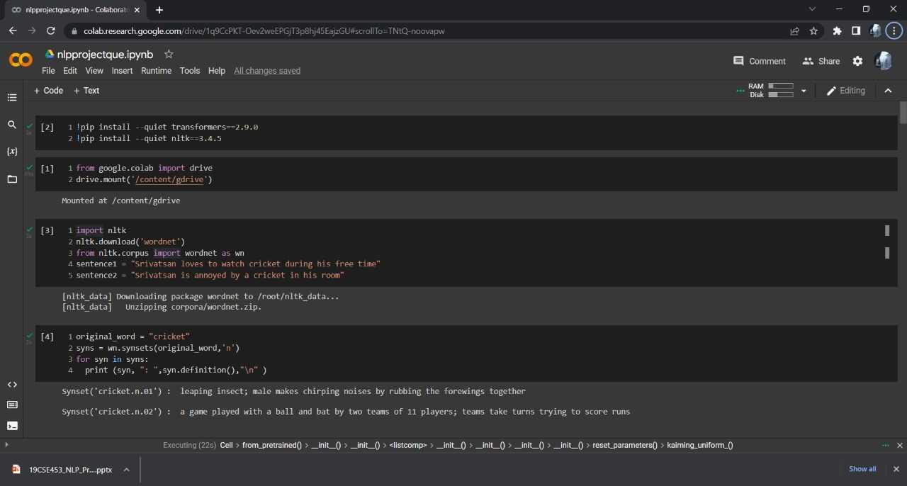
System Implementation
* Expected snapshots of the code snippet OR mention the important function used

Slide 9
System Implementation
* Expected snapshots of the code snippet OR mention the important function used

Slide 10
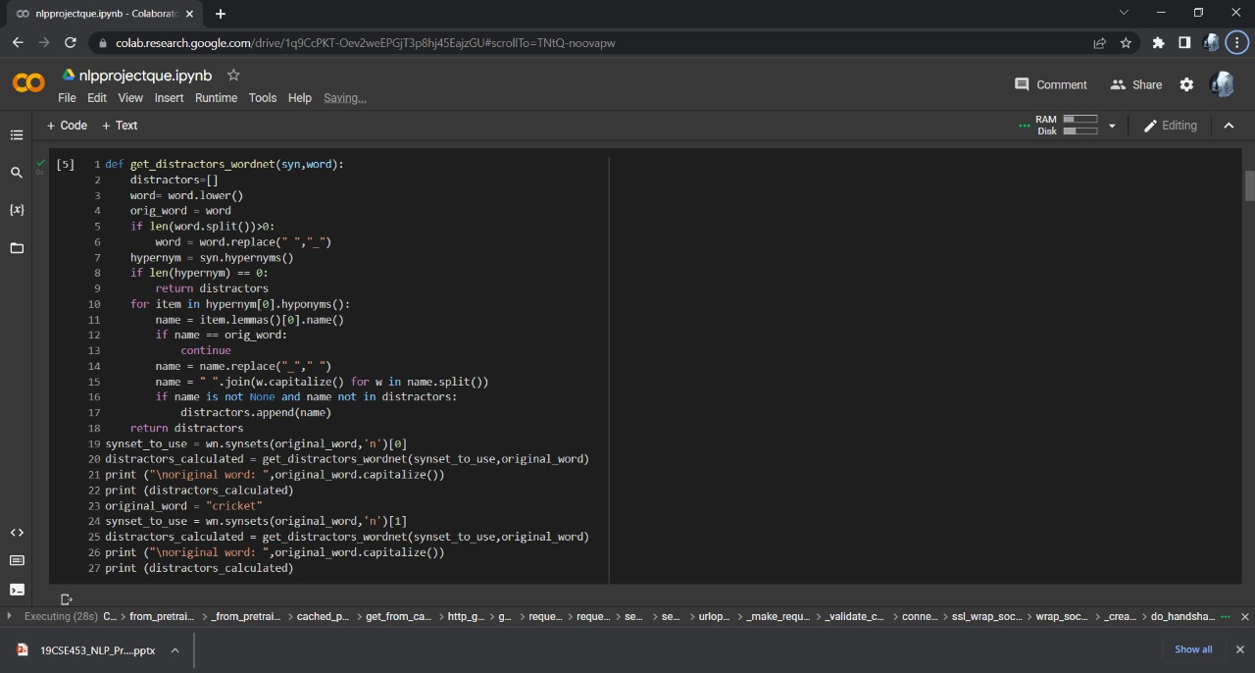
System Implementation
* Expected snapshots of the code snippet OR mention the important function used

Slide 11
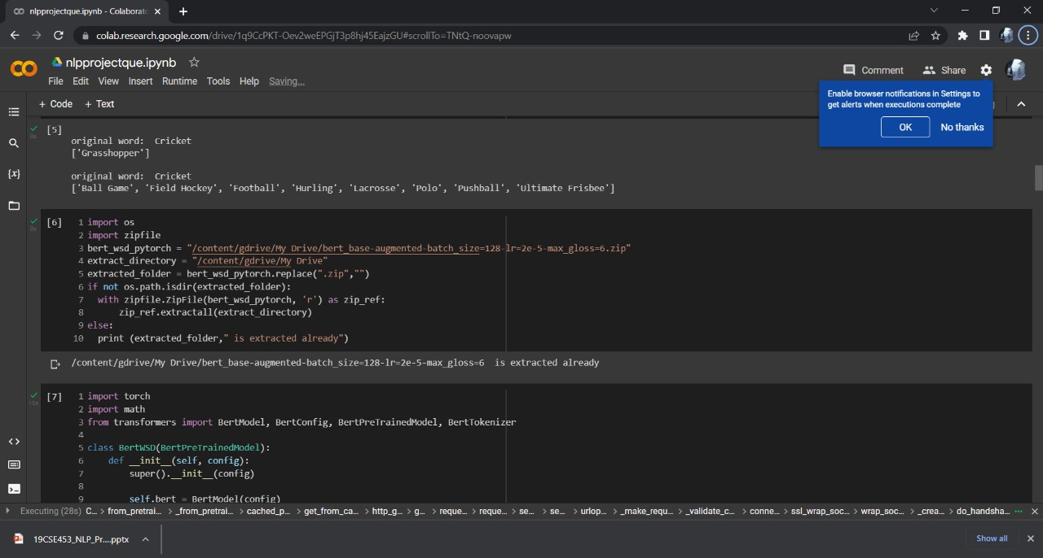
System Implementation
* Expected snapshots of the code snippet OR mention the important function used

Slide 12
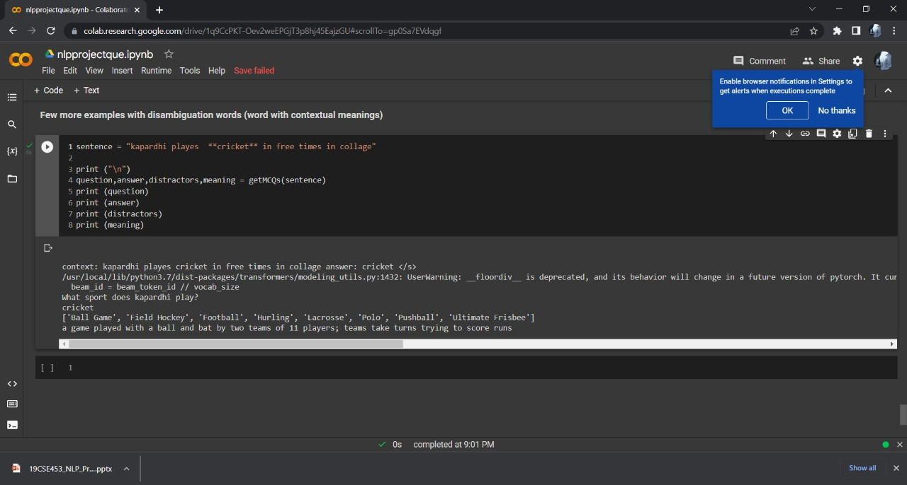
System Testing

Slide 13
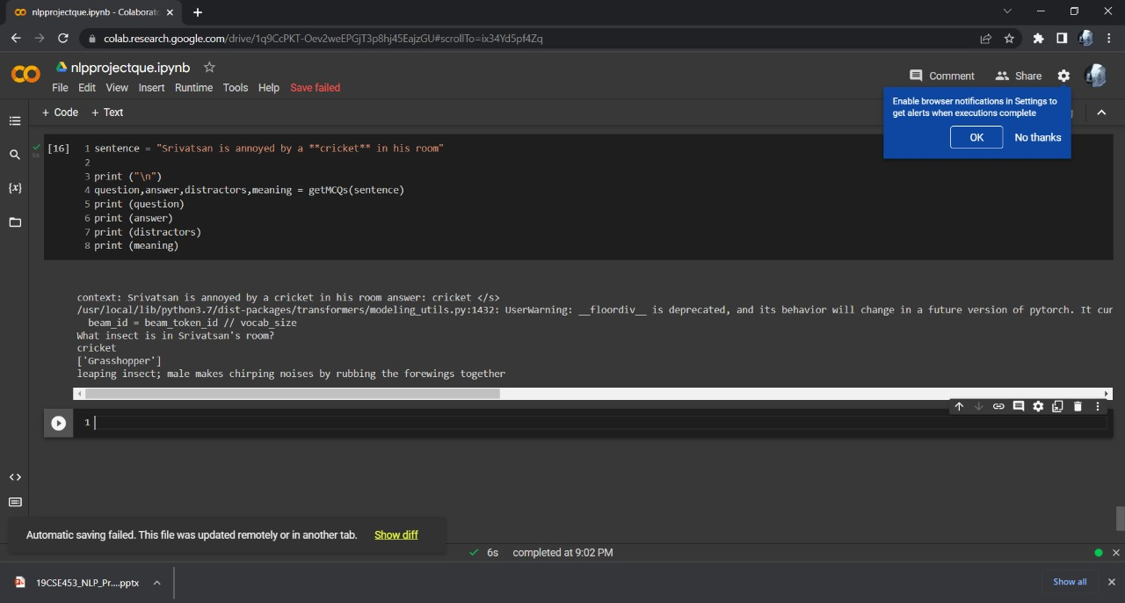
System Testing

Slide 14
Conclusion
Finally we can able to achieve question genation using bertwsd, wordnet,and some tokenixation techniques

Slide 15
Timeline
Literature Survey
Design [Front End, Back End]
Implementation
Testing
Document Submission
17 April 2022
22 April 2022
29 April 2022
8 May 2022
16 May 2022
Abstract Submission
13 April 2022

Slide 16
THANK YOU

Slide 17
References
AUTOMATED QUESTION GENERATOR SYSTEM USING NLP LIBRARIES [1]https://www.irjet.net/archives/V7/i6/IRJET-V7I6848.pdf (priti Gumast1, Shreya Joshi, Srushtee Khadpekar, Shubhangi Mali)
[2]https://arxiv.org/abs/2111.06476 ,Cagatay Akyon
[3]https://drive.google.com/file/d/19HzsYXhIgzMdcjn90RFaajPQQtVNVTv/view?usp=sharing Ramsri Goutha
*Latest references from reputed Journals or conferences in IEEE format…..(Minimum 4 should be listed)

