Slide 1
Welcome!
wifi network: Notman House
password:
useful links:
http://gerg.ca/mpw

Slide 2
Who are you?
What do you want to achieve?

Slide 3
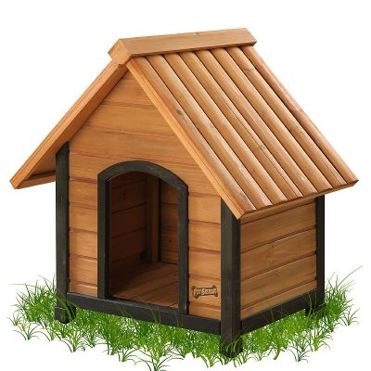
Here to build something?

Slide 4
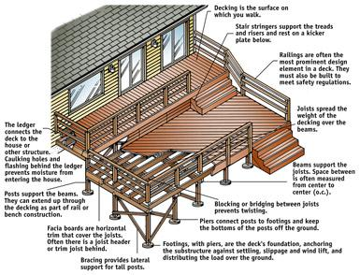
Perhaps something a little fancier?

Slide 5
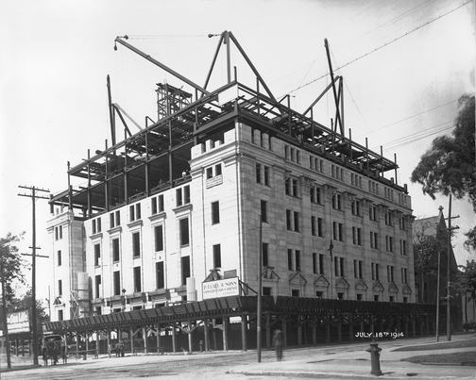
There are limits

Slide 6


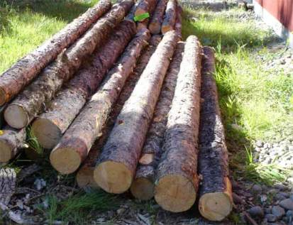
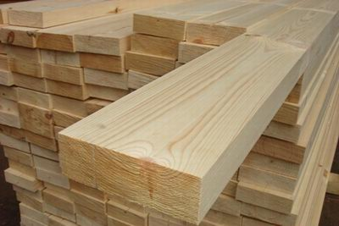
Why Python?
+
vs.
+

Slide 7
The Plan
Fri pm, self-guided: done!
Sat am, lecture
  recap yesterday's tutorial
  exercises
  new stuff (the rest of the core language)
  exercises

Slide 8
The Plan
free lunch
Sat pm, projects
  silly Twitter tricks
  cheat at Scrabble
  pretty colours

Slide 9
A message from our sponsors
your friendly local user group
regular meetings
occasional workshops (like this one)
project nights
http://montrealpython.org/
Python Software Foundation
global organization
copyright, trademarks, conferences
outreach & education
paid for your lunch today
http://www.python.org/psf/

