Slide 1
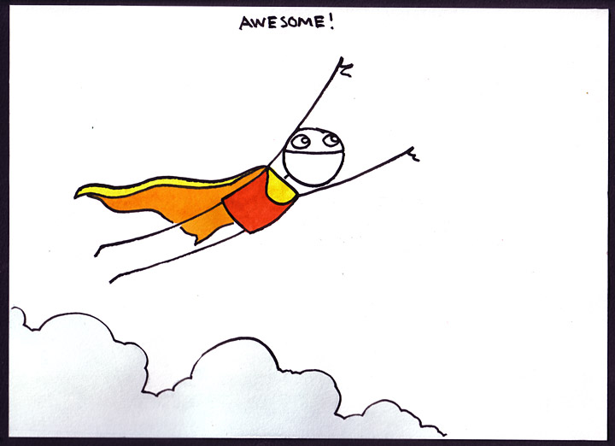
Congratulations!

Slide 2
so you made it this far...
now what?

Slide 3
What can I use Python for?
data analysis and plotting
make a dynamic, interactive website
write games
make and remix music
participate in space exploration
analyze census data
cheat at Scrabble

Slide 4
Come to our PyLadies meetups!
  For women & friends who are learning Python
  First one planned for April 10
  We will email you about it

Slide 5
Python project nights
  For everyone who likes Python
  Meet the Montreal Python community!
  Welcoming to beginners
  Project ideas for beginners

Slide 6
Montreal Python monthly conferences
  People give talks about what they're doing with Python
  Anyone can give a talk! Even you!
  Talks are 5 to 45 minutes

Slide 7
Sign up for the mailing list!
Sign up for the mailing list!
Sign up for the mailing list!
http://bit.ly/mtlpylist

Slide 8
you are awesome!
we want to see you again!
<3

