Slide 1
About me
Julia Evans
Data scientist, Bixi rider

Slide 2
Bixi data, 2012
400+ stations
7 months
# bikes every minute, for each station
More than 100 million data points

Slide 3
The network
400+ stations
7 months
# bikes every minute, for each station
More than 100 million data points

Slide 4
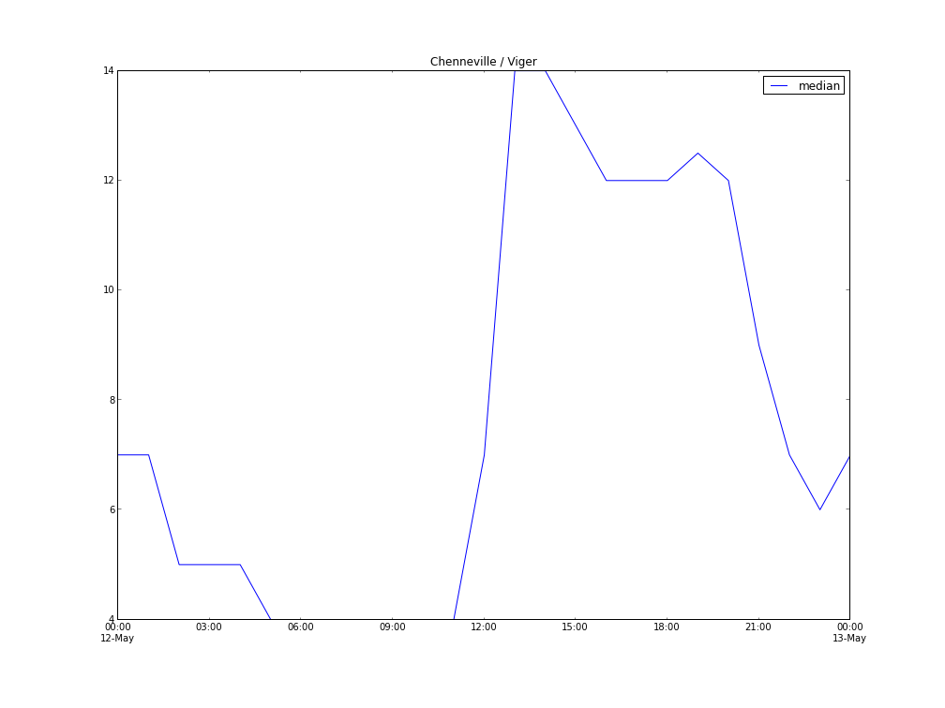
The network
400+ stations
7 months
# bikes every minute, for each station
More than 100 million data points

Slide 5
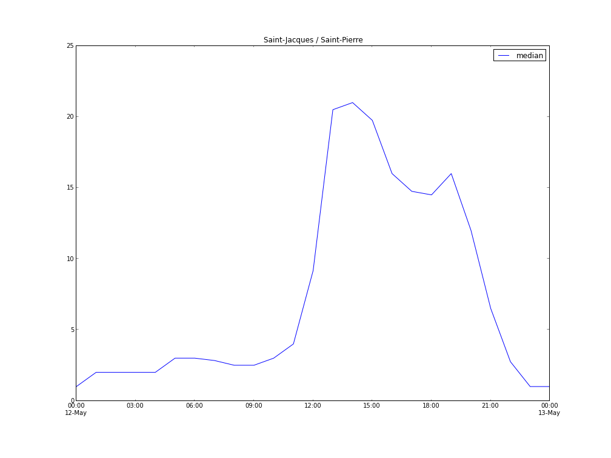
The network
400+ stations
7 months
# bikes every minute, for each station
More than 100 million data points

Slide 6
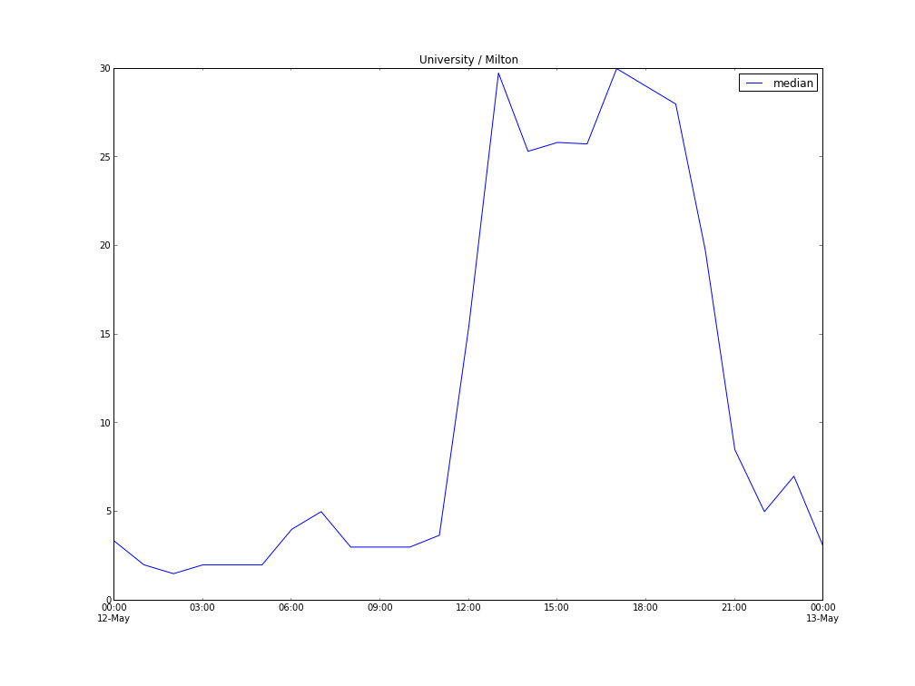
The network
400+ stations
7 months
# bikes every minute, for each station
More than 100 million data points

Slide 7
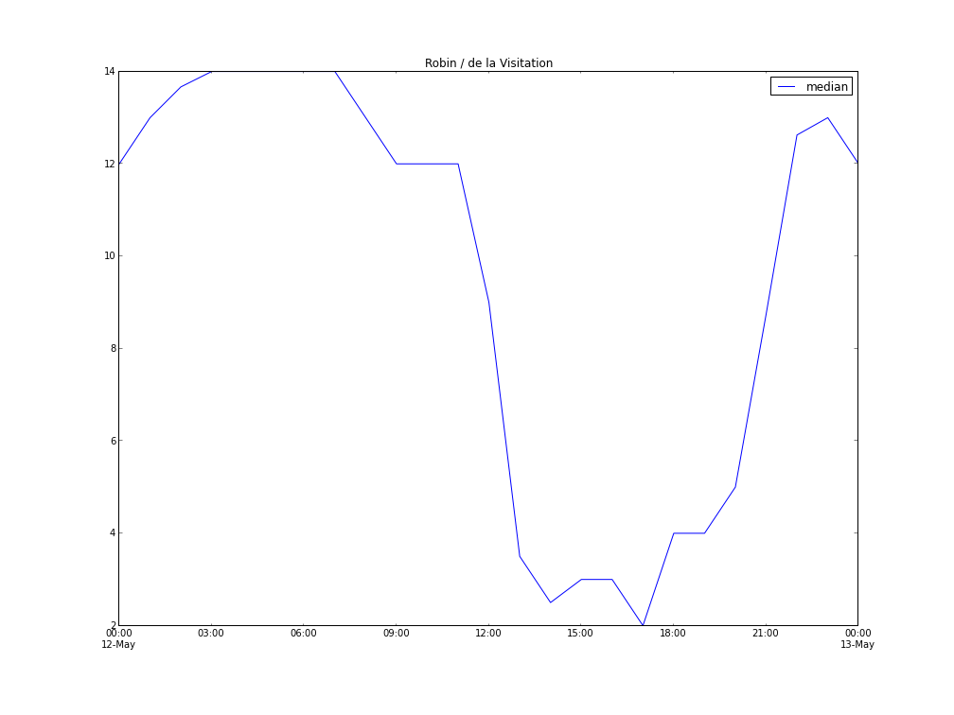
The network
400+ stations
7 months
# bikes every minute, for each station
More than 100 million data points

Slide 8
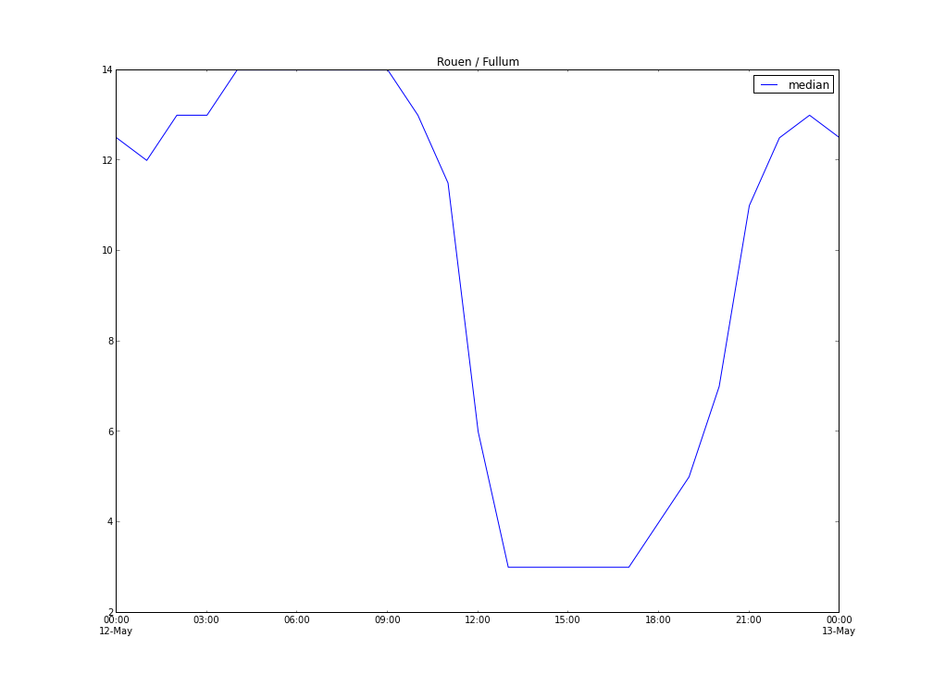
The network
400+ stations
7 months
# bikes every minute, for each station
More than 100 million data points

Slide 9
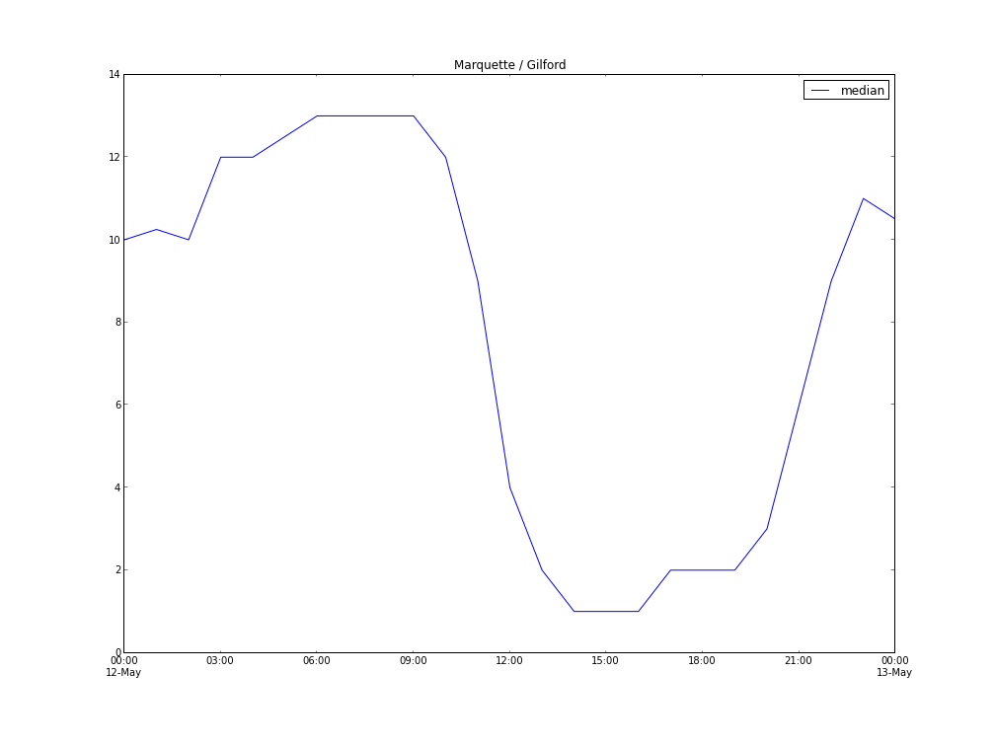
The network
400+ stations
7 months
# bikes every minute, for each station
More than 100 million data points

Slide 10
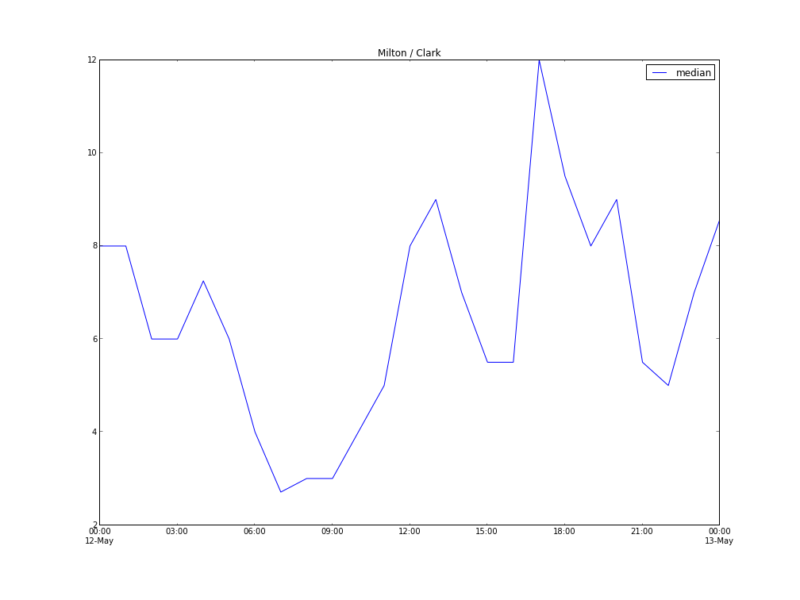
The network
400+ stations
7 months
# bikes every minute, for each station
More than 100 million data points

Slide 11
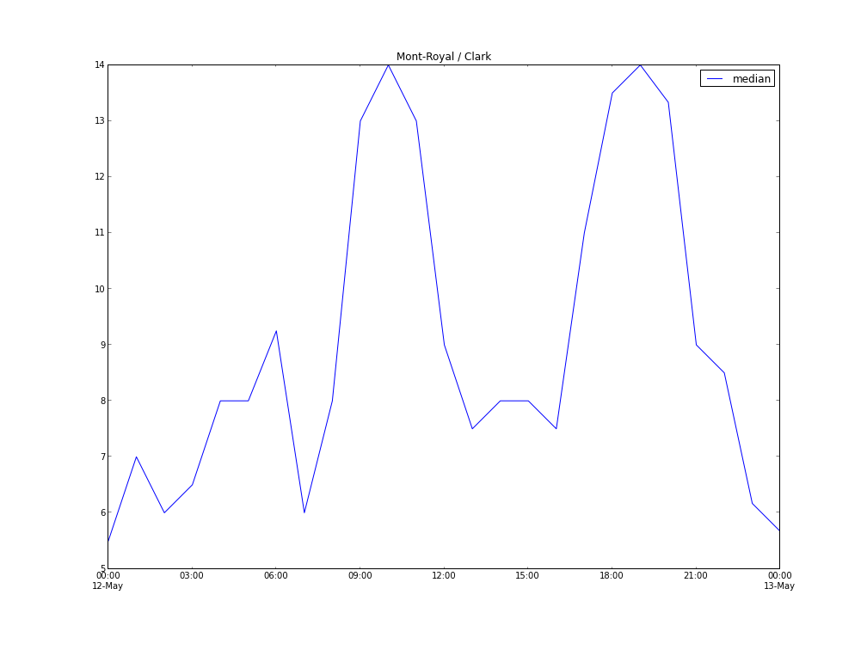
The network
400+ stations
7 months
# bikes every minute, for each station
More than 100 million data points

Slide 12
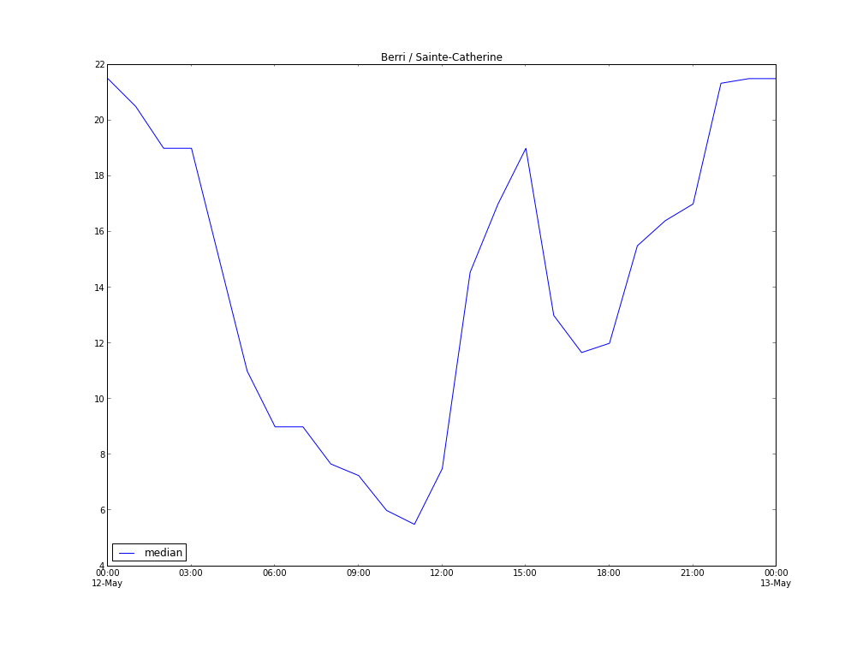
The network
400+ stations
7 months
# bikes every minute, for each station
More than 100 million data points

Slide 13
Station Quality
How often is the station both not full and not empty?

Slide 14
Useful stations:
Station | Full or Empty percentage
Mont Royal / Clark | 2.3%
Métro Mont Royal | 2.2%
Benny / Monkland | 3.4%
Notre Dame / Peel | 1.4%

Slide 15
Less useful stations:
Station | Full or Empty percentage
University / Des Pins | 35%
Métro Villa Maria | 46%
Prince / William | 23%
Sainte-Catherine / Guy | 24%

Slide 16
Things I'm working on
Measures of station quality
… or activity
Predictions

