Slide 1

Intelligent Design
A Dire Threat to Science Education
in America

Slide 2
What Is Intelligent Design?
“Living things are best explained by an intelligent cause, not an undirected process such as natural selection”
Proposed alternative to the scientific theory of evolution by natural selection
Promoted as a scientific theory
A campaign created and promoted by the Discovery Institute

Slide 3

Intelligent Design:
The Watchmaker Analogy
If you look at a watch, you can easily tell that it was designed and built by an intelligent watchmaker.
Similarly, if you look at the complexity of life, you can easily tell that it was designed and built by an intelligent creator/designer.
Source: Wikipedia Article “Watchmaker Analogy”

Slide 4
Does ID Qualify as Science?
It offers no testable hypotheses
No publications supporting ID in any peer-reviewed scientific journal
The vast majority of scientists reject ID
  Discovery Institute: “Over 300 scientists have signed the Scientific Dissent from Darwin statement since it originated in 2001.”
  “300 scientists” – that’s less than one one-hundredth of one percent!

Slide 5
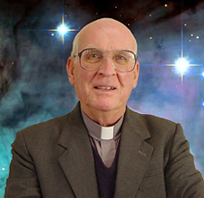
Does ID Qualify as Science?
Fr. George Coyne, Vatican's chief astronomer between 1978 and 2006
  “Intelligent design isn't science even though it pretends to be. If you want to teach it in schools, intelligent design should be taught when religion or cultural history is taught, not science.” (2005)

Slide 6
Teach the Controversy?
There is no controversy!
Greater than 95% of scientists accept evolution as fact
  Greater than 99% of scientists specializing in life sciences accept evolution as fact
Much greater than 99% of scientists reject ID

Slide 7
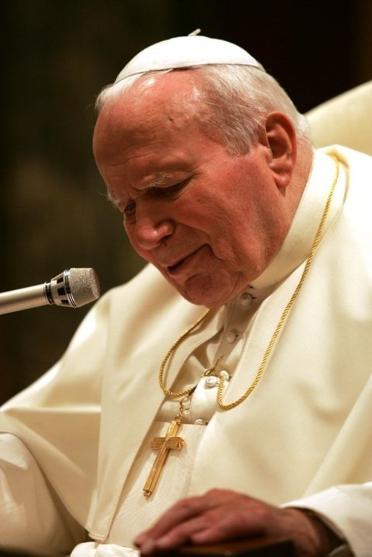
Views of Religious Leaders
Pope John Paul II
  “New findings lead us toward the recognition of evolution as more than a hypothesis”
  The fact that evolution “has been progressively accepted by researchers in various fields of knowledge…is in itself a significant argument in favor of the theory”
  Address to Pontifical Academy of Sciences, 1996

Slide 8
The Threat to Science Education
Teachers are being forced to label evolution as “just a theory” and to teach Intelligent Design as an “alternative theory”
Gives false impression that there is a true controversy and that both viewpoints are equally valid
Undermines critical thinking skills

Slide 9
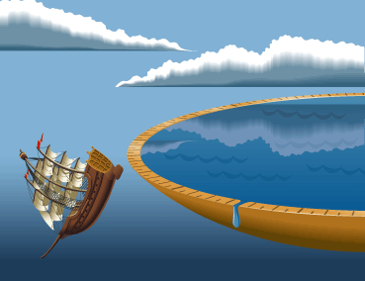
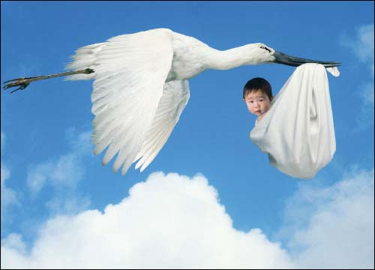
Teach the Controversy?

Slide 10
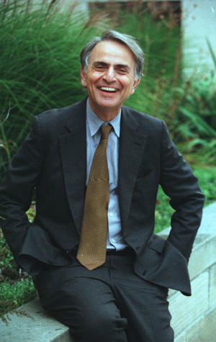
The Burden of Skepticism
“If you are only skeptical…you never learn anything new. On the other hand, if you are open to the point of gullibility and have not an ounce of skeptical sense in you, then you cannot distinguish useful ideas from worthless ones. If all ideas have equal validity then…no ideas have any validity at all.”

